Slide 1
Missing Word Predicition For Long Sentence
Canyu Zhang

Slide 2
Goal
Predict the missing words in long sentences.

Slide 3
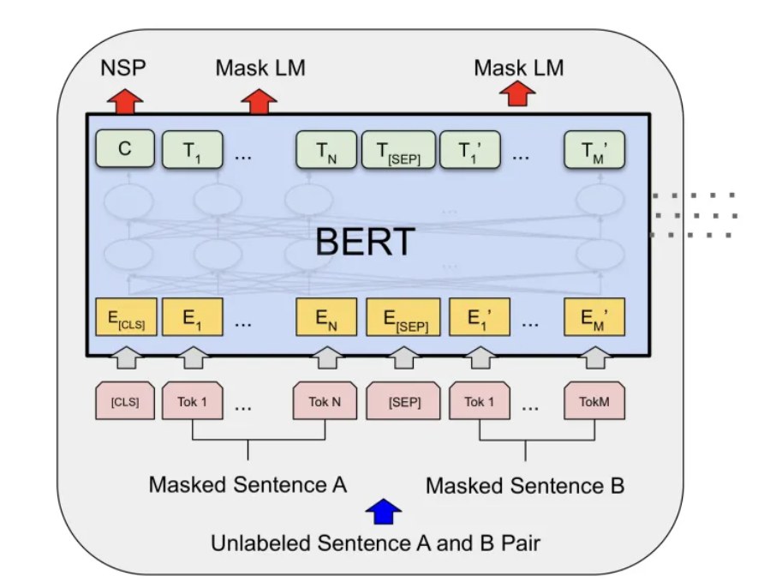
Model
BERT -- a multi-layer bidirectional Transformer encoder
Its composed of several transforemr encoders.

Slide 4
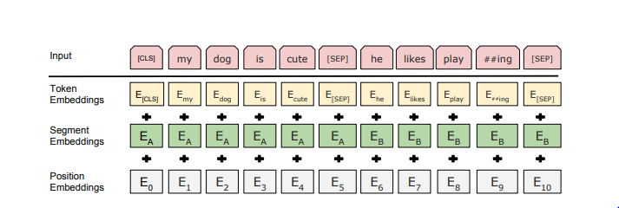
Input

Slide 5
Dataset and training
Generated around 100 long sentences.
Fine-tune pre-trained model for 100 epoches using cross entropy loss.
Trained on Tesla V100 GPU.

Slide 6
Result
Cosine Similarity: reprsenting the similarity between predicted words and the ground truth.
10% missing words: 0.7632
5% missing words: 0.8358

Slide 7
Example
The First World War [MASK] with the Armistice of 11 November 1918, although it was not officially [MASK] over until the signing of the Treaty of Versailles on 28 June 1919. The British [MASK] planned to hold a victory [MASK] in London on 19 July, including soldiers [MASK] to Whitehall, the centre of the [MASK] government.The [MASK] design for what would become the Cenotaph was one of a number of temporary structures erected along the parade's [MASK].
Pred: ended declared government parade marching British original route
GT: ended declared government parade marching British initial route

Slide 8
Example
Lutyens [MASK] his final design to the [MASK]of Works in early July, and on 7 July received [MASK] that the [MASK] had been approved by the foreign secretary, Lord Curzon, who was organising the parade. The unveiling of the monument, [MASK] in wood and plaster by the Office of Works, was [MASK] in The Times as a quiet and unofficial ceremony. It [MASK] place on 18 July 1919, the day [MASK] the Victory Parade.Lutyens was not [MASK]. During the parade, 15,000 soldiers and 1,500 officers marched past and [MASK] the Cenotaph.
GT: submitted Office confirmation design built described took before invited saluted
Pred: submitted Office confirmation design painted described took of present around

