Slide 1
AI-POWERED EDUCATIONAL & CAREER PLATFORM
NEXORA SaaS
AI-Powered Course Recommendation & Dynamic Roadmap Engine
Automated Career Navigation, Topological Curriculum Sequencing, Diagnostic Skill Gap Scoring & 24/7 Context-Aware AI Guidance.
Presenter Information: Team Talent Innovators | Category: AI in Education & Career Placement
Live Deployment: https://nexora-path-finder.vercel.app • Powered by Google Gemini AI & React 19

Slide 2
PRESENTER DETAILS
Project Presentation Team
The innovators behind NEXORA's design and execution
TEAM DETAILS
Team Name:
Talent Innovators
Project Track / Theme:
AI in Education, Adaptive Learning & Career Placement
TEAM MEMBERS
1. ___________________________________ (Team Lead)
2. ___________________________________ (Developer / AI)
3. ___________________________________ (Developer / UI)
4. ___________________________________ (Research / QA)

Slide 3
PROBLEM UNDERSTANDING
The Gap in Modern Technical Learning & Career Readiness
Understanding the structural pain points that cause 90% of learners to drop out
The Gap in E-Learning
Online learners face severe information overload with thousands of disconnected video tutorials. Finding the exact right courses and sequencing them into an actionable study path is frustrating, time-consuming, and prone to abandonment.
Core Pain Points
• Lack of Goal Alignment: Generic courses ignore student starting baselines. • Absence of Prerequisite Clarity: Students fail advanced topics due to unassessed foundation gaps. • No Accountability: Zero real-time diagnostic feedback or personalized next steps.
Our Core Mission
Build an intelligent SaaS platform that dynamically recommends courses, explains technical relevance using Google Gemini LLMs, visualizes prerequisite dependency DAGs, and generates adaptive daily milestones.

Slide 4
SOLUTION APPROACH
How NEXORA Solves Curriculum Sequencing
An end-to-end adaptive framework guiding learners from goal intake to recruiter readiness
1. Smart Goal Matching
Synthesizes natural language inputs (voice/text) into tailored goal profiles (SWE, AI/ML, JEE, NEET, Data Science, Career Switch), matching learners directly to curated high-yield topics.
2. Real-Time Explanation Engine
Curriculum analysis breaking down every milestone into prerequisites, core conceptual topics, verified free learning resources, and capstone project blueprints.
3. Dynamic DAG Sequencing
Generates topological Directed Acyclic Graphs with strict node status tracking (Completed, In Progress, Unlocked, Locked, Remediation) based on real-time diagnostic performance.
4. Secure Workspaces & ATS Readiness
Zero-latency client persistent session with optional Firebase Cloud sync, paired with an automated ATS resume builder calculating real-time recruiter match scores.

Slide 5
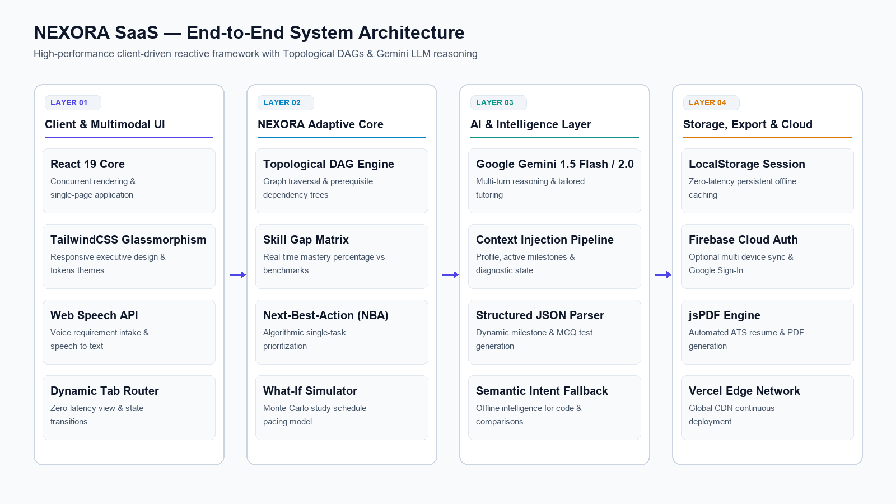
SYSTEM ARCHITECTURE DIAGRAM
Visual End-to-End System Architecture
Dataflow across UI presentation, adaptive engines, Gemini LLM reasoning, and cloud persistence

Slide 6
TECHNICAL EXECUTION
Architectural Stack & System Components
Detailed technical specifications of the 4 core layers
Frontend Application Layer
• React 19 & TypeScript for strict end-to-end type safety. • TailwindCSS with clean executive design tokens and Lucide Icons. • Web Speech API for voice requirement gathering & chat speech-to-text. • Responsive single-page application with zero-latency tab navigation.
Adaptive Engine & Algorithms
• Directed Acyclic Graph (DAG) Engine with topological prerequisite sorting. • Automated Diagnostic Skill Gap Scorer calculating mastery vs benchmarks. • Next-Best-Action (NBA) Scorer computing single highest-leverage task. • What-If Monte-Carlo Timeline Simulator modeling pacing shifts.
AI Services & LLM Layer
• Google Gemini 1.5 Flash & 2.0 API with multi-turn conversational reasoning. • Dynamic system prompt pipeline injected with student profile & milestones. • Resilient offline semantic intent classifier for instant fallback answers. • Dynamic MCQ assessment generator for custom skills.
Storage, Export & Deployment
• LocalStorage Persistent Engine for instant offline session caching. • Firebase Cloud Auth & Cloud Firestore profile sync (Optional). • jsPDF & jsPDF-AutoTable for instantaneous ATS Resume PDF generation. • Continuous Deployment Pipeline: GitHub auto-deployed via Vercel.

Slide 7
AI & ML TECHNIQUES
Core Machine Learning & LLM Implementations
How generative intelligence and topological graphs deliver customized learning
1. Large Language Model Integration
Integrated Google Gemini 1.5 Flash and 2.0 API with dynamic context injection. Sends full user state (Target Goal, Completed Milestones, Active Skill Gaps, Pacing) to generate tailored conversational guidance, code examples, and doubt resolution.
2. Topological Graph Traversal (DAG)
Implements graph-theoretic dependency trees where skills represent nodes and prerequisites represent directed edges. Automatically triggers remedial sub-branches when assessment scores drop below threshold benchmarks (70%).
3. Structured Output & JSON Enforcement
Utilizes strict JSON schema prompting to dynamically generate 8-step roadmap milestones, goal-specific challenge vectors, and diagnostic multiple-choice assessments on the fly.
4. Latency Management & Offline Intelligence
Features multi-tiered execution with fast 4-second timeout handling and a semantic intent classifier capable of addressing technical comparisons (e.g. Web Dev vs ML), OOP, and DSA offline without freezing.

Slide 8
PRODUCT FEATURES
Key Features & Core User Workflows
Comprehensive suite of integrated tools designed for continuous student mastery
AI Conversational Onboarding
Interactive voice & text interface gathering user goals, time availability, and background.
Interactive Flowchart DAG
Visual dependency roadmap with clickable nodes, learning objectives, and status tags.
Automated Diagnostic Engine
Benchmark-driven MCQ quizzes that calculate real-time mastery percentages per skill.
Next-Best-Action (NBA)
Algorithmic decision engine computing the single highest-yield study task for today.
24/7 Context-Aware AI Chatbot
Intelligent tutor providing code blocks with copy buttons, comparisons, and exam tips.
ATS Resume Builder & Scoring
Instant ATS score calculation, Google XYZ bullet optimizers, and 1-click PDF download.
What-If Scenario Simulator
Interactive time-commitment slider modeling how study pacing impacts target completion.
100% Free Resources Catalog
Curated zero-cost materials from MIT OpenCourseWare, CS50, Disha, HCV, & freeCodeCamp.

Slide 9
THE FUTURE OF ADAPTIVE EDUCATION
Thank You! Experience NEXORA SaaS Live
NEXORA bridges the gap between disorganized online educational content and structured, recruiter-ready student outcomes through intelligent sequencing, real-time diagnostics, and personalized AI mentorship.
• Team: Talent Innovators • Live Web Application: https://nexora-path-finder.vercel.app • GitHub Repository: https://github.com/Sirivennela310505/NEXORA

