Slide 1

DEPARTMENT OF COMPUTER SCIENCE & ENGINEERING
Indian Institute of Technology (BHU), Varanasi
Dependency Parsing for
Low Resource Languages
Stanza NLP
Django
using Stanza NLP with
Django Web Integration
Python
Multilingual
Submitted by:
Narra siri
Roll NO:
24074024
Supervisor:
Prof.Anil Kumar Singh
Department of CSE, IIT (BHU)
Academic Year 2024–25
Notes:
1

Slide 2






Project Overview
Natural Language Processing
Dependency Parsing
Multilingual Parsing
Computational methods to analyze and understand human language structure and meaning
Identifies grammatical relationships between words and establishes head–dependent word pairs
Single NLP framework supporting multiple languages — English and Hindi in this project
Web-Based NLP Integration
Syntactic Analysis
Dependency Relations
NLP backend integrated with Django to enable browser-accessible parsing interface
Structural analysis of sentence grammar: tokenization, POS tagging, and dependency extraction
Linguistic labels like nsubj, obj, ROOT connecting tokens in a syntactic dependency tree
Notes:
2

Slide 3
Problem Statement
Need for Dependency Parsing Systems
Key Insight
Structured syntactic analysis is essential for downstream NLP tasks like information extraction and question answering.
1
Hindi is a morphologically rich language with free word order
Multilingual Parsing Challenges
Most tools are optimized for English; adapting parsers to morphologically rich languages like Hindi requires specialized support.
2
Standard English parsers fail on Hindi syntax
Low-Resource Language Support
Hindi, despite millions of speakers, is relatively low-resource in NLP tools. Limited annotated corpora make parsing harder.
3
Stanza provides pretrained multilingual pipelines addressing this gap
Web-Based NLP Accessibility
4
Web integration democratizes access to NLP tools
Parsing systems are often CLI tools. Integrating them into a web interface improves accessibility for non-technical users.
Modular NLP Architecture
5
A modular Django-based architecture enables future extensibility
A clean, extensible pipeline is needed that can support additional languages and tasks without full re-engineering.
Notes:
3

Slide 4



Project Objectives
01
Implement Dependency Parsing
02
Support English & Hindi
Build a working dependency parser that extracts syntactic relations between words in a sentence
Enable multilingual parsing for both English and Hindi using Stanza's pretrained language pipelines
03
Django Web Integration
04
Generate Dependency Trees
Integrate the NLP backend with a Django web application for browser-based user interaction
Produce structured dependency tree outputs displaying word-level syntactic relationships
05
Migrate spaCy → Stanza
06
Modular Architecture
Improve the system by migrating from the initial spaCy prototype to the more capable Stanza library
Design a clean, extensible parsing pipeline that allows easy addition of new languages and features
Notes:
4

Slide 5


Technology Stack
Frontend
Backend
NLP Layer
Dev Tools
HTML5
Python 3.x
Stanza NLP Library
VS Code
CSS3
Django Framework
spaCy (initial)
Python Terminal
Django Templates
SQLite Database
Pretrained en Pipeline
pip / venv
Django Views
Pretrained hi Pipeline
Notes:
5

Slide 6
Methodology — Development Phases
Phase 1
Phase 2
Phase 3
Phase 4
spaCy Prototype
Stanza Migration
Django Integration
Hindi Support Added
Initial dependency parsing prototype using spaCy for English only
Migrated from spaCy to Stanza for richer multilingual support
Built Django web interface with dynamic output rendering
Extended to Hindi using Stanza pretrained multilingual pipeline
Architecture Flow
User
Input
Language
Selection
Django
View
parse_
sentence()
Stanza
Pipeline
Dependency
Extraction
Tree
Generation
Output
Display
Notes:
6

Slide 7
Initial Implementation — spaCy
Why spaCy Initially?
spaCy English Parsing — Prototype
Well-documented and easy to set up
import spacy
nlp = spacy.load("en_core_web_sm")
Fast English dependency parsing out of the box
def parse_sentence(text):
doc = nlp(text)
relations = []
for token in doc:
Good for prototyping NLP pipelines quickly
relations.append({
"word": token.text,
"dep": token.dep_,
"head": token.head.text
Large community and resources available
})
return relations
⚠ Limitation Identified
spaCy lacked robust Hindi / Indic language support, making it unsuitable for the multilingual objective of this project.
Notes:
7

Slide 8
Migration & Improvement — spaCy → Stanza
Feature
spaCy
Stanza
Why
Stanza?
English Parsing
✓ Yes
✓ Yes
Hindi Parsing
✗ No
✓ Yes
Hindi support
Multilingual Pipelines
Limited
strong multilingual support
40+ languages
Pretrained Models
General models
Universal Dependencies
UD labels
Tokenization
Rule-based
Neural tokenizer
Pretrained
POS Tagging
Statistical
Neural POS tagging
Robust NLP
Dependency Labels
Basic
Universal UD labels
Hindi Pipeline
Not available
stanza.Pipeline('hi')
Notes:
8

Slide 9
Model Development — Stanza NLP Pipelines
English Pipeline
Hindi Pipeline
stanza.Pipeline(lang='en')
stanza.Pipeline(lang='hi')
1
Tokenization
1
Tokenization (Hindi)
2
POS Tagging
2
POS Tagging
3
Lemmatization
3
Linguistic Feature Extraction
4
Dependency Parsing
4
Dependency Parsing
5
Dependency Extraction
5
Dependency Extraction
Both pipelines use Universal Dependencies (UD) scheme for consistent dependency labeling across languages
Notes:
9

Slide 10

Django Web Integration
HTML Form
(User Input)
Django
View
parse_sentence()
Function
Stanza
Pipeline
Django
Template
→
→
→
→
Text + Language
Dropdown
views.py
processes request
Language-aware
dispatcher
en / hi
pretrained model
Dynamic HTML
rendering
views.py
Language Selection
Handles HTTP POST requests, calls parse_sentence() with text and language, returns rendered template with results
HTML dropdown lets user select English or Hindi. Django view uses this to instantiate the correct Stanza pipeline
Dynamic Rendering
Modular Design
Dependency table and tree are generated server-side and injected into Django template for display
parse_sentence() is language-agnostic — accepts lang parameter and dispatches to appropriate Stanza pipeline
Notes:
10

Slide 11
English Dependency Parsing — Example
Input: "Although it was raining heavily, Siri went to college because she had an exam."
Word
POS
Dependency
Head
went [ROOT]
├── Siri [nsubj]
├── college [obl]
├── raining [advcl]
│ └── Although [mark]
└── had [advcl]
├── she [nsubj]
└── exam [obj]
Although
SCONJ
mark
raining
Siri
PROPN
nsubj
went
went
VERB
ROOT
went
to
ADP
case
college
college
NOUN
obl
went
because
SCONJ
mark
had
she
PRON
nsubj
had
had
VERB
advcl
went
exam
NOUN
obj
had
Notes:
11

Slide 12
Hindi Dependency Parsing — Example
Input: "राम आम खाता है।" (Raam aam khaata hai — "Ram eats mangoes.")
Hindi Token
Transliteration
POS
Dependency
Head
Parse Result
राम
Raam
PROPN
nsubj
खाता
खाता [ROOT]
आम
aam
NOUN
obj
खाता
राम [nsubj]
आम [obj]
खाता
khaata
VERB
ROOT
खाता
है [aux]
है
hai
AUX
aux
खाता
Multilingual Success
Stanza stanza.Pipeline('hi')
successfully parsed Hindi
using pretrained UD model
✓ Hindi parsing successful — demonstrates multilingual NLP capability of the system
Notes:
12

Slide 13
Key Code Snippets
Stanza Pipeline Initialization
parse_sentence() — Language Dispatcher
import stanza
# English pipeline
nlp_en = stanza.Pipeline(lang='en')
# Hindi pipeline
nlp_hi = stanza.Pipeline(lang='hi')
def parse_sentence(text, lang='en'):
if lang == 'hi':
nlp = nlp_hi
else:
nlp = nlp_en
doc = nlp(text)
return extract_deps(doc)
Dependency Extraction
Django View — render()
def extract_deps(doc):
relations = []
for sent in doc.sentences:
for word in sent.words:
relations.append({
'word': word.text,
'dep': word.deprel,
'head': word.head
})
return relations
def parse_view(request):
if request.method == 'POST':
text = request.POST['text']
lang = request.POST['lang']
result = parse_sentence(text, lang)
return render(request,
'result.html', {'deps': result})
Notes:
13

Slide 14
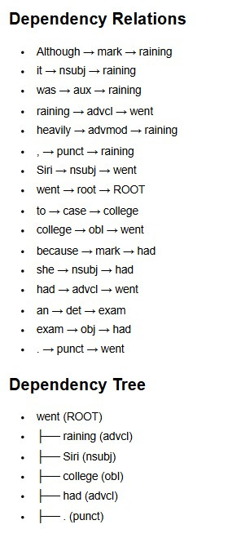
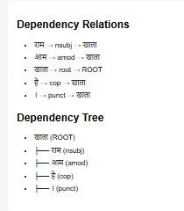
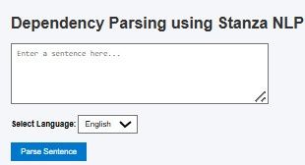
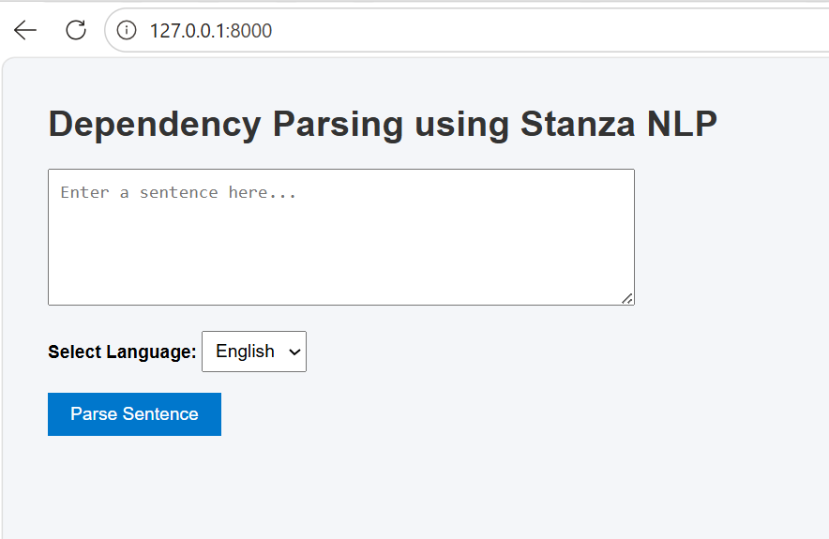
Results & Output
Web Interface
English Parse Output
Hindi Parse Output
Notes:
14

Slide 15


Challenges Faced
Library Compatibility
spaCy → Stanza Migration
Version conflicts between Stanza, spaCy, and Django dependencies required careful environment management
Refactoring the parse pipeline, output format, and API calls from spaCy to Stanza required significant rework
Multilingual Integration
Django Debugging
Loading and managing two separate language pipelines (en + hi) within a single Django application
Tracing issues in request handling, template rendering, and backend-frontend data passing during development
Dependency Tree Generation
Model Loading Delay
Structuring and rendering hierarchical dependency trees from flat token-level Stanza output in the browser
Stanza pretrained models take time to load at startup; managing this gracefully in a web context was a challenge
Notes:
15

Slide 16
Future Scope
01
02
03
More Indian Languages
Interactive Dependency Trees
Improved Visualization
Extend parsing support to Tamil, Telugu, Bengali, and other Stanza-supported Indic languages
Add JavaScript-based interactive tree visualization for intuitive syntactic exploration
Enhanced UI with color-coded dependency arcs, tooltips, and relationship legends
04
05
Chatbot Integration
Multilingual NLP Extensions
Plug the parser into a conversational agent for intent analysis and entity relationship extraction
Add NER, coreference resolution, and sentiment analysis in the same multilingual pipeline
Notes:
16

Slide 17
Conclusion
Successfully implemented English and Hindi dependency parsing using Stanza NLP pretrained pipelines
Delivered a working multilingual system supporting both English and Hindi from a single modular architecture
Improved system quality by migrating from spaCy prototype to Stanza for richer linguistic and multilingual support
Integrated the NLP backend with Django, enabling browser-based access to dependency parsing functionality
Demonstrated applicability to low-resource language NLP, demonstrating multilingual and low-resource language parsing capability
Established an extensible foundation for future multilingual NLP features and additional Indian language support
Department of Computer Science & Engineering | IIT (BHU), Varanasi | 2024–25
Notes:
17

