Slide 1
GEORGIA STATE UNIVERSITY · CBN / TRENDS · DANA NEXTGEN FELLOWSHIP
NeuroEngage Outreach
Cumulative Progress Report
Prepared for Dana Foundation reporting
Reporting period Fall 2025 – December 2027 This snapshot Aug 2025 – Jul 2026

Slide 2
HEADLINE NUMBERS · SINCE FALL 2025
EVENTS HELD
PEOPLE REACHED
EVENT HOURS
DISTINCT VOLUNTEERS
40
3,892
142.25
98
3.3/month — proposal target: 2/month
K-12 students & public — program baseline: 1,000/yr
3.6 hours per event on average
14 have led events — baseline: ~100/yr
Every breadth metric is ahead of, or on pace with, the commitments in the funded proposal.
NEUROENGAGE · DANA NEXTGEN FELLOWSHIP · GSU
2

Slide 3
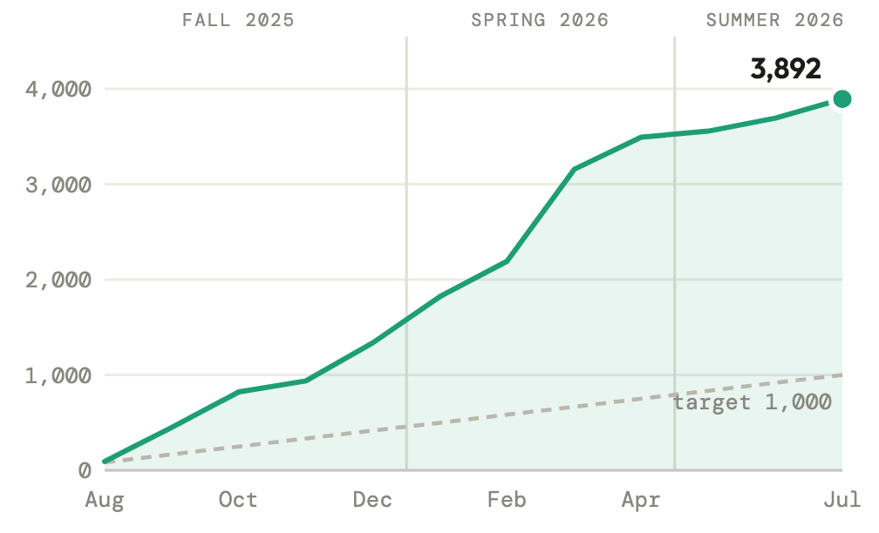
GROWTH SINCE FALL 2025 · PEOPLE REACHED
Cumulative people reached
3,892 people reached in the first 12 months.
Nearly 4× the program baseline of 1,000 people per year stated in the proposal.
4 attendance counts recorded as estimates (shown as ~ in the event log).
NEUROENGAGE · DANA NEXTGEN FELLOWSHIP · GSU
3

Slide 4
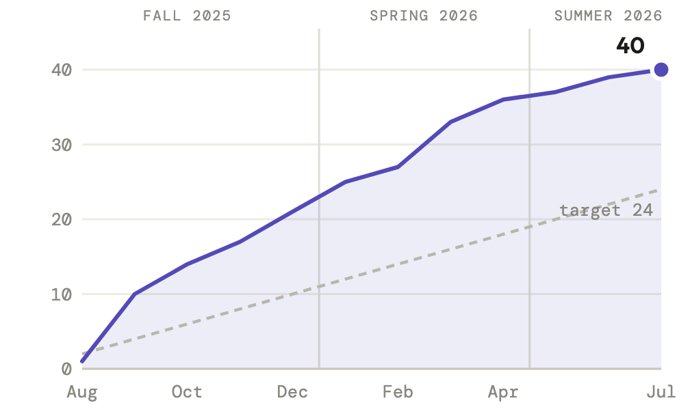
GROWTH SINCE FALL 2025 · EVENTS HELD
Cumulative events held
40 events at 3.3/month.
Ahead of Goal 1b — the proposal commits to doubling outreach from one to two events per month.
Every academic term so far has beaten the target pace.
NEUROENGAGE · DANA NEXTGEN FELLOWSHIP · GSU
4

Slide 5
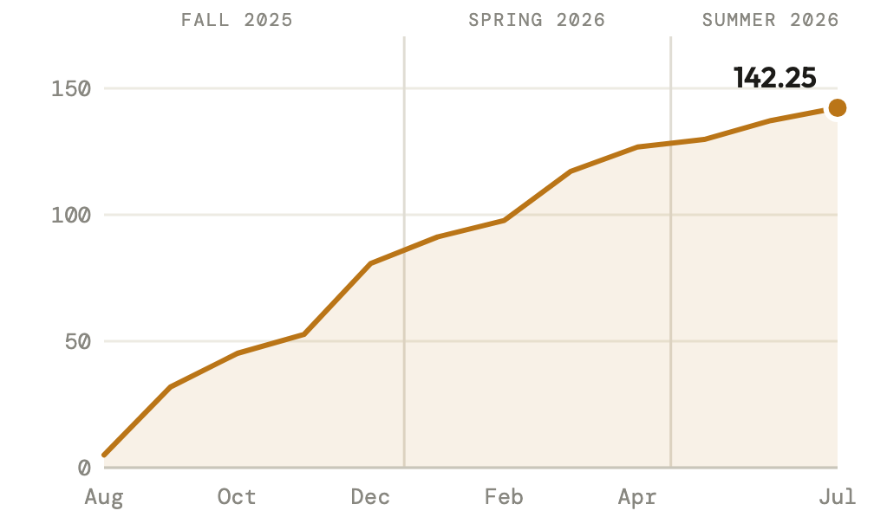
GROWTH SINCE FALL 2025 · EVENT HOURS
Cumulative event hours
142.25 hours of hands-on outreach delivered.
Averaging 3.6 hours per event.
Hours are each event’s duration — person-hours across crews run higher still.
NEUROENGAGE · DANA NEXTGEN FELLOWSHIP · GSU
5

Slide 6
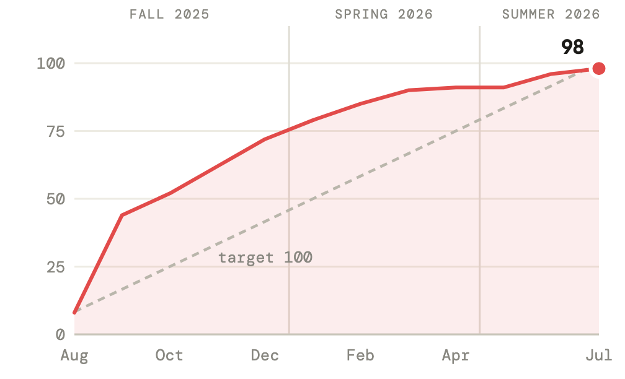
GROWTH SINCE FALL 2025 · DISTINCT VOLUNTEERS
Cumulative distinct volunteers
98 distinct volunteers engaged so far.
On pace with the ~100 volunteers/year the program historically recruits.
37 (38%) have returned for two or more events.
NEUROENGAGE · DANA NEXTGEN FELLOWSHIP · GSU
6

Slide 7
TERM SNAPSHOTS
Activity by academic term, with the cumulative position at term end
Term | Events | People reached | Hours | Volunteers active | New volunteers
Fall 2025 | 21 | 1,338 | 80.75 | 72 | 72
Spring 2026 | 15 | 2,154 | 46 | 37 | 19
Summer 2026 | 4 | 400 | 15.5 | 15 | 7
Total since fall 2025 | 40 | 3,892 | 142.25 | 98 distinct | 98
“Active” counts a person once per term; “new” = first event since fall 2025. The total row counts each volunteer once across the window, so it equals the sum of new volunteers. Terms: Fall = Aug–Dec · Spring = Jan–Apr · Summer = May–Jul.
NEUROENGAGE · DANA NEXTGEN FELLOWSHIP · GSU
7

Slide 8
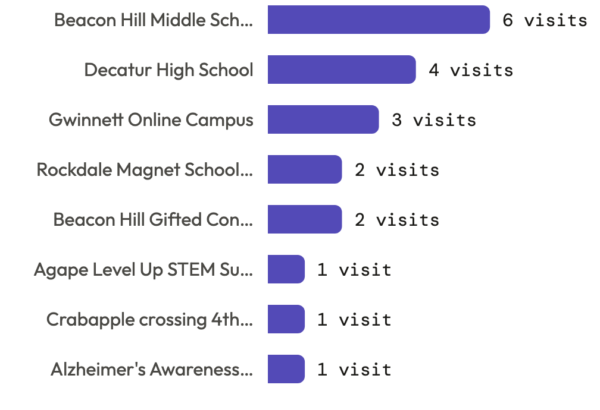
COMMUNITY DEMAND
Schools and partners keep asking us back
28 distinct venues hosted NeuroEngage since fall 2025 — schools, festivals, community groups, and a national meeting.
5 venues booked us more than once — repeat invitations are the clearest signal the work is valued.
Beacon Hill Middle School alone hosted 6 events, including a four-day December residency reaching 100 students a day.
Requests now range from metro Atlanta to Washington, DC.
NEUROENGAGE · DANA NEXTGEN FELLOWSHIP · GSU
8

Slide 9
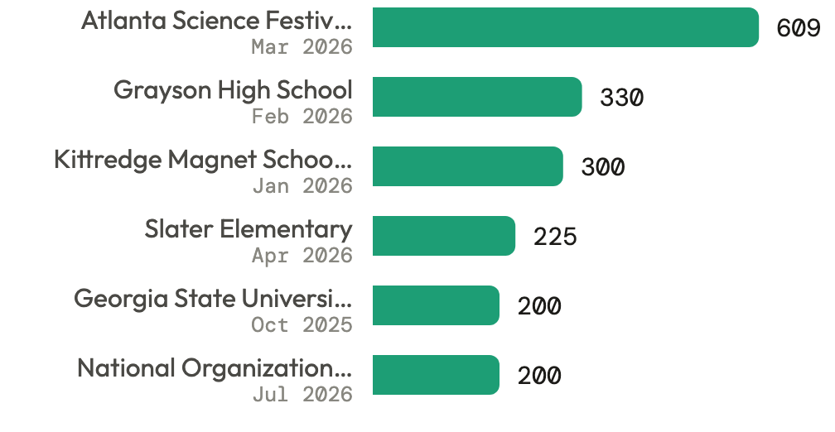
RANGE OF FORMATS
From classrooms to festivals — the biggest single events
6 events reached 200+ people; the Atlanta Science Festival booth alone engaged 609.
Median event: 75 attendees — the same crews also run intensive small-group sessions like sheep-brain dissections for five homeschoolers.
13 distinct activity formats fielded, from the signature lessons to newly piloted stress-physiology stations — the direction Goal 1c formalizes with mini-grant modules.
NEUROENGAGE · DANA NEXTGEN FELLOWSHIP · GSU
9

Slide 10
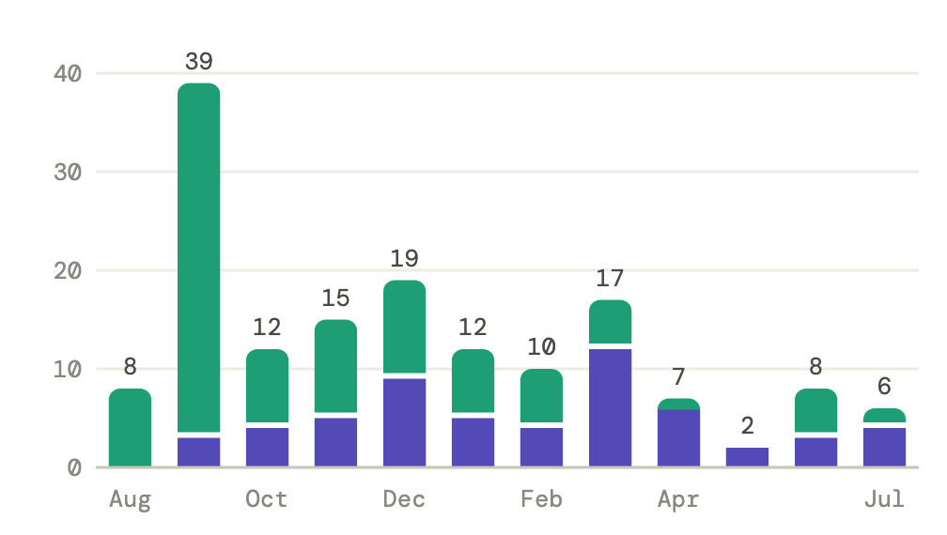
VOLUNTEER PIPELINE
Recruiting new volunteers while keeping the ones we have
first-time
returning
Fresh intake every term — 72 in Fall, 19 in Spring, 7 in Summer first-time volunteers.
The purple share grows through the year — trained volunteers come back instead of churning, exactly what Goal 1a’s workshop pipeline needs.
37 of 98 volunteers have already served multiple events.
NEUROENGAGE · DANA NEXTGEN FELLOWSHIP · GSU
10

Slide 11
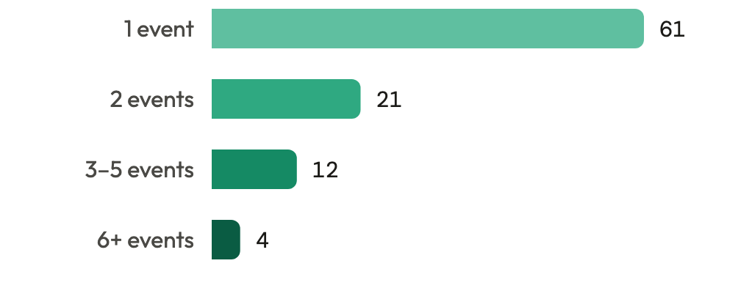
VOLUNTEER ENGAGEMENT & REPEAT SERVICE
Volunteers by number of events served
98 distinct volunteers since fall 2025 — every name is captured on the intake form, so repeat service is trackable today.
37 volunteers (38%) have served at two or more events.
Crews average 4.8 volunteers per event (proposal baseline: 3–4).
14 different people have led at least one event.
Signature lesson plans (Touch-a-Brain, Build-a-Brain, Build-a-Neuron) ran at 32 of 40 events.
NEUROENGAGE · DANA NEXTGEN FELLOWSHIP · GSU
11

