Slide 1

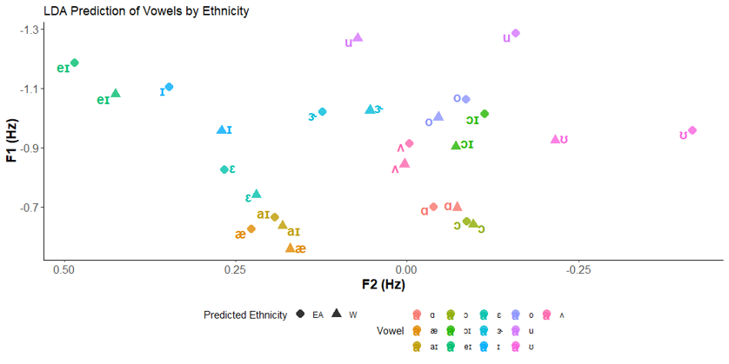
Ethnic Identities Expressed in Phonetic Production
Ryan C McMurry
Department of Linguistics
What is Ethnicity and Identity?
Ethnicity and Identity are very fluid. Ethnicity can be constructed along regional, historical and cultural lines and form an individual’s identity. Individuals that share similar aspects of that construction form a community and express the symbols that signify their identities in that group (Hogg, 2016)(Ochs, 1993). In terms of language, those symbols can be concrete phonetic sounds (Eckert & Labov, 2017).
LDA Results
Where are the predicted vowels for each ethnicity?
Divide the vowel space into 3
Front Vowels
Differ in terms of “height”
The most dramatic /eI/ and /I/ while /ɛ/ is less so
Mid Vowels
Difficult to generalize a pattern
Back Vowels
Differ in terms of “frontness”
/u/ and /ʊ/ strikingly different
Takeaways
The white population have lower front vowels and produce them further back
The white population also front their back vowels
The East Population do not follow this pattern
Front vowels are higher
Back vowels are further back
The two groups have different vowel spaces
Conclusion
Are Ethnic differences present in Phonetic production in California?
Yes!
2. Where do they show in the vowel space?
The two populations in the study have different vowel spaces. Compared to the East Asian population the White population have fronted back vowels and lowered front vowels.
Important takeaways
There is a possibility of variation within the White population that is not present in the East Asian population
A larger sample is needed to confirm this variation
Sources
Cardoso, A., Hall–Lew, L., Kementchedjhieva, Y. & Purse, R. 2016. ‘Between California and the Pacific Northwest: The front lax vowels in San Francisco English.’ American Speech, 101(1), 33–54.
Eckert, P. and Labov, W. (2017), Phonetics, phonology and social meaning. J Sociolinguistics, 21: 467-496.
Gordon, Matthew. Phonological Correlates of Ethnic Identity: Evidence of Divergence?. American Speech, Volume 75, Number2, Summer 2000, pp.115-136.
Hogg, M. A. (2016). Social identity theory (pp. 3-17). Springer International Publishing
hs, E. (1993). Constructing Social Identity: A Language Socialization Perspective. Research on Language and Social Interaction, 26(3), 287–306.
Research Questions:
Are Ethnic differences present in Phonetic production in California?
Where do they show in the vowel space?
SDT Results
Front Vowels
/eɪ/ in the White population has a low hit rate but high hit rate in EA population
/ɛ/ high hit rate in both populations
/ɪ/ near fifty-fifty split in both populations
Back Vowels
/ʊ/ fifty-fifty split in the W population high in the EA population
/u/ high hit rate in both populations
Takeaways
There is possibly high variation within the White population but more consistency in the East Asian.
Previous research
Production differences are present within African and Mexican Americans compared to European Americans (Gordon, 2000) and Asian Americans produce /æ/ differently than European Americans (Cardoso et al. 2016.)
Participants
Normalized vowel formants of 22 undergraduate students
12 East Asian (Japanese, Chinese, Filipino descendants)
10 White (European dependents)
Methods
Linear Discriminant Analysis (LDA)
Lda_model= lda(vowel_ethnicity ~ f11-f15+f21-f25+f31-f35)
Signal Detection Theory Analysis (SDT)
Contact
rcmcmurry@ucdavis.edu
Sirmcmurry.github.io

