Slide 1
Compare living in a city to living in the countrysid

Slide 2
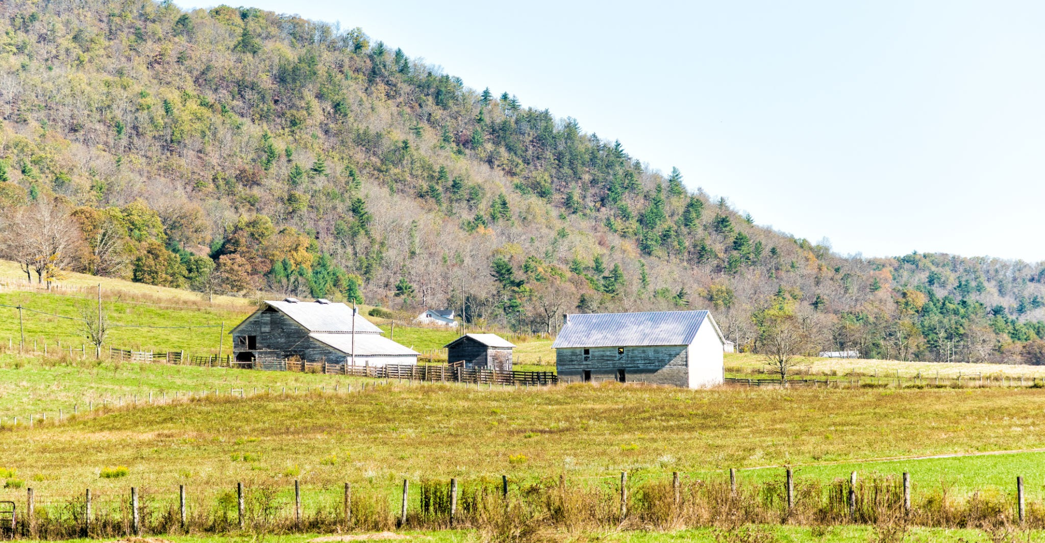

Slide 3


