Slide 1
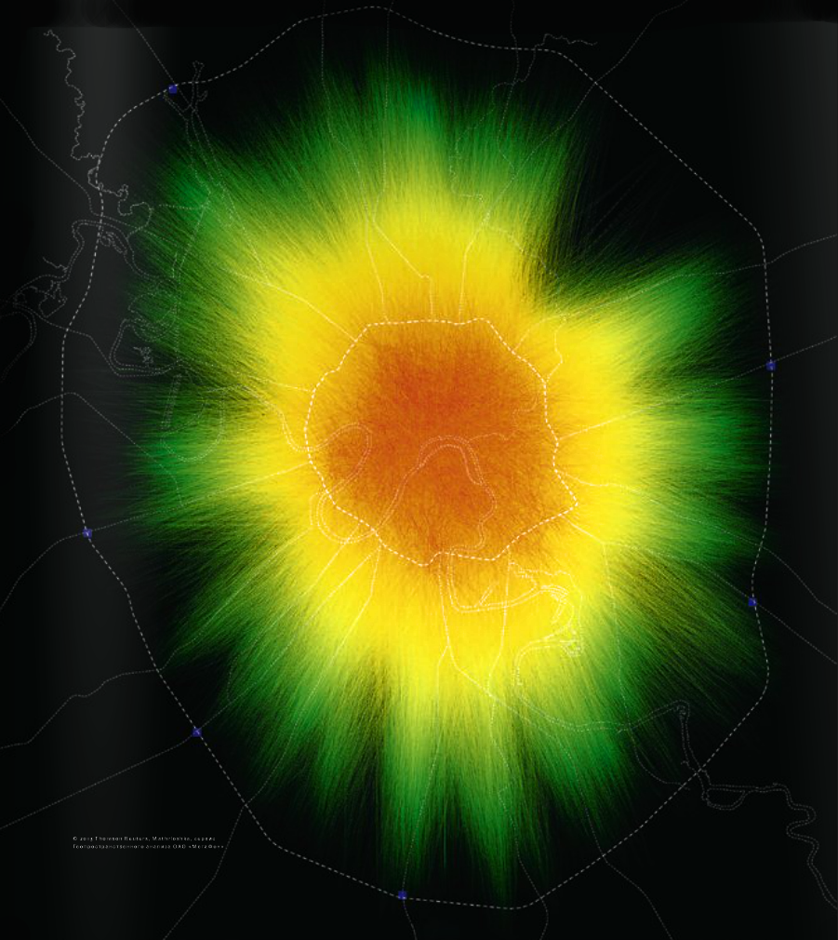
Research of mobile phone subscribers routes
February, 2015

Slide 2
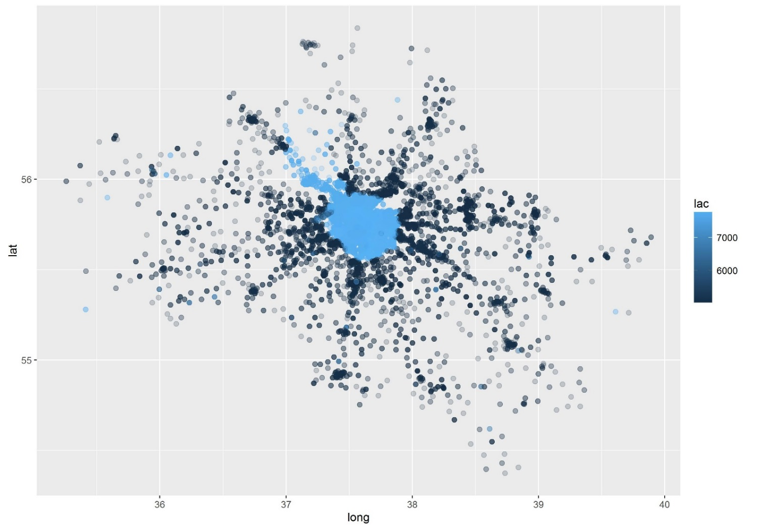
Research objectives and input data
Task
Objective of this research was to build a classifier which would analyze data gathered from base stations around Moscow and would identify all ‘msisdns’ that belongs to a particular user with the high probability. As the result we need to build a database with user id and all msisdns that belong to this user
Input data:
Sample of the matching ‘msisdns’ that belong to a particular users – train data
Database with the ‘msisdns’ and time of the user registration on the base station
“imei – phone type” matching table
Dictionary for ever base station “event type” field
Sample data provided for 23rd – 25th of May 2013

Slide 3
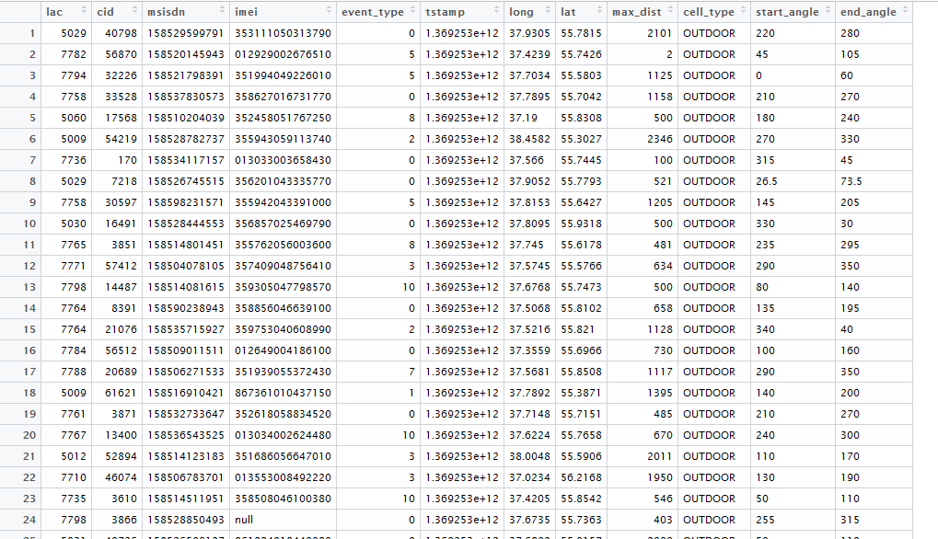
Base station registration data
Data consist of the following fields:
- Lac and cid are base station group_id and unit_id correspondingly
msisdn – unique identifier of a user
Imei – identifier of the phone
Event_type – type of the signal registered on the base station
Tstamp – time of the registered event
Long/lat/ max_dist/start_angle/end_angle parameters of the base station and its coverage area
Cell_type – type of the base station

Slide 4
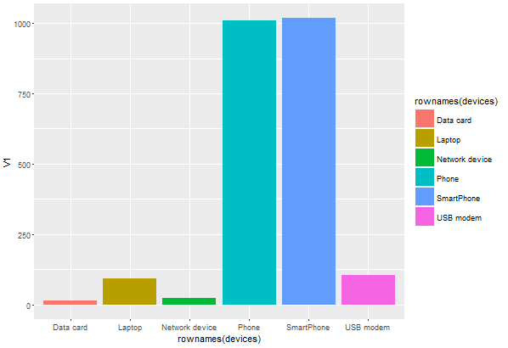
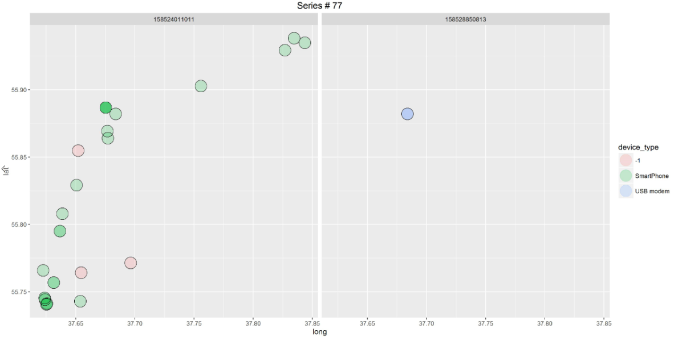
Visual analysis: phone distribution
Visual analyze shows that some of the data is generated by laptop’s and modems
Data generated by laptops and usb modems usually have less data points vs phone data
All phones are divided into two groups “Phone” and “Smartphone”, data analysis suggests that same device can be attributed to both groups (e.g “Apple – iOs – phone” or “Apple – iOs – Smartphone”); During modelling both groups will be merged together

Slide 5
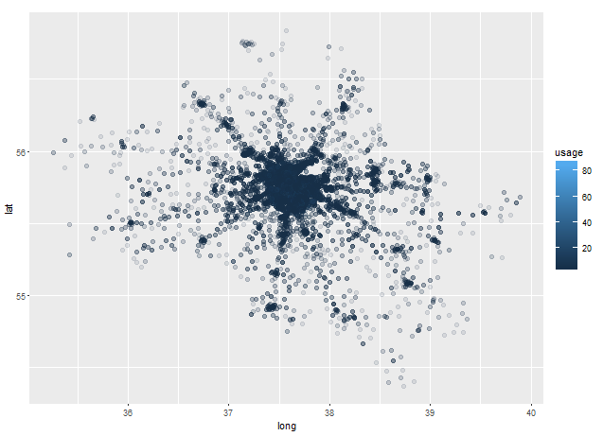
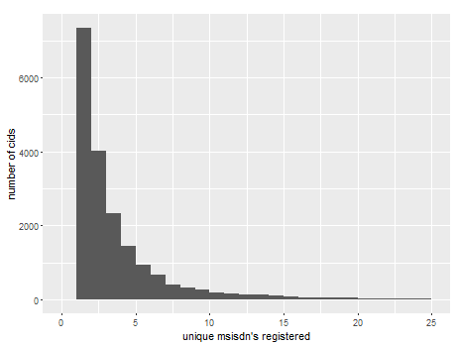
Visual analysis: number of unique msisdns for each base station
Data provided for 18891 different base stations
We will define base station usage as number of unique msidns registered in this base station
Data suggests that most of the base stations were visited by less than five different ‘msisdns’
About 40% of all base stations were visited only by one ‘msisdn’

Slide 6
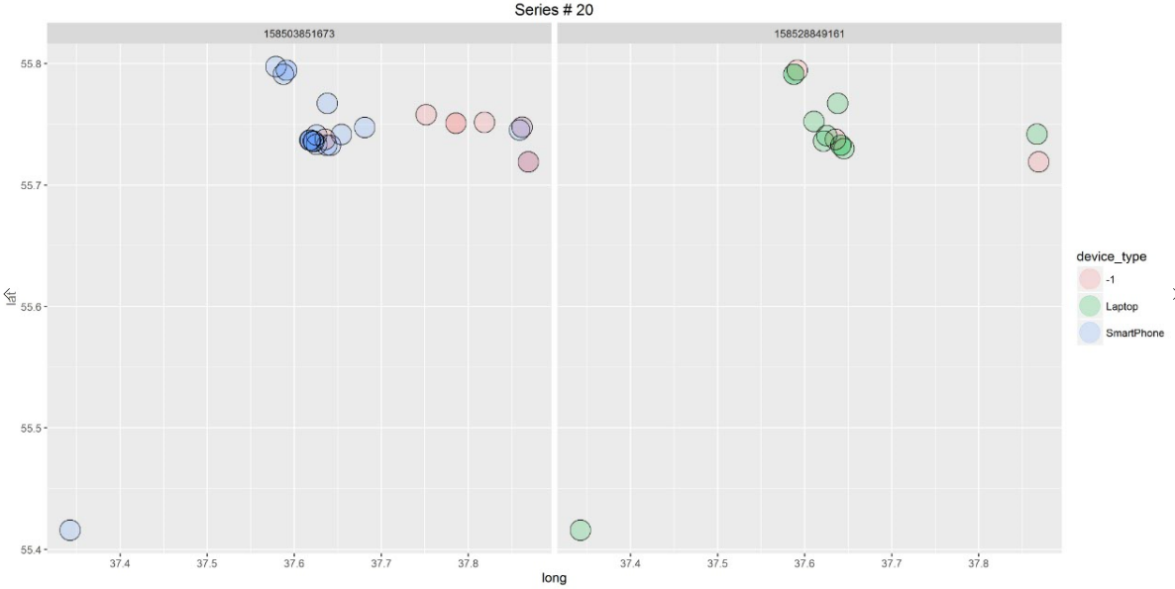
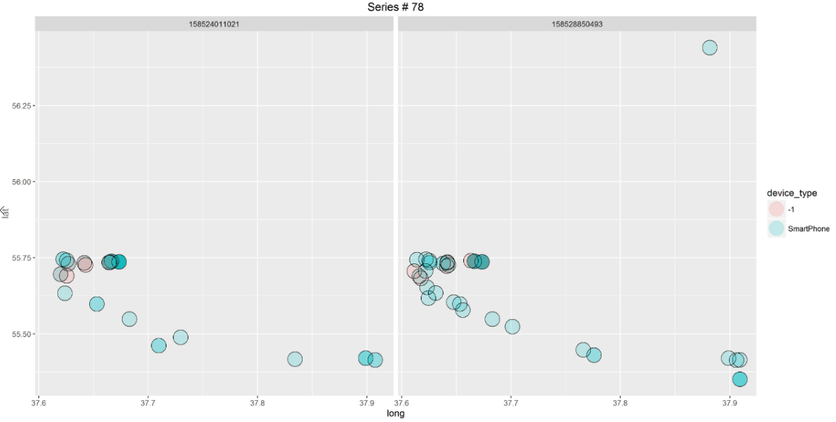
Visual analysis: Fact table
From the fact table we can see that two ‘msisdns’ match if they have a lot of similar base stations
We can measure this similarities using several methods: Jaccard Index, Bernstein and Zobel S2 and S3 similarities measures

Slide 7
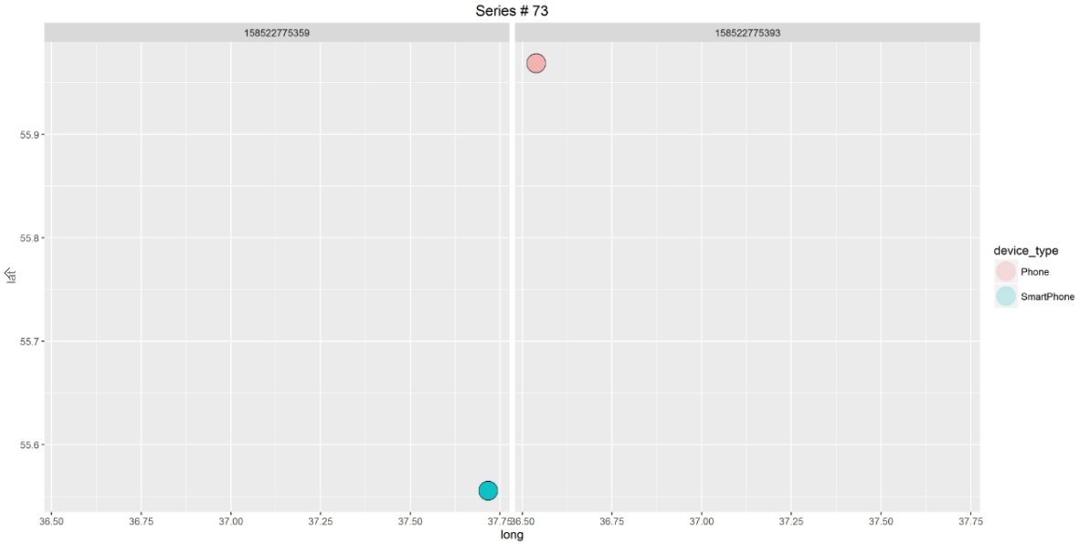
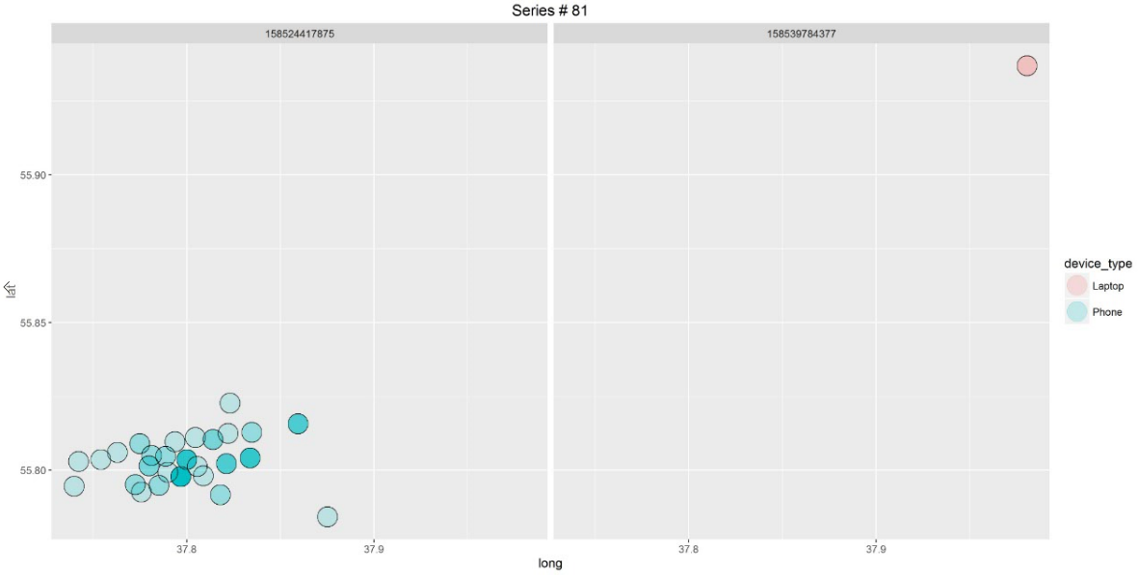
Visual analysis: Fact table
Some msisdn’s that are assumed to be matched in the fact table visually doesn’t have any base stations in common
Geographically this ‘msisdns’ can be far away from each other and can be easily separated by line

Slide 8
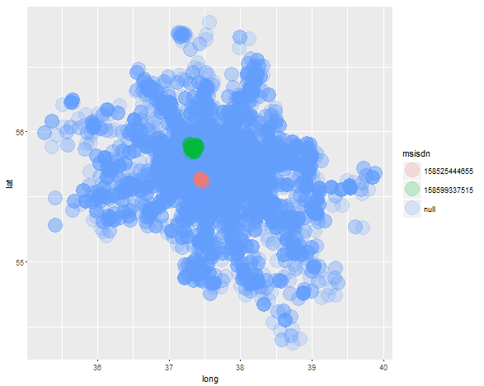
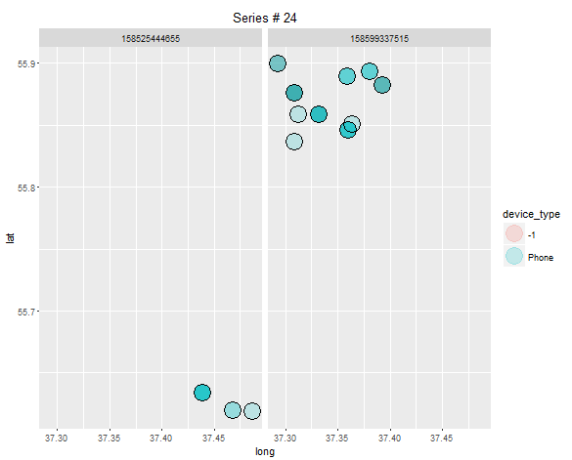
Visual analysis: Fact table
This two ‘msisdns’ are assumed to belong to the same user
However we can visually see on the map that they don’t have any geo data in common and located in different Moscow parts

Slide 9
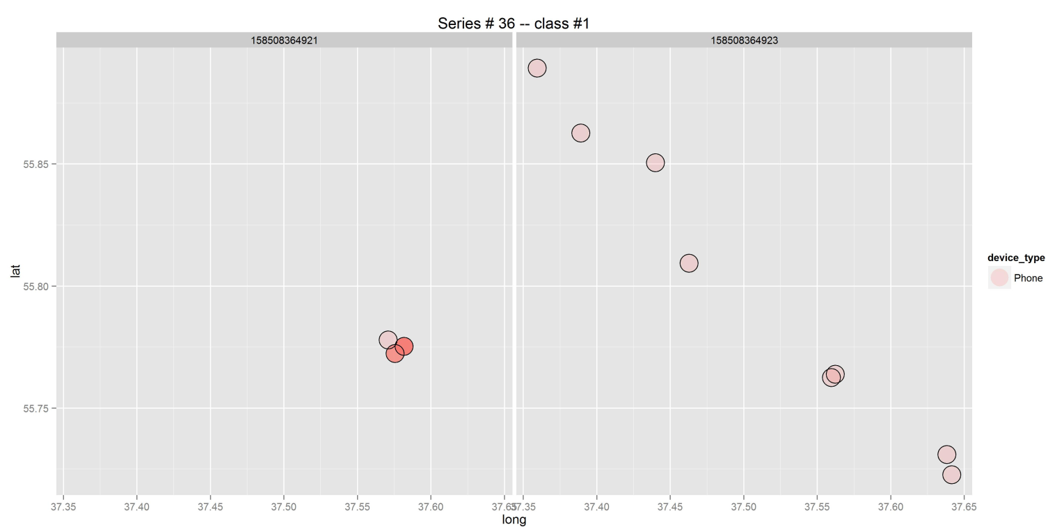
Visual analysis: Fact table
On the other hand we can see examples in the fact table were two ‘msisdn’s’ are matched with each other, but one of the matched msisdn’s have less than 4 points and this points displaced from the track created by the second ‘msisdn’
Jaccard distance won’t work in this cases
My approach would be to take all ‘msisdn’s’ with short tracks (less or equal 3 points) and add to each point of their track all nearest base stations – base stations that have overlapping signals with points from the original track

Slide 10
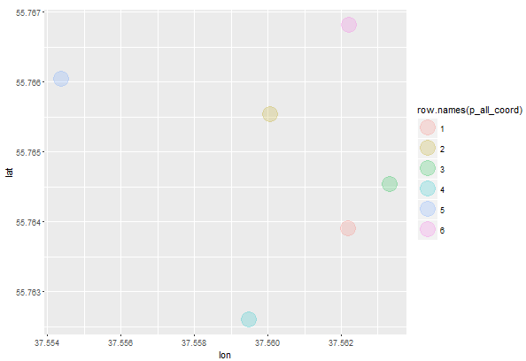
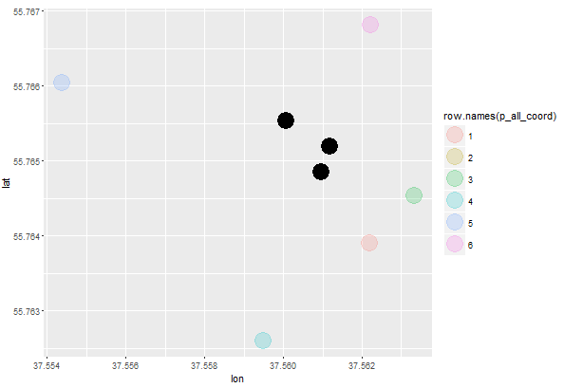
Example of the result from the algorithm that calculate base stations overlapping points

Slide 11
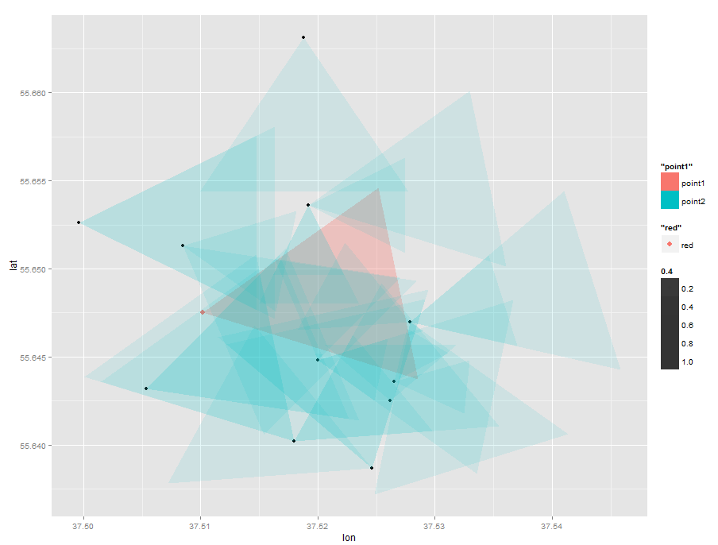
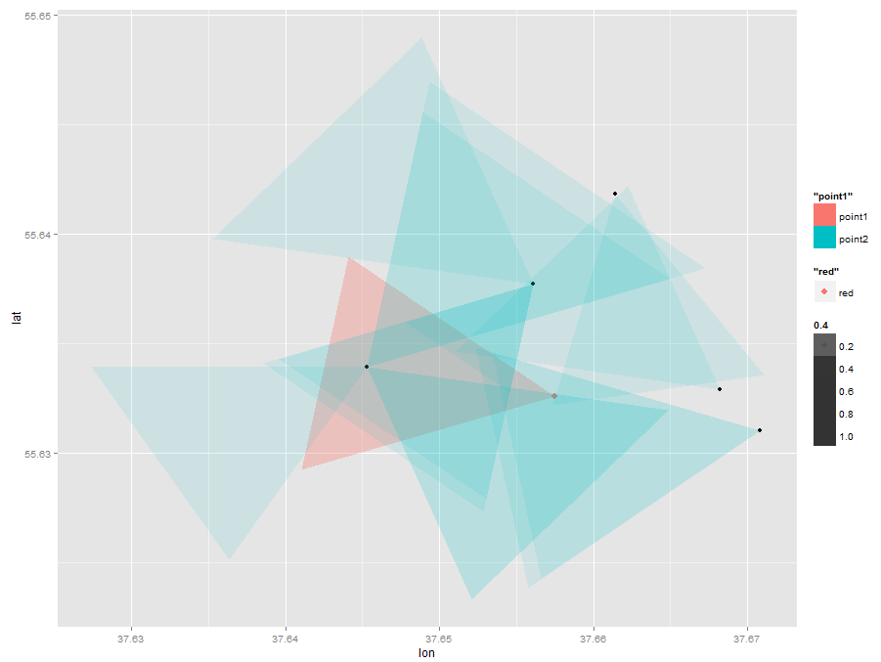
All base stations that overlaps a selected station
On the graphs we can see a red triangle – this is a working zone of the selected base station
To calculate all overlapping stations we use the following algorithm:
Search for all stations in a reasonable radius from the selected stations
For each of the station in this radius we identify if stations have overlapping connection zones with current station or not

Slide 12
Buildling train and test datasets
Test data:
Will contain of 120 pairs from the fact table with the class ‘1’ – e.g. two pairs match
1000 pairs generated from other combinations of the ‘msisdn’s’ available in the fact table. We will assume that with the high probability this ‘msisdn’s’ don’t match. This pairs will have the class ‘0’
Test data:
Input data have 2361 different ‘msisdn’s’
To build the test data we will construct the matrix with all possible unique combinations of this 2361 ids and then we will use our classifier to predict if two ‘msisdn’s’ match with each other or not

Slide 13
Building Features
Jaccard distance, S2 and S3 distances between two ‘msisdn’s’ for the original data
If two ‘msisdn’s’ have matching phones
If two ‘msisdn’s’ have matching phone vendors
If one of two ‘msisdn’s’ used Laptop, USB modem or other Network device
Jaccard distance, S2 and S3 distances for the adjusted data with nearest base stations added to the ‘msisdn’s’ witch have less or equal than three unique points

Slide 14
Testing the Model
The classifier was build with the RandomForest model
Model was tested using 5-folds stratified cross validation
Features selection was made using RandomForest classifier
Two parameters were tuned in the model: maximum number of trees and trees max_depth
Features were build and model was trained on the AWS ‘c3.8xlarge’ instance

Slide 15
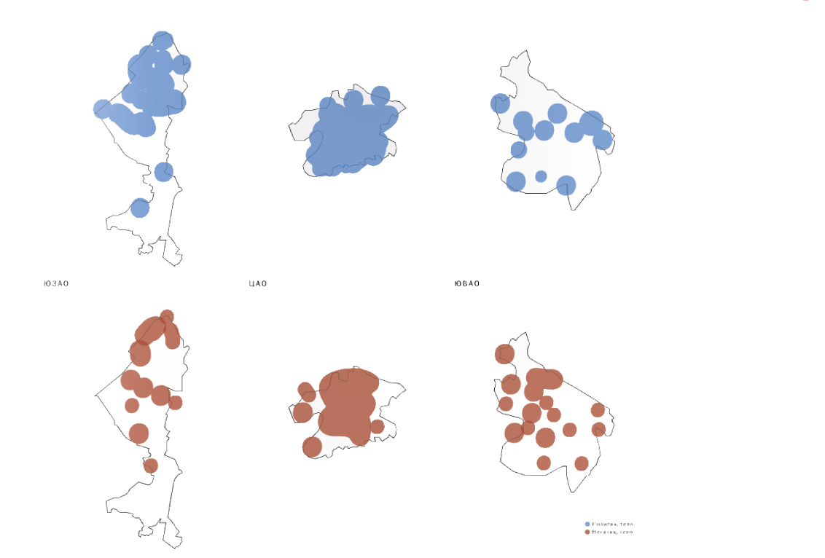
Thank You!

