Slide 1
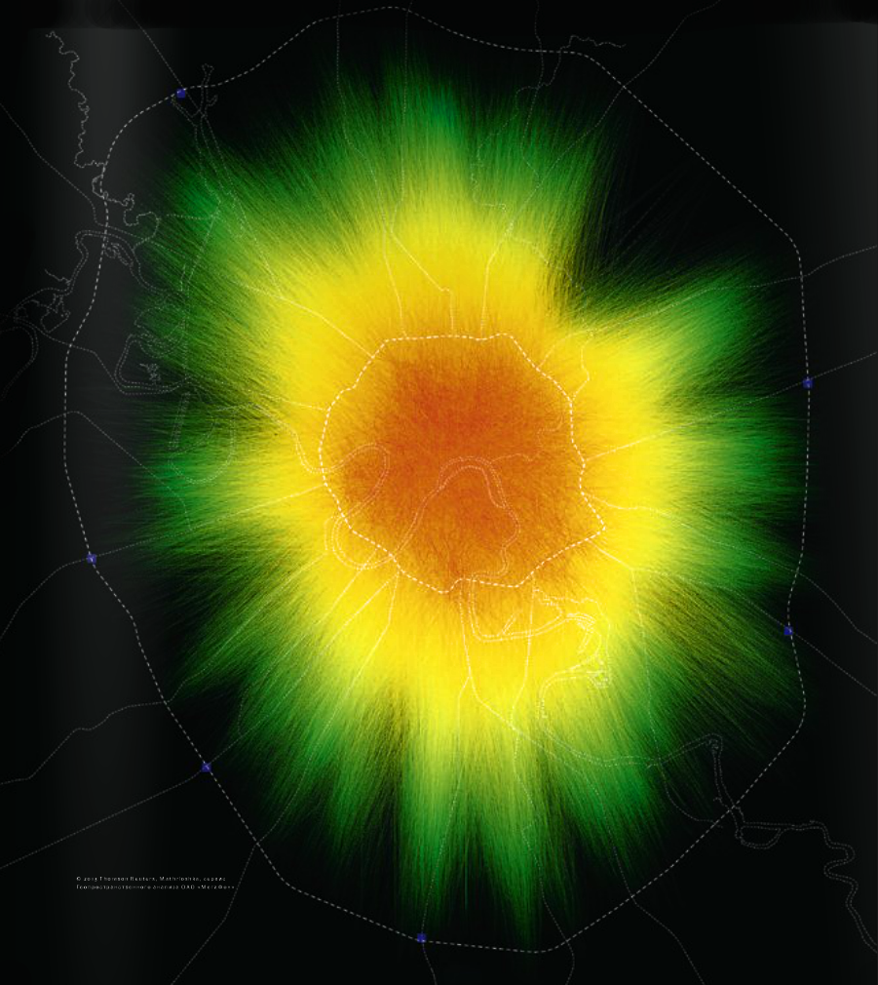
Research of mobile phone subscribers routes
February, 2015

Slide 2
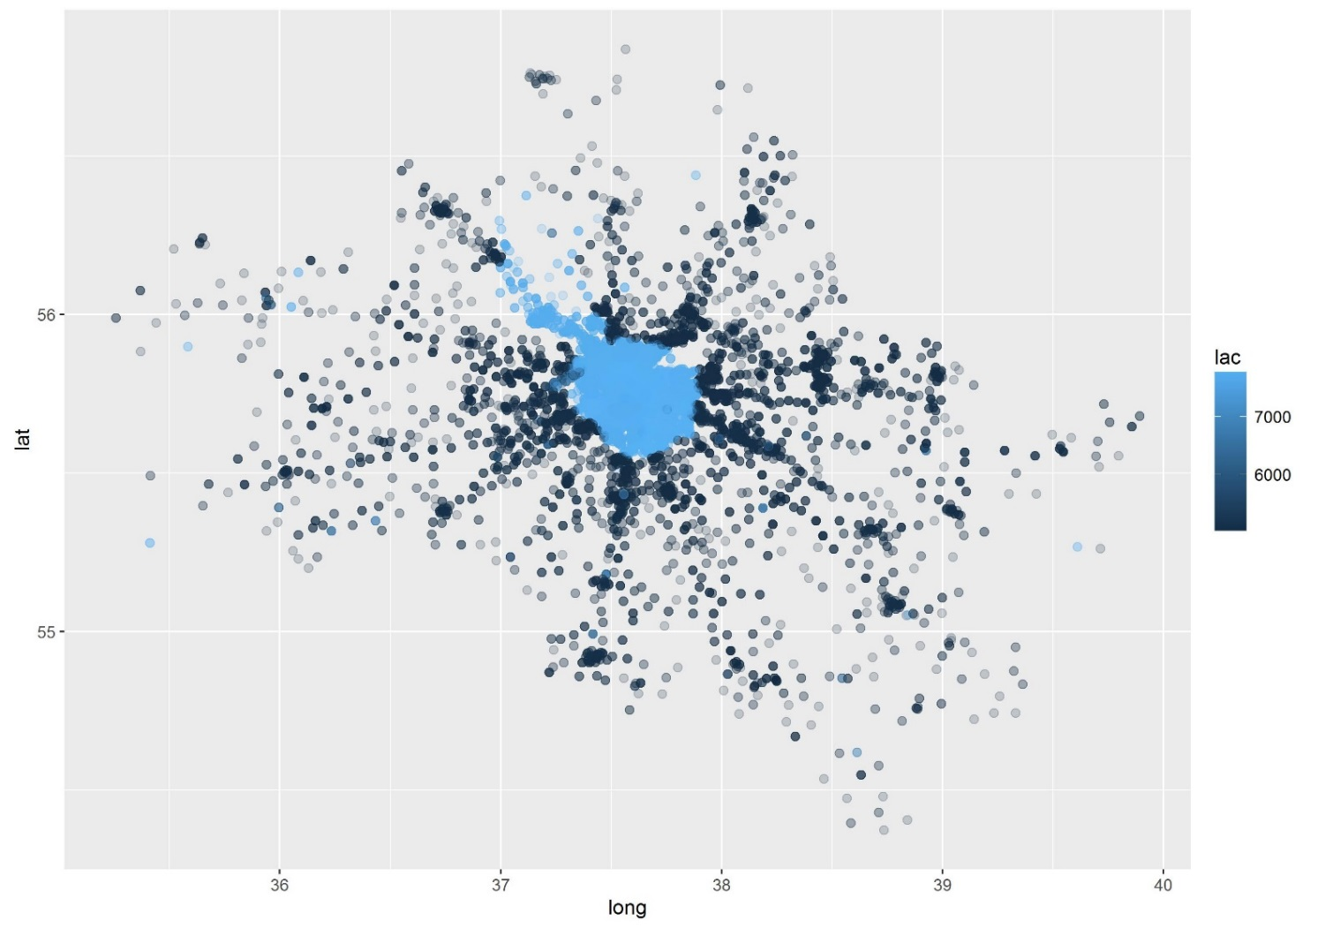
Research objectives and input data
Task
Objective of this research was to build a classifier which would analyze path data gathered from telecom base stations around Moscow and would identify all ‘msisdns’ that belongs to a particular user with the high probability. Purpose of this research is to build a database with user id and corresponding matching ‘msisdns’.
Input data:
Sample with matching ‘msisdns’ that belong to particular users – train data
Database with the ‘msisdns’ and time of the user registration on the base stations during the day
“imei – phone type” matching table
Dictionary with base station “event type” field description
Sample data provided for 23rd – 25th of May 2013

Slide 3
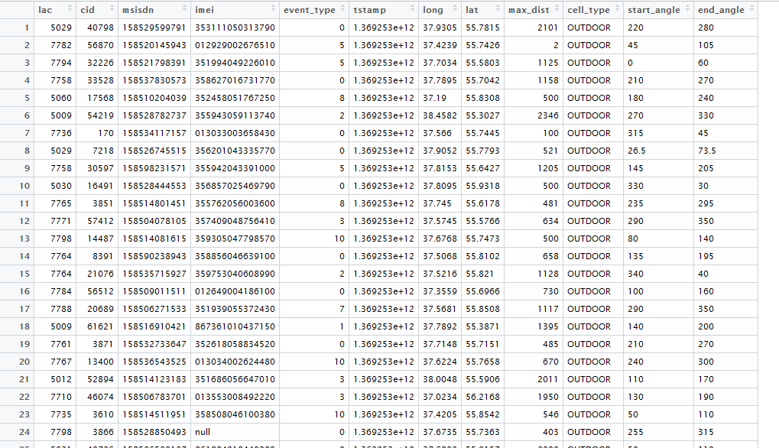
Base station registration data
Data consist of the following fields:
Lac and cid are base stations group_id and station_id correspondingly
msisdn – unique identifier of a user
Imei – identifier of the user phone
Event_type – type of the signal registered on the base station (type of the event)
Tstamp – time of the registered event
Long/lat/ max_dist/start_angle/end_angle parameters of the base station and its coverage area
Cell_type – type of the base station

Slide 4
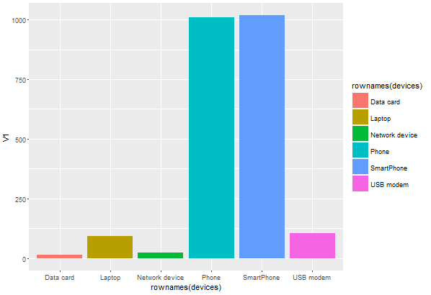
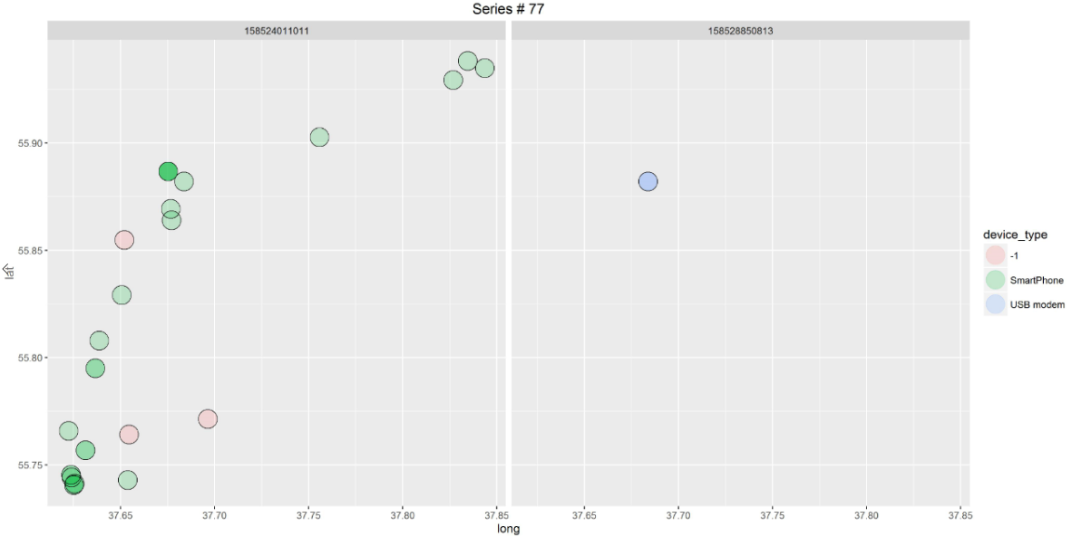
Visual analysis: phone distribution
Visual analyze shows that some of the data is generated by laptop’s and modems
Data generated by laptops and usb modems usually have less data points (points corresponding to ‘msisdn’) vs phone data
All phones are divided into two groups “Phone” and “Smartphone”, later analysis suggests that same device can be attributed to both groups (e.g to both “Apple – iOs – phone” and “Apple – iOs – Smartphone”). This observation lead to merging together “Phone” and “Smartphone” groups.

Slide 5
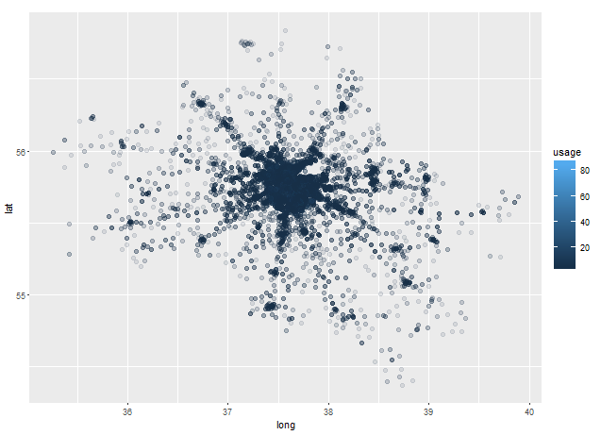
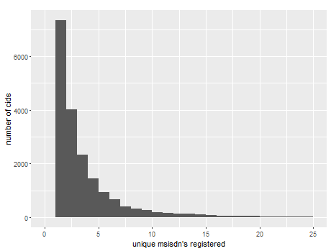
Visual analysis: number of unique ‘msisdns’ for each base station
Data provided for 18891 different base stations
We will define base station usage as number of unique ‘msidns’ registered in this base station
Data shows that most of the base stations were visited by less than five different ‘msisdns’
About 40% of all base stations were visited only by one ‘msisdn’

Slide 6
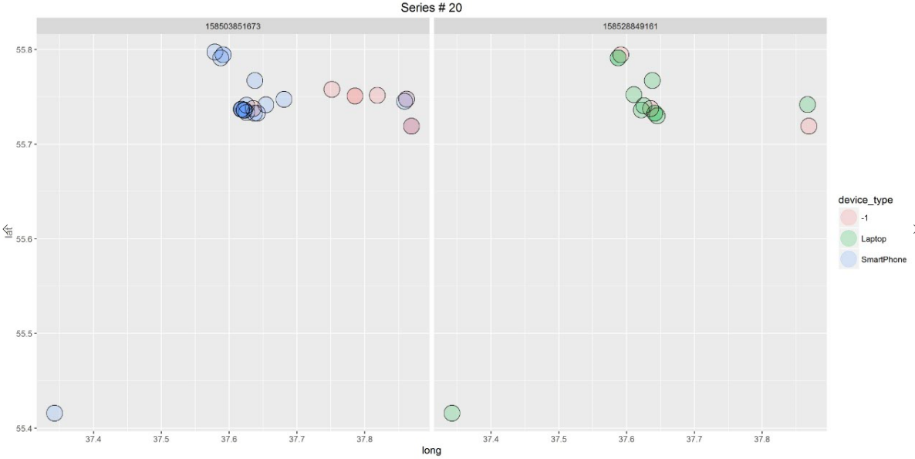
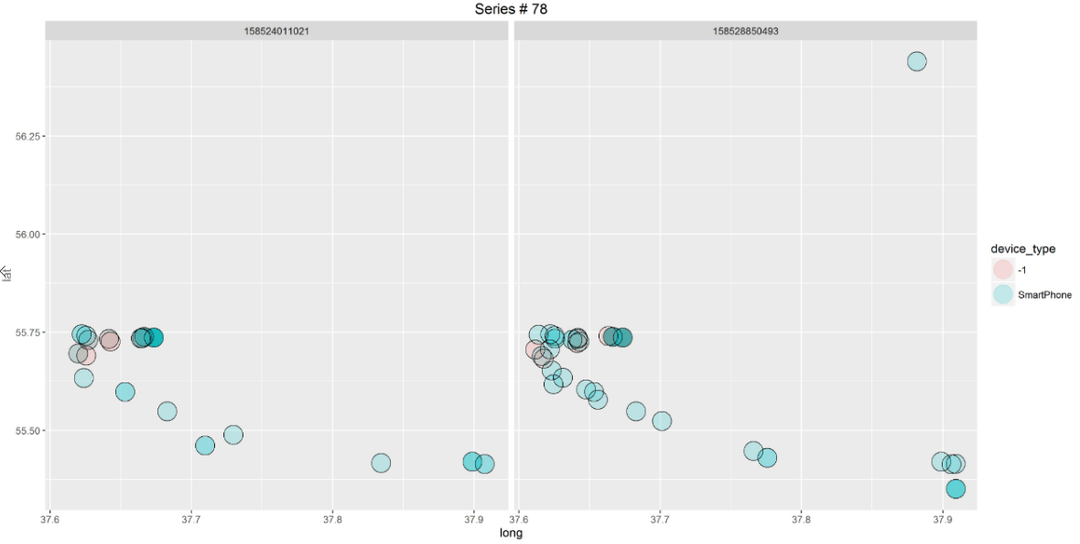
Visual analysis: Fact table
From the fact table we can see that two ‘msisdns’ match if they’ve visited same base stations
We can measure this similarities using several metrics: Jaccard Index, Bernstein and Zobel S2 and S3 similarities measures

Slide 7
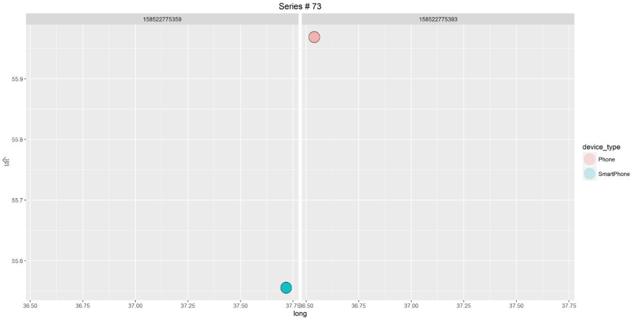
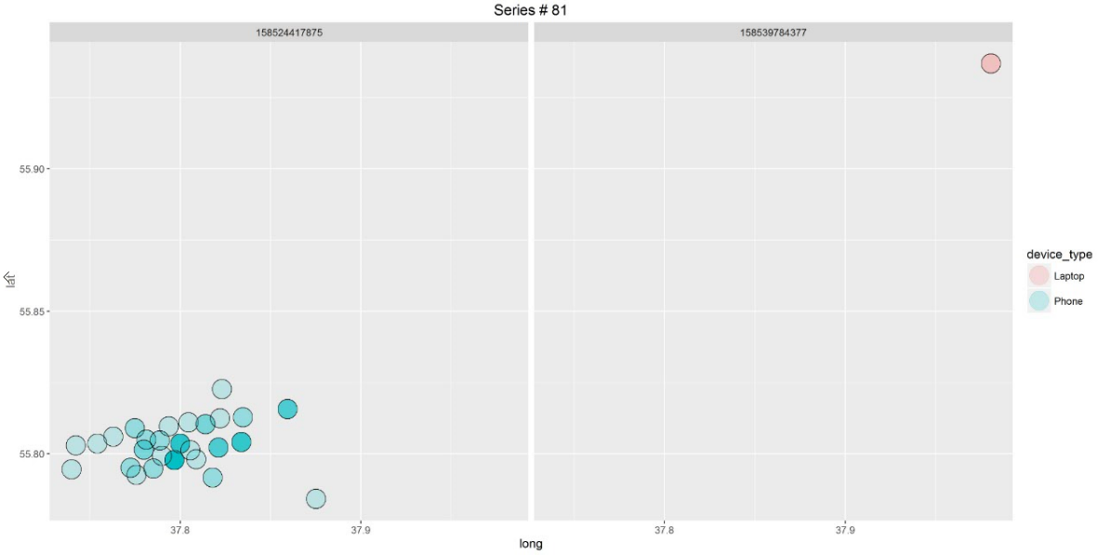
Visual analysis: Fact table
Some msisdn’s that are assumed to be matched in the fact table visually doesn’t have any base stations in common
Geographically this ‘msisdns’ can be far away from each other and can be easily separated by line

Slide 8
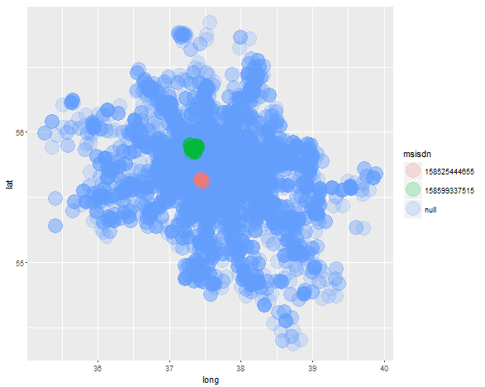
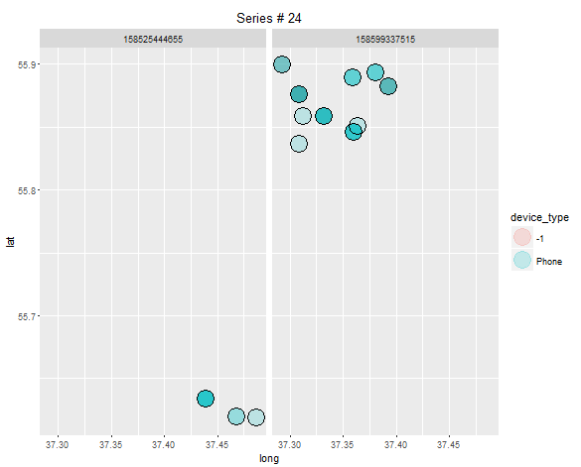
Visual analysis: Fact table
This two ‘msisdns’ are assumed to belong to the same user
However we can visually see on the map that they don’t have any geo data in common and located in different Moscow parts

Slide 9
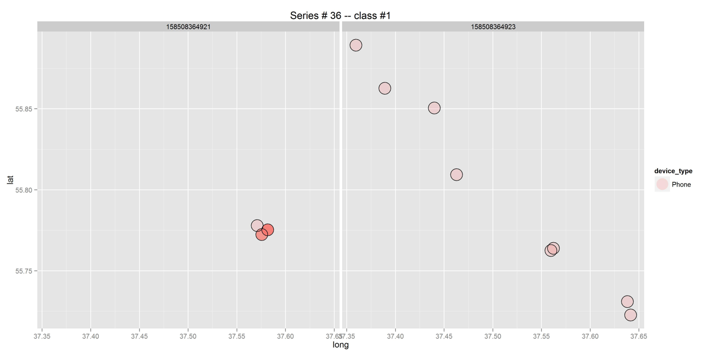
Visual analysis: Fact table
On the other hand we can see examples in the fact table were two ‘msisdn’s’ are matched with each other, but one of the matched msisdn’s have less than 4 points and this points displaced from the track produced by the second ‘msisdn’
Jaccard distance won’t work in this cases
My approach would be to take all ‘msisdn’s’ with short tracks (less or equal 3 points) and add to each point of their track all nearest base stations – base stations that have overlapping signals with points from the original track

Slide 10
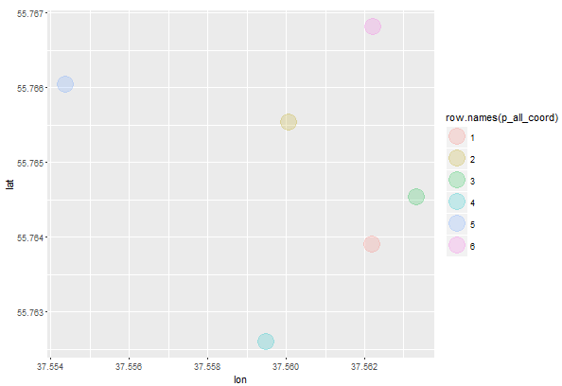
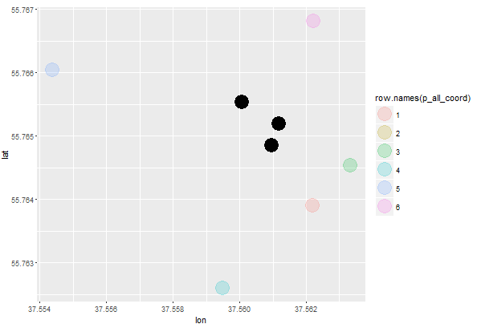
Example of the result from the algorithm that calculate base stations overlapping points
Two base stations have overlapping signals
Searching for overlapping area

Slide 11
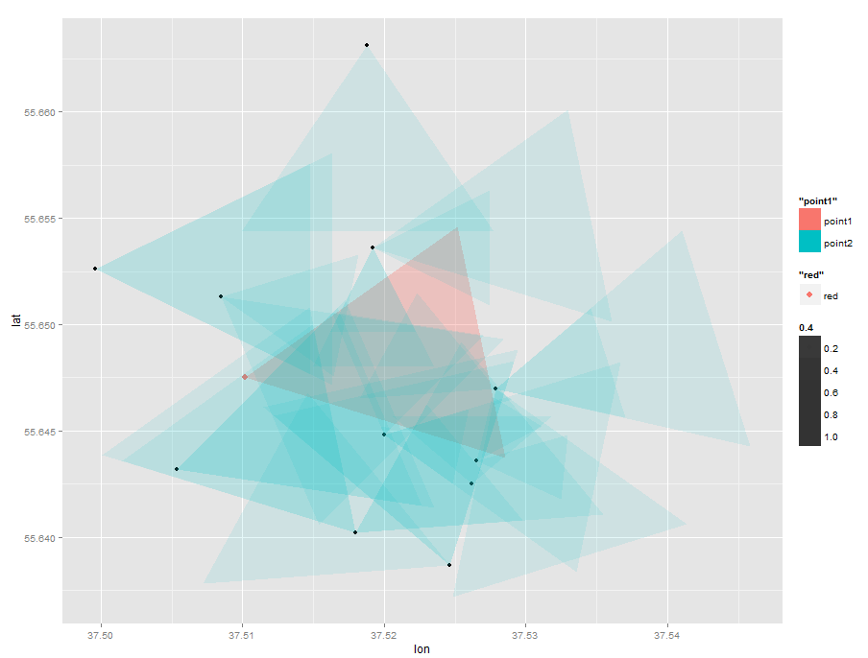
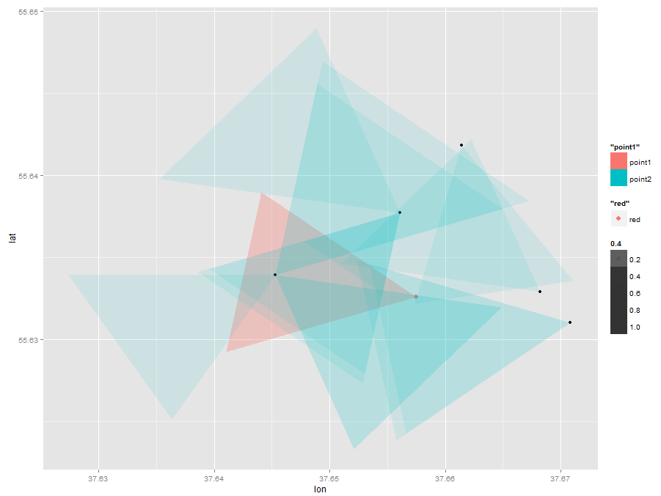
Example of set of base stations that overlaps a selected station
On the graphs we can see a red triangle – this is a working zone of the selected base station
To calculate all overlapping stations we use the following algorithm:
Search for all stations in a reasonable radius from the selected stations
For each of the station in this radius we identify if stations have overlapping connection zones with current station or not

Slide 12
Buildling train and test datasets
Test data:
Will contain of 120 pairs from the fact table with the class ‘1’ – e.g. two pairs match
1100 pairs generated from other combinations of the ‘msisdn’s’ available in the fact table. We will assume that with the high probability this ‘msisdn’s’ don’t match. This pairs will have the class ‘0’ (This fact was visually tested)
Total 1220 observations
Test data:
Input data have 2361 different ‘msisdn’s’
To build the test data we will construct the matrix with all possible unique combinations of this 2361 ids e.g test data will consist of pairs of ‘msisdn’s’. Then we will use classifier to predict if two ‘msisdn’s’ match with each other or not.

Slide 13
Building Features
Jaccard distance, S2 and S3 distances between two ‘msisdn’s’ for the original data
If two ‘msisdn’s’ have matching phones
If two ‘msisdn’s’ have matching phone vendors
If one of two ‘msisdn’s’ used Laptop, USB modem or other Network device
Jaccard distance, S2 and S3 distances for the adjusted data with nearest base stations added to the ‘msisdn’s’ witch have less or equal than three unique points

Slide 14
Model
The classifier was build with the Logistic regression model
Features selection was made using RFECV with logistic regression
Model was tested using 5-folds stratified cross validation
Parameters tuning using 5-folds CV: C-value
Features were build and model was trained on the AWS ‘c3.8xlarge’ instance

Slide 15
Model Evaluation
[ 0.92026515 0.96799242 0.94034091 0.8967803 0.96382576]
Cross val scores for 1220 train observations:
0.920 -- 0.968 -- 0.940 -- 0.897 -- 0.964
Accuracy score = 78%
Confusion matrix:
Class “0” | Class “1”
1098 | 2
26 | 94

Slide 16
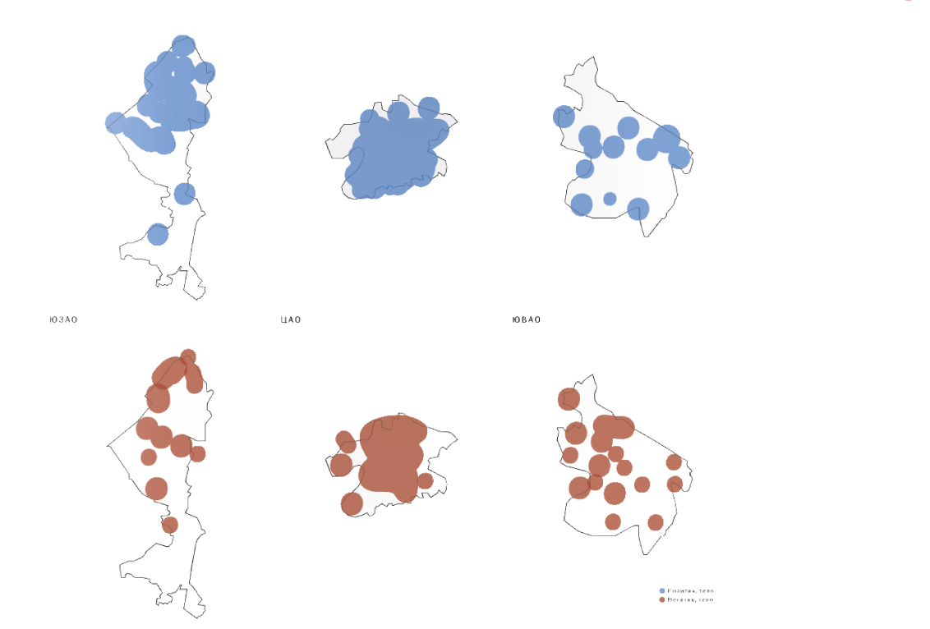
Fin.

