Slide 1
Kafo Signal
✕ AVOID
From farm information to a decision — and a buyer who pays
! CAREFUL
✓ GOOD
UTG ITCA Hackathon 2026 · Challenge 02 · [TEAM NAME]
Notes:
Women's garden groups in The Gambia don't lack information. They lack a clear answer and a buyer. Kafo Signal gives both.
(One-line pitch: The Gambia already has price and advice services — what's missing is the step from information to a decision, and from a decision to a buyer who pays. Kafo Signal gives a clear answer and a real order.)

Slide 2
Farmers get numbers, not decisions
1 : 3,000
22%
Up to 50%
extension workers to farmers
farm households with any market information
of vegetables lost after harvest
Dept. of Agriculture, 2025
Agricultural Census 2011/12
Gambia + Sub-Saharan Africa · AfDB 2026
Everyone plants tomato at the same time
! Glut
✕ “Giveaway” prices
✕ Spoilage
Notes:
Women do most vegetable farming; ~41% of adults can't read; women's literacy 47% vs men 67%; Mandinka is almost absent from speech technology.
Sources: 1:3,000 extension ratio (DG of Agriculture, May 2025); 22.1% market-information access (Agricultural Census 2011/12); "up to half" of vegetables lost (AfDB via AllAfrica, Jun 2026); adult literacy 58.7%.

Slide 3



The pipes exist. The last step is missing
Marché Kibaroo
Voice price service · 29 markets · English + 5 local languages
✕ THE GAP
No one turns information into what to do.
No one guarantees a buyer before planting.
Senenyaa Bantabaa
Government e-extension phone line · 4 languages
Jokkalante
WhatsApp buyer linkage · needs smartphone + data
Notes:
We plug into these, we don't compete. Marché Kibaroo prices are a data source for us. All are donor-funded; ROOTS ends ~2027 — so a buyer-funded model matters.
(Existing services have no published usage data.)

Slide 4






One answer everyone understands
✓ GOOD
! CAREFUL
✕ AVOID
What to plant
Little competition, buyer waiting
Many kafos planting
Glut coming
Where to sell
Good price or confirmed buyer
Average — compare or wait
Price crash, don't travel
Risk alert
All OK
Watch out
Act now
Same answer as
Colour tile
leader app
One word
basic phone
Spoken sentence
voice call
Notes:
How each answer is decided (rules-based, no AI — transparent, works with little data, and every answer shows its reason, e.g. "Avoid tomato: 14 kafos are already growing it"):
- What to plant? Amount already planted vs. what buyers ordered. Lots planted + few orders → AVOID. Little planted + buyer waiting → GOOD.
- Where to sell? Market price minus transport, vs. usual price. A confirmed buyer is always GOOD. Old prices are never shown ("no recent price").
- Is anything coming? Farmer reports alone only reach CAREFUL. ACT NOW needs the leader to confirm, or an official warning.
The same answer reaches each user in their channel: a colour tile in the leader app, one word on the basic phone, a spoken sentence on the voice line.

Slide 5





The buyer's order comes before planting
BEFORE PLANTING
GROWING → HARVEST → PAID
1
2
3
4
5
6
Buyer posts order
Farmer asks “what to plant?”
Leader accepts & logs planting
Alerts while growing
Weigh & deliver
Each farmer paid by mobile money
The order comes first — so “Okra: GOOD, buyer waiting” is real, and not every kafo plants tomato.
✓ Key design choice
Notes:
This order is the key design choice: it's what lets us say "okra is GOOD, a buyer is waiting" and stops every kafo planting tomato.
Demo story ("Fatou's season"): Hotel posts 150 kg okra in ~10 weeks → farmer dials *1234#, sees Tomato: DON'T PLANT · Okra: GOOD, buyer waiting → leader accepts order, logs 40 beds → insect reports turn okra YELLOW → heavy rain warning: SMS + call "ACT NOW, harvest early" → leader weighs each woman's okra → buyer pays each farmer directly by Wave → SMS "PAID 38 kg okra".

Slide 6
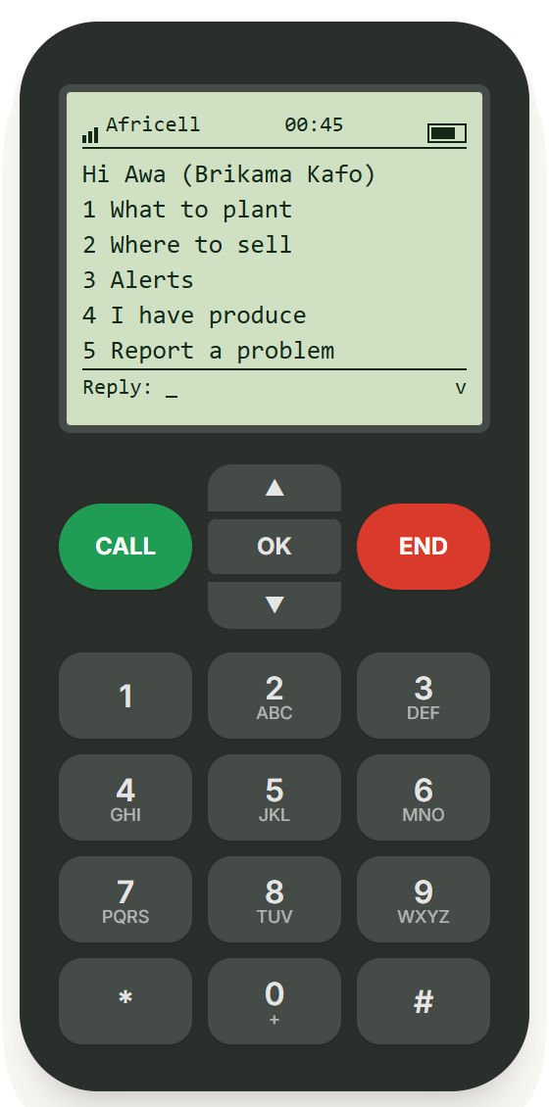


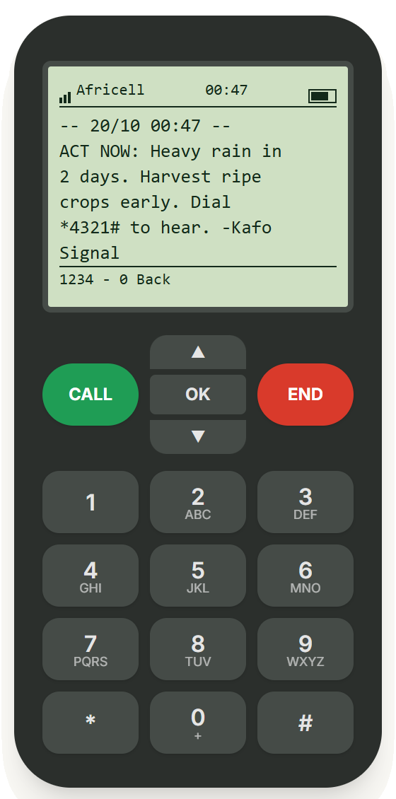


Works on any phone, no internet
Prototype · simulated
*1234#
Free text menu
*4321#
Free call-back in her language
Key word first
Every message starts with it: GOOD, ACT NOW, PAID
Main menu
1 What to plant
SMS alert
Notes:
USSD runs on 2G with no data bundle. Voice uses pre-recorded clips because speech tech barely supports Mandinka.
What the judges see: the on-screen phone simulator from our live demo site (Awa, Brikama kafo). Left: the *1234# main menu. Middle: "1 What to plant" — Tomato: DON'T PLANT, Onion: CAREFUL, Pepper: GOOD TO PLANT, Okra: GOOD-buyer waiting (the screen is scrolled one line so the okra answer is complete). Right: Binta's inbox after the admin triggers heavy rain — "ACT NOW: Heavy rain in 2 days. Harvest ripe crops early."
This is a prototype: USSD/SMS run in a simulator and voice is simulated. The network name shown on the drawn phone is part of the drawing — the demo is not connected to any operator. *1234# / *4321# are placeholder codes until PURA assigns real ones.

Slide 7
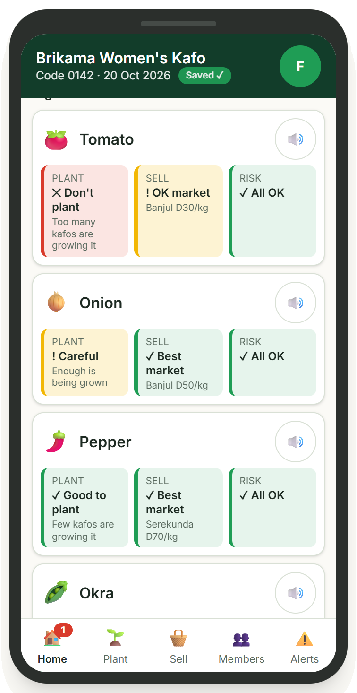
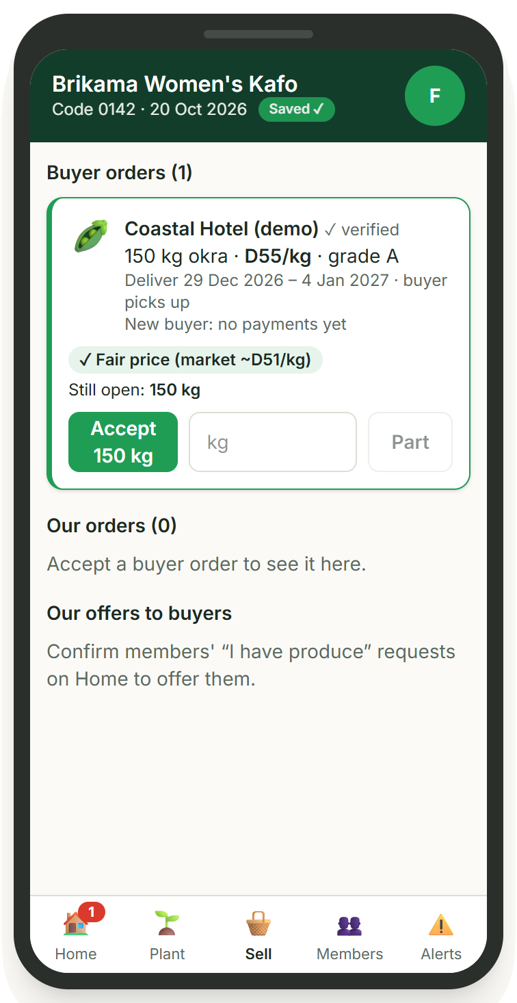

One trusted leader decides for 200 women
Prototype · simulated
Colour tiles + crop pictures + ♪ audio
Shape and word on every tile, read aloud on tap
Logs plantings
Powers the glut warning for every kafo
Accept buyer orders in one tap
Hotel needs 150 kg okra → Accept
Home: a tile per crop
Sell: a buyer order
Notes:
Only verified leaders record plantings and accept orders, so one wrong entry can't mislead every kafo.
Screens from the leader app (Fatou, Brikama Women's Kafo): tomato ✕ Don't plant (red), onion ! Careful (yellow), pepper and okra ✓ Good to plant (green — okra: "A buyer is waiting"). Note: in the app these signal tiles are on the Home tab (the Plant tab is where plantings are logged), so the screenshot shows Home. Right: the Sell tab with the Coastal Hotel (demo) order for 150 kg okra and the Accept 150 kg button. All names, prices and orders are demo data.

Slide 8
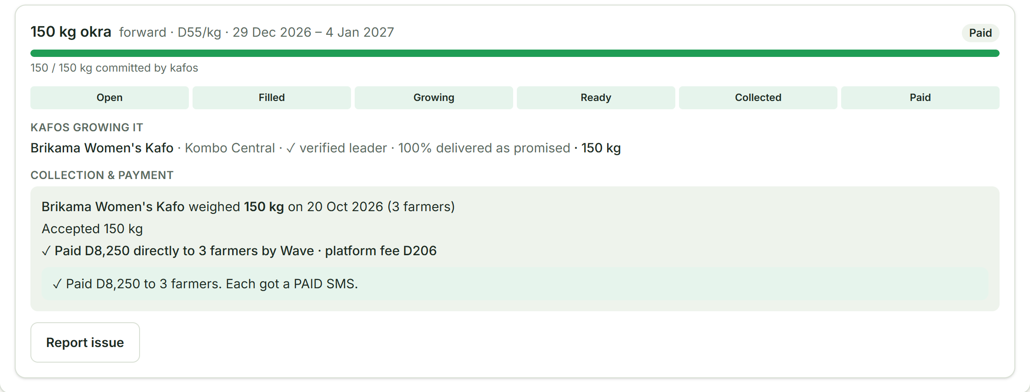
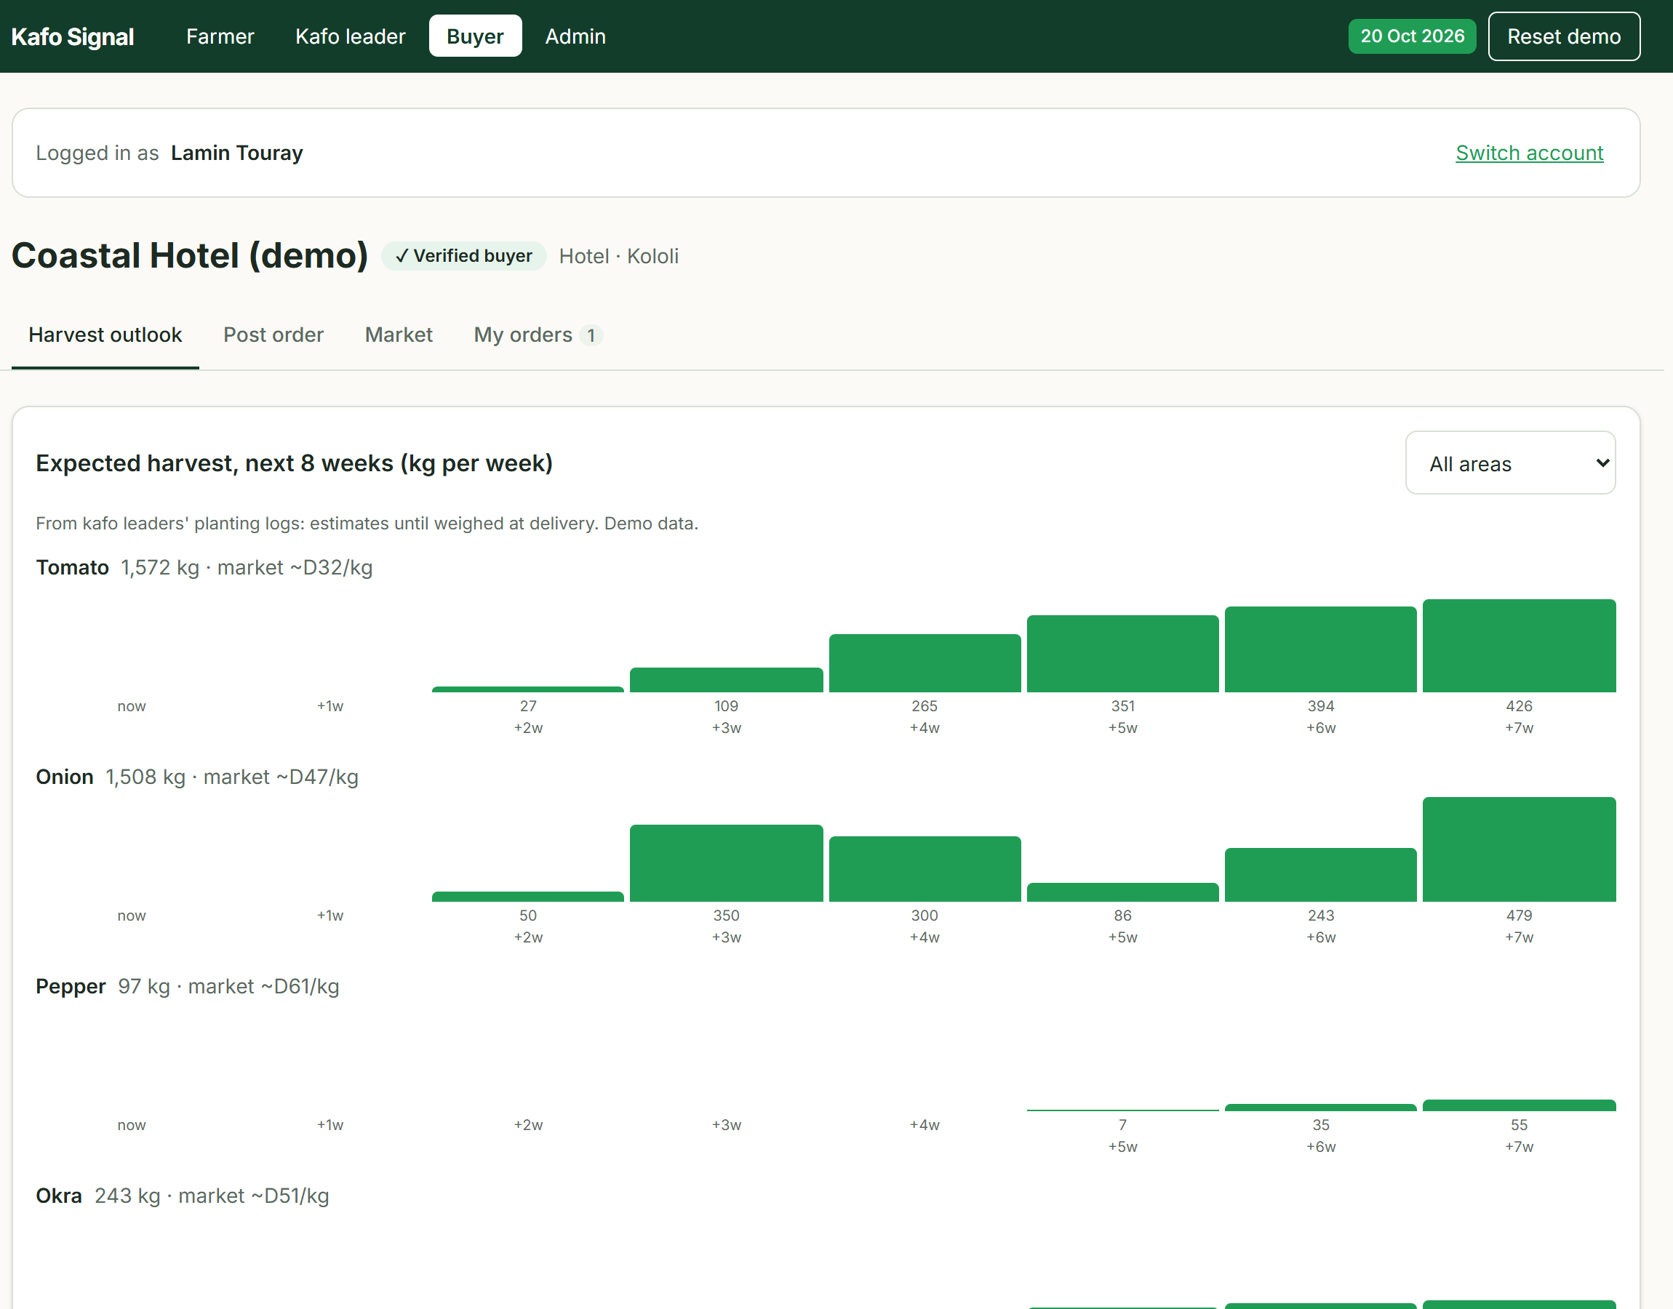
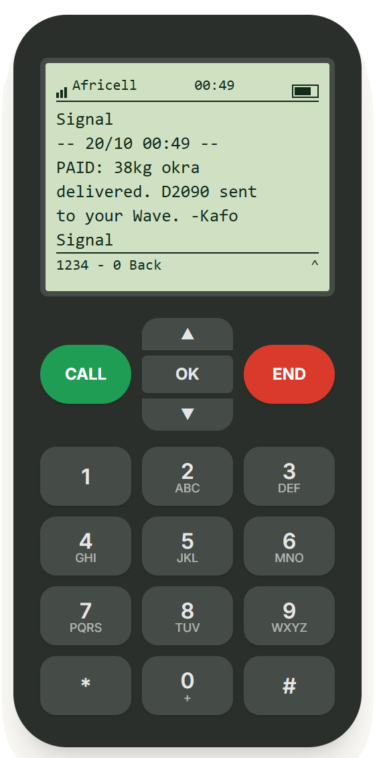


Buyers see the harvest before it exists
Prototype · simulated
Post orders weeks ahead
Harvest outlook by crop
Each farmer paid directly, SMS receipt
Harvest outlook · demo data
Notes:
Buyers pay at collection or within 48h; late payers lose their rating. Buyers see the kafo, never individual farmers' names or numbers.
Screens: the buyer website for Coastal Hotel (demo) — the Harvest outlook tab (expected kg per week per crop for the next 8 weeks, from leaders' planting logs). The Post order form is on the next tab (screenshot 06b-buyer-post-order.png is in the screenshots folder if you want to show it). Top right: the 150 kg okra order after delivery — stage Paid, "Paid D8,250 directly to 3 farmers". Bottom: Awa's phone receives "PAID: 38kg okra delivered. D2090 sent to your Wave."
Payments are mocked in the prototype — nothing is connected to Wave or any mobile-money provider. Prices are demo data.

Slide 9




Who we work with to go live
Going live · after the hackathon
Networks & codes
Mobile-money payouts
Africell · QCell
host *1234#, two-way SMS, call-back voice line
PURA (regulator)
licence for the short / USSD code
Wave Payout API · Modem Pay
pay each farmer directly by phone number, batch payouts
Prices & weather
Buyers, reach & trust
Marché Kibaroo / MoALFS Planning · DWR · Open-Meteo
market prices, dekadal agromet bulletins, 7-day forecast
Gambia Hotel Association · WFP Home-Grown School Feeding · ITC
committed pre-harvest orders
Dept. of Agriculture extension · NACOFAG · ROOTS
kafo sign-up, leader training
Notes:
Real world only — none of these are used in the demo.
International SMS providers (BudgetSMS, SMS.to, Infobip) can send one-way alerts to Gambia today for roughly €0.03–0.10 per SMS, but they do not support two-way SMS or short codes in Gambia — so the USSD menu must go through Africell/QCell (or a licensed local value-added-service partner). Africa's Talking is not live in Gambia — we use its simulator only for the demo.
Terms (verified): Africell/QCell — operator revenue-share terms are not public, to negotiate. PURA — D10,000 application + D25,000/yr per code; toll-free number D5,000 + D7,500/yr; social-service numbers can be exempt from annual fees. Wave enables payouts per business after a compliance check; Modem Pay is one API for Wave, QMoney, Afrimoney. Prices & weather — partnership; Open-Meteo is free. Buyers — fee per completed order. Reach & trust — partnership.

Slide 10
From demo to pilot in 3 steps
Going live · after the hackathon
1
2
3
Year 1 cost
PURA fees only
Now — Demo
Pilot — 3 kafos in Brikama
Launch
1 USSD code
D10,000 + D25,000
D35,000
On-screen USSD/SMS simulator, mock payments.
Outbound SMS via gateway · call-back voice via operator partner · real payouts via Modem Pay / Wave sandbox → live
Own USSD code on Africell + QCell · Marché Kibaroo price feed · buyers onboarded
1 toll-free voice number
D5,000 + D7,500
D12,500
Total ≈ D47,500
Cost: D0
before operator revenue share — or apply for the social-service fee exemption
Notes:
Cost-saving option: use ONE code (*1234#, with "6 = Call me") instead of two, which halves code fees. Two alternatives to a full PURA licence: (a) run under an operator's existing code as a partner service, (b) partner with a licensed value-added-service provider (a VAS licence itself is D75,000 + US$10,000 for 5 years — too big for us now).
Check before presenting: the PURA 2026 fee regulations come into force on a date the Minister gazettes — confirm with PURA that they apply now. PURA may also waive fees for public interest, innovation or small community operators.

Slide 11


Free for farmers. Paid by sales
Business model
Trust built in
Buyers pay ~2–3% on each completed order.
Farmer-paid models failed elsewhere (Esoko); business- and sale-funded ones survived.
✓ Verified leaders & buyers
✓ Every answer shows its reason
✓ Each farmer paid directly, with SMS receipt
✓ Buyers can't cancel after planting
Pilot with 3 kafos in Brikama · Intro to Africell & QCell · PURA social-service exemption · Marché Kibaroo price feed
Our ask
Notes:
Close on Fatou: "She didn't get more data. She got an answer, a buyer, and her money on her phone."
(If asked about data protection: the Personal Data Protection and Privacy Act 2025 requires consent for storing farmer phone and location data — we ask for consent at sign-up.)

Slide 12
Appendix: facts we checked
Fact | Number | Source
Extension workers to farmers | 1 : 3,000 | DG of Agriculture, May 2025
Farm households with market information | 22.1% | Agricultural Census 2011/12
Vegetables lost after harvest | Up to half | AfDB via AllAfrica, Jun 2026
Adult literacy | 58.7% · women 47% vs men 67% | Team research report
PURA short / USSD code | D10,000 + D25,000/yr; social-service exempt from annual fees | PURA Unified Fees Regulations 2026
PURA toll-free number · VAS licence | D5,000 + D7,500/yr · D75,000 + US$10,000 (5 yrs) | PURA Unified Fees Regulations 2026
International SMS gateways | €0.032–0.10 per SMS; no two-way SMS or short codes | budgetsms.net · sent.dm
Africa's Talking | Gambia not listed → simulator only | help.africastalking.com
Marché Kibaroo | 29 markets · English + 5 local languages | marchekibaroo.org
WFP school feeding (2025) | 167,105 children in 422 schools | WFP
Wave agents in Gambia | 1,900+ | Taptap Send help
Phone numbers | 9 digits for Africell/QCell/Comium since 4 Sep 2026 | Twilio · osiris.sn
Notes:
Sources (Section 6 of the build guide):
- PURA Unified Fees Regulations 2026: https://pura.gm/wp-content/uploads/2026/04/PURA-Unified-Fees-Regulations-2026.pdf
- Gambia SMS guide (no two-way SMS / short codes; Africell largest share): https://www.sent.dm/en/resources/sms-compliance/gambia-sms-guide
- SMS gateway prices: https://budgetsms.net/sms-gateway-pricing/gm/gambia
- Gamcel sender IDs registered in advance: https://d7networks.com/sms/gambia/
- 9-digit numbering: https://static0.twilio.com/en-us/guidelines/gm/sms · https://osiris.sn/telephonie-la-gambie-annonce-le-passage-aux-numeros-a-neuf-chiffres-pour.html
- Africa's Talking countries: https://help.africastalking.com/en/articles/2727792-which-countries-are-africa-s-talking-products-in
- Viamo 3-2-1: https://hifa.org/node/96850142
- Wave Business API: https://providers.apievangelist.com/providers/wave-mobile-money/ · payouts per business: https://packagist.org/packages/thales/wave · agents: https://help.taptapsend.com/en/receiving-countries/how-can-i-send-money-to-the-gambia
- Modem Pay: https://vc4a.com/ventures/modem-pay-limited · Afrimoney APIs: https://www.africell.com/?p=939
- Marché Kibaroo: https://marchekibaroo.org/post/twenty-one-markets-of-the-mis
- Gambia Hotel Association B2B: https://academicnewsletter.sufe.edu.cn/info/461856
- WFP school feeding: https://docs.wfp.org/api/documents/WFP-0000172828/download · WFP + ITC women farmers: https://news.fundsforngos.org/2026/09/18/gambia-women-farmers-local-food-schools/
- Problem stats: team research report and challenge brief.

