Slide 1
Kafo Signal
✕ AVOID
From farm information to a decision, and a buyer who pays
! CAREFUL
✓ GOOD
UTG ITCA Hackathon 2026 · Challenge 02 · Linear Growth
Notes:
Opening hook (15 s): "Every dry season, women in The Gambia's garden groups all plant tomato, the price collapses, and the crop rots. They don't need more information. They need a clear answer and a buyer. That's Kafo Signal."
One-line pitch: The Gambia already has price and advice services. What's missing is the step from information to a decision, and from a decision to a buyer who pays.
Timing (7-minute slot):slides 1–6 in 2:30 · live demo 2:30 · slides 10–13 in 2:00. Slides 7–9 only if the live demo fails.
Team: Linear Growth.

Slide 2




Meet Fatou, kafo leader in Brikama
~200 women share one garden, about 4 beds each
Basic phone · reads little English · speaks Mandinka
Sells at harvest to whoever shows up, with no reference price
Fatou · composite persona
6,600 women farm in 33 NEMA community gardens
47% of women can read (men: 67%)
76% of women own a phone (men: 86%)
2
Notes:
Fatou is a composite persona built from our research, not a real person. Saruja garden: 200+ women, ~4 beds each, no storage or transport (Gambiana 2020). ROOTS is upgrading 40 gardens and building 30 new ones, so the number of kafos is growing.
Stat strip: 6,600 women in 33 NEMA community gardens (IISD/IFAD); women's literacy 47% vs men 67%; phone ownership 76% of women vs 86% of men (team research report).

Slide 3

Farmers get numbers, not decisions
1 adviser
About 1 in 5
Up to half
for every 3,000 farmers
of farm households get any market information at all
of vegetables can be lost after harvest, before they are sold
Govt. extension workers · Dept. of Agriculture, 2025
Agricultural Census 2011/12 (22%)
Gambia + Sub-Saharan Africa · AfDB 2026
Same week, July 2026: onions D1,200/bag in Jarra Soma, D1,400 in Kerr Jatta. No official source told farmers.
Everyone plants tomato at the same time
! Glut
✕ “Giveaway” prices
✕ Spoilage
3
Notes:
76% of farmers lose part of their harvest every year. The 50% loss figure is regional (Gambia + Sub-Saharan Africa), so say it that way. No storage means vegetables must sell within days, which kills bargaining power at glut time.
Onion example: DUBAWA, July 2026 (via our research report). Sources for the cards: 1:3,000 extension ratio (DG of Agriculture, May 2025); 22.1% market-information access (Agricultural Census 2011/12); "up to half" lost (AfDB via AllAfrica, Jun 2026).

Slide 4



The pipes exist. The last step is missing
Marché Kibaroo
Voice price service · 29 markets · English + 5 local languages
✕ THE GAP
No one turns information into what to do.
No one guarantees a buyer before planting.
Senenyaa Bantabaa
Government e-extension phone line · 4 languages
Jokkalante
WhatsApp buyer linkage · needs smartphone + data
WHAT THE EVIDENCE SAYS → WHAT WE DID
Price info alone: farmers got only 7–10% better prices, and traders can take the gains
Services grew only through USSD / operator channels (MLouma, Viamo)
Reached through their groups, women's uptake rose from 10% to 48% (DigiFarm)
→ We add a committed buyer
→ We use USSD + voice, not a farmer app
→ We work through the kafo leader
4
Notes:
We plug into these services, we don't compete: Marché Kibaroo prices are a data source for us. All are donor-funded; ROOTS ends ~2027, so a buyer-funded model matters.
Evidence: Courtois & Subervie (Ghana/Esoko): about +10% maize, +7% groundnut. Mozambique (Zant 2024): producer prices fell 8–14% while traders gained. Esoko stopped selling farmer-paid price services in 2016 after heavy losses. Services that scaled went through USSD/operator channels (MLouma, Viamo). Women's uptake rose when reached through their groups (DigiFarm: 10% → 48%).
Our improvement is turning information into a decision AND a guaranteed sale.

Slide 5





One answer everyone understands
✓ GOOD
! CAREFUL
✕ AVOID
What to plant
Little competition, buyer waiting
Many kafos planting
Glut coming
Where to sell
Good price or confirmed buyer
Average — compare or wait
Price crash, don't travel
Risk alert
All OK
Watch out
Act now
Same answer as
Colour tile
leader app
One word
basic phone
Spoken sentence
voice call
5
Notes:
Why it suits farmers who can't read: colour + shape + one word + a spoken sentence, so it still works in black and white, for colour-blind users, and by ear.
How each answer is decided (rules, no AI; every answer carries its reason, e.g. "Avoid tomato: 14 kafos are already growing it"):
- Plant: expected supply ÷ buyer demand — below 0.8 GOOD, 0.8–1.3 CAREFUL, above 1.3 AVOID.
- Sell: (market price − transport) vs the 4-week average; a confirmed order is always GOOD; prices older than 14 days are hidden ("no recent price").
- Risk: an official alert issued by the admin — e.g. from a DWR bulletin, or from the Open-Meteo 7-day forecast cached in the app, which offers to pre-fill a heavy-rain alert for any day with ≥ 30 mm — or ≥ 3 pest reports from the area within 7 days. Farmer reports alone reach only CAREFUL; ACT NOW needs a leader-confirmed report or an official alert. Alerts count from up to 7 days before they start.

Slide 6





The buyer's order comes before planting
BEFORE PLANTING
GROWING → HARVEST → PAID
1
2
3
4
5
6
Buyer posts order
Farmer asks “what to plant?”
Leader accepts & logs planting
Alerts while growing
Weigh & deliver
Each farmer paid by mobile money
“
It works when a project arranges it.
Kafo Signal makes it the default for every kafo.
We know we have a buyer before we even plant.
Kumba Jallow, Jahaur women's group, which supplies school meals weekly (GAFSP, Mar 2026)
6
Notes:
The order comes first: that's what lets us say "okra is GOOD, a buyer is waiting" and stops every kafo planting tomato.
Proof it works: the Jahaur women's group supplies school meals weekly — "We know we have a buyer before we even plant" (Kumba Jallow, GAFSP, Mar 2026). WFP Home-Grown School Feeding fed 164,194 children in 422 schools in 2025/26 using local suppliers. Hotels met farmers at an ITC / Gambia Hotel Association matchmaking event in early 2026. Demand exists; the problem is coordination.
Next: switch to the live demo.

Slide 7
Live demo: Fatou's season
1 Buyer posts order
2 Farmer: *1234#
3 Leader accepts
4 Admin triggers rain
5 PAID SMS
Prototype · simulated · demo data
Notes:
Live demo (~2:30) on https://sirret.github.io/FarmerHackaton10/ — start with Admin → Demo → Reset demo.
1. Buyer (Coastal Hotel) posts the okra order (Post order tab).
2. Farmer phone: dial *1234#, press 1 → Tomato: DON'T PLANT · Okra: GOOD-buyer waiting.
3. Leader app (Fatou): Sell → Accept 150 kg; Plant → log okra beds for the order.
4. Admin → Demo → Trigger heavy rain in Brikama → ACT NOW SMS (+ call farmers with alert).
5. Leader records weighed delivery; buyer confirms collection and pays (mock) → farmer gets "PAID: 38kg okra…".
If the live demo fails (e.g. no Wi-Fi): skip to slides 7–9, which show the same story as screenshots.
Everything here runs in our own on-page simulator; nothing is connected to an operator, PURA or a payment provider.

Slide 8
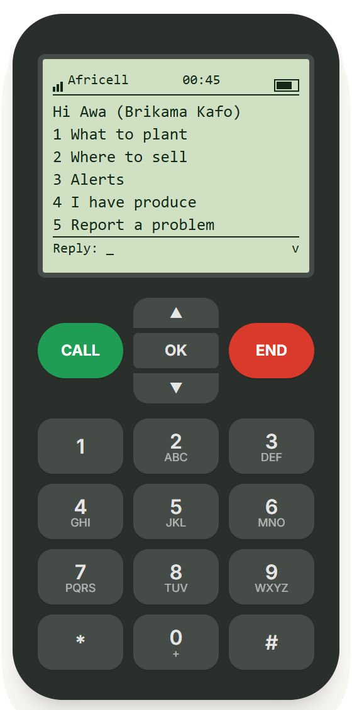


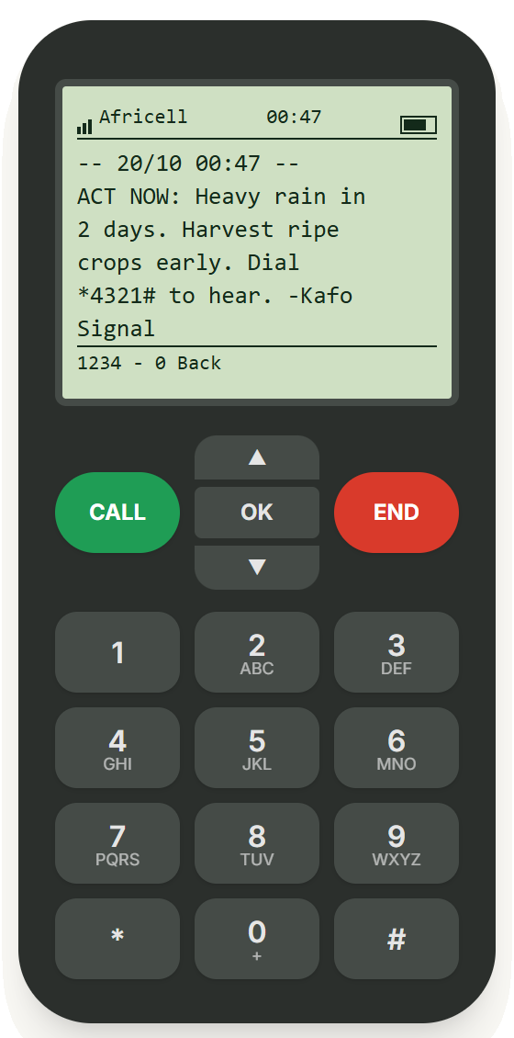



Works on any phone, no internet
Prototype · simulated
*1234#
Free text menu
*4321#
Free call-back in her language
Key word first
GOOD, ACT NOW, PAID
1–2 key presses to an answer
Longest screen 128 characters (USSD limit 182)
Main menu
1 What to plant
SMS alert
7
Notes:
This is our own on-page phone simulator. Africa's Talking is not live in Gambia. USSD runs on 2G with no data bundle. Voice uses pre-recorded clips because speech tech barely supports Mandinka.
Screens (Awa, Brikama kafo): left, the *1234# main menu; middle, "1 What to plant" — Tomato: DON'T PLANT, Onion: CAREFUL, Pepper: GOOD TO PLANT, Okra: GOOD-buyer waiting (scrolled one line so the okra answer is complete); right, the ACT NOW heavy-rain SMS. The network name on the drawn phone is part of the drawing — the demo is not connected to any operator. *1234# / *4321# are placeholder codes until PURA assigns real ones.
UX numbers (checked on our seed data with src/lib/ussd.js, all 100 reachable screens for a farmer, also with an active heavy-rain alert): planting advice and alerts are 1 key press from the main menu, the best market 2 (pick the crop); the longest screen is the 128-character main menu, inside the 182-character USSD limit. The longest flow ("I have produce": crop, amount, when, confirm) takes 4 presses.

Slide 9
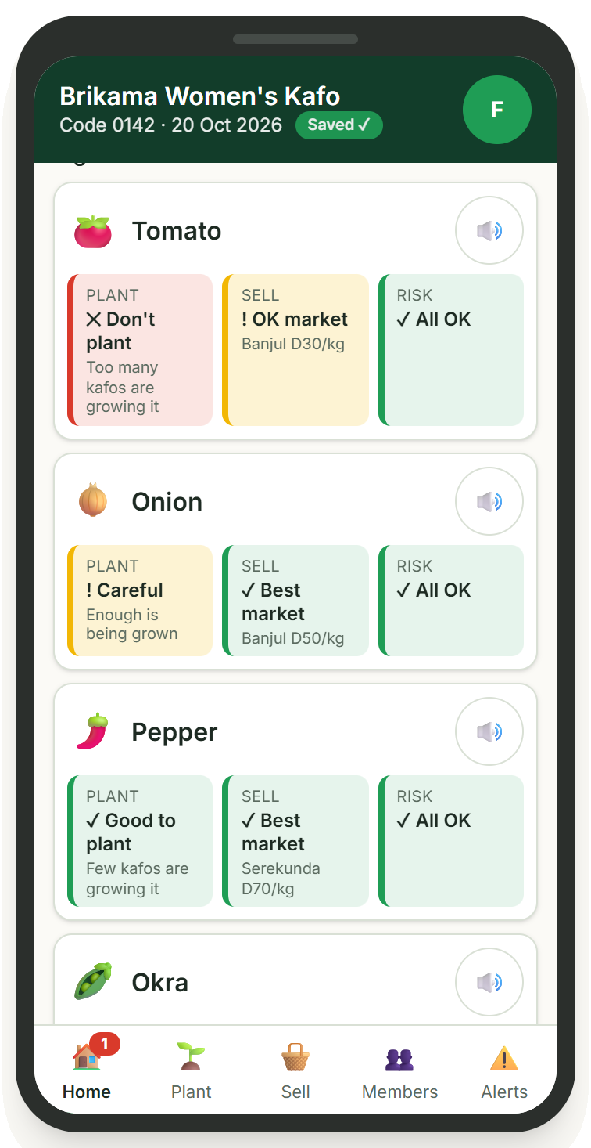
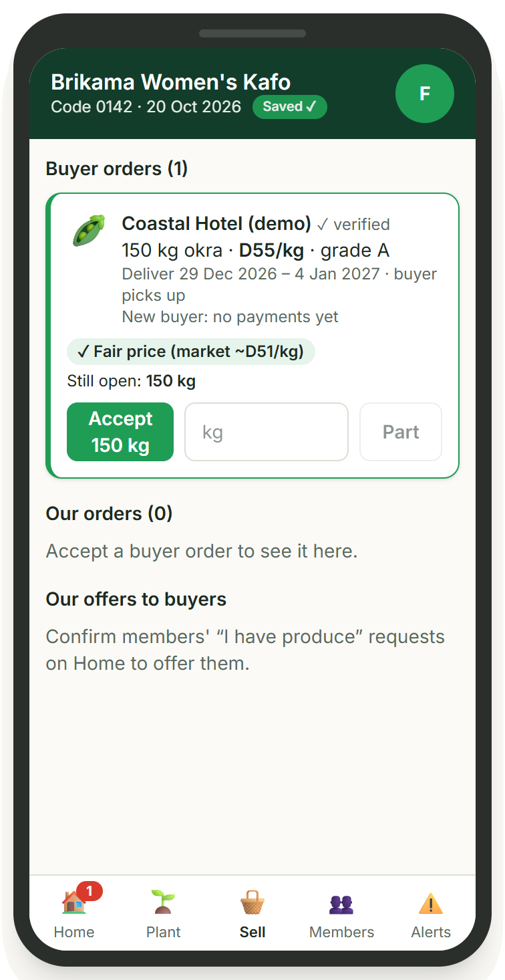

One trusted leader decides for 200 women
Prototype · simulated
Colour tiles + crop pictures + ♪ audio
Shape and word on every tile, read aloud on tap
Logs plantings
Powers the glut warning for every kafo
Accept buyer orders in one tap
Hotel needs 150 kg okra → Accept
Home: a tile per crop
Sell: a buyer order
8
Notes:
200 women is sourced: ~6,600 women across 33 gardens ≈ 200 per garden.
Only verified leaders record plantings and accept orders, so one wrong entry can't mislead every kafo.
Screens (Fatou, Brikama Women's Kafo): tomato ✕ Don't plant, onion ! Careful, pepper and okra ✓ Good to plant (okra: "A buyer is waiting"). The signal tiles are on the app's Home tab (the Plant tab is where plantings are logged). Right: the Sell tab with the Coastal Hotel (demo) order for 150 kg okra and Accept 150 kg. All names, prices and orders are demo data.

Slide 10
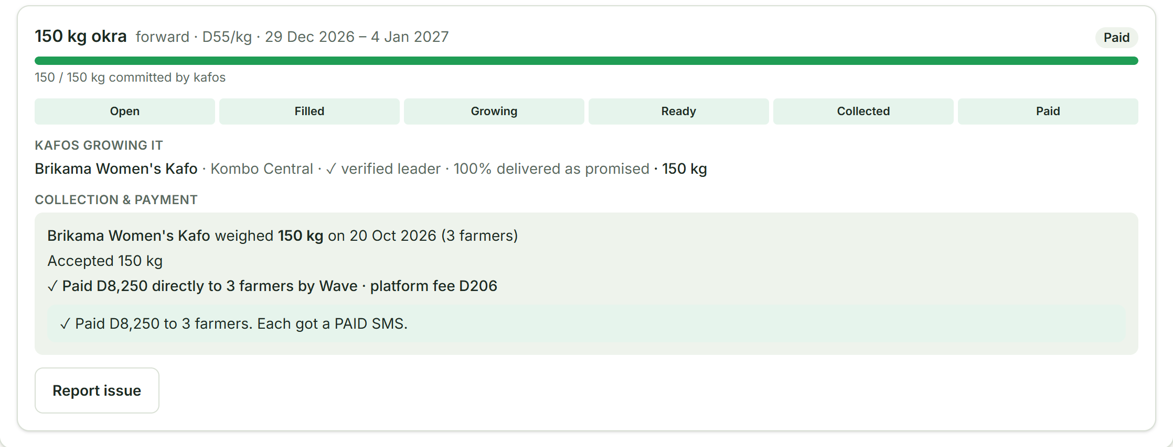
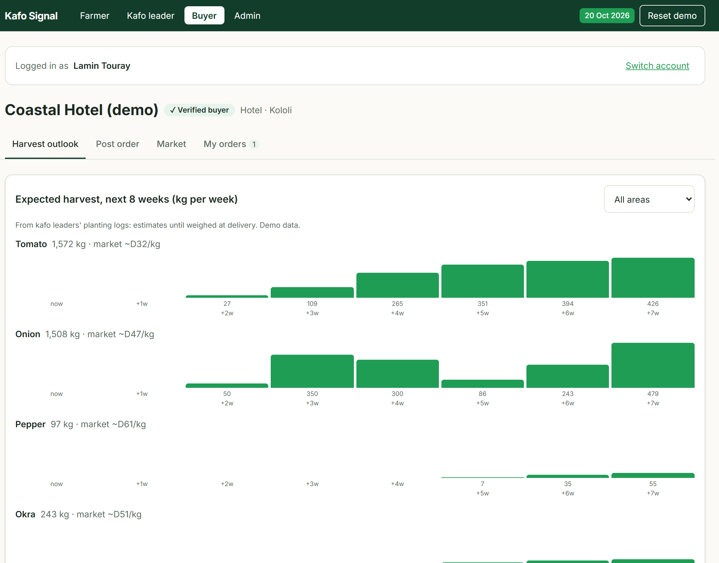
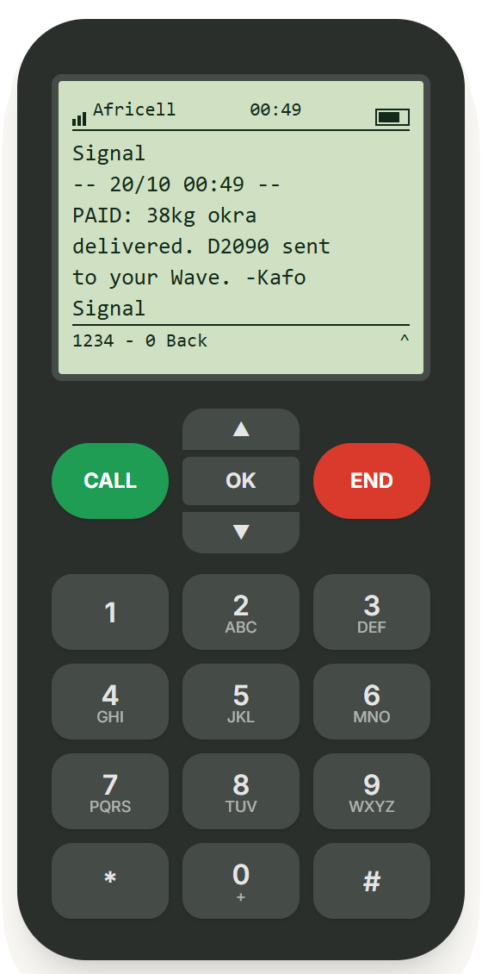


Buyers see the harvest before it exists
Prototype · simulated
Post orders weeks ahead
Harvest outlook by crop
Each farmer paid directly, SMS receipt
Harvest outlook · demo data
9
Notes:
Buyers pay at collection or within 48h; late payers lose their rating. Buyers see the kafo, never individual farmers' names or numbers.
Screens: the buyer website for Coastal Hotel (demo) — Harvest outlook (expected kg per week per crop, next 8 weeks, from leaders' planting logs). Top right: the 150 kg okra order after delivery — stage Paid, "Paid D8,250 directly to 3 farmers" (platform fee D206 at the prototype's 2.5%). Bottom: Awa's phone gets "PAID: 38kg okra delivered. D2090 sent to your Wave."
Payments are mocked — Wave/QMoney/Afrimoney are labels only; nothing is connected to a payment provider. Prices are demo data.

Slide 11

Simple tech, chosen on purpose
TODAY · PROTOTYPE
GOING LIVE
Astro + Tailwind static site on GitHub Pages
Same front end + a small server, cloud host
Browser database: Dexie (IndexedDB) + JSON seed
Hosted database
Rules engine
one shared JS module
plant · sell · risk
→ tile · USSD word · voice
Our own on-page phone simulator (USSD, SMS)
Operator USSD gateway (session ID → CON / END)
Recorded voice clips (*4321#), subtitles if missing
Same clips on an IVR call-back line
Open-Meteo forecast (cached JSON) → admin issues alert
Open-Meteo + DWR + Marché Kibaroo prices
Mock payment (labels only)
Wave Payout API / Modem Pay with webhooks
✓ Rules, not AI: transparent, works with little data
✓ No server for the demo: runs on any laptop
✓ Same rules module in demo and production
10
Notes:
Where it happens in the repo (so anyone can answer "show us"):
- Framework: Astro (static output) + Tailwind CSS v4 + Preact islands. Hosting: GitHub Pages via GitHub Actions (.github/workflows/deploy.yml), base path /FarmerHackaton10. `npm run dev` runs locally with no server or backend (only Google Fonts need internet; offline it falls back to system fonts).
- Rules engine: src/lib/rules.js — pure functions plantSignal / sellSignal / riskSignal. Thresholds in src/data/seed/config.json: plant_green_below 0.8, plant_red_above 1.3; sell compares price minus transport with the 4-week average (price_avg_weeks 4; sell_green_above 1.05, sell_red_below 0.9); prices older than 14 days → "no recent price"; report_count 3 within report_window_days 7; unverified reports only reach yellow; red needs a leader-verified report or an admin alert. src/lib/render.js: render(signal, 'tile' | 'ussd' | 'voice') turns one signal into a colour tile, a USSD word or a voice-clip chain.
- Weather: risk is NOT computed directly from the forecast. `npm run weather` (scripts/fetch-weather.mjs) calls https://api.open-meteo.com/v1/forecast with daily=precipitation_sum,temperature_2m_max, forecast_days=7, timezone Africa/Banjul, for Brikama and Gunjur, and caches it in src/data/weather.json. The admin Alerts tab shows it and offers to pre-fill a heavy-rain alert for any day ≥ 30 mm; the admin's alert (from a template) drives the risk signal (counted from up to 7 days before it starts).
- Database: Dexie (IndexedDB) in the browser, not sql.js — schema in src/lib/db.js; seed JSON in src/data/seed/*.json; every write goes through src/lib/actions.js; changes sync live across browser tabs.
- Phone simulator: our own components src/components/farmer/BasicPhone.jsx + FarmerSim.jsx. The USSD menu is data (src/data/ussd/menu.json) run by the state machine src/lib/ussd.js. Voice line *4321#: src/lib/ivr.js + src/data/ivr/flow.json, clips played by src/lib/audio.js from public/audio/<lang>/ (10 Mandinka recordings in public/audio/mnk/ today; unrecorded clips fall back to subtitles + English speech). SMS are simulated rows in the browser database (src/lib/notify.js). Payments are mocked (Wave/QMoney/Afrimoney labels only).
- Tests: Vitest, 137 tests in tests/*.test.js, including a step-by-step run of the demo story.
USSD limits we design for: 182 characters per screen, input timeout ~20–60 s, whole session ~180–300 s, so every answer arrives in under 60 s. Going live, each key press reaches our server with the session ID and we reply CON (more) or END (done).

Slide 12




Who we work with to go live
Going live · after the hackathon
Networks & codes
Mobile-money payouts
Africell · QCell
host *1234#, two-way SMS, call-back voice line
PURA (regulator)
licence for the short / USSD code
Wave Payout API · Modem Pay
pay each farmer directly by phone number, batch payouts
Prices & weather
Buyers, reach & trust
Marché Kibaroo / MoALFS Planning · DWR · Open-Meteo
market prices, dekadal agromet bulletins, 7-day forecast
Gambia Hotel Association · WFP Home-Grown School Feeding · ITC
committed pre-harvest orders
Dept. of Agriculture extension · NACOFAG · ROOTS
kafo sign-up, leader training
11
Notes:
Real world only — none of these are used in the demo. The demo uses our own on-page phone simulator. Africa's Talking is not live in Gambia.
International SMS providers (BudgetSMS, SMS.to, Infobip) can send one-way alerts to Gambia today for roughly €0.03–0.10 per SMS, but they do not support two-way SMS or short codes in Gambia — so the USSD menu must go through Africell/QCell (or a licensed local value-added-service partner).
Terms: Africell/QCell revenue share is not public, to negotiate. PURA: D10,000 application + D25,000/yr per code; toll-free number D5,000 + D7,500/yr; social-service numbers can be exempt from annual fees. Wave enables payouts per business after a compliance check; Modem Pay is one API for Wave, QMoney, Afrimoney. Open-Meteo is free. Buyers: fee per completed order. Reach & trust: partnership.

Slide 13
From demo to pilot in 3 steps
Going live · after the hackathon
1
2
3
Year 1 cost
PURA fees only
Now — Demo
Pilot — 3 kafos in Brikama
Launch
1 USSD code
D10,000 + D25,000
D35,000
On-screen USSD/SMS simulator, mock payments. Cost: D0
Outbound SMS via gateway · call-back voice via operator partner · real payouts via Modem Pay / Wave sandbox → live
Own USSD code on Africell + QCell · Marché Kibaroo price feed · buyers onboarded
1 toll-free voice number
D5,000 + D7,500
D12,500
Total ≈ D47,500
Pilot success measures 3 kafos in Brikama · ~600 women · one dry season
before operator revenue share, or apply for the social-service fee exemption
✓ At least 6 in 10 members use *1234# or *4321# every month
✓ At least half the harvest sold through orders agreed in advance
Running cost: SMS
4–10 euro cents per SMS · ~600 farmers × ~10 SMS a season ≈ €240–600 a season
✓ On 9 in 10 orders, farmers are paid within 2 days (48 h)
✓ Farm-gate vs middleman price, measured before and after
12
Notes:
Targets are our own goals for the pilot, not results. Growth path: ROOTS-supported gardens (40 upgraded + 30 new) → more kafos with no new tech.
Cost-saving option: use ONE code (*1234#, with "6 = Call me") instead of two, which halves code fees. Alternatives to a full PURA licence: (a) run under an operator's existing code as a partner service, (b) partner with a licensed value-added-service provider (a VAS licence itself is D75,000 + US$10,000 for 5 years — too big for us now). Check with PURA that the 2026 fee regulations are in force (they start on a date the Minister gazettes).

Slide 14


Free for farmers. Paid by sales
Success = Fatou plants what's needed, sells before harvest, and is paid on her phone.
Business model
Trust built in
Buyers pay a small fee, about D2–3 per D100, on each completed order.
Esoko stopped selling farmer-paid price services in 2016 after heavy losses.
✓ Verified leaders & buyers
✓ Every answer shows its reason
✓ Each farmer paid directly, with SMS receipt
✓ Buyers can't cancel after planting
One 150 kg okra order = D8,250 to 3 farmers
→ the buyer pays a D206 fee (2.5%)
demo prices · the prototype's fee setting
Pilot with 3 kafos in Brikama · Intro to Africell & QCell · PURA social-service exemption · Marché Kibaroo price feed
Our ask
Notes:
Unit example: one 150 kg okra order at the demo price pays D8,250 to 3 farmers; at the prototype's 2.5% fee the buyer pays ≈ D206 on top (the guide's 3% example would be ≈ D250).
Honest maths: to cover the year-1 PURA fees (D47,500) from a 3% fee alone takes about D1.6M of orders (≈190 orders this size); at 2.5% it is about D1.9M (≈230 orders). So pilot year 1 needs a partner or grant (ROOTS, ITC, WFP) and the fee covers costs as volume grows.
Close: "She didn't get more data. She got an answer, a buyer, and her money on her phone."
(Data privacy if asked: consent at sign-up under the Personal Data Protection and Privacy Act 2025; buyers see the kafo, never individual farmers.)

Slide 15
Appendix: facts we checked
Fact | Number | Source
Extension workers to farmers | 1 : 3,000 | DG of Agriculture, May 2025
Farm households with market information | 22.1% | Agricultural Census 2011/12
Vegetables lost after harvest | Up to half (Gambia + Sub-Saharan Africa) | AfDB via AllAfrica, Jun 2026
Literacy | Women 47% vs men 67% | Team research report
Women in community gardens | 6,600 women in 33 NEMA gardens | IISD / IFAD
Onion price gap, same week | D1,200 vs D1,400 per bag (Jul 2026) | DUBAWA via team research report
Price information alone | +10% maize, +7% groundnut (Ghana/Esoko) | Courtois & Subervie 2015
Buyer before planting | “We know we have a buyer before we even plant.” | Kumba Jallow, Jahaur · GAFSP, Mar 2026
WFP school feeding (2025/26) | 164,194 children in 422 schools | WFP
PURA short / USSD code | D10,000 + D25,000/yr; social-service exempt | PURA Unified Fees Regulations 2026
PURA toll-free · VAS licence | D5,000 + D7,500/yr · D75,000 + US$10,000 (5 yrs) | PURA Unified Fees Regulations 2026
International SMS gateways | €0.032–0.10 per SMS; no two-way SMS or short codes | budgetsms.net · sent.dm
USSD screen limit | 182 characters per screen | helloduty.com USSD guide
Africa's Talking | Gambia not listed → not used | help.africastalking.com
A
Notes:
Sources (guide v2, Section 9):
- 6,600 women / 33 gardens: https://sdg.iisd.org/commentary/guest-articles/the-women-transforming-the-rural-gambia-through-horticulture/
- Jahaur quote: https://www.gafspfund.org/news/gambia-turning-post-harvest-losses-value-jahaur-village
- School feeding "the buyer is known": https://allafrica.com/stories/202607020008.html
- Onion price gap: DUBAWA, Jul 2026 (via team research report)
- Evidence on existing approaches (via team research report): Courtois & Subervie 2015 · Nyarko et al. · Zant 2024 · Esoko (ICTworks, OD Impact) · MLouma (Orange Developer) · Viamo Mali (ILO 2026) · DigiFarm (Mercy Corps)
- WFP Gambia: https://docs.wfp.org/api/documents/WFP-0000172828/download
- Hotel Association matchmaking: https://academicnewsletter.sufe.edu.cn/info/461856 · tourism season +15% forecast: https://allafrica.com/stories/202610120552.html
- PURA fees: https://pura.gm/wp-content/uploads/2026/04/PURA-Unified-Fees-Regulations-2026.pdf
- SMS prices: https://budgetsms.net/sms-gateway-pricing/gm/gambia · no two-way SMS/short codes: https://www.sent.dm/en/resources/sms-compliance/gambia-sms-guide
- USSD limits and CON/END flow: https://helloduty.com/blogs/the-comprehensive-guide-to-understanding-and-building-ussd-applications
- Africa's Talking countries: https://help.africastalking.com/en/articles/2727792-which-countries-are-africa-s-talking-products-in
- 9-digit numbers: https://static0.twilio.com/en-us/guidelines/gm/sms
- Payments: https://providers.apievangelist.com/providers/wave-mobile-money/ · https://vc4a.com/ventures/modem-pay-limited · https://www.africell.com/?p=939
- Problem stats: team research report and challenge brief.

