Slide 1
ML4Earth Hackathon 2022(online)
Technische Universität München
Crop yield prediction with remote sensing and machine learning and exploring relations with explainable AI
Sirui Wang
Data Science in Earth Observation
Prof. Dr. Xiaoxiang Zhu

Slide 2
Outline
Crop yield prediction with remote sensing and machine learning
1 Motivation
2 Challenges
3 Dataset — input & output
4 Visualization of Ground truth data
5 Methodology
6 Experiments
7 Conclusion
Reference

Slide 3
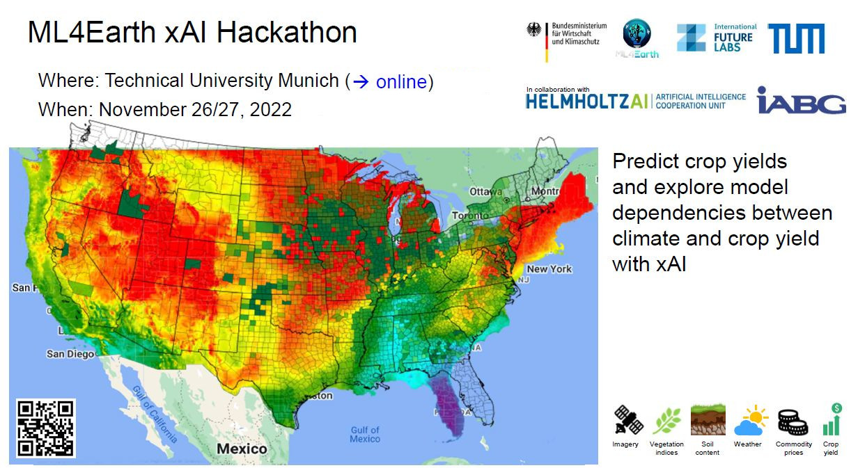
1 Motivation
https://github.com/zhu-xlab/ML4Earth-Hackathon-2022
Crop yield prediction is one of the challenging problems in precision agriculture, and many models have been proposed and validated so far. This problem requires the use of several datasets since crop yield depends on many different factors such as climate, weather, soil, use of fertilizer, and seed variety. [Feng et al., 2021]

Slide 4
2 Challenges
Nowadays, crop yield prediction models can estimate the actual yield reasonably, but a better performance in yield prediction is still desirable
Not enough ground truth data
Use each pixel as input training data instead of counties. This method can significantly increase the number of samples. And avoid the influence of pre-processing method like averaging yield value based on counties.
Can’t represent human activity as the features
Use history yield value as one of the input features. The farming ability of farmers is very important. Farmers' planting methods will vary from city to city. For example, the development of mechanization is different.
Most machine and deep learning models are black boxes
Random forest can give us the importance of each factor in the model. We can see which factor influence the result clearly by library SHAP.
Key steps in this project:
Dataset selection
Features selection
Model selection

Slide 5
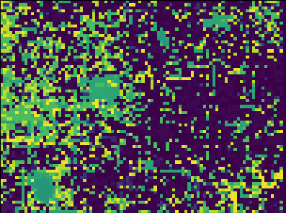
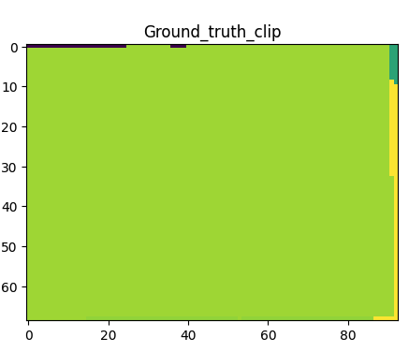
3 Dataset — input & output
X_train
Y_train
June August
Features:
15 bands from dataset + one band of last year yield
Number of groups:
7 years * n * i * x * y ≈ 280,000,000
n: number of pitches(counties, approximately 400)
i: number of dates(approximately 10)
x,y: dimension of pitches
Each year’s yield value:
eg. 185.5 bushels/acre
How to get Y_train image:
Join the table between TIGER vector and yield data. Transform vector to raster with the value of yield for the ROI area. Match X_train and Y_train by geoinformation with same projection.
2004-2021

Slide 6
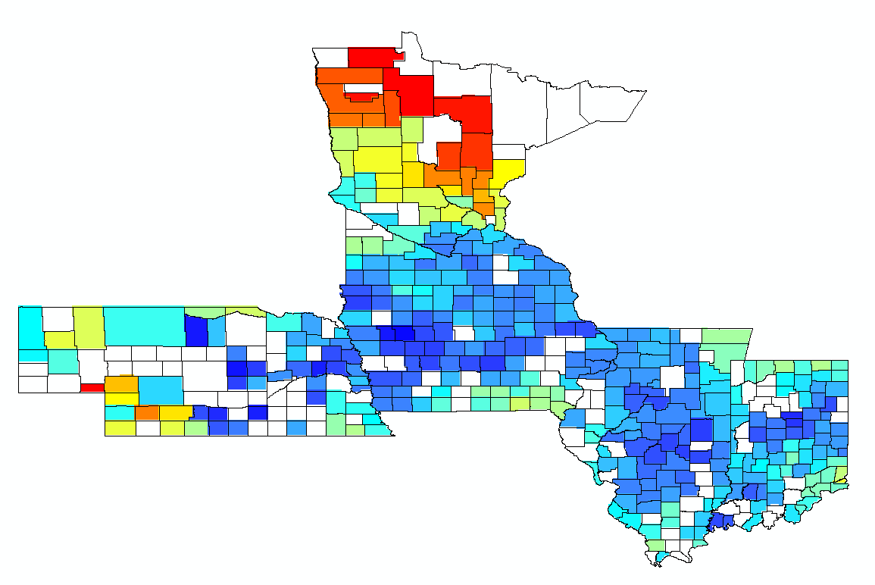
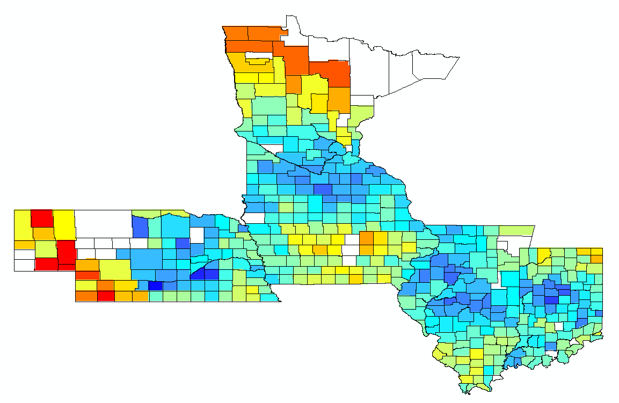


4 Visualization of Ground truth data

Slide 7
5 Methodology
Data acquisition
Datasets
One year
Test
Train-validation
The other years
80%Train+20%Validation
fitting
Machine learning
Random forest + ANN
Prediction
Visualization
Workflow

Slide 8
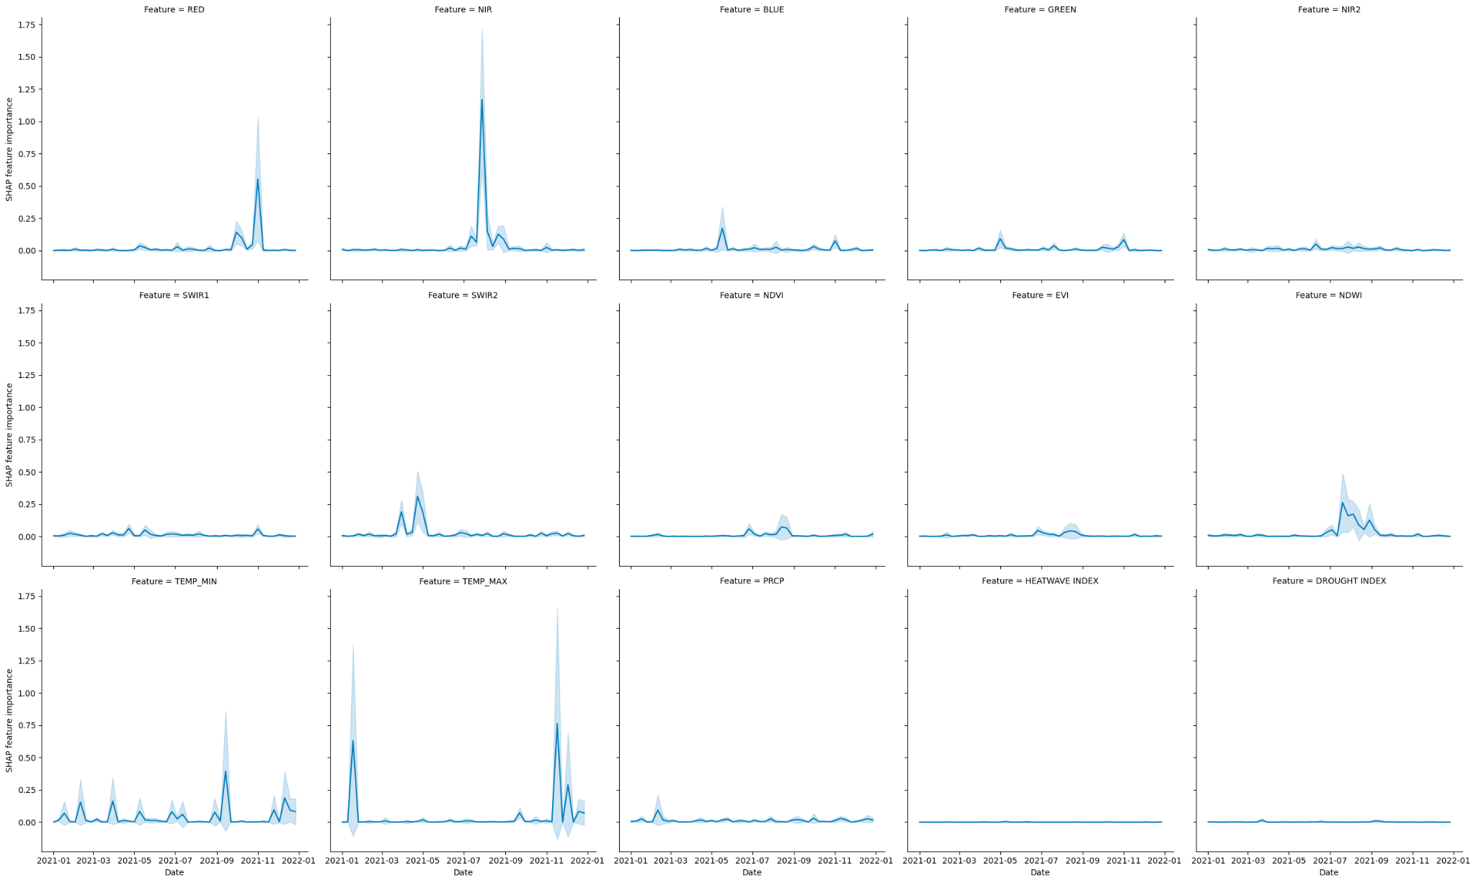
5 Methodology
RED
NIR
Tempreture_max

Slide 9
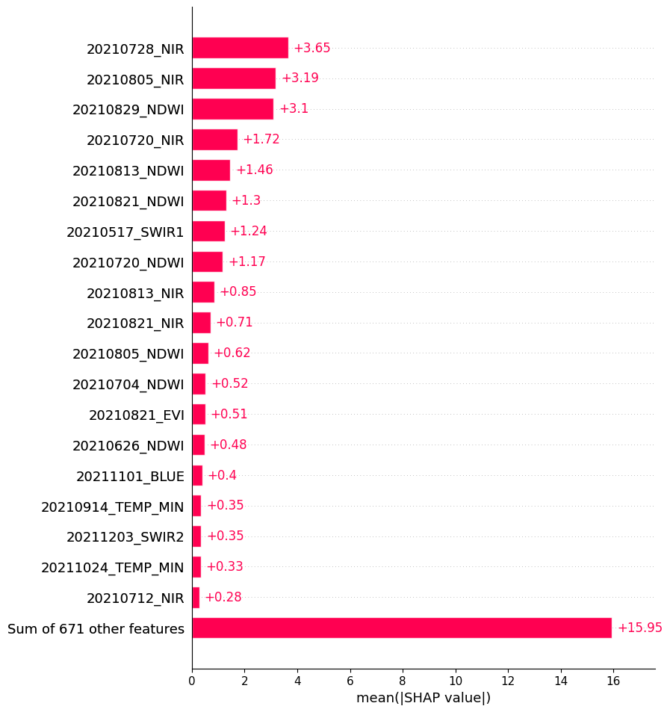
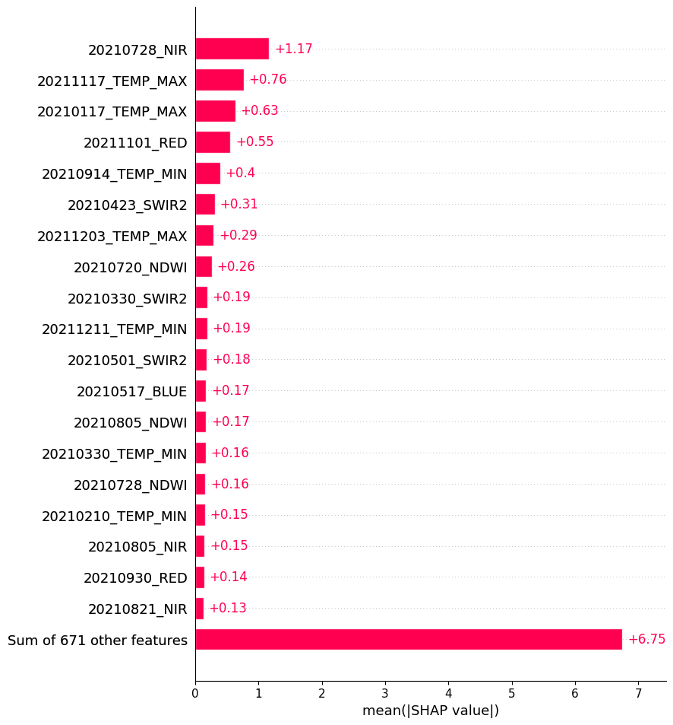
5 Methodology
Corn Soybean

Slide 10
5 Methodology
Random forest
A random forest regressor is a meta estimator that fits a number of classifying regression trees on various sub-samples of the dataset and uses ‘averaging’ to improve the regression performance and control over-fitting.
Artificial Neural Networks (ANN)
Artificial Neural Networks (ANN) is the most used algorithm for crop yield prediction. Recently, deep learning, which is a sub-branch of machine learning, has provided state-of-the-art results in many different domains, such as face recognition and image classification. These Deep Neural Networks (DNN) algorithms use similar concepts of ANN algorithms; however, they include different hidden layer types such as convolutional layer and pooling layer and consist of many hidden layers instead of a single hidden layer. [Klompenburg et al., 2020]
In the experiment part, changing activation method and adding layers or changing the number of epochs can improve the accuracy of model.

Slide 11
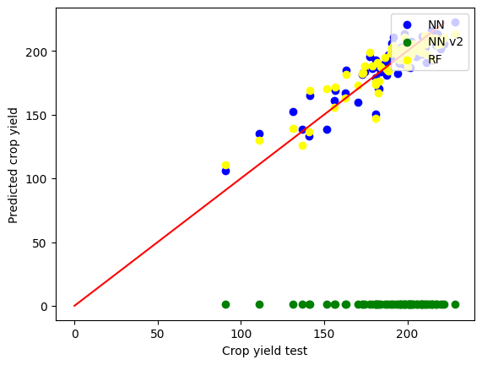
6 Experiments
Input:
Corn_dataset.npy
Labels.json
 | RF | ANN | ANN_V2
MAE | 8.34 | 9.40 | 189.13
RMSE | 10.75 | 11.45 | 190.93
R2 | 0.16 | 123.46 | 3826.11

Slide 12
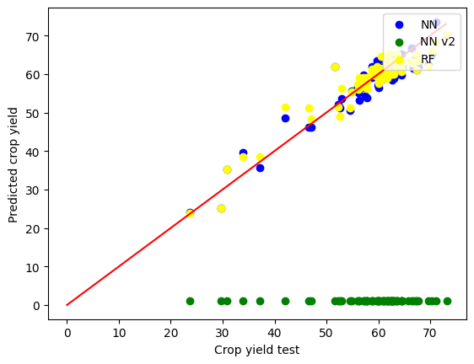
6 Experiments
Input:
Soybean_dataset.npy
Labels.json
 | RF | ANN | ANN_V2
MAE | 2.42 | 2.46 | 57.45
RMSE | 3.14 | 3.18 | 58.22
R2 | 0.11 | 129.56 | 2614.14

Slide 13
7 Conclusion
Machine learning method is one of the most efficient way to build models for crop yield prediction. When we don’t have enough data groups, random forest performs better than neural networks. With the hundreds groups of samples, neural network have overfitting problem. But random forest can help us analysis the importance of each factor.
In order to get enough dataset, we can use each pixel as a training sample. But the training speed will be low.
Achievement:
Random forest model and ANN model by .npy file.
Reading and preprocessing of .tif dataset and ground truth data.
Detailed plan of image based neural network training.
Difficulties:
Time limitation
Computer memory limitation
Working solo

Slide 14
References
[1] Feng, L., Wang, Y., Zhang, Z., & Du, Q. (2021). Geographically and temporally weighted neural network for winter wheat yield prediction. Remote Sensing of Environment, 262. https://doi.org/10.1016/j.rse.2021.112514
[2] Klompenburg, T.V, Kassahun, A., & Catal, C. (2020). Crop yield prediction using machine learning: A systematic literature review. In Computers and Electronics in Agriculture (Vol. 177). Elsevier B.V. https://doi.org/10.1016/j.compag.2020.105709
[3] https://ml4earth.devpost.com
[4] Wolanin, Aleksandra, et al. "Estimating and understanding crop yields with explainable deep learning in the Indian Wheat Belt." Environmental research letters 15.2 (2020): 024019.
[5] Lundberg, Scott M., and Su-In Lee. "A unified approach to interpreting model predictions." Advances in neural information processing systems 30 (2017).
[6] https://syncandshare.lrz.de/getlink/fiUh1RofUeMbugsSGD19QX/
[7] https://shap.readthedocs.io/en/latest/index.html

