Slide 1
Employee Data Analysis using Excel
STUDENT NAME: SIRUSHIYA.S
REGISTER NO: 312209446
DEPARTMENT: BCOM ACCOUNTING AND FINANCE
COLLEGE: ANNA ADARSH COLLEGE FOR WOMEN

Slide 2
PROJECT TITLE
Employee Performance Analysis using Excel

Slide 3
AGENDA
Problem Statement
Project Overview
End Users
Our Solution and Proposition
Dataset Description
Modelling Approach
Results and Discussion
Conclusion

Slide 4
PROBLEM STATEMENT
Analyzing employee performance is important because it helps :
Improve company performance - A high performing workforce contributes to the overall success of the company.
Identify strengths and weaknesses - This helps employees understand where they excel and where they can improve.
Make informed decision - Performance analysis can help in making decisions about promotions, raises, and training (fair appraisals and employee development).
Address performance issues - Early identification of performance issues/problems can help prevent larger issues.
Foster a positive work environment

Slide 5
PROJECT OVERVIEW
Employee performance analysis is a process of evaluating an. It involves assessing their skills, contributions, and overall effectiveness in their role. This information is used to provide feedback, identify areas for improvement, and make informed decisions about promotions, raises, and training. This helps both the employee and the company grow and succeed. employee's work to determine how well they are meeting job expectations

Slide 6
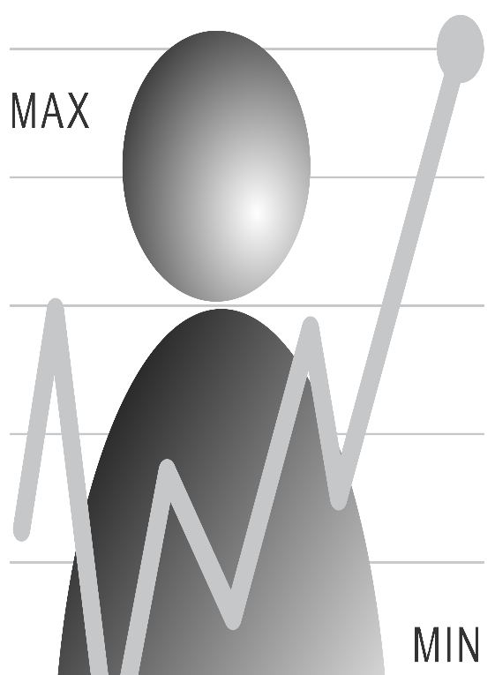

WHO ARE THE END USERS?
Different end users for different purpose:
Managers and team leaders
HR department
Employees
Executives and Senior management
Project managers
Training and Development teams

Slide 7
OUR SOLUTION AND ITS VALUE PROPOSITION
Conditional formatting - A tool that changes the appearance (color, font, etc.) of cells based on specific criteria, making it easy to highlight important data automatically.
Formula - An expression that calculates the value of a cell, using functions, operators, and references to other cells.
Pivot table - A feature that allows you to summarize, analyze, explore, and present large amounts of data in a more manageable and insightful way.
Slicer - A visual filter that allows you to quickly and easily filter data in a Pivot Table or Pivot Chart by clicking on buttons.
Filtering - Manually selecting specific data to display in the pivot table.
Graph - A visual representation of data in Excel, helping to identify trends, patterns, and comparisons.
Bar graph - A type of graph that displays data using rectangular bars where the length of each bar is proportional to the value it represents.
Trendline - A line added to a graph that shows the general direction (trend) of the data, helping to predict future values.

Slide 8
DATASET DESCRIPTION
EMPLOYEE DATASET : Kaggle
TOTAL COLUMNS : 26 columns + 1 column ( created using formula )
COLUMNS CONSIDERED : 9 COLUMNS
First name – text
Gender – text ( male or female )
Business unit – text
Employee status – text
Pay zone – text
Department type – text
Division – text
Employee Classification Type
Performance level – text ( very high or high or med or low )

Slide 9
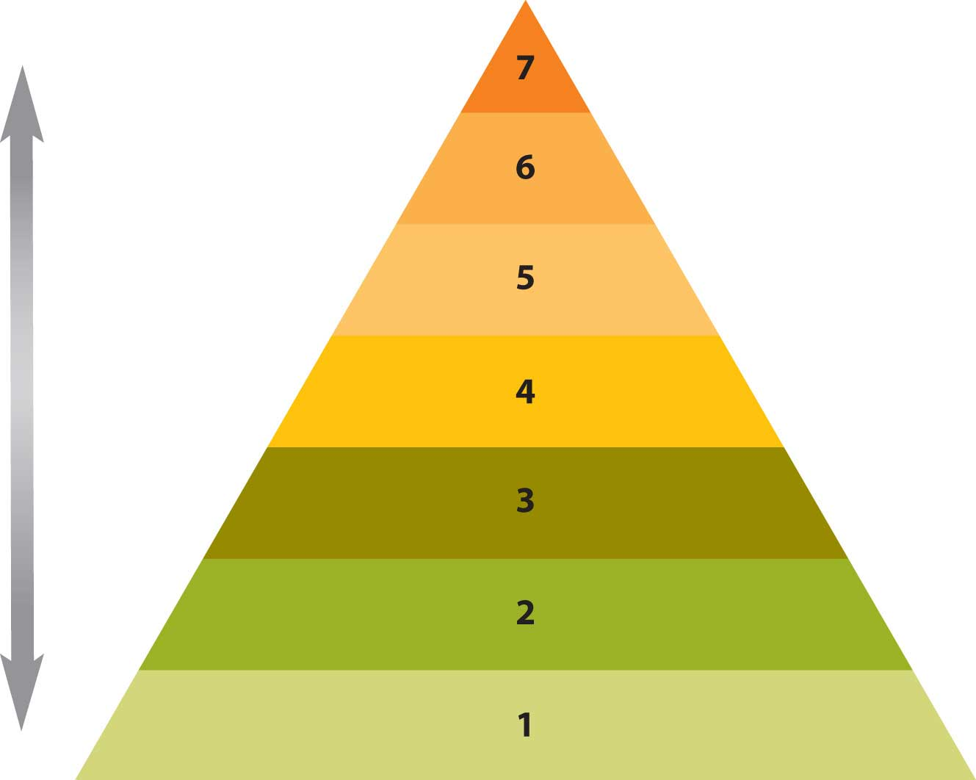
THE "WOW" IN OUR SOLUTION
1. Created a new column ( performance level ) using a formula
=IFS(Z2>=5,”very high”,Z2>=4,”high”,Z2>=3,”med”,TRUE,”low”)
2. Use the SmartArt feature in my analysis to show the hierarchy of performance levels.
This Photo by Unknown Author is licensed under CC BY-SA-NC

Slide 10
Data Collection: I collected the dataset from the Edunet dashboard titled "Employee Data.“
2. Column Selection: I selected and highlighted the columns required for my analysis. The eight selected columns are:
First Name
Gender
Business Unit
Employee Status
Pay Zone
Department Type
Division
Employee Classification Type
3. New Column Creation: I created a new column titled "Performance Level" by applying a formula based on the current employee rating column.
Formula: =IFS(Z2>=5, "Very High", Z2>=4, "High", Z2>=3, "Medium", TRUE, "Low")
This formula converts the numerical rating into a text form (Very High, High, Medium, or Low) according to the specified conditions.
MODELLING

Slide 11
4. Conditional Formatting: I used this feature to highlight the blank cells in the "Exit Date" column of the employee data. The "Exit Date" is only filled in for employees who have retired or resigned.Steps:
Go to Home > Conditional Formatting > Highlight Cells Rules > More Rules.
Choose Format only cells with "Blank".
Select format and choose color, then click OK.
5. Pivot Table:
Select the data in Excel that you want to analyze.
Go to Insert, then click Pivot Table.
Choose whether to create the Pivot Table in the same worksheet or a new worksheet, and click OK.
In the Pivot Table field:
Place the Business Unit column in Rows.
Place the First Name column in Values to get the count.
Add the Gender and Employee Status columns to Filters.
Add the Performance Level column to Columns.
Finally, use the Division, Department Type, and Pay Zone columns in the Slicer.
Filtering – The filter function allows you to filter a range of data based on criteria you define.
Slicer - Slicers provide buttons that you can click to filter tables, or PivotTables. Slicers also indicate the current filtering state, which makes it easy to understand what exactly is currently displayed.

Slide 12
6. Graph: To visualize the Pivot Table data, I selected a recommended Bar Graph for easier understanding. Customizations can also be made using the columns in Filters and Slicers. This helps end users easily interpret the data and make informed decisions to achieve organizational goals.
7. Trend Line in Graph: I also included a trend line in the graph to visually represent the data's trend over time.

Slide 13
8. SmartArt: I created a hierarchy chart using SmartArt to display employee performance levels (Very High, High, Medium, or Low), highlighting the highest and next levels.

Slide 14
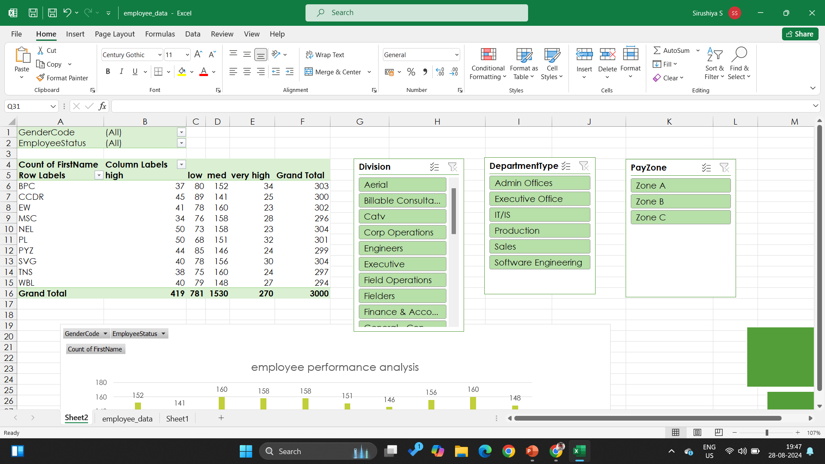
RESULTS

Slide 15
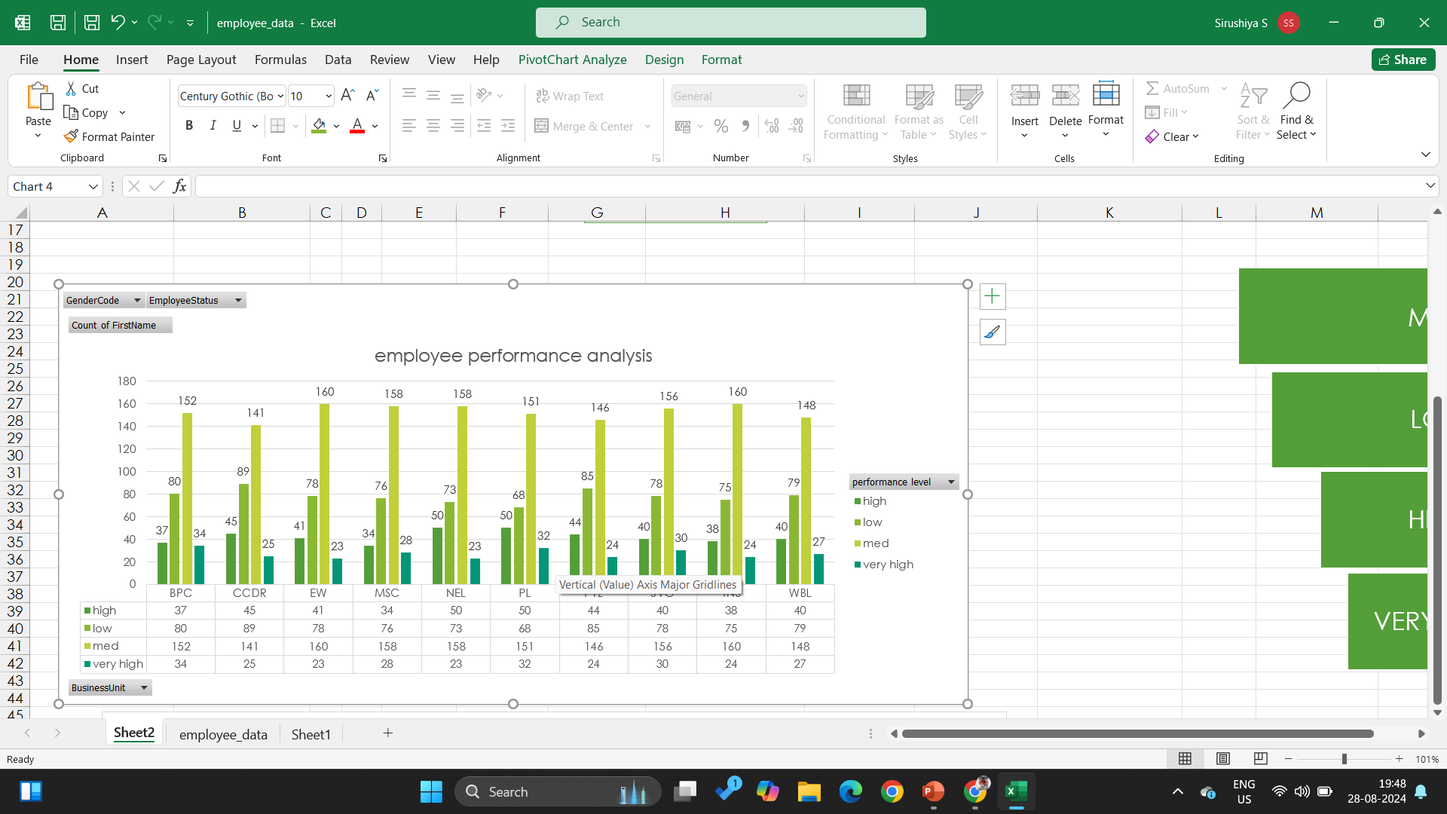

Slide 16
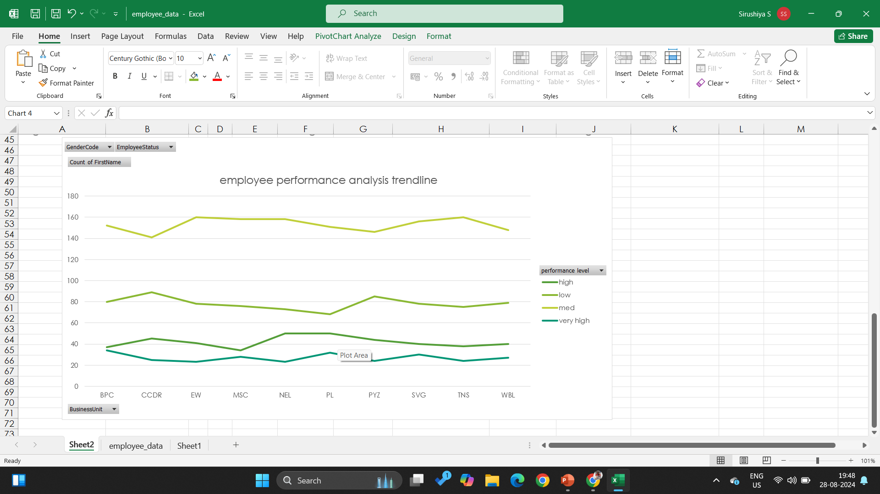

Slide 17
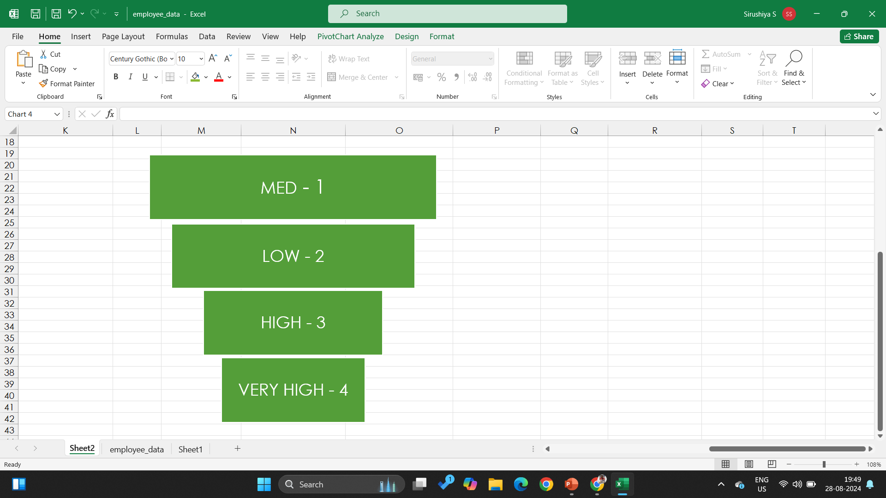

Slide 18
CONCLUSION
In my analysis, using a pivot table, I reached the following conclusions:
Employees with a "medium" performance level are more numerous than those at other levels. b. Employees with a "very high" performance level are fewer compared to other employees. c. Based on these observations, I recommend that the company take corrective actions or initiatives to improve employee performance levels by motivating them.
Training programs
Recognition and rewards
Clear communication
Employee engagement

