Slide 1


MULTICLASS CLASSIFICATION FOR QUERY TOPIC PREDICTION
BY
DISHA SHETIYA (dshet4@uis.edu)
GAURAV PATIL (gpati4@uis.edu)

Slide 2
CONTENTS
Description
Data Exploration and Preprocessing
Training
Result

Slide 3
DESCRIPTION
The main aim of the project is to classify topics on Yahoo Answers by using Class Index as the target variable.
The scope of the project is limited to the topic such as:
Society & Culture 6. Sports
Science & Mathematics 7. Business & Finance
Health 8. Entertainment & Music
Education & References 9. Family & Relationship
Computers & Internet 10. Politics & Government

Slide 4
DATA EXPLORATION AND PREPROCESSING
The dataset used in the project was obtained from KAGGLE and the link to which is provided below:
https://www.kaggle.com/datasets/bhavikardeshna/yahoo-email-classification?select=test.csv
There are 60000 entries in the dataset and there exist 10 types of classes of topics.
There are mainly 4 attributes in the dataset namely: Class Index, Question Title, Question Content, Best Answer.
Out of these 4 attributes Class Index is Integer type while the rest are Categorical type.
There are no missing values in the dataset.

Slide 5
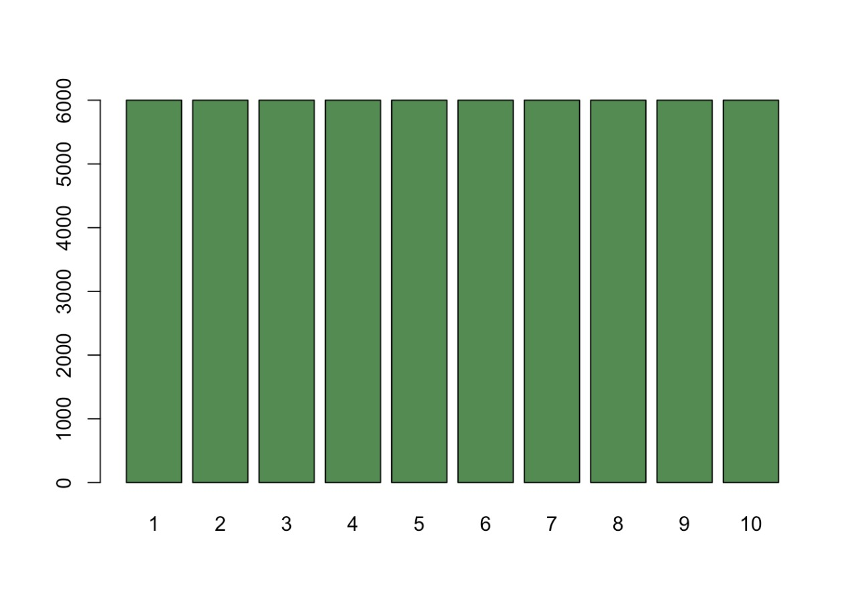
After checking for class imbalance, it was found out that the data is perfectly balanced and hence, no balancing techniques were needed to be performed on the data.

Slide 6
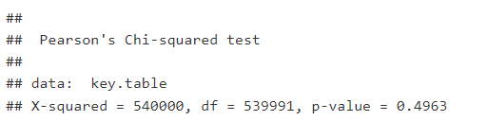
CHI- SQUARE TEST RESULT

Slide 7
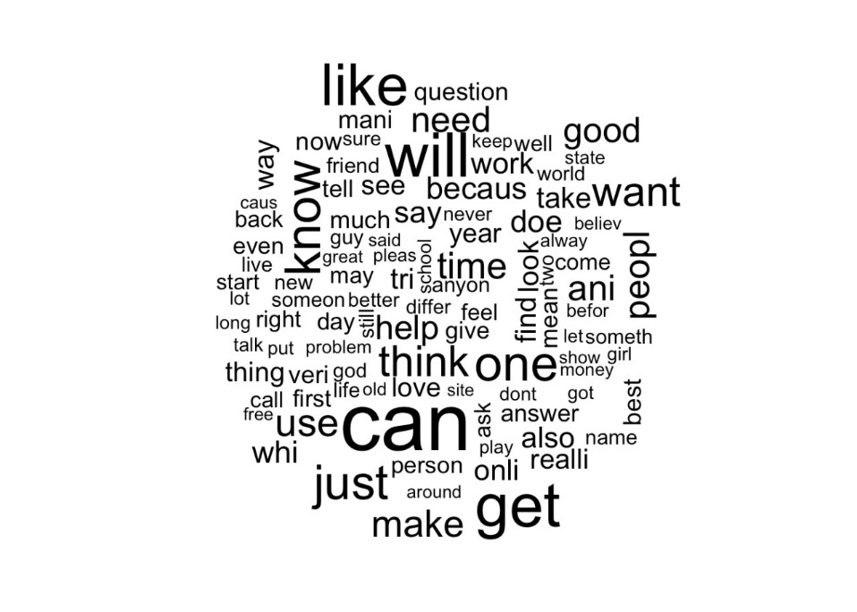
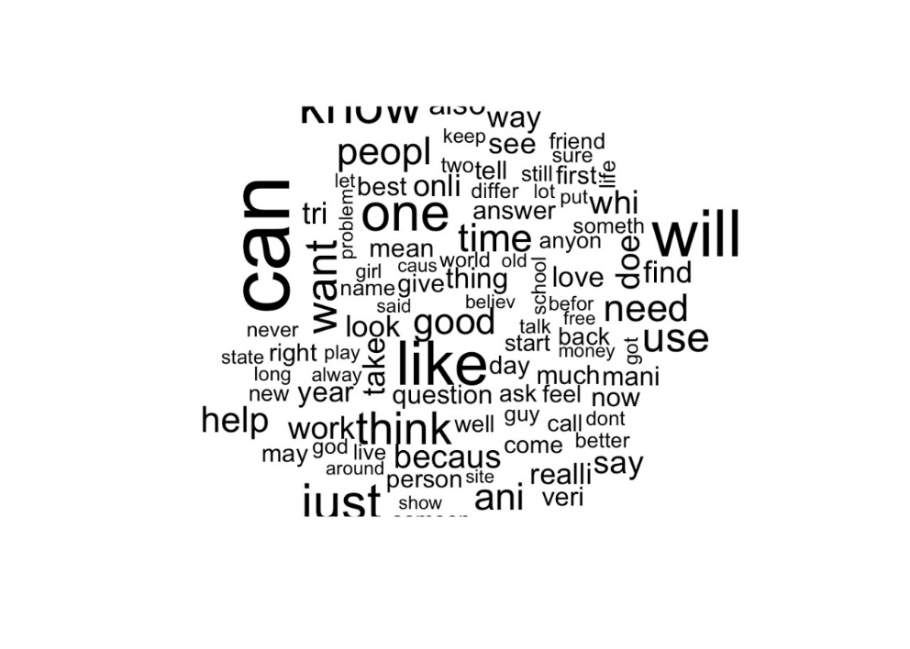
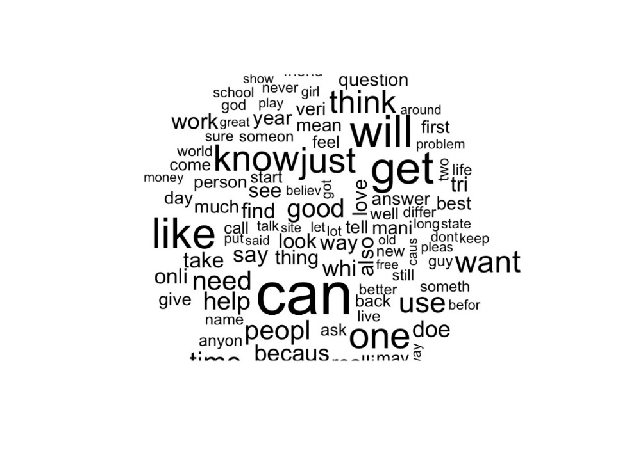
WORD CLOUD OF THE DATA

Slide 8
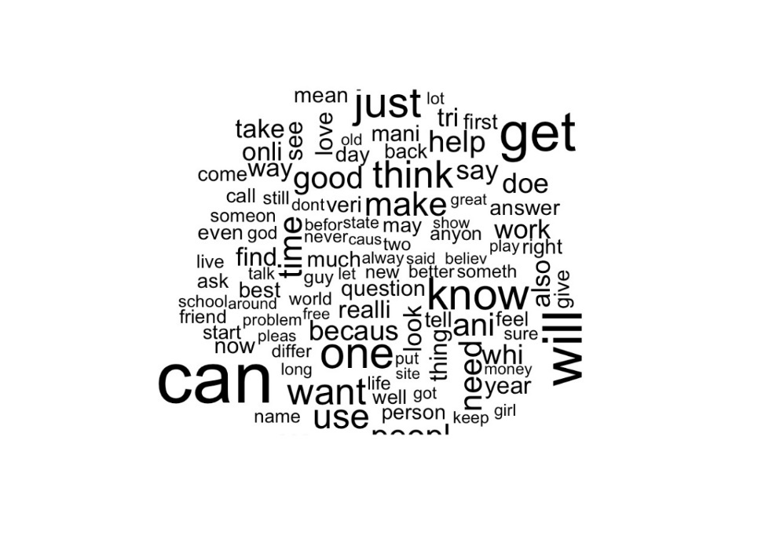
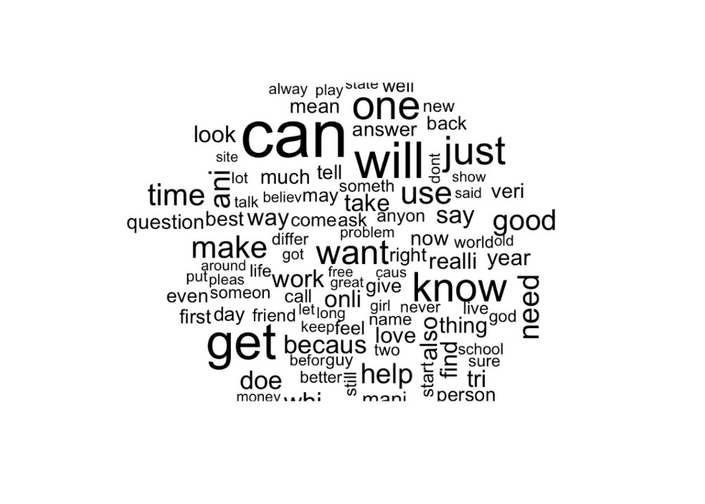
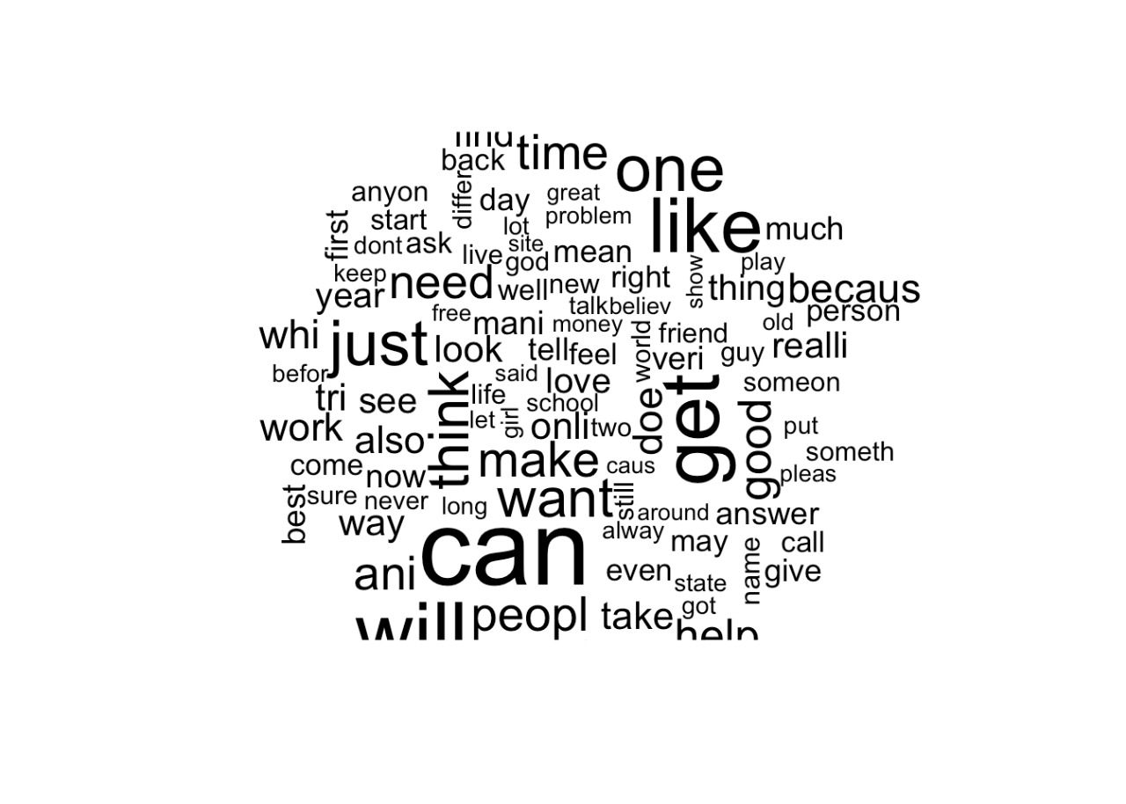

Slide 9
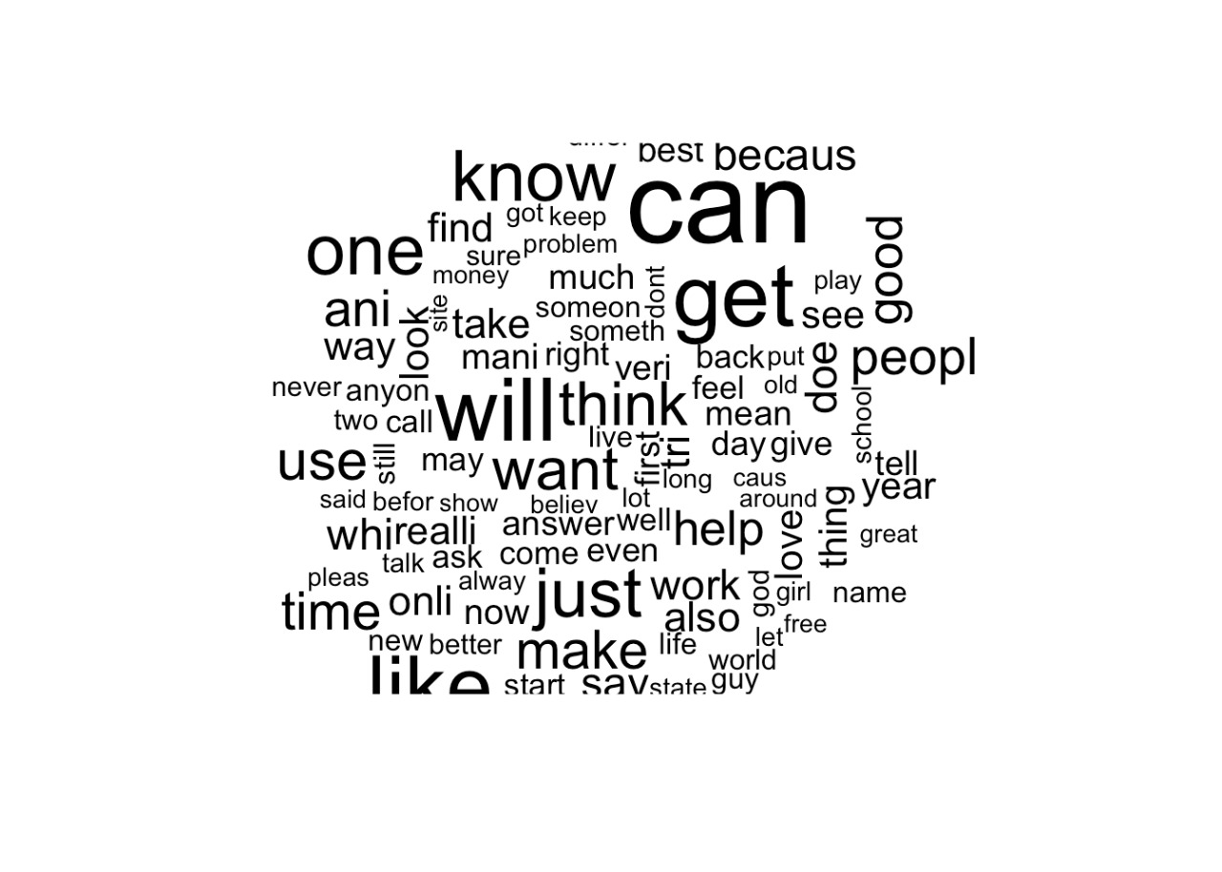
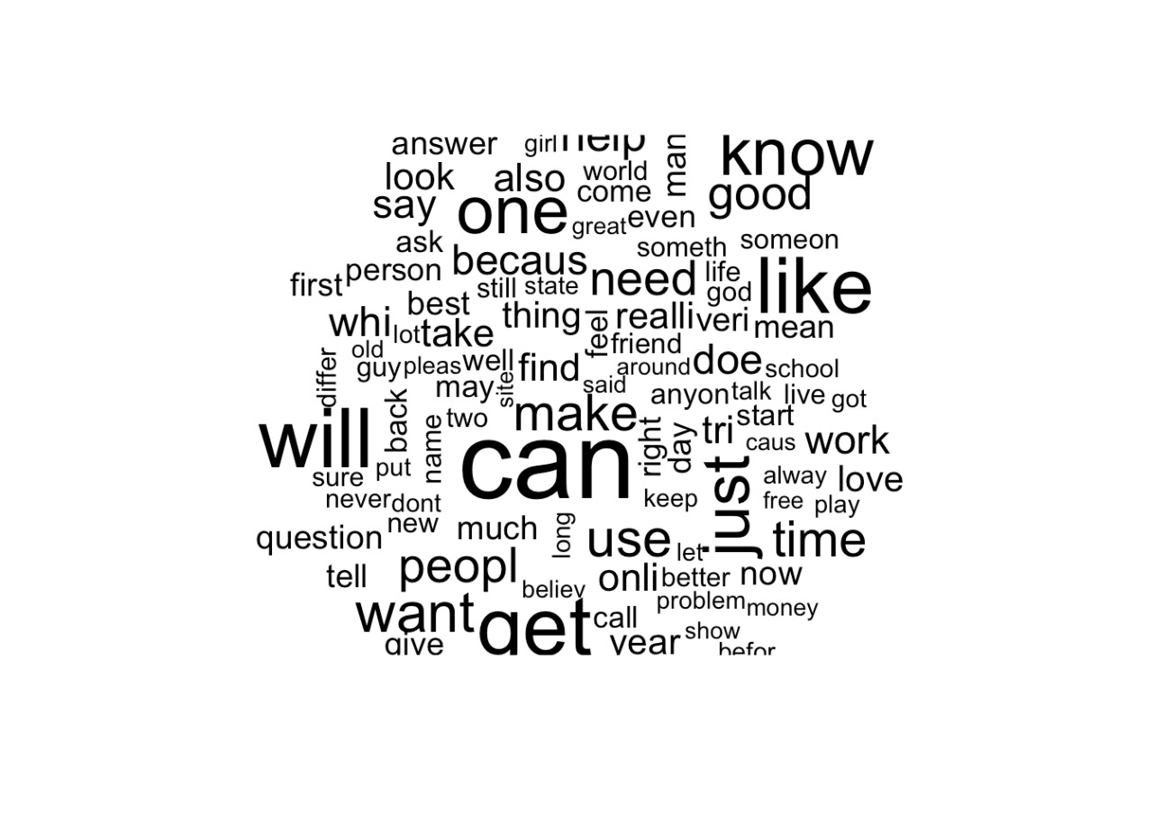
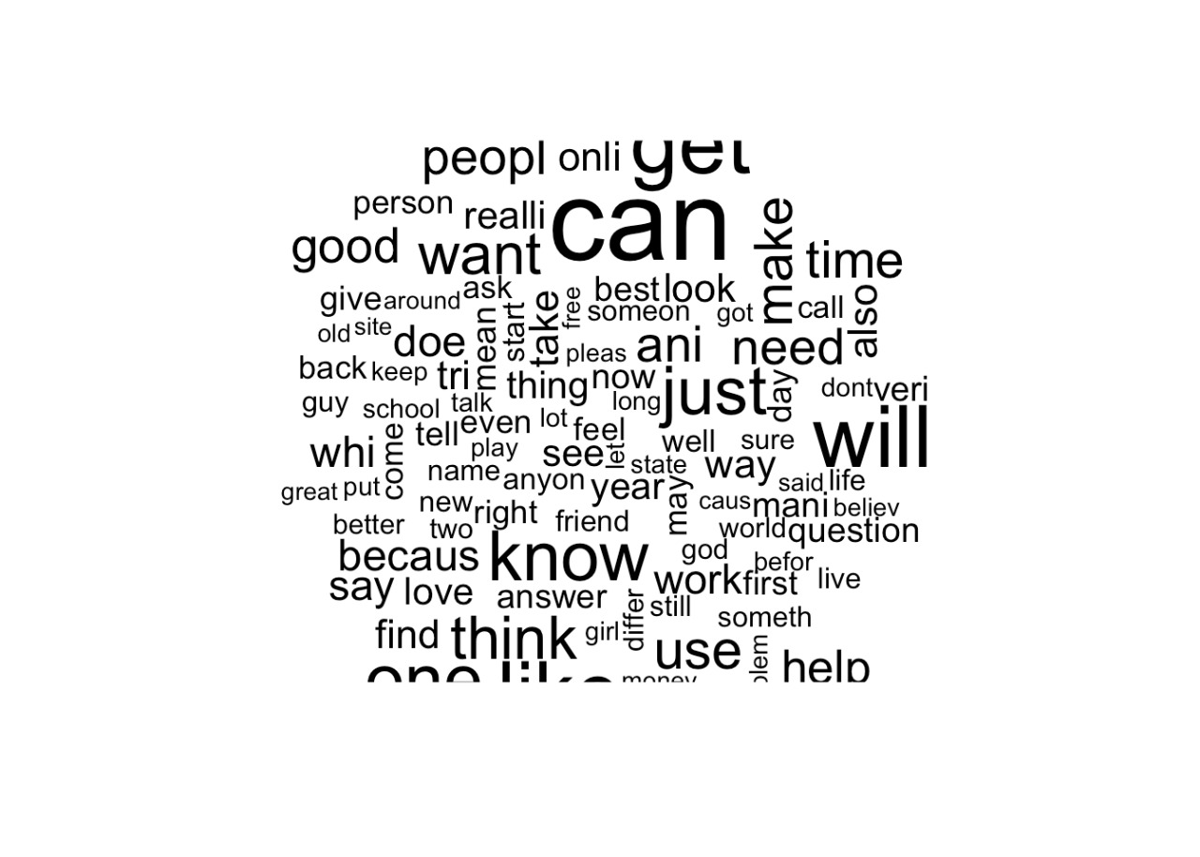
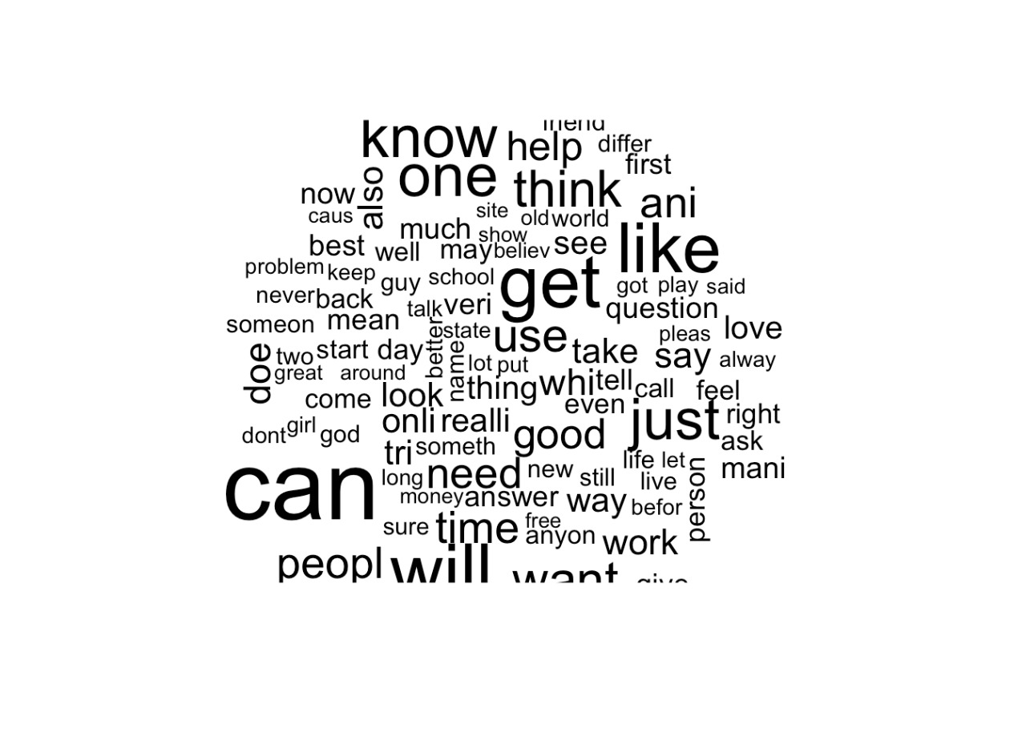

Slide 10
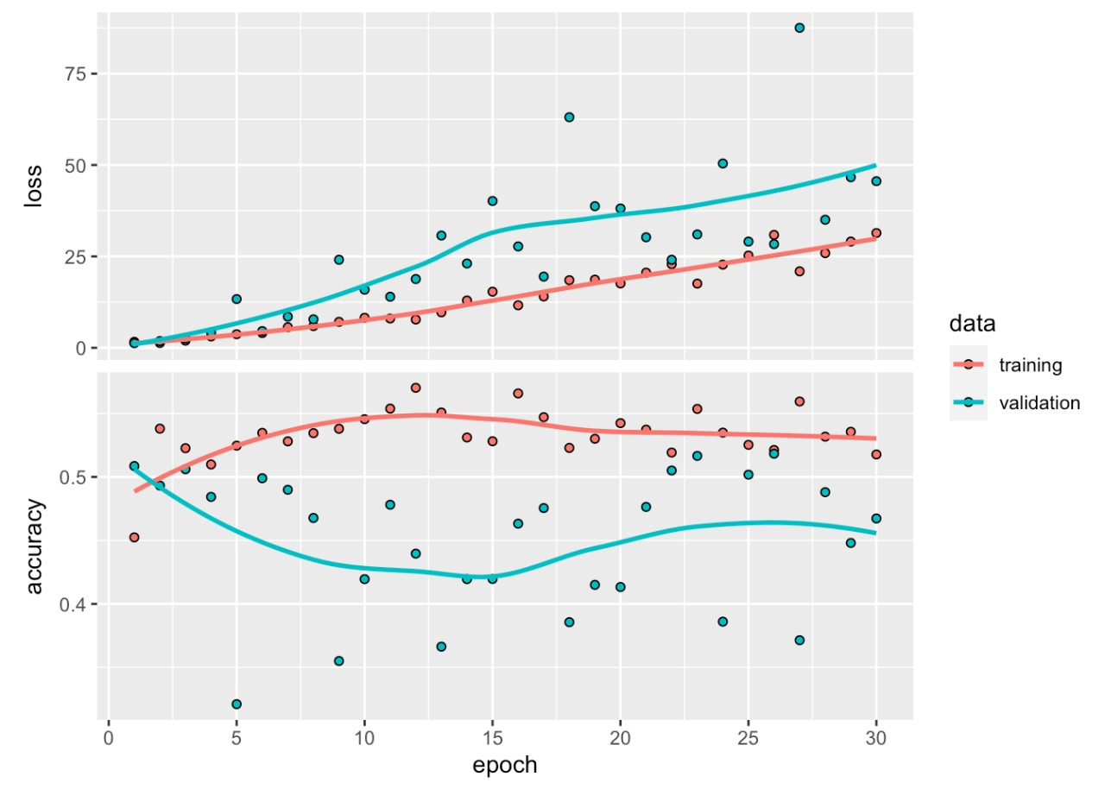
TRAINING
The neural network model was tuned
Using the ‘softmax’ activation function and ‘ sparse categorical crossentropy’ as the loss function.

Slide 11
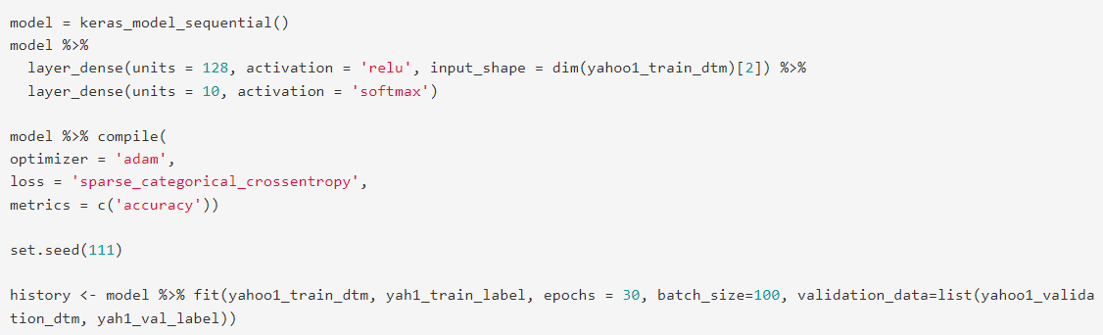

Slide 12
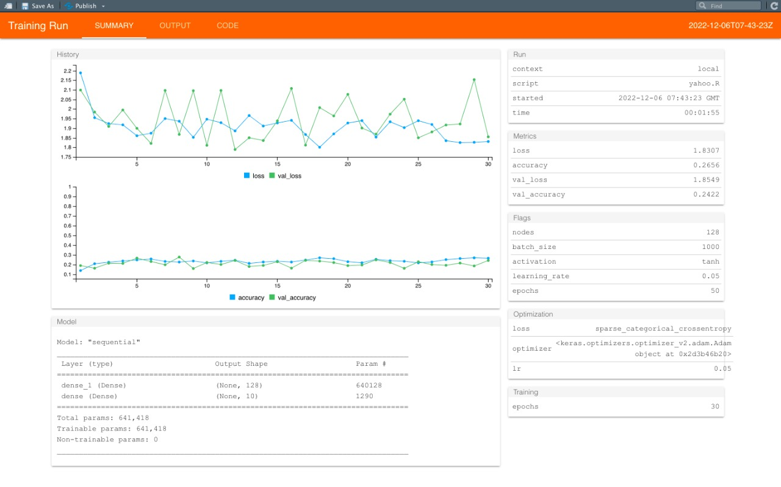

Slide 13
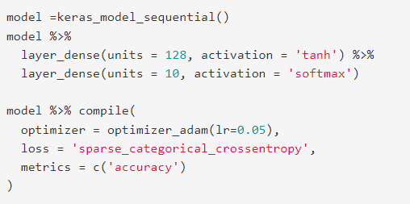

Slide 14
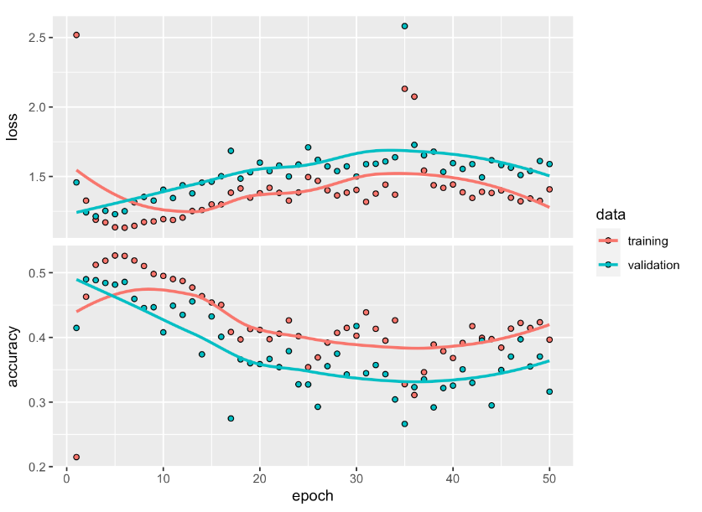

Slide 15
RESULT
For the evaluation we used the confusion matrix to find out the accuracy of the model and the kappa value.
Thus, the final accuracy we got after the entire training and evaluating process was 0.316100 with a loss of 1.589522.

Slide 16
