Slide 1

Integrated lithium niobate photonics for
sub-ångström snapshot spectroscopy
集成铌酸锂光子学实现亚埃级快照光谱成像
Source: Nature (2025)
Authors: Lu Fang, et al.(Tsinghua University)
Presenter: Xiyu Wu

Slide 2
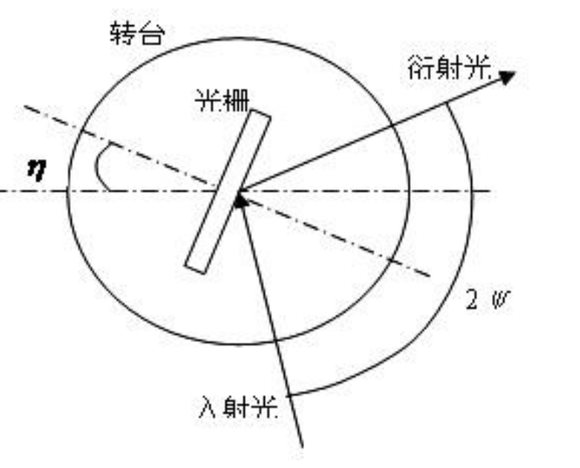
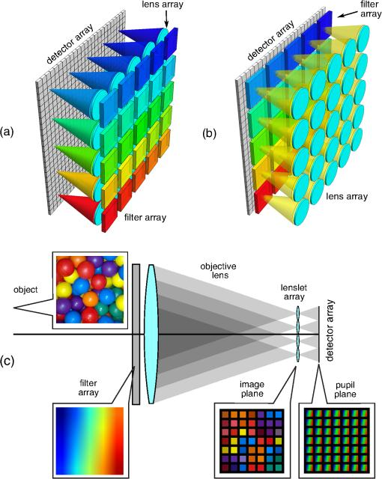

Background
·Core Concept: High-resolution spectroscopic imaging(光谱成像) is essential for precision detection.
·Detection Demand: Sub-ångström resolution for atomic line detection and high-throughput snapshot imaging for dynamic or faint targets.
·State-of-the-Art Limitation: Traditional spectrometers face an trade-off between spectral resolution(光谱分辨率), optical throughput(光通量), and imaging speed(成像速度).
添加标题
此处输入你的正文，文字是您理想的提炼
Grating / Prism spectrometers(光栅 / 棱镜色散)
NFSSI(窄带滤波快照)
BMSSI(宽带调制型快照)
通量大，分辨率一般在纳米级，且取决于编码设计、色散能力和重建算法
d（sinα+sinβ）=mλ
分辨率高，通量低，扫描速度慢
光谱分辨率极高，但透过率极低（<0.02%）

Slide 3
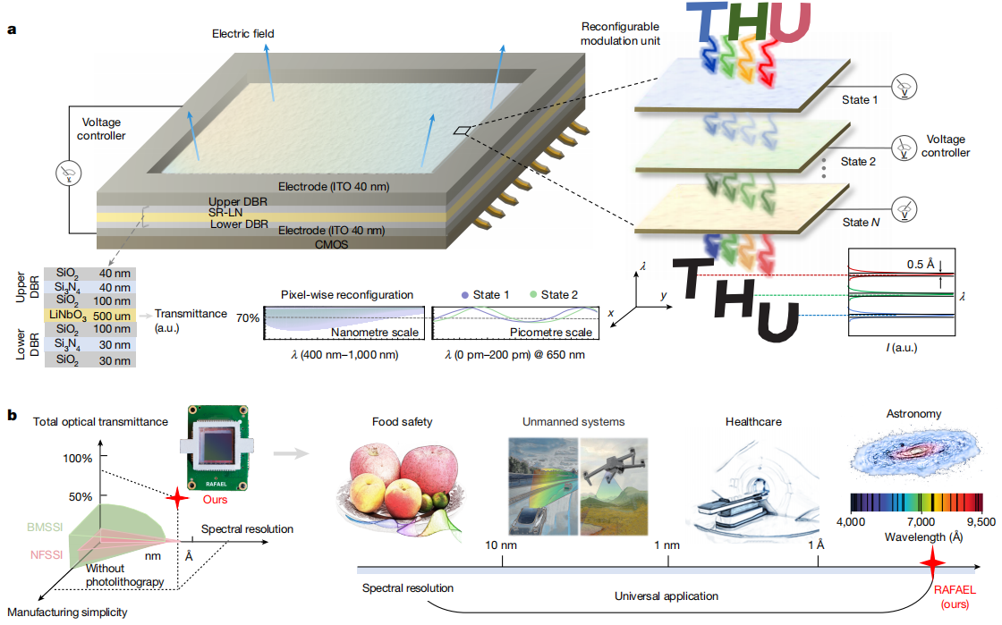
Objective & Core Contributions
·Objective:
Break the resolution-throughput-speed trade-off.
·Key Contributions:
(a) Propose the RAFAEL architecture based on reconfigurable lithium niobate（铌酸锂） photonics.
(b) Achieve simultaneous sub-ångström resolution, high transmittance, and high-speed imaging.
(c) chip-integrated, miniaturized, and widely applicable “玉衡”

Slide 4
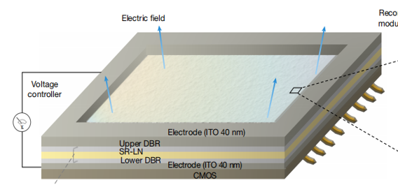
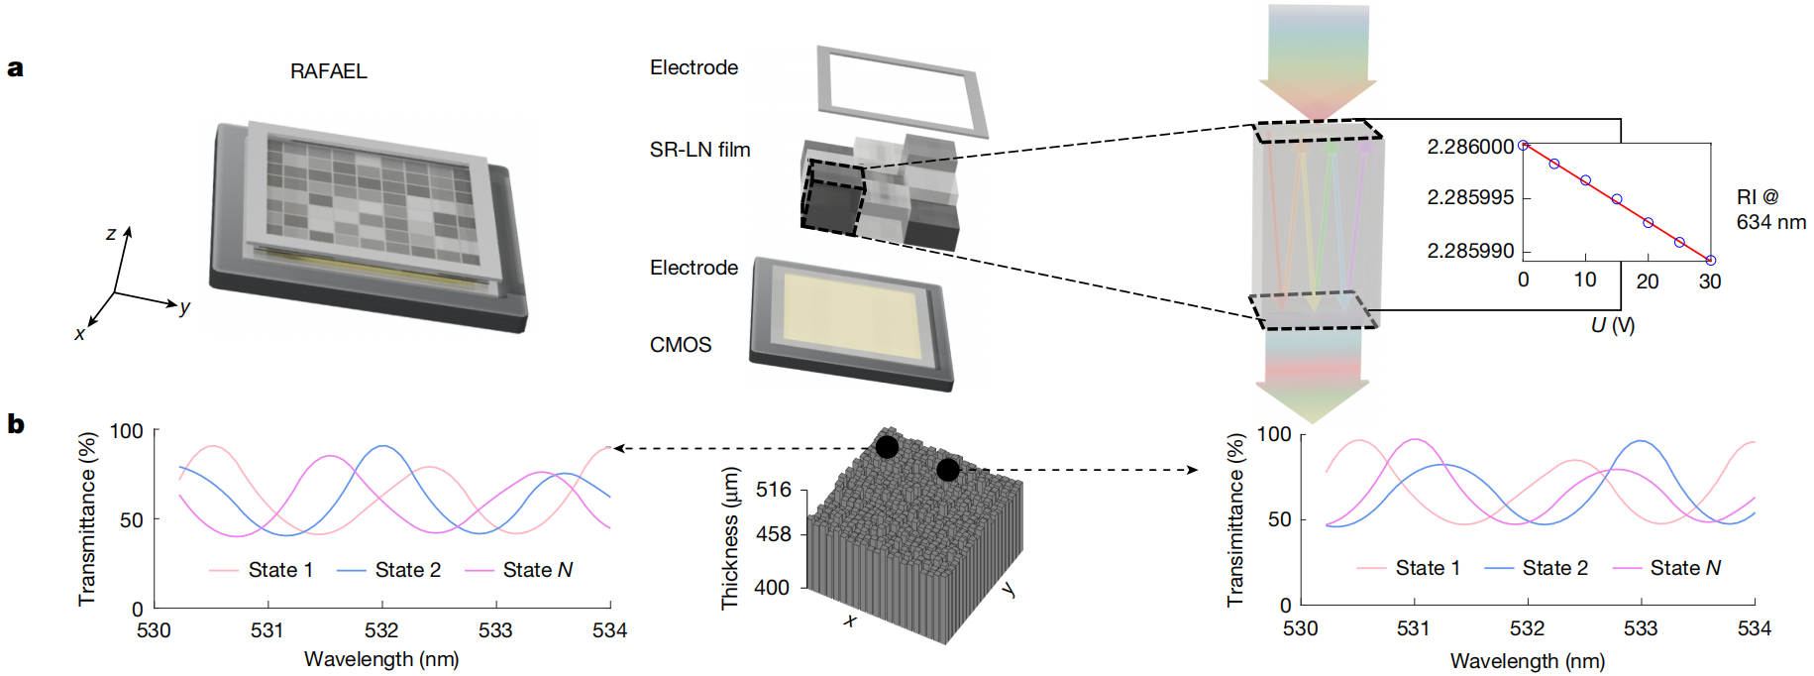
Device Structure
·Transparent top electrode、Bottom transparent electrode（透明电极）：用于施加外部电压。
·Top DBR reflector、Bottom DBR reflector（分布式DBR 反射镜）：多层介质膜，构成光学微腔。
·Spatially Random Lithium Niobate thin-film layer（SR-LN 层）：核心功能层，这一层是像素化的，整个芯片被划分成二维像素阵列，每个像素对应一个独立的微腔。每个像素的 LN 薄膜厚度存在微小、随机、可控的差异。
·CMOS image sensor（ 图像传感器）：直接集成在芯片下方，每个像素对准 CMOS 上的一个感光点。

Slide 5
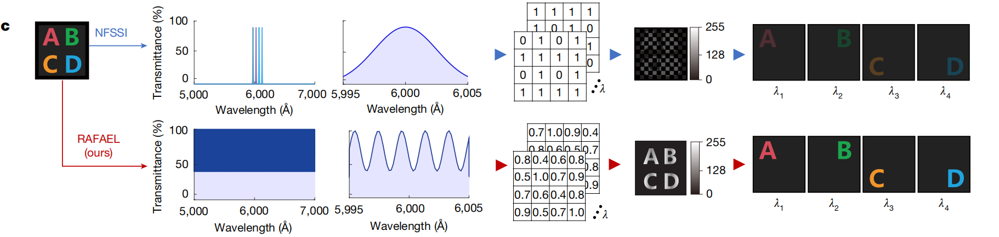
Working Principle
（A）FP resonance(法布里-珀罗共振): Each pixel resonates at a wavelength determined by thickness and refractive index.
（B）Electro‑optic effect(电光效应): Voltage changes LN refractive index → shifts resonant wavelength.
（C）Spatial encoding(空间编码): Random thickness gives each pixel a unique spectral response.
（D）Reconfigurable encoding(可重构编码): Multiple voltage states provide diverse encoding patterns.
（E) Reconstruction(光谱重建): Algorithms recover sub‑ångström spectra from multiple coded snapshots.

Slide 6
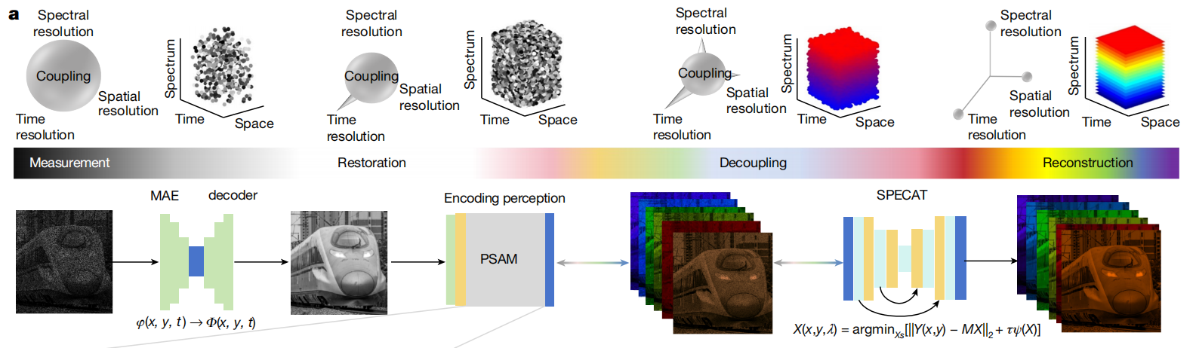
PSAIR Reconstruction Framework
3 Core Functional Modules：
（A）MAE Decoder：Restores complete spatio-temporal measurement data, completes missing encodings via inter-frame correlation
恢复完整的时空维度测量数据，通过帧间相关性补全缺失的编码信息.
（B）PSAM Module (Physics-Driven Core)：
·基于光学传输模型构建系统观测矩阵，描述“芯片是怎么把三维光谱，压缩成二维图像的”.
·通过对芯片像素的物理标定，将耦合的光场信息按照空间、时间、光谱解耦.
（C）SPECAT Transformer：通过空间 - 光谱累积注意力机制（算法同时兼顾“图像细节”和“光谱精度”）优化逆问题求解

Slide 7
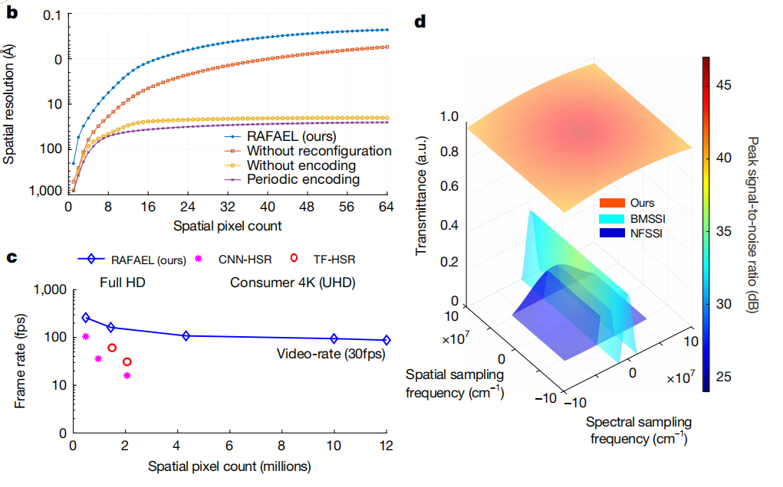
Performance Summary
·Spectral Resolution: ~0.5 Å (sub‑ångström)
实现了 0.5 埃亚埃级光谱分辨率，通过 SRSM 编码和铌酸锂可重构特性，分辨率提升两个数量级
·Optical Transmittance: 73.2%
光学透过率 73.2%，全面优于传统 NFSSI/BMSSI 方案
·Imaging Frame Rate: 88 Hz (88 fps)，Spatial Resolution: 2048 × 2048
在 2048×2048 满分辨率下，实现 88Hz 高速成像，性能超越传统 CNN/Transformer 基光谱仪。
·Spectral Coverage: 400–1000 nm (12,000 spectral channels)

Slide 8
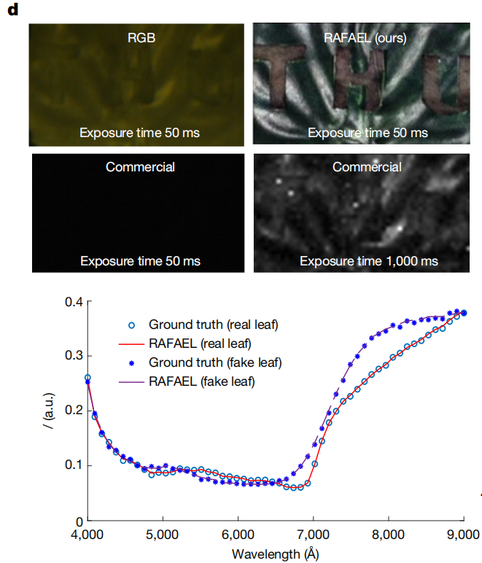
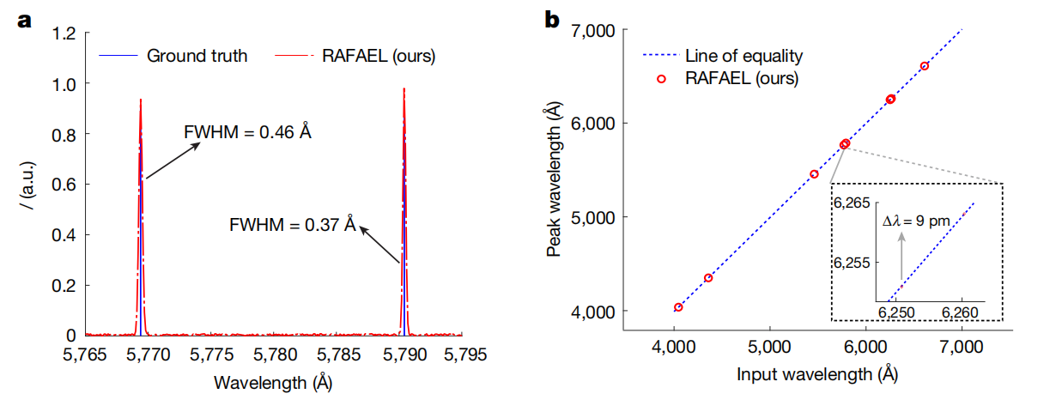
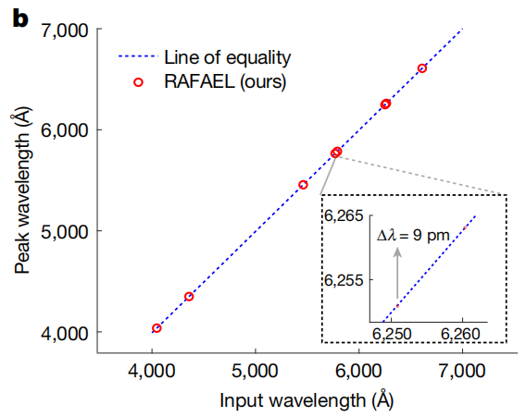
Experimental Verification
(A) Atomic Spectroscopy (原子光谱实验)
(B) Material Identification (材料识别实验)
·Distinguished real leaves vs. artificial leaves
（区分真实叶片与仿真叶片）
·High similarity (>99.5%) with ground‑truth spectra
·Enabled high‑precision material discrimination
·Measured mercury lamp emission lines
(测量汞灯的特征发射峰)
·Resolved two narrow peaks with spacing of 0.37–0.46 Å
·Verified sub‑ångström spectral resolution (~0.5 Å)

Slide 9
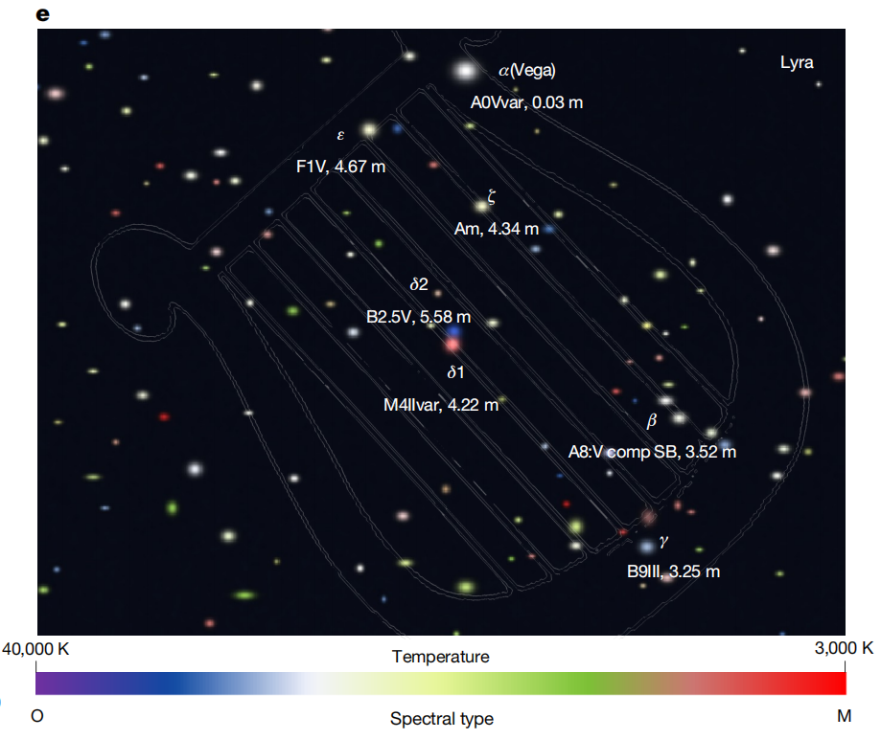
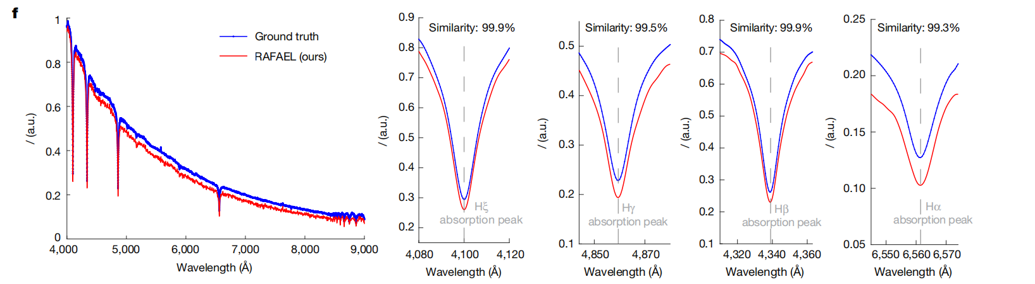
Experimental Verification
(C) Astronomical Snapshot Spectroscopy (天文快照光谱成像)
·Large field-of-view stellar spectral imaging in constellation Lyra
（对天琴座区域开展大视场恒星光谱成像）
·Captured 5,600+ stellar spectra in a single snapshot，
Spectral resolution: 2.048 × 2.048 pixels, 0.08 Å per channel (400–1,000 nm)
·Reconstructed spectra show >99% similarity with astronomical ground truth
·Clearly resolved stellar hydrogen absorption lines (Hα, Hβ, Hγ, Hδ)
清晰分辨恒星氢原子吸收线

Slide 10
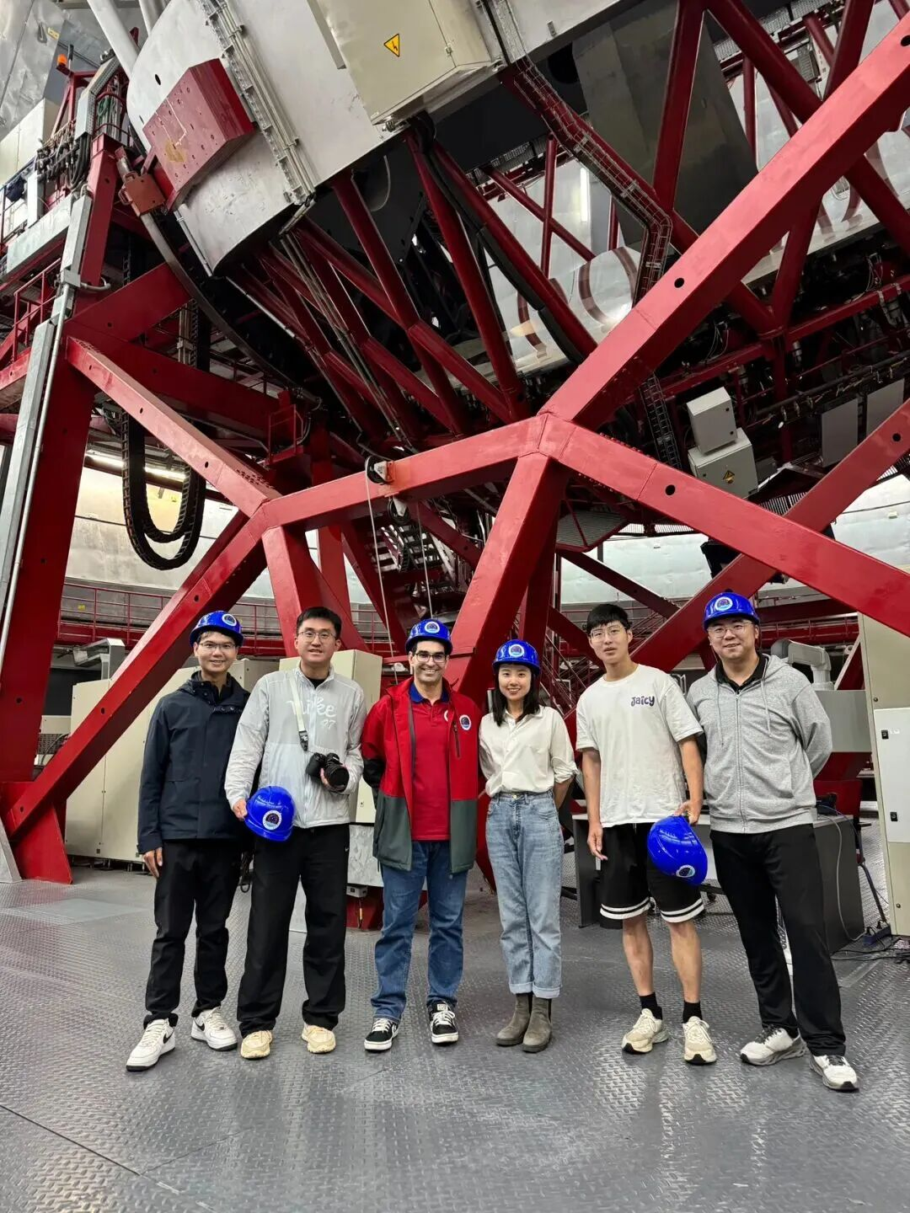
Conclusion & Outlook
Application Prospects
·High-precision spectral recognition in materials science, biomonitoring, autonomous driving, and industrial inspection
·Large-field astronomical spectral surveys
Future Goals
·Improve integration and stability of the system
·Extend spectral coverage and imaging speed
·Promote the development of chip-scale, portable high-resolution spectroscopic imaging systems
未来，将进一步提升系统集成度，拓展光谱覆盖范围，推动这项技术在天文观测、遥感、材料分析以及生物医学等领域的实际应用，为深空探测、瞬态光谱捕捉等前沿科学研究，提供全新的技术支撑。
2025年5月方璐（右三）团队访问加那利大型望远镜

