Slide 1
Emergency Medical System
Group : Tiercel

Slide 2
1
Problem Statement
2
Approach
CONTENTS
3
Object Model
4
Screen Shots
5
Project Demo

Slide 3
1
Problem Statement
PART

Slide 4
Problem Statement
Calling emergency service
Specific、accurate information
Information Inaccuracy
1
Untimely Rescue
Waiting for an ambulance
Proper、effective treatment
2
Untraceable Process
3
emergency response procedures ambulance's real-time status
Inaccessible
Appointment
4
hospital doctors reservation
manage health data uniformly

Slide 5
2
Interesting Features
PART

Slide 6
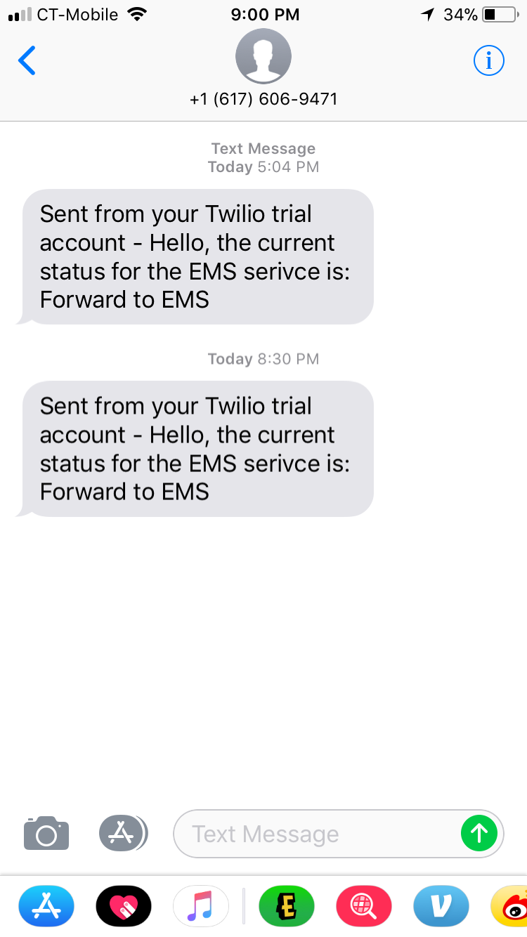
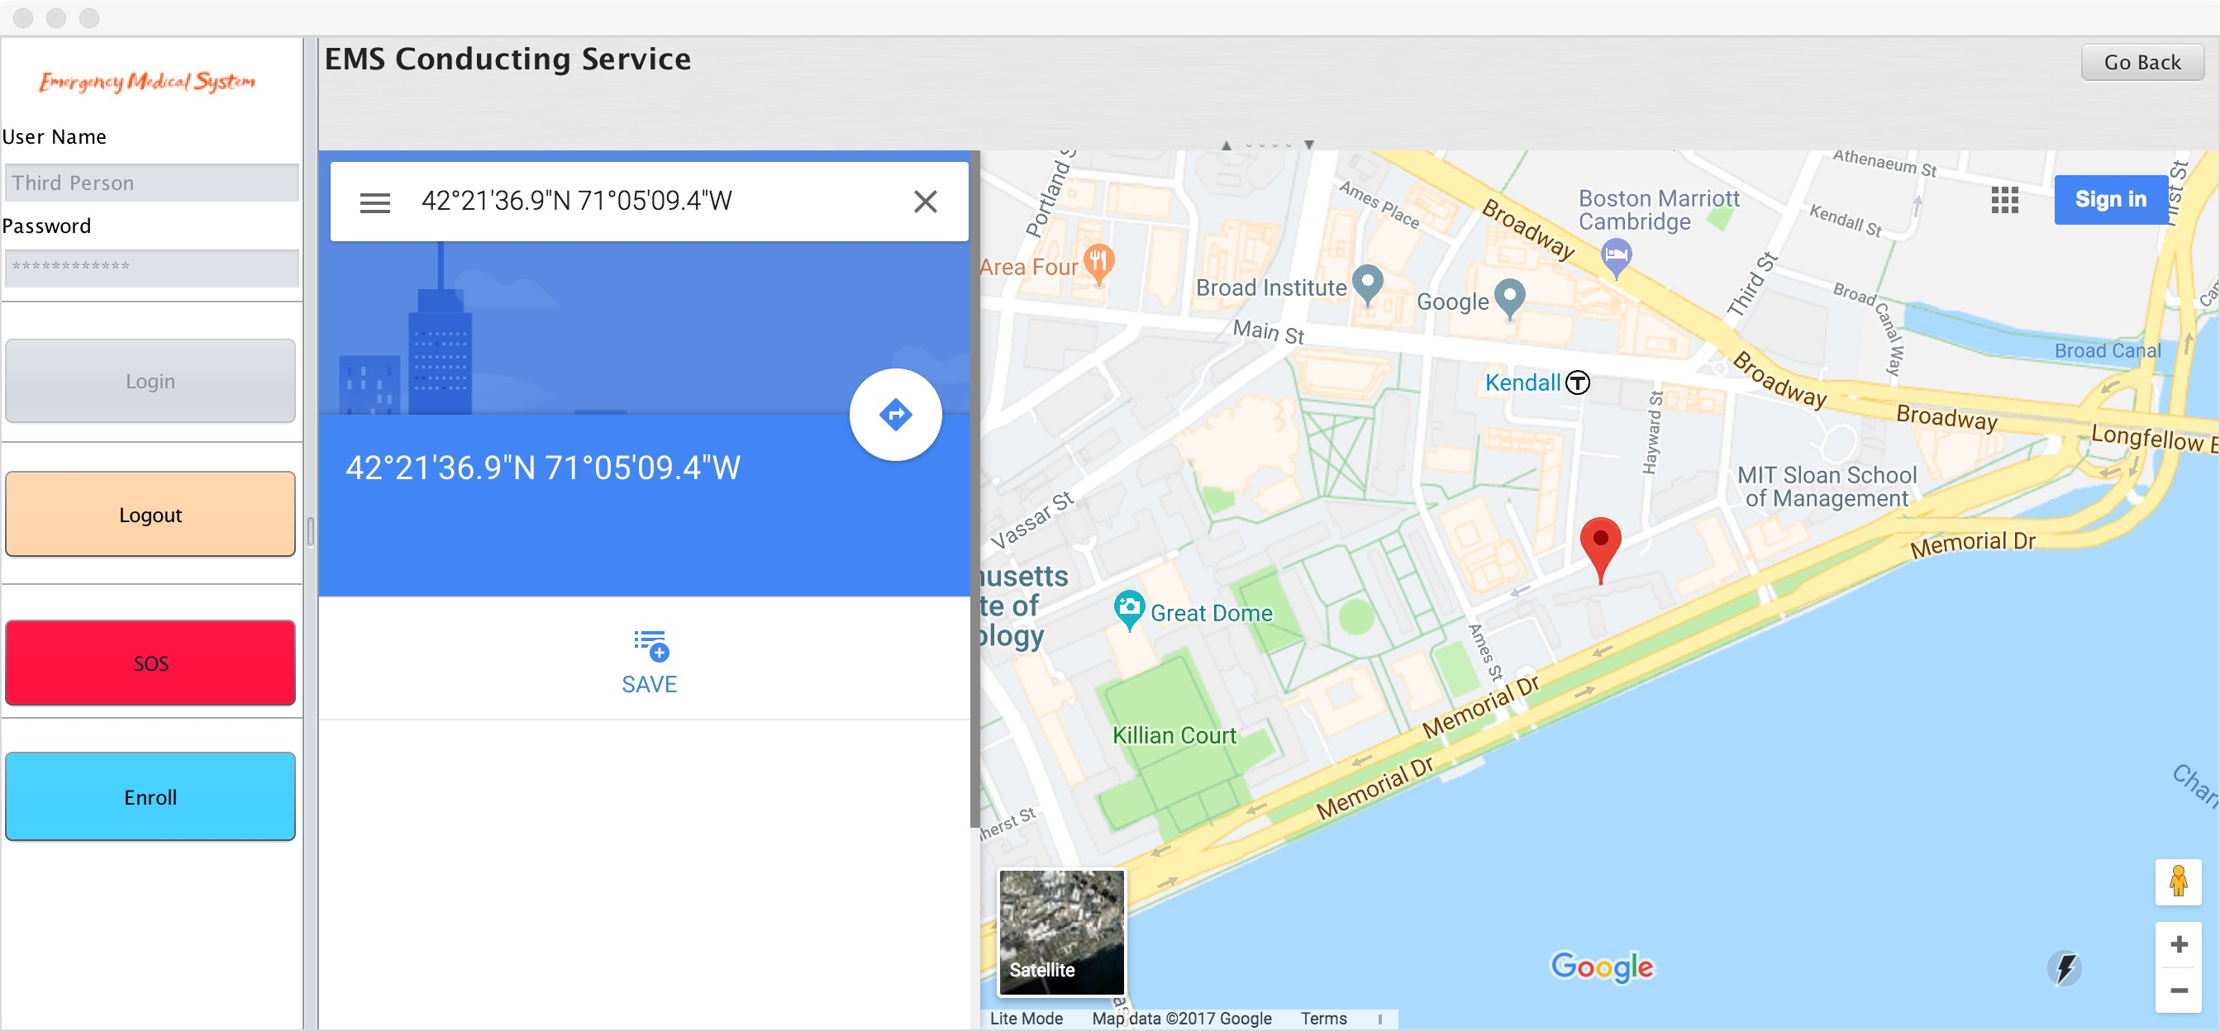
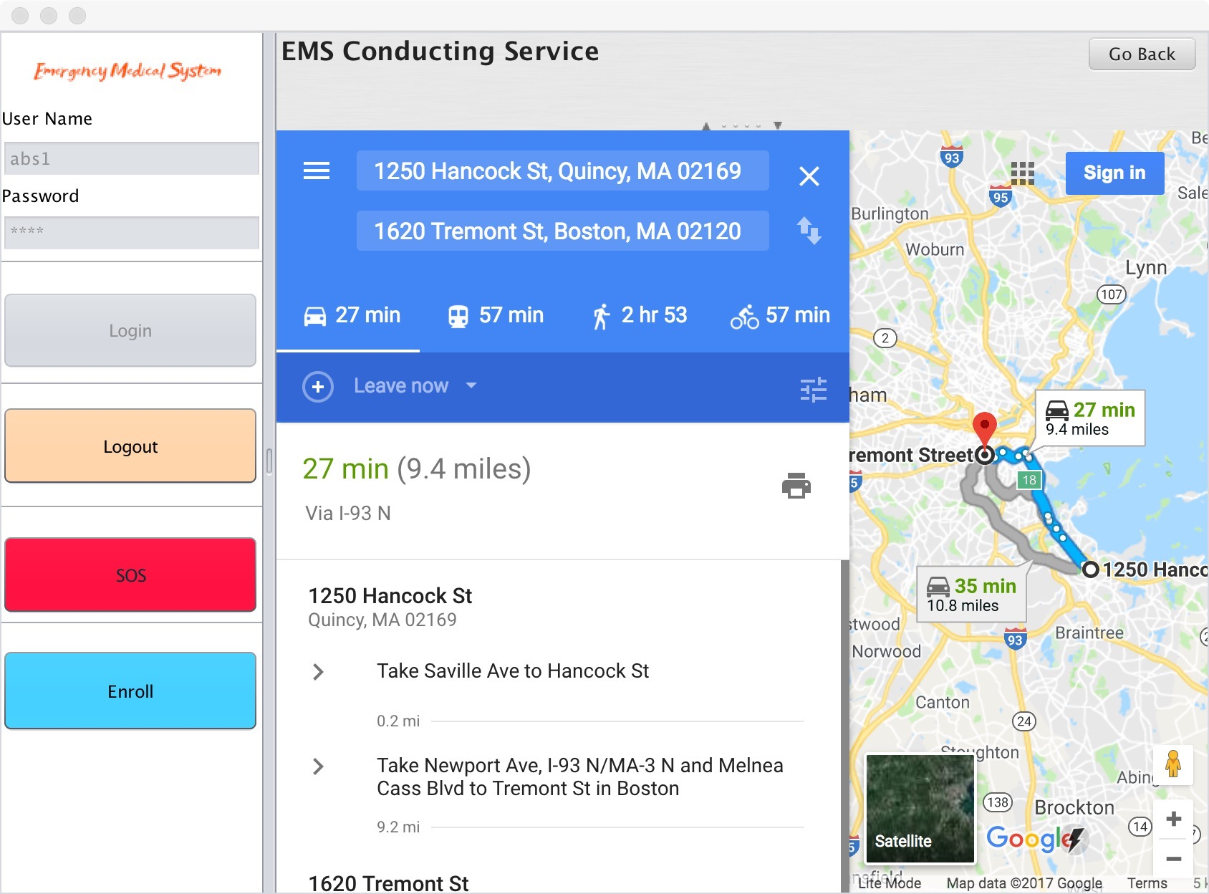
Interesting Feature

Slide 7
3
Object Model And Key Roles
PART

Slide 8
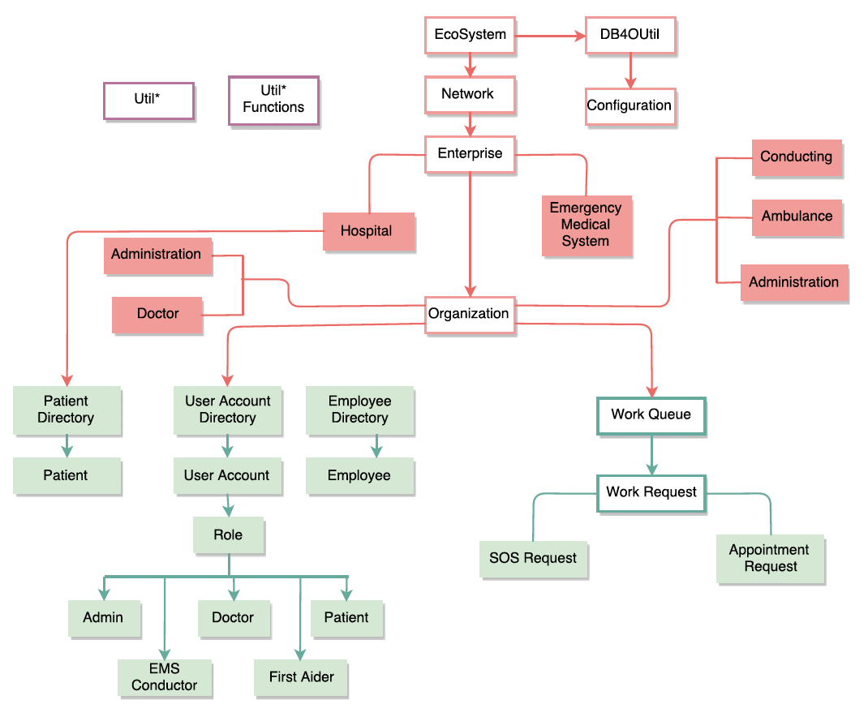
1 Object model

Slide 9
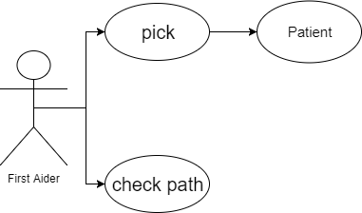
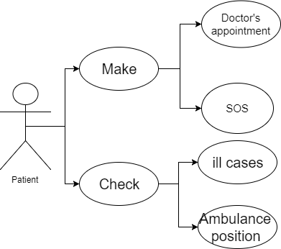
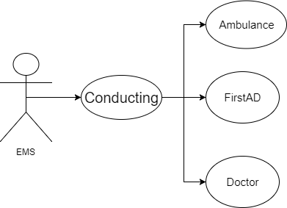
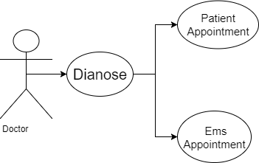
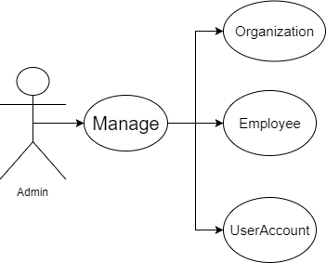
2 Key Role

Slide 10
4
Screen Shots
PART

Slide 11

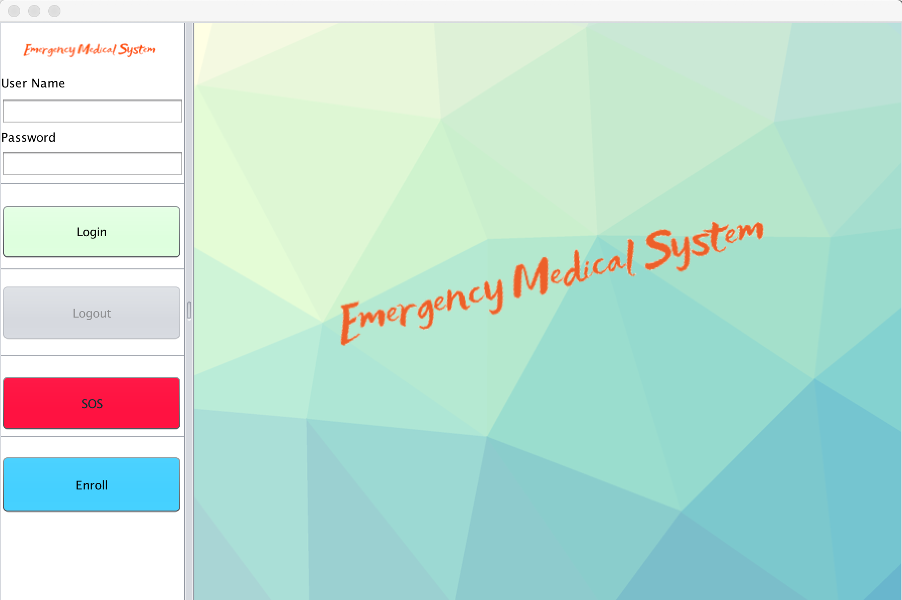
Main Page 1
1. Log In Part
2. SOS Button : Patient send SOS request to EMS Conductor
3. Enroll Button : Patient input personal information

Slide 12
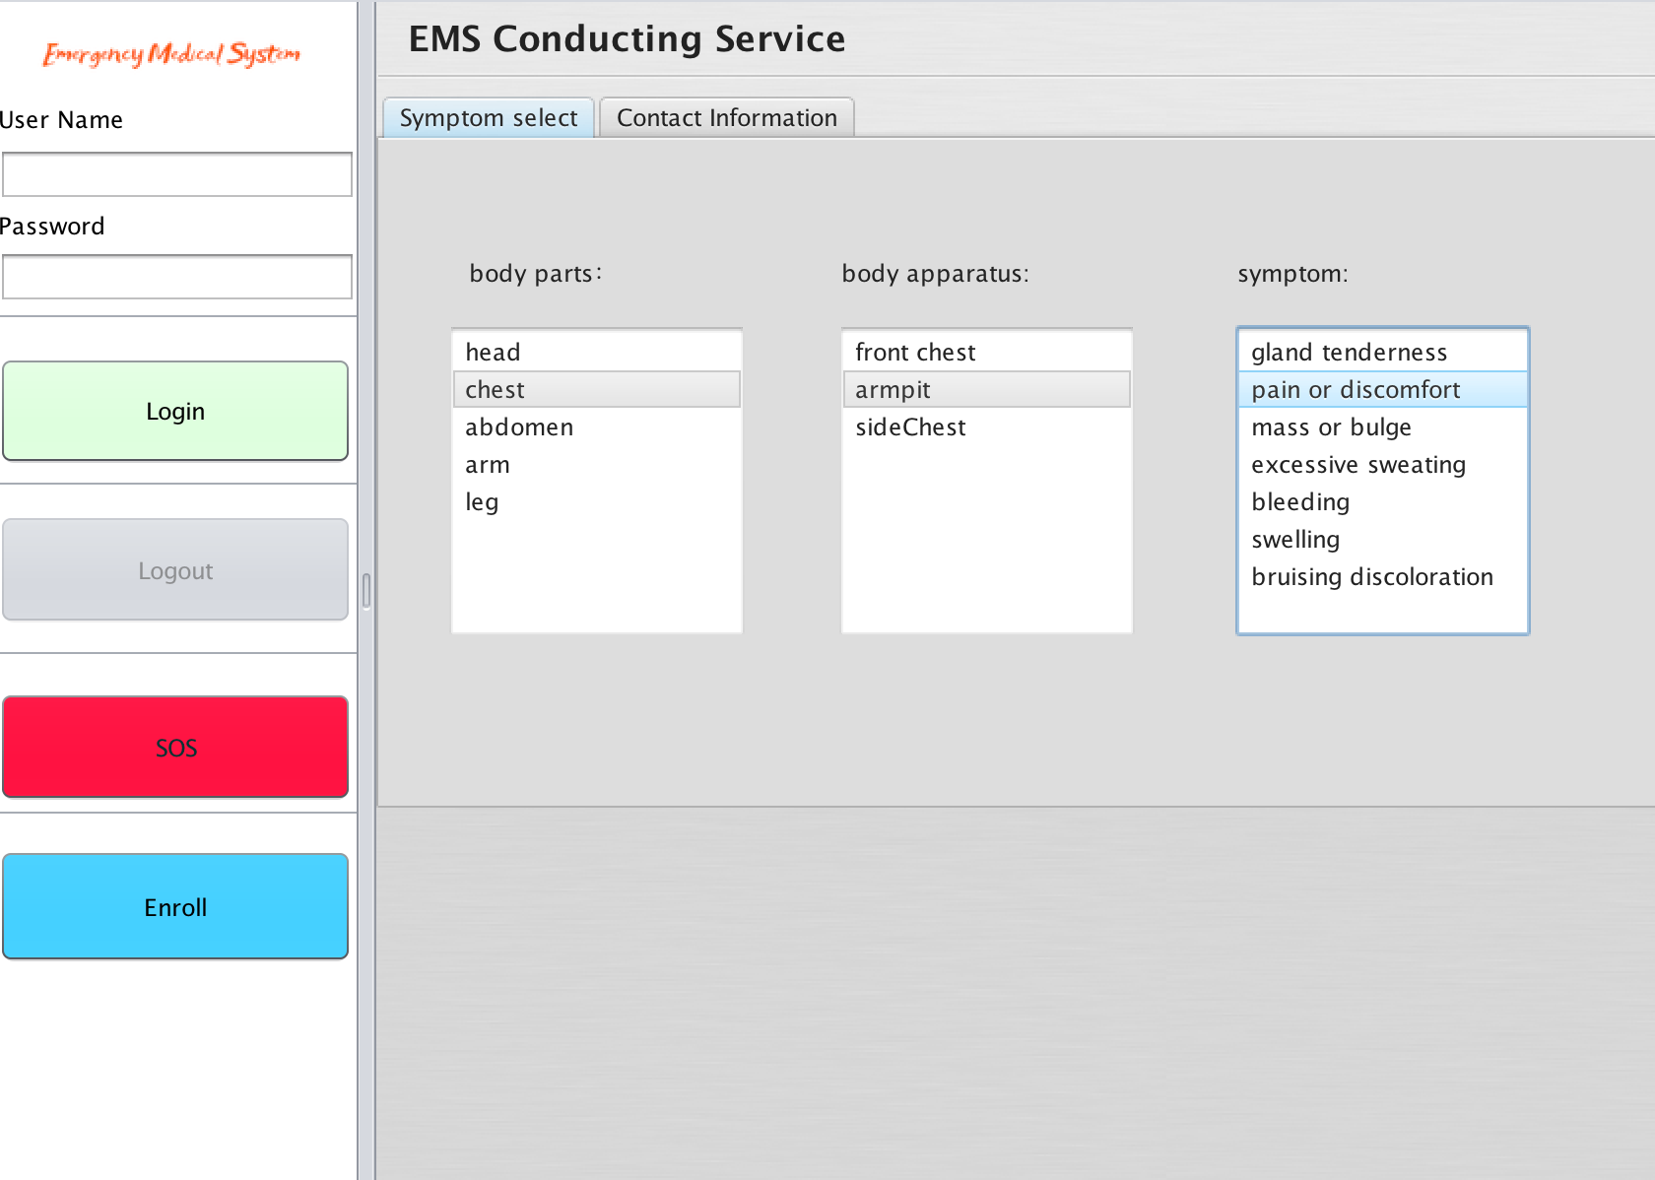
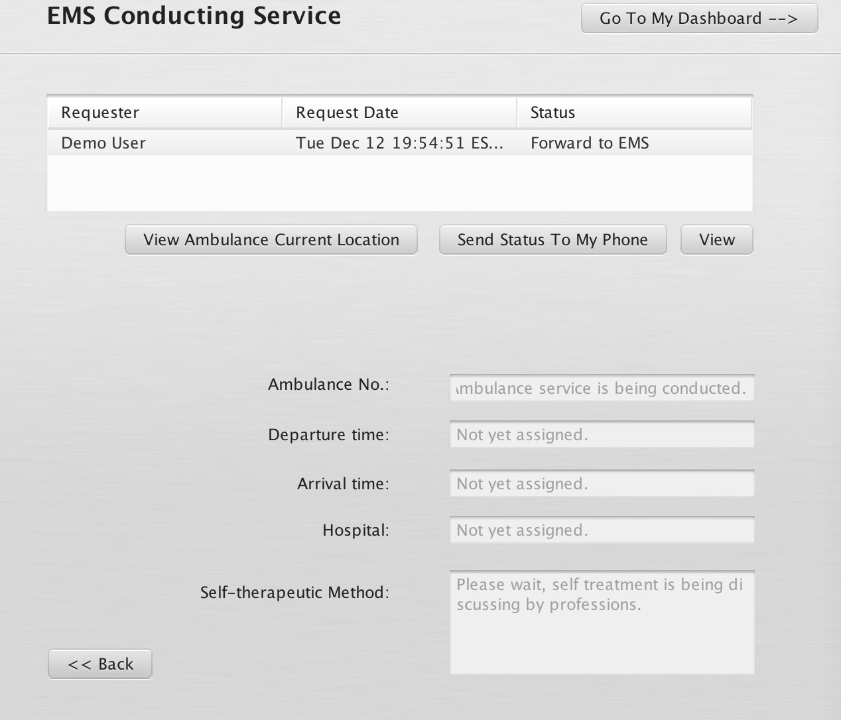
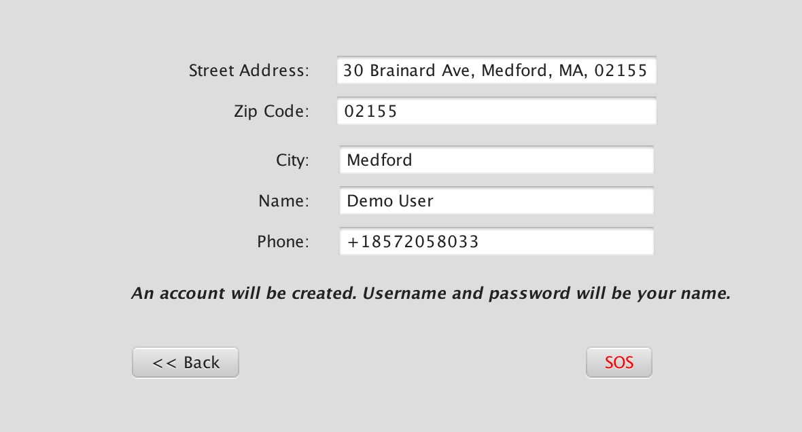
1 Patient – Send And View SOS Request
Select body parts and
relevant symptom
Input contact information
View SOS Request Procedure

Slide 13
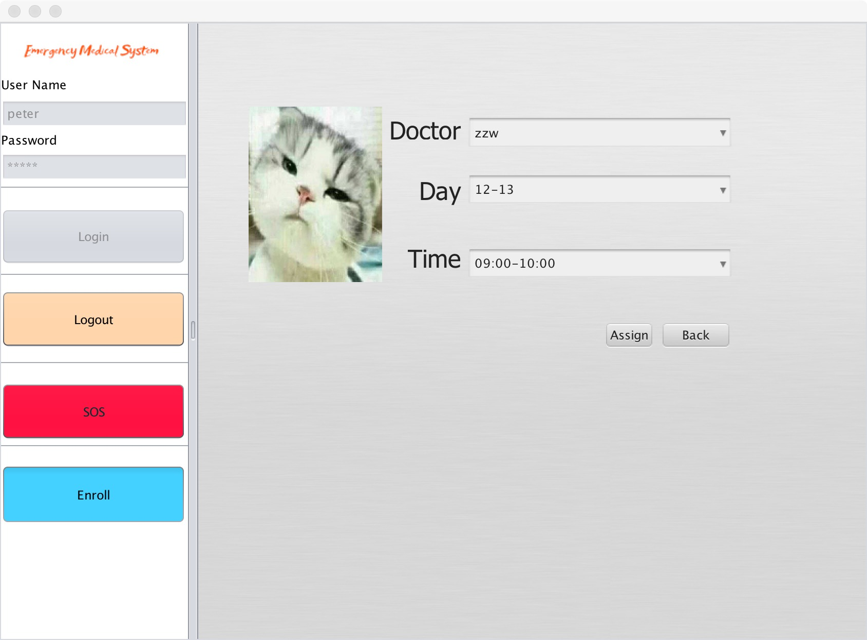
1 Patient – Make appointment
Doctor Reservation
Choose doctor
date
time slot
View doctor’s picture

Slide 14
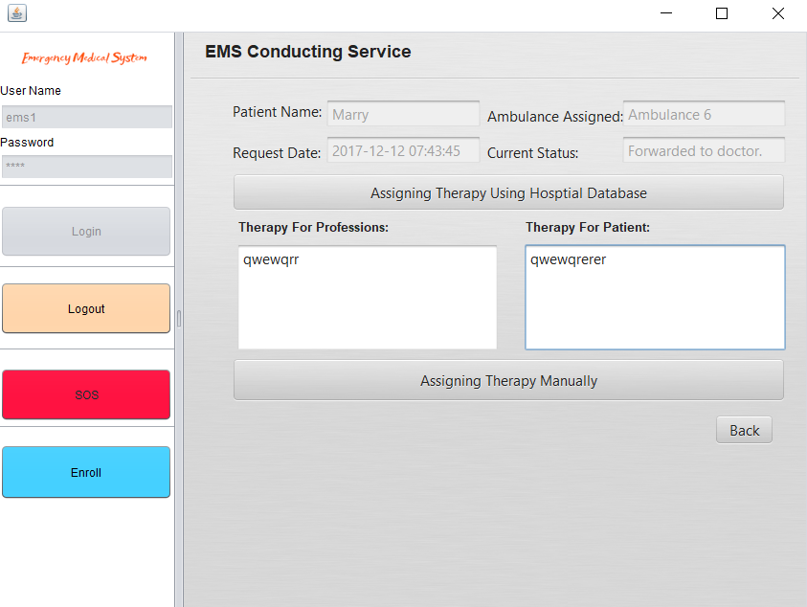
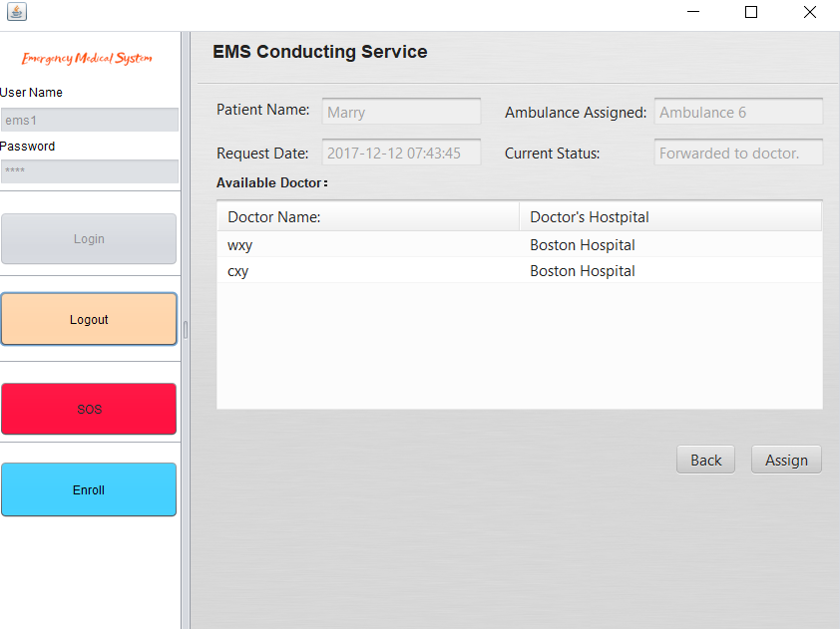
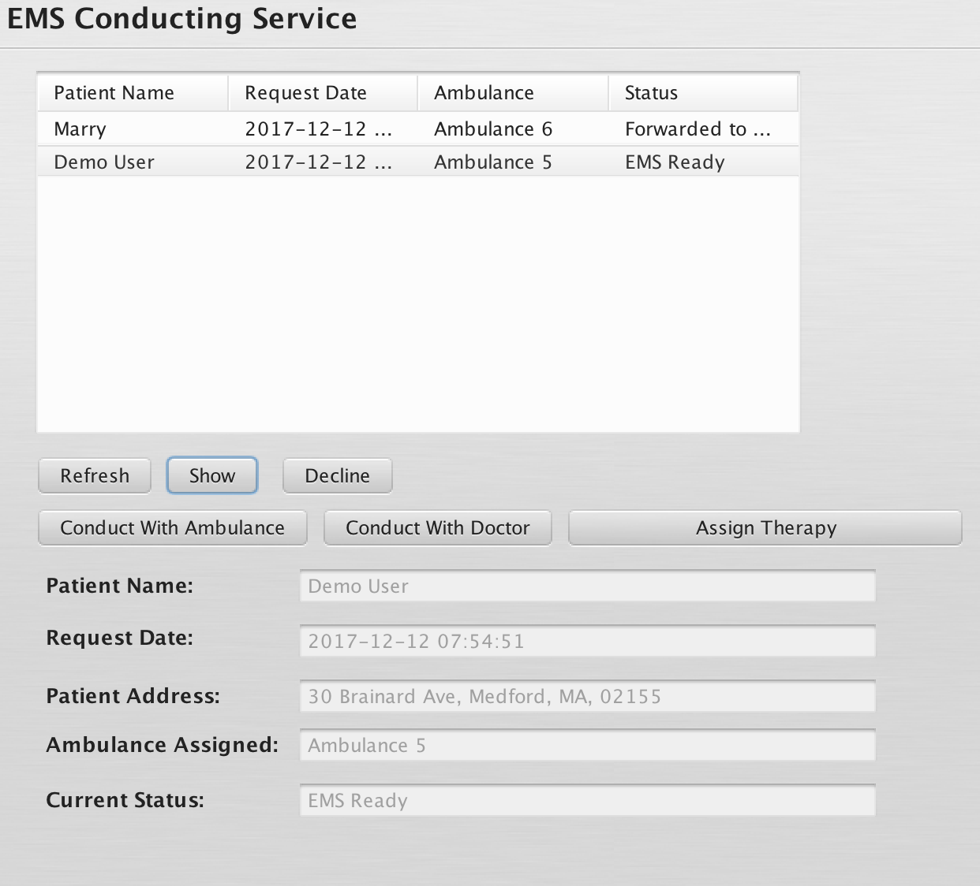
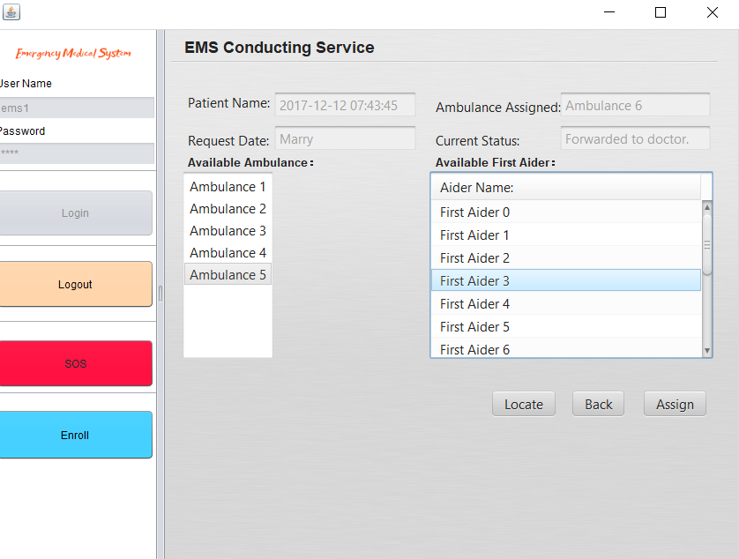
EMS Conductor – Assign Ambulance and Therapy 2
Conduct Doctor
Conduct Ambulance
Assign ambulance and first-aiders
Assign Therapy
to patients and
first-aiders

Slide 15

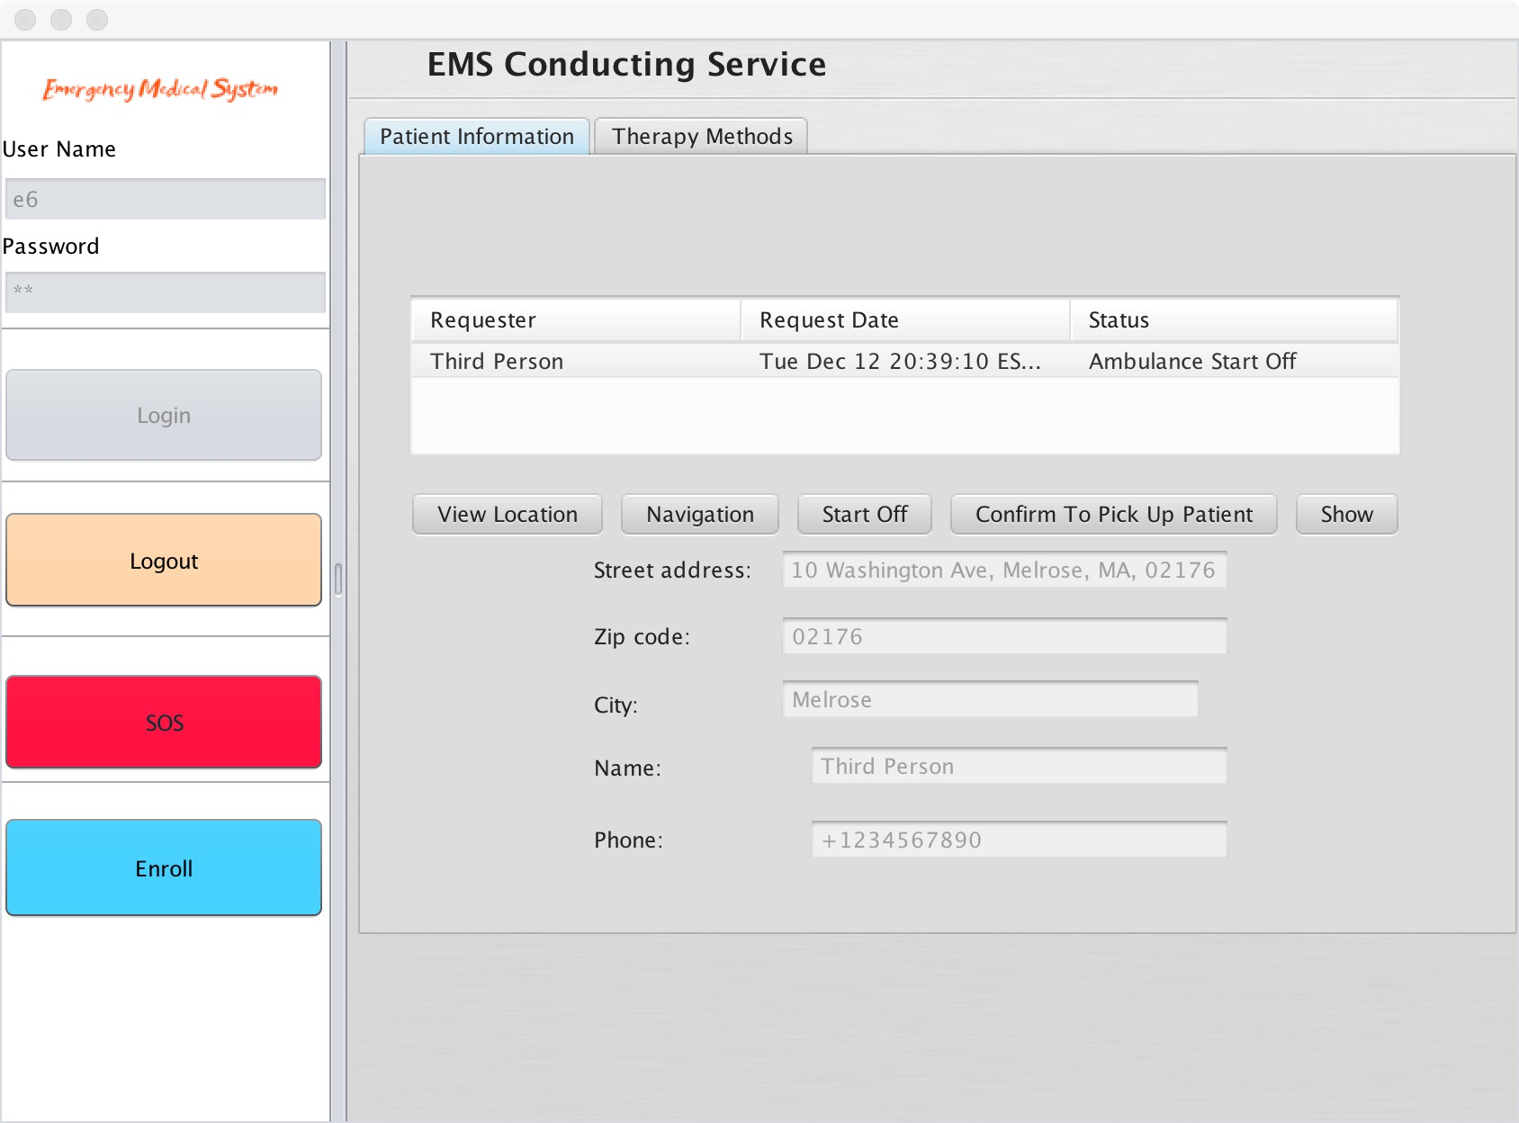
2 First-aider – Execute medical service
Send Action Message
View Navigation

Slide 16
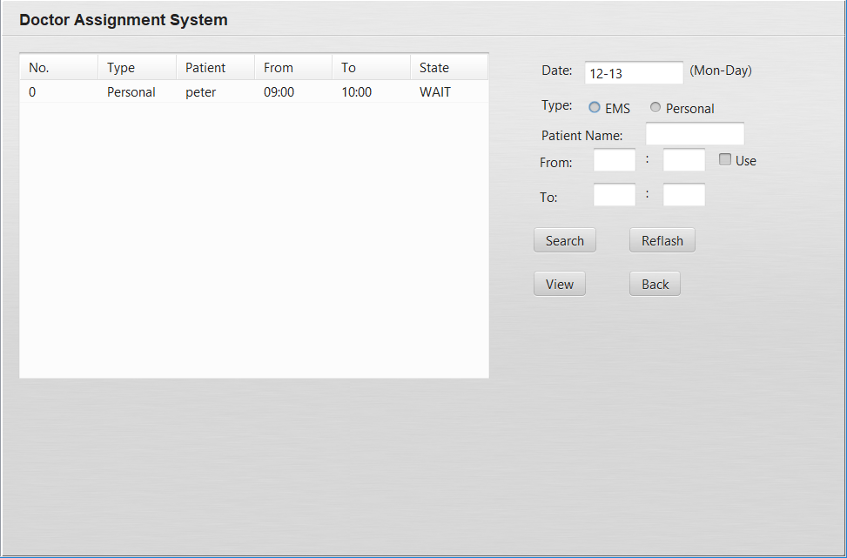
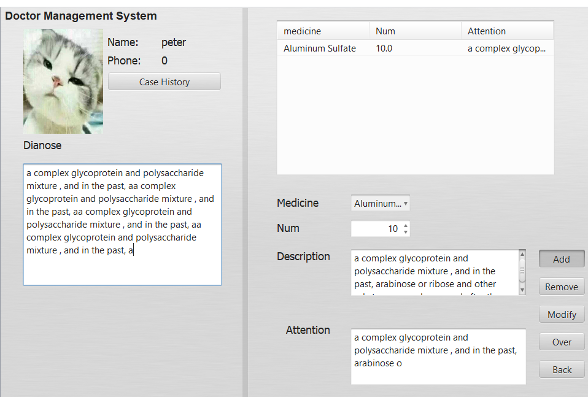
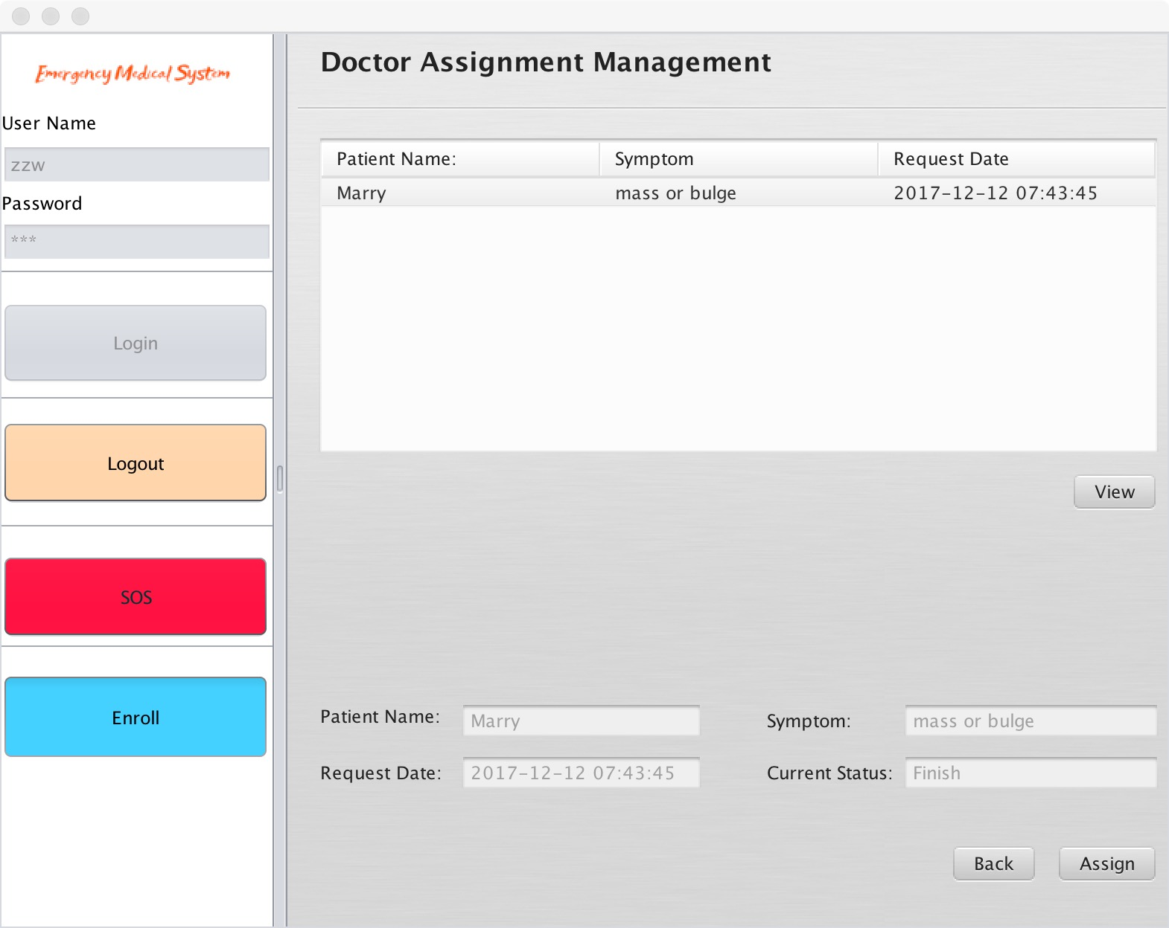
3 Doctor – Deal with SOS request and Appointment
View SOS request
Manage Appointment
Make Diagnose

Slide 17
5
Project Demo
PART

Slide 18
THANKS
Group ： Tiercel

