Slide 1
SYSTEM WALKTHROUGH
Paper Attribution
and Connection Intelligence
How the AC bibliometric system explains papers, tracks relationships,
and prepares source-grounded knowledge for cross-SDL reuse.
01
ATTRIBUTION
02
CONNECTIONS
03
KNOWLEDGE
UNIVERSITY OF TORONTO · ACCELERATION CONSORTIUM
JULY 2026
Notes:
Open by correcting the scope: the system is not primarily a classifier.
It attributes papers to AC with evidence, turns many paper-level decisions into a relationship map, and then prepares that map for retrieval and cross-SDL knowledge work.
[Sources]
- Local source: backend/docs/technical_overview.md
- Local source: frontend/src/main.tsx
[/Sources]

Slide 2
SYSTEM SCOPE
02
Classification is the first decision, not the product
1
2
3
4
CLASSIFICATION
PAPER ATTRIBUTION
CONNECTION INTELLIGENCE
KNOWLEDGE REUSE
Which relevance class is plausible?
Which AC people, institutions, funding, citations, and graph paths support it?
Which authors, institutions, topics, and methods are connected across the corpus?
Which source-grounded methods and lessons can transfer to another SDL?
DURABLE OUTPUT
A provenance-preserving research graph in which every node, edge, label, and generated claim can be traced back to papers and source text.
PAPER ATTRIBUTION SYSTEM
ATTRIBUTION · CONNECTIONS · KNOWLEDGE
Notes:
Classification narrows and organizes the corpus. Attribution records why; connection intelligence aggregates those records; knowledge reuse consumes the evidence without detaching it from sources.
[Sources]
- Local source: backend/docs/technical_overview.md
- Local source: backend/app/services/attribution_evidence_tree.py
- Local sources: backend/app/services/tku_extractor.py; backend/app/services/transfer_designer.py
[/Sources]

Slide 3
PAPER ATTRIBUTION
03
Paper attribution resolves five relationships around every paper
PEOPLE
direct AC author · matched identity
INSTITUTIONS
SUPPORT
partner / external affiliation
alias-resolved identity
funding · acknowledgement
program or partner mention
PAPER
canonical identity + provenance
SCIENTIFIC CONTENT
NETWORK
core / adjacent topics
methods · entities · propositions
coauthor paths · AC-core citations
cited by corpus
Human review records the final decision and locks it against later automated overrides.
PAPER ATTRIBUTION SYSTEM
ATTRIBUTION · CONNECTIONS · KNOWLEDGE
Notes:
An attribution record is a bundle of resolved relationships, not a single label.
The five families correspond directly to fields and evidence displayed in the paper review interface.
[Sources]
- Local source: frontend/src/components/EvidencePanel.tsx
- Local source: backend/app/schemas.py
- Local source: backend/app/api/graph_explain.py
[/Sources]

Slide 4
PAPER ATTRIBUTION
04
What the system stores for one attributed paper
OUTPUT FIELD
WHAT IT CONTAINS
WHY IT MATTERS
paper identity
DOI, title, year, venue, source provenance
prevents duplicate or ambiguous records
classification
label, confidence, model version, reasons
supports filtering and review priority
matched people
person ID, name, match type: exact / alias / initials / fuzzy / AC publication
distinguishes identity evidence from topic similarity
matched institutions
canonical institution ID and partner status
supports partner and collaboration reporting
scientific evidence
topics, methods, entities, full-text evidence, chunk IDs
keeps the scientific basis source-addressable
graph explanation
direct AC authors, second-degree paths, AC-core citations, cited-by-corpus
makes indirect attribution inspectable
human review
human label, reviewer, notes, timestamp / lock state
preserves accountable decision authority
PAPER ATTRIBUTION SYSTEM
ATTRIBUTION · CONNECTIONS · KNOWLEDGE
Notes:
This slide is the clearest answer to 'what is paper attribution?'
The label is one field among several; the relationship evidence and human review make the record reusable for analytics and future knowledge work.
[Sources]
- Local source: backend/app/schemas.py
- Local source: frontend/src/components/EvidencePanel.tsx
- Local source: backend/app/api/papers.py
[/Sources]

Slide 5
CLASSIFICATION SUBROUTINE
05
Seven evidence signals feed label-specific gates
A
I
T
F
N
Q
E
CORE
direct / gold AC evidence + core SDL evidence
author identity
institution
topic
full text
network
citations
entities
RELATED
strong identity, funding, or AC-core citation support
C = .35A + .15I + .25T + .20F + .10N + .10Q + .05E − .15D
ADJACENT
strong scientific relevance without sufficient attribution
D = disqualifying evidence count. Metadata-only mode redistributes weight toward A, I, and T.
UNCERTAIN
partial or conflicting evidence requiring review
IMPORTANT
EXCLUDE
no necessary condition survives
Confidence ranks cases. Necessary conditions assign labels. A high score cannot bypass the evidence required for a high-value attribution.
PAPER ATTRIBUTION SYSTEM
ATTRIBUTION · CONNECTIONS · KNOWLEDGE
Notes:
Keep this section brief in the meeting. Classification is a subroutine that proposes a relevance class.
The important design choice is that high-value labels require specific evidence, not just a large weighted score.
[Sources]
- Local source: backend/app/services/relevance_classifier.py
- Local source: backend/app/config.py
[/Sources]

Slide 6
PAPER ATTRIBUTION
06
Attribution is an evidence tree, not a flat score
Paper → Author → AC member
+0.25
S(AET) = clamp(Σ positive path weights
− Σ negative path weights, 0, 1)
Paper → Affiliation → AC partner
+0.30
Paper → Funding → AC program
+0.35
EACH PATH RETAINS
Paper → Coauthor → AC author
+0.10
path ID and evidence type
polarity and weight
Paper → Citation → AC core paper
+0.08
core vs supporting centrality
Paper → Methods → SDL workflow
+0.30 core
source section and chunk ID
generation and review context
Negative evidence remains visible; it is not discarded after scoring.
PAPER ATTRIBUTION SYSTEM
ATTRIBUTION · CONNECTIONS · KNOWLEDGE
Notes:
The AET is the attribution product: it stores positive and negative evidence as paths that can be reviewed independently.
The weights shown are representative values from the current scoring implementation.
[Sources]
- Local source: backend/app/services/attribution_evidence_scoring.py
- Local source: backend/app/services/attribution_evidence_tree.py
[/Sources]

Slide 7
PAPER ATTRIBUTION
07
Every graph claim can be opened as a path
DIRECT
Paper → AC author
GRAPH EXPLANATION OUTPUT
direct_ac_authors[]
verified names
The paper has a verified AC member among its authors.
second_degree_paths[]
via author · AC author · shared papers · strength
SECOND DEGREE
citation_signals[]
AC-core paper · title · DOI
Paper → external author → AC author
cited_by_corpus[]
reverse corpus citations
summary
deterministic explanation text
The path records the two authors, shared paper IDs, and a path strength.
CITATION
N(p) = maxₐ PPRAC(a) × [1 + .25·max(0, cnorm(a) − 1)]
Paper → cites → AC core paper
The cited AC-core title and DOI remain attached to the signal.
Q(p) = min(1, 0.5 × | unique AC-core citations |)
PAPER ATTRIBUTION SYSTEM
ATTRIBUTION · CONNECTIONS · KNOWLEDGE
Notes:
The graph-explanation endpoint assembles an explanation from stored signals; no LLM is needed.
This supports a reviewer who wants to know exactly how an indirect connection was inferred.
[Sources]
- Local source: backend/app/api/graph_explain.py
- Local source: backend/app/services/graph_service.py
[/Sources]

Slide 8
CONNECTION INTELLIGENCE
08
Raw co-publication counts are normalized before they become relationship strength
R(u,v) = shared papers(u,v) / min(paper count(u), paper count(v))
ADDITIONAL STRUCTURAL SIGNALS
PPR toward AC
This asks how much of the smaller publication portfolio is explained by the collaboration.
Proximity to AC-seeded authors through the weighted coauthor graph.
EXAMPLE
SHARED
PAPERS (u,v)
RAW IMPRESSION
NORMALIZED R
Evans–Chen excess centrality
Highlights authors whose collaborative reach is larger than degree alone would predict.
A
3
4 and 12
moderate tie
0.75
B
5
30 and 20
larger raw count
0.25
Bridge score
B(a) = min[1, PPRAC(a) × max(cnorm(a),0) × SDL diversity(a)]
Example A is the more concentrated relationship even though it has fewer shared papers.
PAPER ATTRIBUTION SYSTEM
ATTRIBUTION · CONNECTIONS · KNOWLEDGE
Notes:
The normalization example explains why the system does not rank relationships by joint-paper count alone.
PPR, excess centrality, and cross-SDL diversity add complementary notions of proximity and bridging.
[Sources]
- Local source: backend/app/services/network_service.py
- Local source: backend/app/services/graph_service.py
[/Sources]

Slide 9
CONNECTION INTELLIGENCE
09
AC can rank the same network for different questions
Iₚ(a) = Σₖ wₚ,ₖ × xₖ(a)
PROFILE
PRIMARY QUESTION
NON-ZERO WEIGHTS
AC attribution
Who is structurally closest to AC work?
AC proximity .55 · relationship .20 · citation .15 · recency .10
Bridge builders
Who connects AC-adjacent communities across SDL contexts?
AC proximity .35 · excess centrality .30 · SDL diversity .25 · relationship .10
Institution hubs
Who sustains institution-spanning collaboration?
relationship .30 · excess centrality .25 · SDL diversity .20 · AC proximity .15 · citation .10
Emerging connectors
Which newer authors show early bridge potential?
recency .30 · excess centrality .25 · SDL diversity .20 · AC proximity .15 · relationship .10
Topic diffusion
Who helps methods and topics spread between SDL areas?
SDL diversity .35 · relationship .20 · excess centrality .20 · AC proximity .15 · recency .10
The UI exposes both the profile weights and each dimension’s contribution; profile changes are therefore explainable rather than opaque.
PAPER ATTRIBUTION SYSTEM
ATTRIBUTION · CONNECTIONS · KNOWLEDGE
Notes:
The network is not tied to one universal importance score.
A profile is an explicit research question expressed as weights over normalized dimensions. The user can inspect and override the weights.
[Sources]
- Local source: backend/app/services/node_importance_service.py
- Local source: frontend/src/pages/CoauthorNetworkPage.tsx
[/Sources]

Slide 10
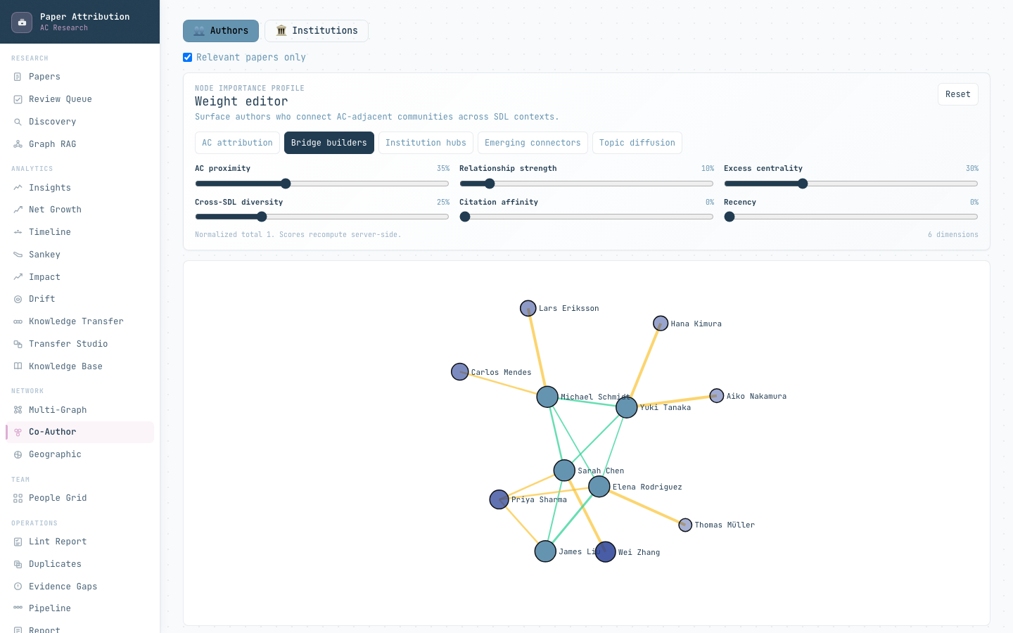
IMPLEMENTED VIEW
10
The coauthor view exposes bridge authors and the evidence behind each edge
WHAT AC CAN INSPECT
Question-specific ranking
Switch between AC attribution, bridge builders, institution hubs, emerging connectors, and topic diffusion.
Author-level explanation
Paper count, collaborators, PPR, cnorm, importance components, and a human-readable explanation.
Edge provenance
Joint-paper IDs, normalized relationship strength, and whether an edge involves AC.
Interface captured from the current frontend with mock data; values are illustrative.
PAPER ATTRIBUTION SYSTEM
ATTRIBUTION · CONNECTIONS · KNOWLEDGE
Notes:
Use the screenshot to move from algorithm to product behavior.
The same coauthor graph supports different AC questions because the profile weights and component contributions remain visible.
[Sources]
- Local interface: frontend/src/pages/CoauthorNetworkPage.tsx
- Local API: backend/app/api/networks.py
- Screenshot: local frontend with VITE_USE_MOCK=true; values illustrative
[/Sources]

Slide 11
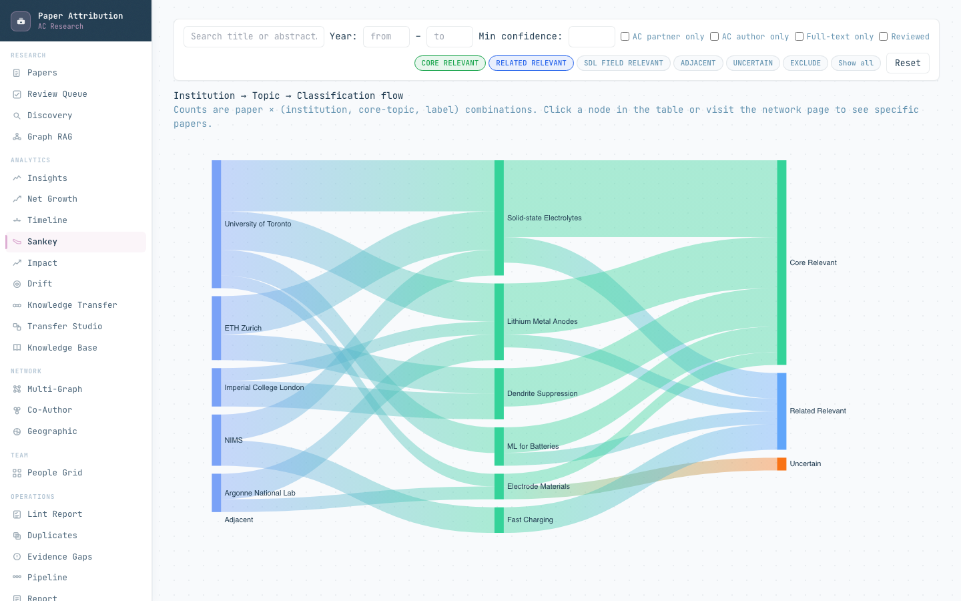
IMPLEMENTED VIEW
11
Institution connections can be traced from joint papers to topics and labels
THREE LINKED QUESTIONS
INSTITUTION
Which organizations appear on the attributed papers?
TOPIC
Which scientific themes connect those organizations?
LABEL
How does the evidence resolve into attribution classes?
INSTITUTION HUB SCORE
H = .4 degree + .4 betweenness
+ .1 partner reach + .1 international reach
Interface captured from the current frontend with mock data; values are illustrative.
PAPER ATTRIBUTION SYSTEM
ATTRIBUTION · CONNECTIONS · KNOWLEDGE
Notes:
The Sankey aggregates paper × institution × topic × label combinations.
The institution network separately retains joint-paper IDs and normalized edge strength, while the hub score tracks degree, betweenness, partner reach, and international reach over time.
[Sources]
- Local source: backend/app/services/analytics_service.py
- Local source: backend/app/api/analytics.py
- Local interface: frontend/src/pages/SankeyPage.tsx
- Screenshot: local frontend with VITE_USE_MOCK=true; values illustrative
[/Sources]

Slide 12
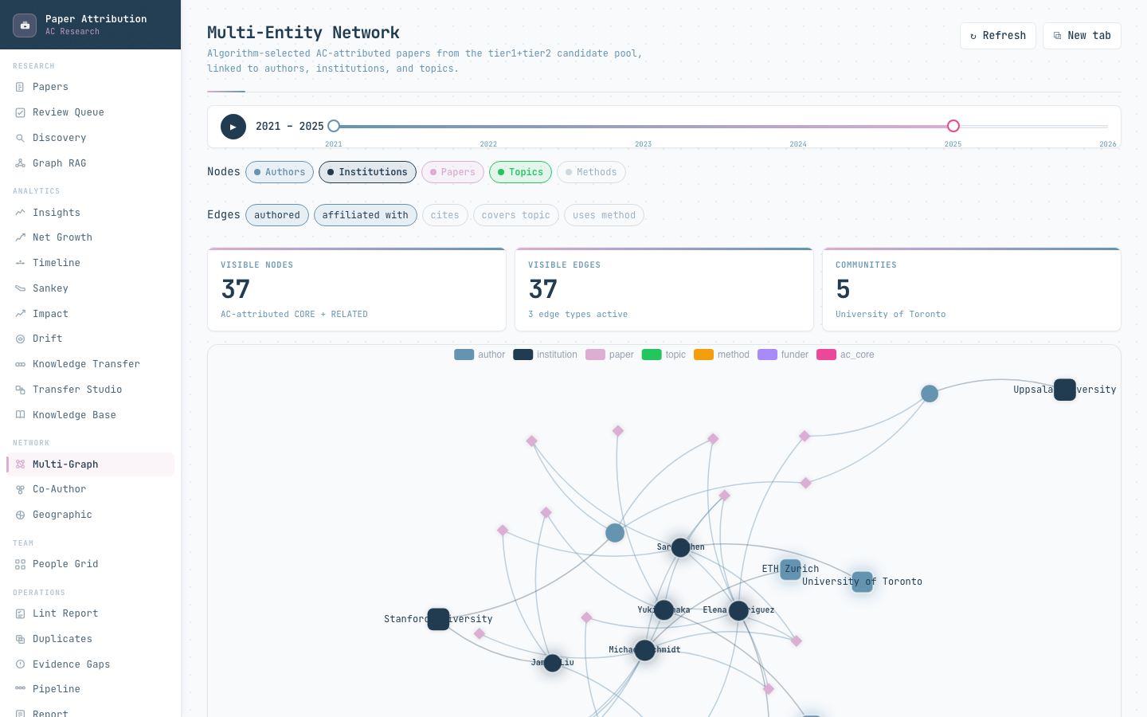
IMPLEMENTED VIEW
12
The multi-entity graph joins people, institutions, papers, topics, methods, funders, and AC core
NODE TYPES
EDGE PREDICATES
authors
institutions
papers
topics
methods
funders
AC core
authored
affiliated with
belongs to topic
uses method
cites / cites AC core
institution collaboration
Center any entity, set a hop limit, choose edge types, and move the time window without changing the underlying provenance.
Interface captured from the current frontend with mock data; values are illustrative.
PAPER ATTRIBUTION SYSTEM
ATTRIBUTION · CONNECTIONS · KNOWLEDGE
Notes:
This is the most complete connection view: it lets AC move between people, organizations, papers, topics, methods, funding, and AC-core anchors.
The backend materializes selected node and edge providers, supports ego graphs by center and hop limit, then assigns stable groups.
[Sources]
- Local source: backend/app/services/multi_graph/service.py
- Local source: backend/app/services/multi_graph/providers.py
- Local interface: frontend/src/pages/MultiGraphPage.tsx
- Screenshot: local frontend with VITE_USE_MOCK=true; values illustrative
[/Sources]

Slide 13
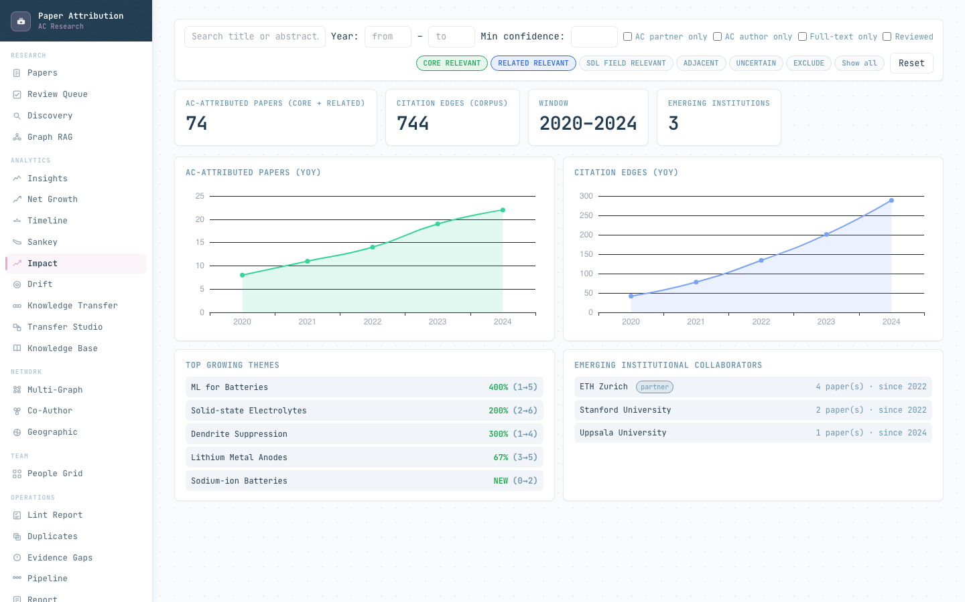
IMPLEMENTED VIEW
13
AC can monitor growth, emerging collaborators, themes, and citation activity
METRICS ARE SQL-DERIVED
Attributed papers
CORE + RELATED by year
Citation activity
corpus citation edges by year
Emerging institutions
first year + paper count + partner status
Emerging authors
first year + attributed-paper activity
Growing themes
recent versus earlier topic counts
Drift events
year-to-year topic-vector similarity
LLMs do not calculate these numbers.
Interface captured from the current frontend with mock data; values are illustrative.
PAPER ATTRIBUTION SYSTEM
ATTRIBUTION · CONNECTIONS · KNOWLEDGE
Notes:
This converts paper-level attribution into program-level monitoring.
The analytics service explicitly derives chart data from SQL and Python aggregation; optional LLM reporting can only rewrite supplied metrics and source links.
[Sources]
- Local source: backend/app/services/analytics_service.py
- Local source: backend/app/services/drift_service.py
- Local source: backend/app/services/reporting_service.py
- Local interface: frontend/src/pages/ImpactPage.tsx
- Screenshot: local frontend with VITE_USE_MOCK=true; values illustrative
[/Sources]

Slide 14
USE CASES
14
Connection intelligence supports concrete operating questions
OPERATING QUESTION
SYSTEM EVIDENCE
POSSIBLE AC ACTION
Which papers are attributable to AC, and why?
paper record · AET · graph explanation
review, publish, or correct the attribution
Who bridges AC to an external SDL community?
PPR · excess centrality · SDL diversity · joint papers
prioritize outreach or collaboration review
Which institutions are emerging collaborators?
first-year activity · institution edges · hub score · geography
support partnership development
Which topics or methods move across communities?
Sankey · multi-graph · topic diffusion profile
identify translation opportunities
Where are the evidence and ingestion blind spots?
evidence gaps · duplicate candidates · missed-paper groups · drift
improve dataset coverage and review policy
Which claims can go into a stakeholder report?
SQL metric triples with source links
produce auditable reporting without invented numbers
The system turns bibliometric records into a decision surface for curation, partnership tracking, and scientific translation.
PAPER ATTRIBUTION SYSTEM
ATTRIBUTION · CONNECTIONS · KNOWLEDGE
Notes:
This is the practical summary for a non-developer audience.
Each question maps to a current endpoint or interface rather than a speculative future capability.
[Sources]
- Local sources: backend/app/api/papers.py; backend/app/api/networks.py; backend/app/api/analytics.py
- Local source: backend/app/services/reporting_service.py
- Local source: backend/app/services/missed_papers_service.py
[/Sources]

Slide 15
EVIDENCE ACCESS
15
Retrieval answers questions with graph context, propositions, and source chunks
QUERY
TEXT
FUSION
GRAPH
STRUCTURE
OUTPUT
natural-language question
BM25 + cosine
RRF, k = 60
centrality rerank
proposition channel
answer + sources + retry signal
RRF(d) = 1 / [60 + rankBM25(d)] + 1 / [60 + rankcosine(d)]
EVERY RETURNED SOURCE INCLUDES
paper ID and chunk ID
section type and title
BM25, cosine, fused, and graph scores
graph-path context when available
source precision and missing-evidence signals
score′(d) = RRF(d) × [1 + 0.3 × graph importance(d)]
Structured questions about methods or funding can use proposition-first retrieval instead of relying only on free text.
PAPER ATTRIBUTION SYSTEM
ATTRIBUTION · CONNECTIONS · KNOWLEDGE
Notes:
Retrieval is downstream of attribution: graph importance and graph paths enrich text retrieval, while source chunks and propositions preserve evidence.
The graph boost is bounded so centrality cannot replace textual relevance.
[Sources]
- Local source: backend/app/services/retrieval_service.py
- Local source: backend/app/api/retrieval.py
- Local interface: frontend/src/pages/RetrievalPage.tsx
[/Sources]

Slide 16
GOVERNANCE
16
Human review and reporting preserve authority
AUTOMATED PROPOSAL
HUMAN DECISION
LOCKED ATTRIBUTION
REPORT / EXPORT
label · confidence · AET paths
uncertainty queue
include / exclude / uncertain
reviewer + rationale
later automated passes cannot
silently override
CSV + SQL metrics +
source-linked narrative
SAFE ROLE FOR CLAUDE
AUTHORITY BOUNDARY
• adjudicate only an uncertainty queue
• summarize retrieved evidence
• draft reviewer rationale
• rewrite reports from supplied metric triples
Claude may not create papers, graph edges, citations, measurements, results, or numerical claims. Human-confirmed decisions remain locked.
PAPER ATTRIBUTION SYSTEM
ATTRIBUTION · CONNECTIONS · KNOWLEDGE
Notes:
Claude credits are most useful for bounded adjudication and reporting assistance.
They should fund review acceleration, not move scientific or attribution authority away from the database, evidence paths, and human decision.
[Sources]
- Local source: backend/app/services/llm_judge.py
- Local source: backend/app/api/reviews.py
- Local source: backend/app/services/reporting_service.py
- Local source: backend/docs/technical_overview.md
[/Sources]

Slide 17
KNOWLEDGE PREPARATION
17
Attributed papers become source-grounded cross-SDL transfer candidates
ATTRIBUTED PAPER
STRUCTURED CLAIMS
TKU
TARGET MATCH
TRANSFER DESIGN
KNOWLEDGE CARD
reviewed evidence paths
entities + propositions
method core + assumptions + lessons
different SDL domain
plan + risks + citations
human-reviewed reusable asset
Transfer score = match strength + novelty + transferability + evidence − risk penalty
SOURCE CONTRACT
Every generated claim carries a source tag such as [src:paper_id]. Same-domain matches are excluded. Human review precedes acceptance.
Classification makes the corpus searchable; attribution makes the extracted knowledge defensible.
PAPER ATTRIBUTION SYSTEM
ATTRIBUTION · CONNECTIONS · KNOWLEDGE
Notes:
The knowledge pipeline depends on attribution: TKUs and transfer proposals should inherit source-grounded evidence, not start from detached summaries.
The evolutionary search score shown is the current deterministic candidate score.
[Sources]
- Local source: backend/app/services/tku_extractor.py
- Local source: backend/app/services/transfer_designer.py
- Local source: backend/app/services/evolutionary_transfer_service.py
- Local source: backend/app/services/kb_service.py
[/Sources]

Slide 18
SYSTEM BOUNDARY
18
Current capability, optional layers, and experimental work remain distinct
STATUS
CAPABILITIES
AUTHORITY / LIMIT
CURRENT
paper attribution record · AET evidence paths · deterministic graph explanations · coauthor / institution / multi-entity networks · Sankey / impact / drift · source-linked retrieval · TKU and transfer services
implemented paths in the current repository; outputs remain evidence-linked
OPTIONAL
Claude uncertainty judge · Claude report rewriter · learned classifier using 14 engineered features
default-off or conditional; bounded by retrieved evidence and high-margin rules
OFFLINE BASELINE
ten leakage-safe structural graph features + balanced logistic regression + leave-one-out evaluation
evaluation artifact only; no production authority
FUTURE EXPERIMENT
PyTorch Geometric / DGL model training, saved weights, inference service, production classifier integration
not implemented as a production GNN path
Do not describe graph export or the offline structural baseline as a deployed GNN classifier.
PAPER ATTRIBUTION SYSTEM
ATTRIBUTION · CONNECTIONS · KNOWLEDGE
Notes:
This slide prevents the architecture from being overstated.
The current system already has substantial attribution and connection functionality; the optional model layers and future GNN work remain separate.
[Sources]
- Local source: backend/docs/development_progress.md
- Local source: backend/docs/gnn_graph_ml_development_plan.md
- Local source: backend/app/services/graph_feature_baseline.py
- Local source: backend/app/services/learned_classifier.py
[/Sources]

Slide 19
MEETING OUTCOME
Decisions for a shared
bibliometric program
The first release should define not only which papers enter the dataset,
but which relationships and evidence paths the consortium agrees to trust.
01
CORPUS
02
ATTRIBUTION POLICY
Which bibliometric sources, date range, and gold papers define the trusted starting set?
Which evidence paths are sufficient for CORE, RELATED, and organization-level reporting?
03
CONNECTION METRICS
04
REVIEW & MODEL BUDGET
Which profiles should AC use for attribution, bridge discovery, institutions, and topic diffusion?
Which uncertainty bands require humans, and where should Claude credits reduce review work?
PAPER ATTRIBUTION · CONNECTION INTELLIGENCE · CROSS-SDL KNOWLEDGE
DISCUSSION
Notes:
Close with decisions, not a generic summary.
The central point is that a shared bibliometric program needs a shared attribution policy and shared relationship definitions, not only a common classifier.
[Sources]
- Local source: backend/docs/technical_overview.md
- Local sources: backend/app/services/attribution_evidence_tree.py; backend/app/services/node_importance_service.py
[/Sources]

