Slide 1
SYSTEM WALKTHROUGH
Paper Attribution
and Connection Intelligence
How the AC bibliometric system explains papers, tracks relationships,
and prepares source-grounded knowledge for cross-SDL reuse.
01
ATTRIBUTION
02
CONNECTIONS
03
KNOWLEDGE
UNIVERSITY OF TORONTO · ACCELERATION CONSORTIUM
JULY 2026
Notes:
Suggested time: 1:00
Delivery cue: Open calmly. Make eye contact before naming the four-stage scope.
VERBATIM SCRIPT
Good morning, and thank you for making the time. I want to walk through this system as more than a paper classifier. Classification is one necessary step, but the real purpose is to build a bibliometric dataset that can explain why a paper belongs, show how people and institutions are connected, and preserve enough provenance for later knowledge reuse.
I will use AC to mean the Acceleration Consortium, and SDL to mean self-driving laboratory. The walkthrough has three main layers. First, paper attribution: what relationships and evidence support a paper’s inclusion. Second, connection intelligence: what we can learn when those paper-level decisions are assembled into networks. Third, knowledge preparation: how source-grounded papers can support retrieval and eventually cross-SDL knowledge transfer.
The central idea is simple: every important label, relationship, and generated claim should remain traceable to a paper and, where possible, to the relevant source text.
TRANSITION: Let me start by separating the first decision from the full product.
[Sources]
- Local source: backend/docs/technical_overview.md
- Local source: frontend/src/main.tsx
[/Sources]

Slide 2
SYSTEM SCOPE
02
Classification is the first decision, not the product
1
2
3
4
CLASSIFICATION
PAPER ATTRIBUTION
CONNECTION INTELLIGENCE
KNOWLEDGE REUSE
Which relevance class is plausible?
Which AC people, institutions, funding, citations, and graph paths support it?
Which authors, institutions, topics, and methods are connected across the corpus?
Which source-grounded methods and lessons can transfer to another SDL?
DURABLE OUTPUT
A provenance-preserving research graph in which every node, edge, label, and generated claim can be traced back to papers and source text.
PAPER ATTRIBUTION SYSTEM
ATTRIBUTION · CONNECTIONS · KNOWLEDGE
Notes:
Suggested time: 1:15
Delivery cue: Move left to right across the four stages. Pause on paper attribution.
VERBATIM SCRIPT
This slide defines the system boundary. Classification asks a narrow question: which relevance class is plausible for this record? That is useful for organizing a large corpus, but it does not yet tell us why the paper is attributable to AC.
Paper attribution is the next and more important decision. It resolves the people, institutions, funding, citations, topics, methods, and graph paths that support the record. Once those relationships are stored consistently across many papers, we can calculate connection intelligence: bridge authors, institution hubs, topic diffusion, collaboration growth, and other patterns across the corpus.
The final stage is knowledge reuse. Here, the system does not simply summarize papers. It extracts source-grounded methods, assumptions, entities, and lessons that may be useful in another SDL context.
So the durable output is not a spreadsheet of labels. It is a provenance-preserving research graph in which the consortium can inspect the path from a decision or claim back to the underlying evidence.
TRANSITION: To see what that means in practice, consider the relationships that must be resolved around one paper.
[Sources]
- Local source: backend/docs/technical_overview.md
- Local source: backend/app/services/attribution_evidence_tree.py
- Local sources: backend/app/services/tku_extractor.py; backend/app/services/transfer_designer.py
[/Sources]

Slide 3
PAPER ATTRIBUTION
03
Paper attribution resolves five relationships around every paper
PEOPLE
direct AC author · matched identity
INSTITUTIONS
SUPPORT
partner / external affiliation
alias-resolved identity
funding · acknowledgement
program or partner mention
PAPER
canonical identity + provenance
SCIENTIFIC CONTENT
NETWORK
core / adjacent topics
methods · entities · propositions
coauthor paths · AC-core citations
cited by corpus
Human review records the final decision and locks it against later automated overrides.
PAPER ATTRIBUTION SYSTEM
ATTRIBUTION · CONNECTIONS · KNOWLEDGE
Notes:
Suggested time: 1:20
Delivery cue: Point to the paper, then move clockwise through the five relationship families.
VERBATIM SCRIPT
For each paper, attribution means resolving five families of relationships.
First are people. Does the author list contain a verified AC member, an alias of a known person, or another identity match that we can defend? Second are institutions. Are the affiliations AC partners, external organizations, or ambiguous names that need normalization? Third is support, including funding, acknowledgements, programs, and partner mentions.
Fourth is scientific content. Which core or adjacent topics are present? Which methods, entities, and propositions are supported by the text? Fifth is the network context. Does the paper have a direct coauthor path to AC, cite an AC-core paper, or receive citations from the corpus?
The paper in the center also needs a canonical identity and provenance, so duplicate or conflicting records can be detected. Finally, a human reviewer can confirm the decision and lock it. The system may propose an attribution, but it should not silently overwrite a human-confirmed result later.
TRANSITION: These relationships are not only visual concepts; they become explicit fields in the attributed paper record.
[Sources]
- Local source: frontend/src/components/EvidencePanel.tsx
- Local source: backend/app/schemas.py
- Local source: backend/app/api/graph_explain.py
[/Sources]

Slide 4
PAPER ATTRIBUTION
04
What the system stores for one attributed paper
OUTPUT FIELD
WHAT IT CONTAINS
WHY IT MATTERS
paper identity
DOI, title, year, venue, source provenance
prevents duplicate or ambiguous records
classification
label, confidence, model version, reasons
supports filtering and review priority
matched people
person ID, name, match type: exact / alias / initials / fuzzy / AC publication
distinguishes identity evidence from topic similarity
matched institutions
canonical institution ID and partner status
supports partner and collaboration reporting
scientific evidence
topics, methods, entities, full-text evidence, chunk IDs
keeps the scientific basis source-addressable
graph explanation
direct AC authors, second-degree paths, AC-core citations, cited-by-corpus
makes indirect attribution inspectable
human review
human label, reviewer, notes, timestamp / lock state
preserves accountable decision authority
PAPER ATTRIBUTION SYSTEM
ATTRIBUTION · CONNECTIONS · KNOWLEDGE
Notes:
Suggested time: 1:10
Delivery cue: Do not read every row. Group them into identity, evidence, explanation, and authority.
VERBATIM SCRIPT
This table shows what one attributed paper actually contains. I would group the record into four parts.
The first is identity: DOI, title, year, venue, and source provenance. The second is the proposed classification, including the label, confidence, model version, and reasons. The third is relationship evidence: matched people, canonical institutions, scientific topics and methods, full-text chunks, and graph explanations such as direct authors, second-degree paths, and AC-core citations.
The fourth part is decision authority. The record stores the human label, reviewer, notes, timestamp, and lock state.
This structure matters because different questions need different evidence. An author match is not the same as topic similarity. An institutional relationship is not the same as a citation relationship. By storing these separately, the system can support review, analytics, and reporting without collapsing everything into one opaque score.
TRANSITION: Classification still plays a role, so I will briefly explain how that subroutine works.
[Sources]
- Local source: backend/app/schemas.py
- Local source: frontend/src/components/EvidencePanel.tsx
- Local source: backend/app/api/papers.py
[/Sources]

Slide 5
CLASSIFICATION SUBROUTINE
05
Seven evidence signals feed label-specific gates
A
I
T
F
N
Q
E
CORE
direct / gold AC evidence + core SDL evidence
author identity
institution
topic
full text
network
citations
entities
RELATED
strong identity, funding, or AC-core citation support
C = .35A + .15I + .25T + .20F + .10N + .10Q + .05E − .15D
ADJACENT
strong scientific relevance without sufficient attribution
D = disqualifying evidence count. Metadata-only mode redistributes weight toward A, I, and T.
UNCERTAIN
partial or conflicting evidence requiring review
IMPORTANT
EXCLUDE
no necessary condition survives
Confidence ranks cases. Necessary conditions assign labels. A high score cannot bypass the evidence required for a high-value attribution.
PAPER ATTRIBUTION SYSTEM
ATTRIBUTION · CONNECTIONS · KNOWLEDGE
Notes:
Suggested time: 1:30
Delivery cue: Explain the letters first, then emphasize the necessary-condition rule in the lower left.
VERBATIM SCRIPT
The classifier combines seven positive evidence signals: author identity, institution, topic, full text, network, citations, and structured entities. It also subtracts disqualifying evidence. When full text is unavailable, the metadata-only mode shifts more weight toward author, institution, and topic evidence.
The formula is useful for ranking cases by confidence, especially for deciding what should enter a review queue. But confidence alone does not assign the final class. The classes use label-specific gates.
For a core attribution, we need direct or gold AC evidence together with core SDL evidence. A related paper can have strong identity, funding, or AC-core citation support. An adjacent paper can be scientifically relevant without enough evidence for organizational attribution. Uncertain means the evidence is partial or conflicting and should be reviewed. Exclude means no necessary condition survives.
The key point is the sentence at the bottom: confidence ranks cases, but necessary conditions assign labels. A high numerical score cannot bypass evidence that the consortium has decided is required.
TRANSITION: For attribution, those pieces of evidence are more useful when they are represented as paths rather than as a flat list.
[Sources]
- Local source: backend/app/services/relevance_classifier.py
- Local source: backend/app/config.py
[/Sources]

Slide 6
PAPER ATTRIBUTION
06
Attribution is an evidence tree, not a flat score
Paper → Author → AC member
+0.25
S(AET) = clamp(Σ positive path weights
− Σ negative path weights, 0, 1)
Paper → Affiliation → AC partner
+0.30
Paper → Funding → AC program
+0.35
EACH PATH RETAINS
Paper → Coauthor → AC author
+0.10
path ID and evidence type
polarity and weight
Paper → Citation → AC core paper
+0.08
core vs supporting centrality
Paper → Methods → SDL workflow
+0.30 core
source section and chunk ID
generation and review context
Negative evidence remains visible; it is not discarded after scoring.
PAPER ATTRIBUTION SYSTEM
ATTRIBUTION · CONNECTIONS · KNOWLEDGE
Notes:
Suggested time: 1:30
Delivery cue: Trace two example paths with your hand. State that the weights are policy parameters, not universal constants.
VERBATIM SCRIPT
The Attribution Evidence Tree, or AET, represents the reason for attribution as a set of typed paths. For example, paper to author to AC member is one path. Paper to affiliation to AC partner is another. Funding, coauthorship, citations, and method-to-SDL relationships form additional paths.
Each path carries an identifier, evidence type, polarity, weight, source location, and context. The score shown on the right is the positive path weight minus the negative path weight, clamped between zero and one. The displayed weights are policy parameters that can be reviewed; they are not universal scientific constants.
This structure gives us two advantages. First, it distinguishes central evidence from supporting evidence. A direct funding or partner relationship can carry more weight than a weak indirect citation. Second, negative evidence remains visible. It is not deleted after scoring.
For reviewers, the AET answers a practical question: exactly which evidence paths caused this paper to be proposed for attribution, and which contrary evidence was considered?
TRANSITION: The graph explanation uses the same principle: every connection claim should be openable as a concrete path.
[Sources]
- Local source: backend/app/services/attribution_evidence_scoring.py
- Local source: backend/app/services/attribution_evidence_tree.py
[/Sources]

Slide 7
PAPER ATTRIBUTION
07
Every graph claim can be opened as a path
DIRECT
Paper → AC author
GRAPH EXPLANATION OUTPUT
direct_ac_authors[]
verified names
The paper has a verified AC member among its authors.
second_degree_paths[]
via author · AC author · shared papers · strength
SECOND DEGREE
citation_signals[]
AC-core paper · title · DOI
Paper → external author → AC author
cited_by_corpus[]
reverse corpus citations
summary
deterministic explanation text
The path records the two authors, shared paper IDs, and a path strength.
CITATION
N(p) = maxₐ PPRAC(a) × [1 + .25·max(0, cnorm(a) − 1)]
Paper → cites → AC core paper
The cited AC-core title and DOI remain attached to the signal.
Q(p) = min(1, 0.5 × | unique AC-core citations |)
PAPER ATTRIBUTION SYSTEM
ATTRIBUTION · CONNECTIONS · KNOWLEDGE
Notes:
Suggested time: 1:20
Delivery cue: Contrast direct, second-degree, and citation paths. Avoid dwelling on the formulas.
VERBATIM SCRIPT
A graph relationship should never appear as an unexplained line. The current graph explanation distinguishes three common cases.
A direct path is paper to AC author. The author identity is verified and attached to the record. A second-degree path is paper to an external author to an AC author. In that case, the explanation retains both authors, the shared paper identifiers, and a path strength. A citation path is paper to an AC-core paper, with the cited title and DOI attached.
The output on the right is deterministic. It lists direct AC authors, second-degree paths, citation signals, reverse citations from the corpus, and a human-readable summary. An LLM is not required to invent the explanation.
The two formulas at the bottom show bounded network and citation contributions. Personalized PageRank provides an AC-proximity signal, adjusted modestly by excess centrality. Citation support is capped and based on unique AC-core citations. These signals enrich attribution, but they do not replace identity or source evidence.
TRANSITION: Once we aggregate paper-level paths, we also need a fair definition of relationship strength.
[Sources]
- Local source: backend/app/api/graph_explain.py
- Local source: backend/app/services/graph_service.py
[/Sources]

Slide 8
CONNECTION INTELLIGENCE
08
Raw co-publication counts are normalized before they become relationship strength
R(u,v) = shared papers(u,v) / min(paper count(u), paper count(v))
ADDITIONAL STRUCTURAL SIGNALS
PPR toward AC
This asks how much of the smaller publication portfolio is explained by the collaboration.
Proximity to AC-seeded authors through the weighted coauthor graph.
EXAMPLE
SHARED
PAPERS (u,v)
RAW IMPRESSION
NORMALIZED R
Evans–Chen excess centrality
Highlights authors whose collaborative reach is larger than degree alone would predict.
A
3
4 and 12
moderate tie
0.75
B
5
30 and 20
larger raw count
0.25
Bridge score
B(a) = min[1, PPRAC(a) × max(cnorm(a),0) × SDL diversity(a)]
Example A is the more concentrated relationship even though it has fewer shared papers.
PAPER ATTRIBUTION SYSTEM
ATTRIBUTION · CONNECTIONS · KNOWLEDGE
Notes:
Suggested time: 1:25
Delivery cue: Walk through examples A and B slowly; this is an intuitive teaching moment.
VERBATIM SCRIPT
A raw count of joint papers can be misleading. An author with a small publication portfolio may have a very concentrated relationship with a collaborator, even if the absolute number of shared papers is modest.
The normalized relationship strength divides the number of shared papers by the smaller publication count of the two authors. In example A, the authors share three papers, and the smaller portfolio contains four papers. The normalized strength is point seven five. In example B, the authors share five papers, but the smaller portfolio contains twenty papers, so the normalized strength is only point two five.
Example B has the larger raw count, but example A has the more concentrated relationship.
The system can then add complementary structural signals. Personalized PageRank measures proximity to AC-seeded authors. Evans-Chen excess centrality highlights people whose collaborative reach is greater than degree alone predicts. The bridge score combines AC proximity, excess centrality, and cross-SDL diversity. Together, these measures help AC distinguish frequent collaborators from strategically important connectors.
TRANSITION: Different strategic questions, however, require different combinations of those dimensions.
[Sources]
- Local source: backend/app/services/network_service.py
- Local source: backend/app/services/graph_service.py
[/Sources]

Slide 9
CONNECTION INTELLIGENCE
09
AC can rank the same network for different questions
Iₚ(a) = Σₖ wₚ,ₖ × xₖ(a)
PROFILE
PRIMARY QUESTION
NON-ZERO WEIGHTS
AC attribution
Who is structurally closest to AC work?
AC proximity .55 · relationship .20 · citation .15 · recency .10
Bridge builders
Who connects AC-adjacent communities across SDL contexts?
AC proximity .35 · excess centrality .30 · SDL diversity .25 · relationship .10
Institution hubs
Who sustains institution-spanning collaboration?
relationship .30 · excess centrality .25 · SDL diversity .20 · AC proximity .15 · citation .10
Emerging connectors
Which newer authors show early bridge potential?
recency .30 · excess centrality .25 · SDL diversity .20 · AC proximity .15 · relationship .10
Topic diffusion
Who helps methods and topics spread between SDL areas?
SDL diversity .35 · relationship .20 · excess centrality .20 · AC proximity .15 · recency .10
The UI exposes both the profile weights and each dimension’s contribution; profile changes are therefore explainable rather than opaque.
PAPER ATTRIBUTION SYSTEM
ATTRIBUTION · CONNECTIONS · KNOWLEDGE
Notes:
Suggested time: 1:35
Delivery cue: Frame each profile as a research question, not as a new model.
VERBATIM SCRIPT
There is no single universally correct importance score for a collaboration network. The ranking should reflect the question being asked.
The formula at the top is a weighted sum over normalized dimensions. The profile makes those weights explicit. For AC attribution, proximity to AC receives the largest weight. For bridge builders, excess centrality and cross-SDL diversity become more important. Institution hubs emphasize sustained relationship strength and institution-spanning reach. Emerging connectors give more weight to recency and early bridge signals. Topic diffusion emphasizes diversity across SDL areas.
These are not five opaque models. They are five declared interpretations of the same network. The interface exposes both the profile weights and the contribution of each dimension. A researcher can see why an author ranks highly, compare profiles, and adjust the weights if the consortium adopts a different policy.
That transparency is important for a shared dataset. A ranking becomes discussable and governable when its research question and weighting assumptions are visible.
TRANSITION: The current coauthor interface makes that explanation available directly to the user.
[Sources]
- Local source: backend/app/services/node_importance_service.py
- Local source: frontend/src/pages/CoauthorNetworkPage.tsx
[/Sources]

Slide 10
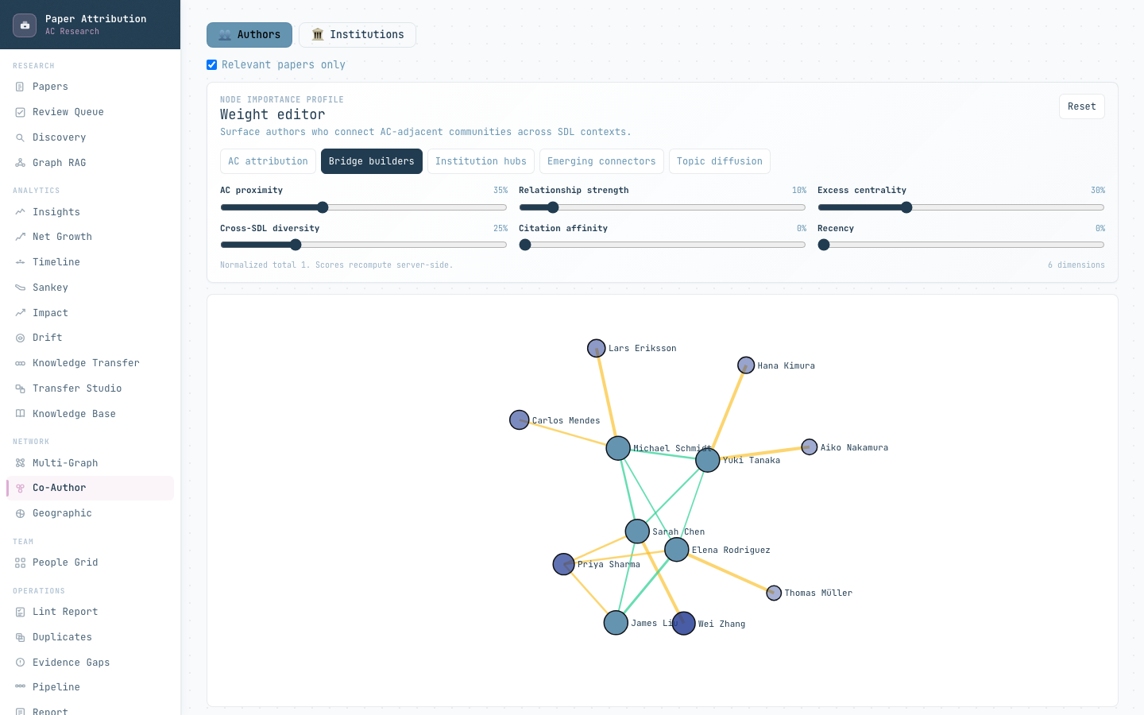
IMPLEMENTED VIEW
10
The coauthor view exposes bridge authors and the evidence behind each edge
WHAT AC CAN INSPECT
Question-specific ranking
Switch between AC attribution, bridge builders, institution hubs, emerging connectors, and topic diffusion.
Author-level explanation
Paper count, collaborators, PPR, cnorm, importance components, and a human-readable explanation.
Edge provenance
Joint-paper IDs, normalized relationship strength, and whether an edge involves AC.
Interface captured from the current frontend with mock data; values are illustrative.
PAPER ATTRIBUTION SYSTEM
ATTRIBUTION · CONNECTIONS · KNOWLEDGE
Notes:
Suggested time: 1:30
Delivery cue: Acknowledge immediately that the screenshot uses mock values. Point to the profile controls, then the graph.
VERBATIM SCRIPT
This is the current coauthor interface. The screen was captured with mock data, so the names and values are illustrative; what matters here is the implemented interaction and evidence structure.
At the top, the user can switch among the importance profiles we just discussed. The weight controls show exactly how much emphasis is assigned to AC proximity, relationship strength, excess centrality, cross-SDL diversity, citation affinity, and recency.
The network view then shows authors and their collaboration edges. Selecting an author exposes paper count, collaborators, Personalized PageRank, excess centrality, the importance components, and a plain-language explanation. Selecting an edge exposes the joint-paper identifiers, normalized relationship strength, and whether the relationship directly involves AC.
This is useful for AC because the graph is not only a visualization. It can support questions such as: Who connects an AC-adjacent community to another SDL area? Which relationship is supported by specific joint papers? Why did this person rank as a bridge builder?
TRANSITION: We can apply the same traceability to institutions, topics, and attribution labels.
[Sources]
- Local interface: frontend/src/pages/CoauthorNetworkPage.tsx
- Local API: backend/app/api/networks.py
- Screenshot: local frontend with VITE_USE_MOCK=true; values illustrative
[/Sources]

Slide 11
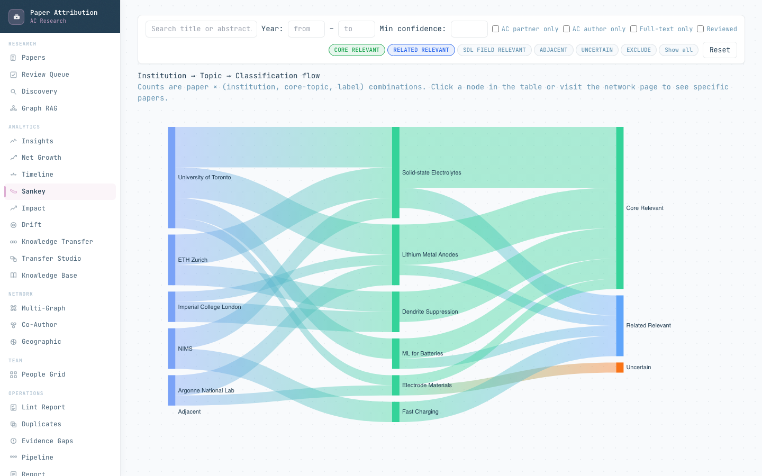
IMPLEMENTED VIEW
11
Institution connections can be traced from joint papers to topics and labels
THREE LINKED QUESTIONS
INSTITUTION
Which organizations appear on the attributed papers?
TOPIC
Which scientific themes connect those organizations?
LABEL
How does the evidence resolve into attribution classes?
INSTITUTION HUB SCORE
H = .4 degree + .4 betweenness
+ .1 partner reach + .1 international reach
Interface captured from the current frontend with mock data; values are illustrative.
PAPER ATTRIBUTION SYSTEM
ATTRIBUTION · CONNECTIONS · KNOWLEDGE
Notes:
Suggested time: 1:25
Delivery cue: Follow the Sankey from left to right. Then point to the three questions.
VERBATIM SCRIPT
This Sankey view connects three levels of the dataset. On the left are institutions found on attributed papers. In the middle are scientific topics. On the right are attribution classes. Again, the screenshot values are illustrative mock data, but the flow and filtering are implemented in the current frontend.
The view supports three linked questions. Which organizations appear on the attributed papers? Which scientific themes connect those organizations? And how does the evidence resolve into attribution classes?
Because the flows are derived from paper records, a user can move from an aggregate pattern back to the underlying papers. The institution hub score adds another lens. It combines degree, betweenness, partner reach, and international reach. Degree reflects how many collaborators an institution has. Betweenness identifies organizations that connect otherwise separate parts of the network.
This gives AC a defensible way to identify sustained partners, international connectors, and institutions that may be emerging around a topic rather than relying on a manually assembled contact list.
TRANSITION: The institution view is one projection of a larger multi-entity research graph.
[Sources]
- Local source: backend/app/services/analytics_service.py
- Local source: backend/app/api/analytics.py
- Local interface: frontend/src/pages/SankeyPage.tsx
- Screenshot: local frontend with VITE_USE_MOCK=true; values illustrative
[/Sources]

Slide 12
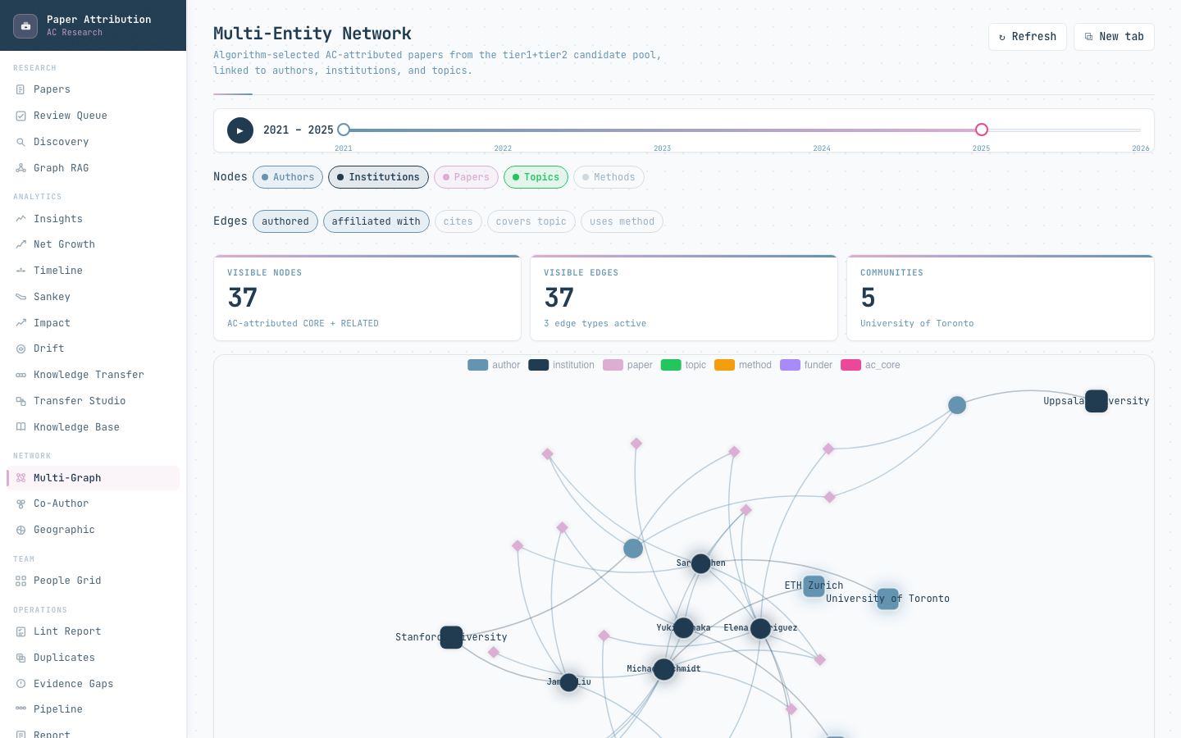
IMPLEMENTED VIEW
12
The multi-entity graph joins people, institutions, papers, topics, methods, funders, and AC core
NODE TYPES
EDGE PREDICATES
authors
institutions
papers
topics
methods
funders
AC core
authored
affiliated with
belongs to topic
uses method
cites / cites AC core
institution collaboration
Center any entity, set a hop limit, choose edge types, and move the time window without changing the underlying provenance.
Interface captured from the current frontend with mock data; values are illustrative.
PAPER ATTRIBUTION SYSTEM
ATTRIBUTION · CONNECTIONS · KNOWLEDGE
Notes:
Suggested time: 1:20
Delivery cue: Name node types, then edge types, then the interactive ego-graph workflow.
VERBATIM SCRIPT
The multi-entity graph brings the major bibliometric objects into one inspectable structure. The node types include authors, institutions, papers, topics, methods, funders, and AC-core entities. The edge predicates record relationships such as authored, affiliated with, belongs to topic, uses method, cites, cites AC core, and institution collaboration.
The screenshot uses mock values, but it shows the implemented controls. A user can select which node and edge types are visible, choose a center entity, set a hop limit, and move the time window. This creates an ego graph around a person, institution, paper, or topic without changing the underlying provenance.
That distinction matters. The interface can simplify the view for a particular question, but it does not simplify the stored evidence by deleting relationships. A researcher can move from a topic to the papers that support it, from a paper to its authors and institutions, and from those institutions to their collaboration partners.
TRANSITION: When these relationships are aggregated over time, they support monitoring as well as exploration.
[Sources]
- Local source: backend/app/services/multi_graph/service.py
- Local source: backend/app/services/multi_graph/providers.py
- Local interface: frontend/src/pages/MultiGraphPage.tsx
- Screenshot: local frontend with VITE_USE_MOCK=true; values illustrative
[/Sources]

Slide 13
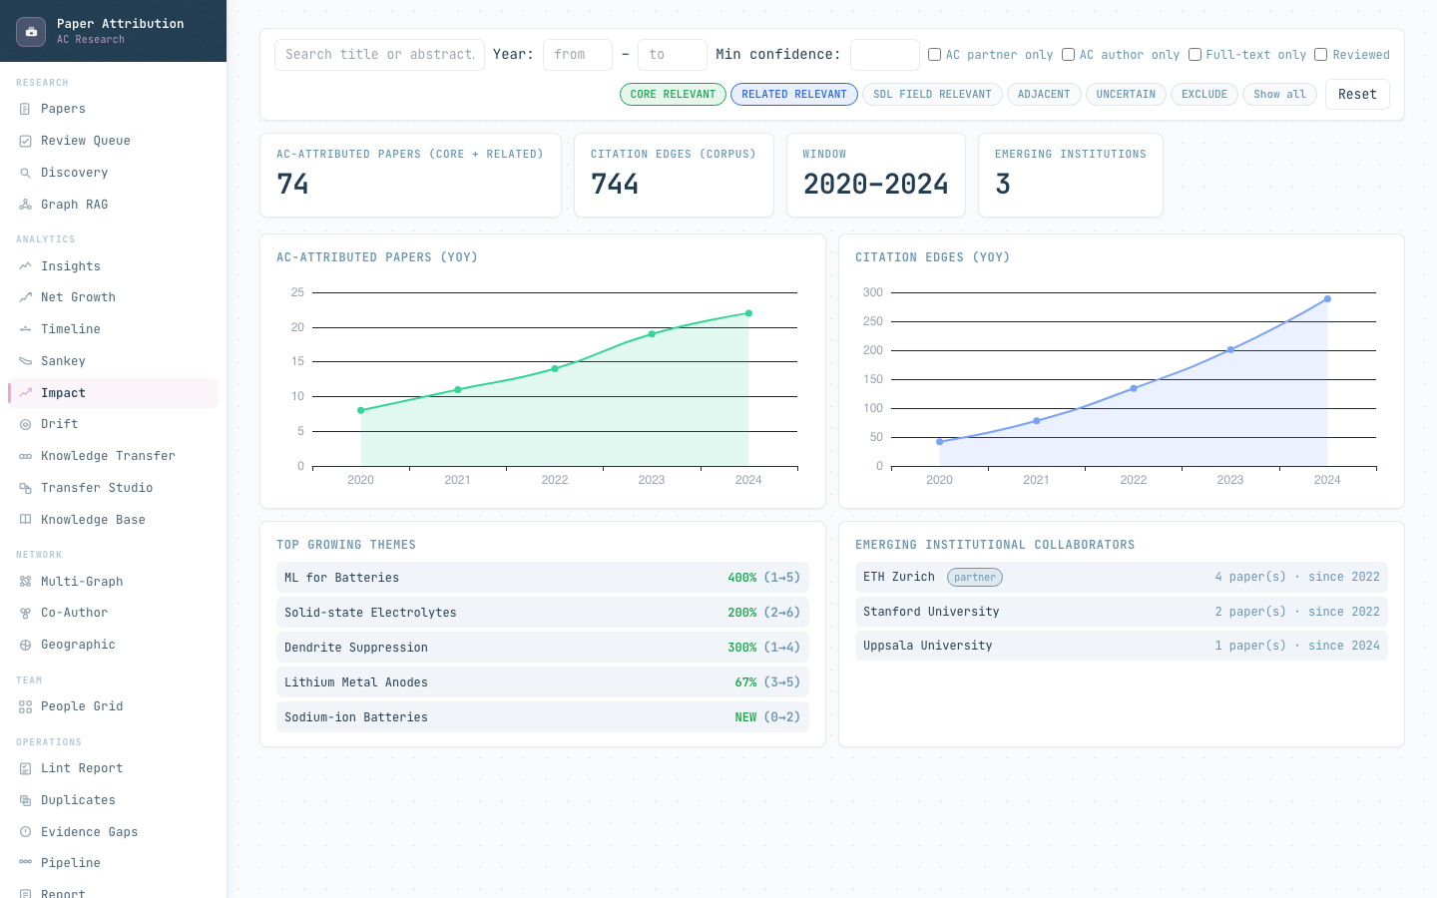
IMPLEMENTED VIEW
13
AC can monitor growth, emerging collaborators, themes, and citation activity
METRICS ARE SQL-DERIVED
Attributed papers
CORE + RELATED by year
Citation activity
corpus citation edges by year
Emerging institutions
first year + paper count + partner status
Emerging authors
first year + attributed-paper activity
Growing themes
recent versus earlier topic counts
Drift events
year-to-year topic-vector similarity
LLMs do not calculate these numbers.
Interface captured from the current frontend with mock data; values are illustrative.
PAPER ATTRIBUTION SYSTEM
ATTRIBUTION · CONNECTIONS · KNOWLEDGE
Notes:
Suggested time: 1:20
Delivery cue: State the SQL provenance before mentioning any metric. Do not present mock numbers as results.
VERBATIM SCRIPT
This impact view shows the types of monitoring the system can support. The screenshot contains illustrative mock values, not a claim about the current AC corpus.
In production, the numbers are derived from SQL queries over the attributed dataset. The system can count core and related papers by year, citation edges by year, emerging institutions, emerging authors, growing topics, and drift events. Emerging institutions and authors include a first year and activity count, so the user can distinguish genuinely new relationships from long-standing ones. Topic drift compares year-to-year topic vectors to identify changes in the scientific mix.
The important governance point is shown at the lower right: an LLM does not calculate these numbers. Reporting begins with metric triples produced by database queries, including the metric key, value, and source. A language model may help rewrite a narrative around supplied metrics, but it should not invent, estimate, or silently recalculate the evidence.
TRANSITION: These capabilities become most useful when they are tied to concrete operating questions.
[Sources]
- Local source: backend/app/services/analytics_service.py
- Local source: backend/app/services/drift_service.py
- Local source: backend/app/services/reporting_service.py
- Local interface: frontend/src/pages/ImpactPage.tsx
- Screenshot: local frontend with VITE_USE_MOCK=true; values illustrative
[/Sources]

Slide 14
USE CASES
14
Connection intelligence supports concrete operating questions
OPERATING QUESTION
SYSTEM EVIDENCE
POSSIBLE AC ACTION
Which papers are attributable to AC, and why?
paper record · AET · graph explanation
review, publish, or correct the attribution
Who bridges AC to an external SDL community?
PPR · excess centrality · SDL diversity · joint papers
prioritize outreach or collaboration review
Which institutions are emerging collaborators?
first-year activity · institution edges · hub score · geography
support partnership development
Which topics or methods move across communities?
Sankey · multi-graph · topic diffusion profile
identify translation opportunities
Where are the evidence and ingestion blind spots?
evidence gaps · duplicate candidates · missed-paper groups · drift
improve dataset coverage and review policy
Which claims can go into a stakeholder report?
SQL metric triples with source links
produce auditable reporting without invented numbers
The system turns bibliometric records into a decision surface for curation, partnership tracking, and scientific translation.
PAPER ATTRIBUTION SYSTEM
ATTRIBUTION · CONNECTIONS · KNOWLEDGE
Notes:
Suggested time: 1:25
Delivery cue: Choose four rows to discuss; do not read the table verbatim.
VERBATIM SCRIPT
This table translates the technical components into operating questions for AC.
For paper curation, the question is: which papers are attributable to AC, and why? The evidence is the paper record, the Attribution Evidence Tree, and the graph explanation. The action may be to review, publish, or correct the attribution.
For partnership intelligence, we can ask who bridges AC to an external SDL community, or which institutions are becoming collaborators. The evidence comes from proximity, excess centrality, cross-SDL diversity, joint papers, institution edges, and first-year activity.
For scientific translation, we can ask which topics or methods move across communities. Sankey flows, the multi-entity graph, and topic-diffusion profiles provide the evidence.
Finally, the system can expose evidence gaps, duplicate candidates, missed-paper groups, and drift. That supports better corpus coverage and review policy. The goal is not another dashboard. It is a decision surface for curation, partnership tracking, and scientific translation, with the evidence attached.
TRANSITION: Researchers also need a reliable way to ask questions of that evidence without losing the source context.
[Sources]
- Local sources: backend/app/api/papers.py; backend/app/api/networks.py; backend/app/api/analytics.py
- Local source: backend/app/services/reporting_service.py
- Local source: backend/app/services/missed_papers_service.py
[/Sources]

Slide 15
EVIDENCE ACCESS
15
Retrieval answers questions with graph context, propositions, and source chunks
QUERY
TEXT
FUSION
GRAPH
STRUCTURE
OUTPUT
natural-language question
BM25 + cosine
RRF, k = 60
centrality rerank
proposition channel
answer + sources + retry signal
RRF(d) = 1 / [60 + rankBM25(d)] + 1 / [60 + rankcosine(d)]
EVERY RETURNED SOURCE INCLUDES
paper ID and chunk ID
section type and title
BM25, cosine, fused, and graph scores
graph-path context when available
source precision and missing-evidence signals
score′(d) = RRF(d) × [1 + 0.3 × graph importance(d)]
Structured questions about methods or funding can use proposition-first retrieval instead of relying only on free text.
PAPER ATTRIBUTION SYSTEM
ATTRIBUTION · CONNECTIONS · KNOWLEDGE
Notes:
Suggested time: 1:30
Delivery cue: Walk through the pipeline once in plain language, then summarize the two formulas.
VERBATIM SCRIPT
The retrieval layer starts with a natural-language question. It searches the text using BM25, which is a lexical method, and cosine similarity, which captures semantic similarity. Reciprocal rank fusion combines the two rankings without requiring their raw scores to be directly comparable.
The first formula shows that fusion: a document receives credit based on its position in each ranking. The graph layer then applies a bounded importance boost. The second formula limits that boost to thirty percent of the fused score, so network centrality cannot replace textual relevance.
For structured questions, the system can use a proposition channel. For example, a question about a method, funding relationship, or experimental assumption can retrieve extracted propositions rather than relying only on free text.
Every returned source includes a paper and chunk identifier, section type, title, retrieval scores, and graph-path context when available. The answer should therefore include both sources and a retry or missing-evidence signal. Retrieval is valuable here because it preserves the route back from an answer to the evidence used to produce it.
TRANSITION: This evidence access also defines a safe and useful role for Claude.
[Sources]
- Local source: backend/app/services/retrieval_service.py
- Local source: backend/app/api/retrieval.py
- Local interface: frontend/src/pages/RetrievalPage.tsx
[/Sources]

Slide 16
GOVERNANCE
16
Human review and reporting preserve authority
AUTOMATED PROPOSAL
HUMAN DECISION
LOCKED ATTRIBUTION
REPORT / EXPORT
label · confidence · AET paths
uncertainty queue
include / exclude / uncertain
reviewer + rationale
later automated passes cannot
silently override
CSV + SQL metrics +
source-linked narrative
SAFE ROLE FOR CLAUDE
AUTHORITY BOUNDARY
• adjudicate only an uncertainty queue
• summarize retrieved evidence
• draft reviewer rationale
• rewrite reports from supplied metric triples
Claude may not create papers, graph edges, citations, measurements, results, or numerical claims. Human-confirmed decisions remain locked.
PAPER ATTRIBUTION SYSTEM
ATTRIBUTION · CONNECTIONS · KNOWLEDGE
Notes:
Suggested time: 1:35
Delivery cue: Use a firm tone on the authority boundary. Pause before describing the Claude role.
VERBATIM SCRIPT
The workflow separates an automated proposal from a human decision. The system proposes a label, confidence, evidence paths, and an uncertainty status. A reviewer can include, exclude, or mark the paper uncertain, and record a rationale. Once confirmed, the attribution is locked against silent automated overrides.
This is where Claude can add value if credits are available. A safe use is to adjudicate only the uncertainty queue, summarize retrieved evidence, draft reviewer rationales, or rewrite a report from supplied SQL metric triples. Those tasks reduce reading and writing effort while remaining bounded by evidence that already exists.
The authority boundary is equally important. Claude may not create papers, graph edges, citations, measurements, results, or numerical claims. It should not replace deterministic database operations or the reviewer’s final decision.
So I would describe agent funding as review acceleration and evidence synthesis, not as funding an autonomous bibliometric classifier. The database, evidence paths, and human-confirmed decisions remain the system of record.
TRANSITION: With that governance in place, attributed papers can safely support downstream knowledge work.
[Sources]
- Local source: backend/app/services/llm_judge.py
- Local source: backend/app/api/reviews.py
- Local source: backend/app/services/reporting_service.py
- Local source: backend/docs/technical_overview.md
[/Sources]

Slide 17
KNOWLEDGE PREPARATION
17
Attributed papers become source-grounded cross-SDL transfer candidates
ATTRIBUTED PAPER
STRUCTURED CLAIMS
TKU
TARGET MATCH
TRANSFER DESIGN
KNOWLEDGE CARD
reviewed evidence paths
entities + propositions
method core + assumptions + lessons
different SDL domain
plan + risks + citations
human-reviewed reusable asset
Transfer score = match strength + novelty + transferability + evidence − risk penalty
SOURCE CONTRACT
Every generated claim carries a source tag such as [src:paper_id]. Same-domain matches are excluded. Human review precedes acceptance.
Classification makes the corpus searchable; attribution makes the extracted knowledge defensible.
PAPER ATTRIBUTION SYSTEM
ATTRIBUTION · CONNECTIONS · KNOWLEDGE
Notes:
Suggested time: 1:35
Delivery cue: Move across the pipeline and stress the source contract at the right.
VERBATIM SCRIPT
The cross-SDL pipeline begins with reviewed attributed papers, not detached summaries. From each paper, the system extracts structured claims, including entities and propositions. It then creates a transfer knowledge unit, or TKU, containing the method core, assumptions, and lessons.
The target-matching stage looks for a different SDL domain where that knowledge may be relevant. Same-domain matches are excluded. A transfer design then describes a possible plan, risks, and citations. The final knowledge card is a human-reviewed reusable asset.
Candidate designs are ranked using match strength, novelty, transferability, evidence, and a risk penalty. This ranking helps prioritize review; it is not a claim that a transfer will succeed experimentally.
The source contract on the right is essential. Every generated claim carries a source tag such as a paper identifier. Human review precedes acceptance. Classification makes the corpus searchable, but attribution makes the extracted knowledge defensible because the methods and lessons inherit evidence paths from the paper record.
TRANSITION: Before closing, I want to be precise about what is current, optional, offline, and still future work.
[Sources]
- Local source: backend/app/services/tku_extractor.py
- Local source: backend/app/services/transfer_designer.py
- Local source: backend/app/services/evolutionary_transfer_service.py
- Local source: backend/app/services/kb_service.py
[/Sources]

Slide 18
SYSTEM BOUNDARY
18
Current capability, optional layers, and experimental work remain distinct
STATUS
CAPABILITIES
AUTHORITY / LIMIT
CURRENT
paper attribution record · AET evidence paths · deterministic graph explanations · coauthor / institution / multi-entity networks · Sankey / impact / drift · source-linked retrieval · TKU and transfer services
implemented paths in the current repository; outputs remain evidence-linked
OPTIONAL
Claude uncertainty judge · Claude report rewriter · learned classifier using 14 engineered features
default-off or conditional; bounded by retrieved evidence and high-margin rules
OFFLINE BASELINE
ten leakage-safe structural graph features + balanced logistic regression + leave-one-out evaluation
evaluation artifact only; no production authority
FUTURE EXPERIMENT
PyTorch Geometric / DGL model training, saved weights, inference service, production classifier integration
not implemented as a production GNN path
Do not describe graph export or the offline structural baseline as a deployed GNN classifier.
PAPER ATTRIBUTION SYSTEM
ATTRIBUTION · CONNECTIONS · KNOWLEDGE
Notes:
Suggested time: 1:15
Delivery cue: Use this slide to prevent overclaiming. Slow down on the offline baseline and future experiment rows.
VERBATIM SCRIPT
The current repository already implements substantial functionality: paper attribution records, AET evidence paths, deterministic graph explanations, coauthor, institution, and multi-entity networks, impact and drift analytics, source-linked retrieval, and transfer services.
Claude-based uncertainty judging and report rewriting are optional layers. They should be default-off or conditionally invoked, and bounded by retrieved evidence and high-margin rules. The learned classifier is also an optional layer using engineered features.
Separately, the repository contains an offline structural graph-feature baseline. It uses leakage-safe graph features, balanced logistic regression, and leave-one-out evaluation. That is an evaluation artifact, not production authority.
A deployed graph neural network would require PyTorch Geometric or DGL training, saved weights, an inference service, and production integration. That future path is not currently implemented. We should therefore avoid describing graph export or the offline baseline as a deployed GNN classifier.
TRANSITION: With those boundaries clear, the meeting can end with four concrete program decisions.
[Sources]
- Local source: backend/docs/development_progress.md
- Local source: backend/docs/gnn_graph_ml_development_plan.md
- Local source: backend/app/services/graph_feature_baseline.py
- Local source: backend/app/services/learned_classifier.py
[/Sources]

Slide 19
MEETING OUTCOME
Decisions for a shared
bibliometric program
The first release should define not only which papers enter the dataset,
but which relationships and evidence paths the consortium agrees to trust.
01
CORPUS
02
ATTRIBUTION POLICY
Which bibliometric sources, date range, and gold papers define the trusted starting set?
Which evidence paths are sufficient for CORE, RELATED, and organization-level reporting?
03
CONNECTION METRICS
04
REVIEW & MODEL BUDGET
Which profiles should AC use for attribution, bridge discovery, institutions, and topic diffusion?
Which uncertainty bands require humans, and where should Claude credits reduce review work?
PAPER ATTRIBUTION · CONNECTION INTELLIGENCE · CROSS-SDL KNOWLEDGE
DISCUSSION
Notes:
Suggested time: 1:15
Delivery cue: Close by inviting decisions, not by summarizing every feature.
VERBATIM SCRIPT
I would like to close with four decisions that define a shared bibliometric program.
First is the corpus. Which bibliometric sources, date range, and gold papers define the trusted starting set?
Second is attribution policy. Which evidence paths are sufficient for core, related, and organization-level reporting? This is a consortium decision, not only a software decision.
Third is connection metrics. Which profiles should AC use for attribution, bridge discovery, institution analysis, and topic diffusion? The weights can be transparent, but they still need an agreed interpretation.
Fourth is the review and model budget. Which uncertainty bands require human review, and where should Claude credits reduce review work without gaining authority over the evidence?
If we agree on those four areas, the first release will define more than which papers enter the dataset. It will also define which relationships and evidence paths the consortium is prepared to trust. That shared policy is what makes the dataset reusable for connection intelligence and future cross-SDL knowledge generation.
TRANSITION: I will stop here and open the discussion.
[Sources]
- Local source: backend/docs/technical_overview.md
- Local sources: backend/app/services/attribution_evidence_tree.py; backend/app/services/node_importance_service.py
[/Sources]

