Slide 1



Online Value Added Course on Machine Learning, Deep Learning and Neural Networks
Day 3
Conducted by
Mr. Anupam Borthakur
Prime Minister’s Research Fellows (PMRF)
Centre of Excellence in Artificial Intelligence
Indian Institute Of Technology, Kharagpur
Department of Electrical and Electronics Engg.
Sagi Rama Krishnam Raju Engineering College (A), Bhimavaram

Slide 2

Indian Institute Of Technology Kharagpur | Centre of Excellence in Artificial Intelligence
Agenda
Practical Use cases of Machine Learning
Types of Machine Learning
Difference between Supervised and Unsupervised Learning
Difference between Classification and Regression
One simple algorithm for Unsupervised Learning

Slide 3
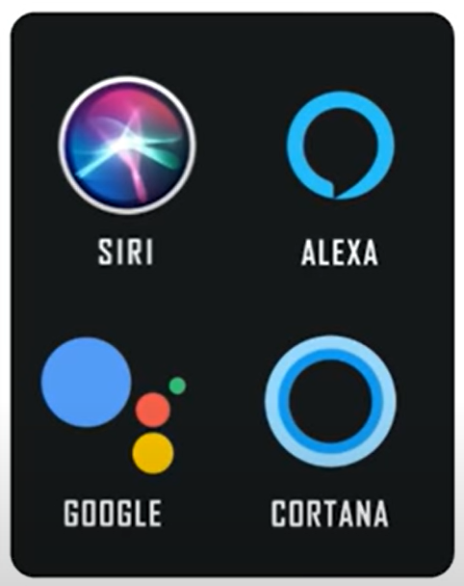
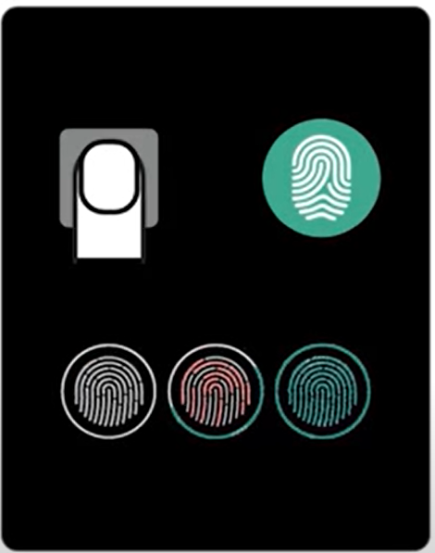

Indian Institute Of Technology Kharagpur | Centre of Excellence in Artificial Intelligence
Applications of Machine Learning in our day to day life
Google Maps
Voice Recognition
Finger Print Recognition

Slide 4

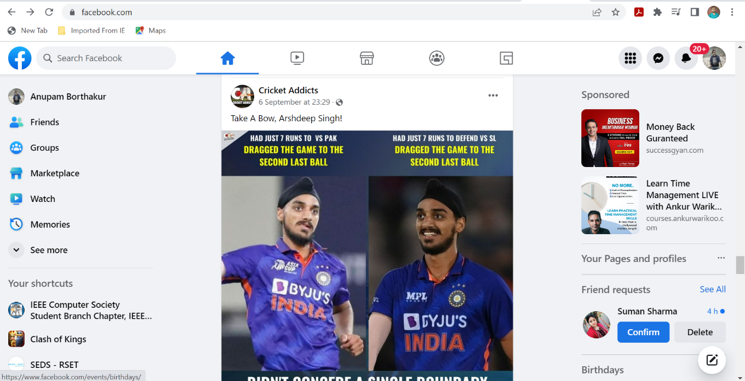
Indian Institute Of Technology Kharagpur | Centre of Excellence in Artificial Intelligence
Importance of Data
Facebook
YouTube

Slide 5
Indian Institute Of Technology Kharagpur | Centre of Excellence in Artificial Intelligence
Why its important to study ML now
Abundant amount of data
High Computational Resources
Growing progress in the available platforms and algorithms
Increase support from industry
Facebook: 10 Million Photos uploaded per hour
YouTube: 1 hour of video uploaded every minute
Google: 24 Peta bytes of data per day
Twitter 400 Million tweets per day

Slide 6

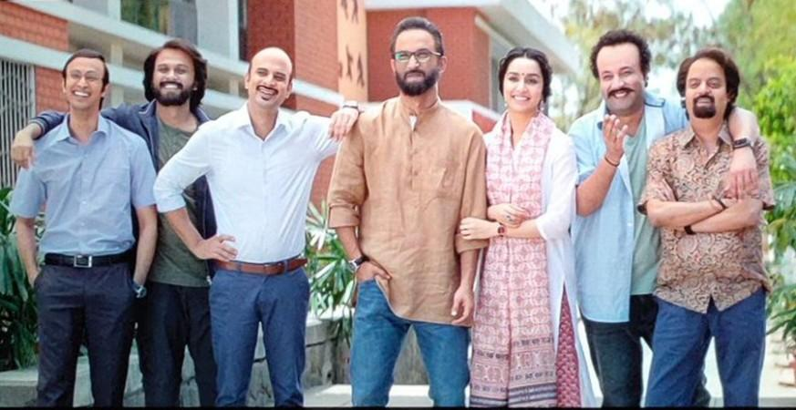
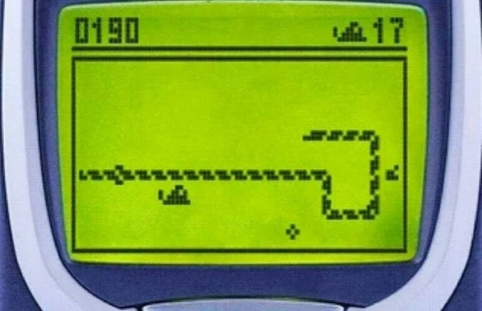

Indian Institute Of Technology Kharagpur | Centre of Excellence in Artificial Intelligence
Types of Machine Learning
Supervised Learning
Un-supervised Learning
Reinforcement Learning
https://in.pinterest.com/pin/257690409914685423/
https://stock.adobe.com/in/images/teacher-pulling-her-student-ear/164847519

Slide 7

Indian Institute Of Technology Kharagpur | Centre of Excellence in Artificial Intelligence
Supervised vs Unsupervised Learning
Supervised
Unsupervised
Age
Age
Class
14
14
T
24
Find patterns
24
A
Teenager (T)
Adult (A)
17
17
T
30
30
A
New: 15

Slide 8


Indian Institute Of Technology Kharagpur | Centre of Excellence in Artificial Intelligence
Supervised
Unsupervised
Age
Class
Age
14
T
14
24
A
Teenager (T)
Adult (A)
24
Find patterns
17
T
17
Groups
Clusters
30
A
30
Decision Surface
New: 15

Slide 9
Indian Institute Of Technology Kharagpur | Centre of Excellence in Artificial Intelligence
Simple Structure of a Database
No Class is present
Supervised
Unsupervised
Class
Samples
Samples
Attributes/Dimension
Attributes/Dimension
Database
Database

Slide 10
Indian Institute Of Technology Kharagpur | Centre of Excellence in Artificial Intelligence
Supervised
Types of Supervised Learning
Age
Class
14
T
Supervised Learning
24
A
17
T
30
A
Classification
Regression
Decision Surface

Slide 11
Indian Institute Of Technology Kharagpur | Centre of Excellence in Artificial Intelligence
Types of Supervised Learning
Age
Class
Floor
Bedroom
Years
Price
Supervised Learning
2
3
15
40 lakh
14
T
1
2
7
24 lakh
24
A
3
3
12
60 lakh
17
T
30 lakh
2
2
8
30
A
1
1
10
15 lakh
Price of a house?
Classification
Regression
Output having labels(discrete value)
output having continuous value.
T
A
Classification
Regression

Slide 12
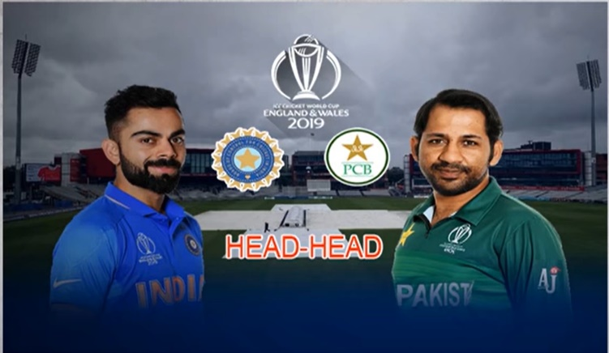

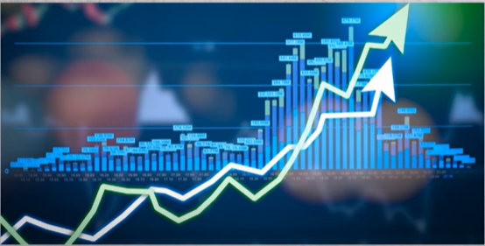
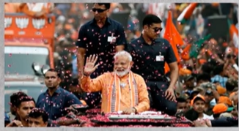
Indian Institute Of Technology Kharagpur | Centre of Excellence in Artificial Intelligence
Classification vs Regression
Regression
Classification
Who will win?
Predict weather for next 1 week?
Regression
Classification
Predict the stock price?
Will Modi win in 2024 election?

Slide 13
Indian Institute Of Technology Kharagpur | Centre of Excellence in Artificial Intelligence
Simple Training Pipeline of Machine Learning
Unknown Dataset
Dataset
Algorithm
Model
Prediction

Slide 14
Indian Institute Of Technology Kharagpur | Centre of Excellence in Artificial Intelligence
Unsupervised Learning
Simple Training Pipeline of Machine Learning
Input/Database
Unknown Dataset
Age
14
24
Find patterns
17
Dataset
Algorithm
Model
30
Prediction
Output/Model

Slide 15
Indian Institute Of Technology Kharagpur | Centre of Excellence in Artificial Intelligence
Age
Unsupervised Learning
14
Data
Data
24
Age
17
14
30
24
Find patterns
17
30
Step 1: Choose a centroid (random)
Step 2: Find the distance for each of the points to that centroid
Step 3: Assign each point to the closet centroid
Model

Slide 16




Indian Institute Of Technology Kharagpur | Centre of Excellence in Artificial Intelligence
Centroid
14
30
Data
Age
14
Centroid
17
24
$$\left|24−14\right|=10$$
24
24
14
30
17
$$\left|24−30\right|=6$$
30
Centroid
$$\left|17−14\right|=3$$
17
$$\left|17−30\right|=13$$
Model
Algorithm
Step 1: Choose a centroid (random)
Step 2: Find the distance for each of the points to that centroid
Step 3: Assign each point to the closet centroid

Slide 17

Indian Institute Of Technology Kharagpur | Centre of Excellence in Artificial Intelligence
Identify which one is Supervised and which one is Unsupervised

Slide 18


Thank You
For your Attention!
Any Questions?

