Slide 1



Online Value Added Course on Machine Learning, Deep Learning and Neural Networks
Conducted by
Mr. Sista Raviteja & Mr. Anupam Borthakur
Prime Minister’s Research Fellows (PMRF)
Centre of Excellence in Artificial Intelligence
Indian Institute Of Technology, Kharagpur
Department of Electrical and Electronics Engg.
Sagi Rama Krishnam Raju Engineering College (A), Bhimavaram

Slide 2

Indian Institute Of Technology Kharagpur | Centre of Excellence in Artificial Intelligence
Contents
Instructor Overview
Course Overview
Course Contents
Platforms

Slide 3
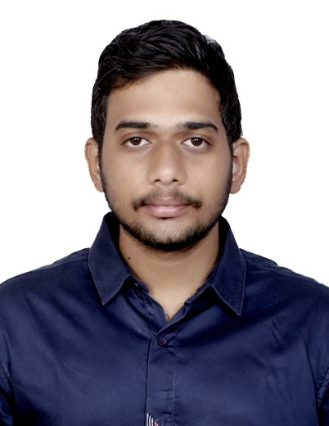
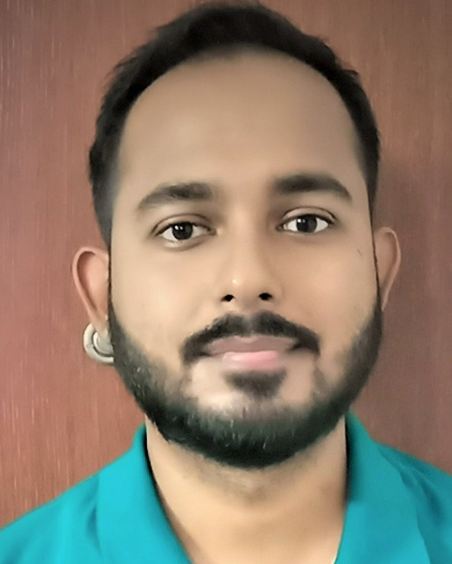
Indian Institute Of Technology Kharagpur | Centre of Excellence in Artificial Intelligence
Instructor’s Overview
Sista Raviteja
Ph.D. Candidate, IIT Kharagpur
Area of Research: Surgical Video Analytics, Knowledge Graphs, Deep Learning
Know more at: https://sites.google.com/view/sistaraviteja
Anupam Borthakur
Ph.D. Candidate, IIT Kharagpur
Area of Research: Privacy, Deep Learning, Machine Learning
Know more at: https://sites.google.com/view/anupamborthakur

Slide 4
Indian Institute Of Technology Kharagpur | Centre of Excellence in Artificial Intelligence
Course Overview
Weeks | Broad Topic | Delivery | Mode
Week 1 | Introduction to Machine Learning | Theory + Hands on | Online
Week 2 | Introduction to Deep learning | Theory + Hands on
Week 3 | Introduction to Convolution Neural Networks | Theory + Hands on
Week 4 | Complexity Analysis of Deep Neural Networks | Theory + Hands on
Week 5 | Selecting a Deep Neural Network | Theory + Hands on

Slide 5
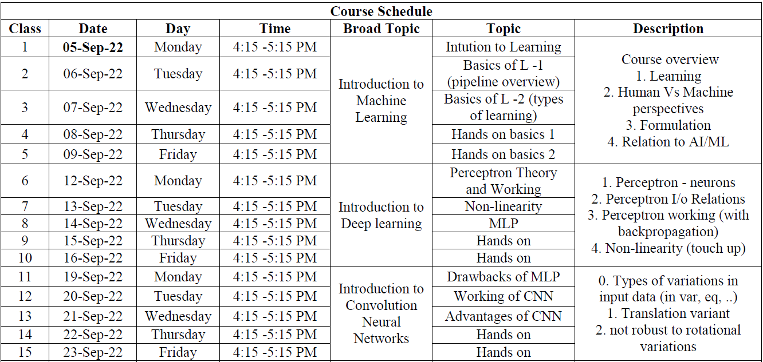
Indian Institute Of Technology Kharagpur | Centre of Excellence in Artificial Intelligence
Course Contents

Slide 6
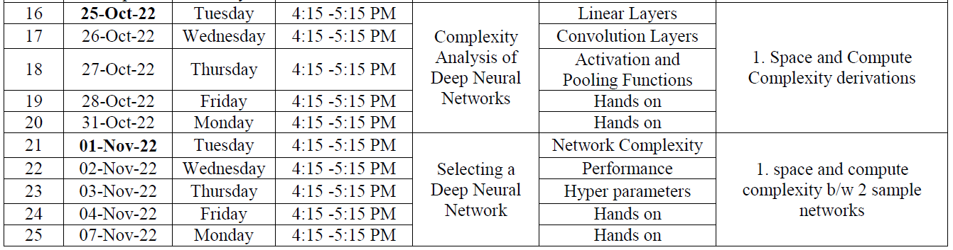
Indian Institute Of Technology Kharagpur | Centre of Excellence in Artificial Intelligence
Course Contents

Slide 7
Indian Institute Of Technology Kharagpur | Centre of Excellence in Artificial Intelligence
Platforms
Class Streaming:
Google Meet (Primary)
Slides and Tutorials :
GitHub
Software and platforms
PyTorch
Anaconda
Colaboratory

Slide 8


Thank You
For your Attention!
Any Questions?

