Slide 1
What Serverless Computing Is and Should Become: The Next Phase of Cloud Computing
Autor: Acquila Santos Rocha
Disciplina: Sistemas Distribuídos (Mestrado)
Professor: Sérgio Teixeira de Carvalho

Slide 2
Introduction - Cloud Computing Phases
First Phase: mainly simplified system administration by making it easier to configure and manage computing infrastructure.
Target: System Administrators
Called: Serverful Computing
Second Phase: hides the servers by providing programming abstractions for application builders that simplify cloud development, making cloud software easier to write.
Target: Programmers
Called: Serverless Computing

Slide 3
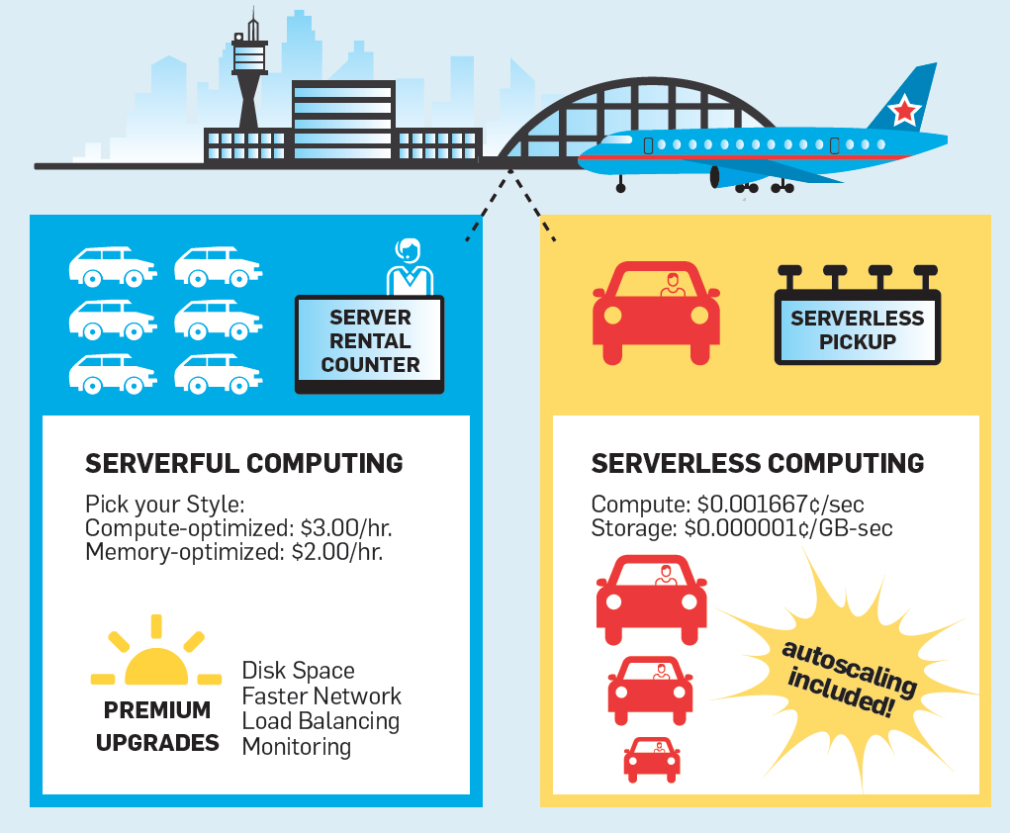

Slide 4
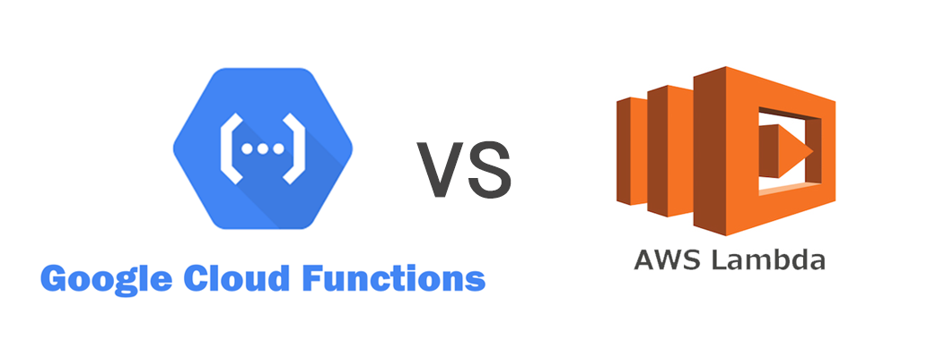
Serverless Computing - Cloud Functions
Function-as-a-Service (FaaS): Managed cloud function services
How it is done: programmers create applications using high-level (HL) abstractions offered by the cloud provider.
Example: cloud functions*
* using functional-style "stateless" programming in the language of their choice, then specify how the functions should run, whether in response to Web requests or to triggering events.

Slide 5
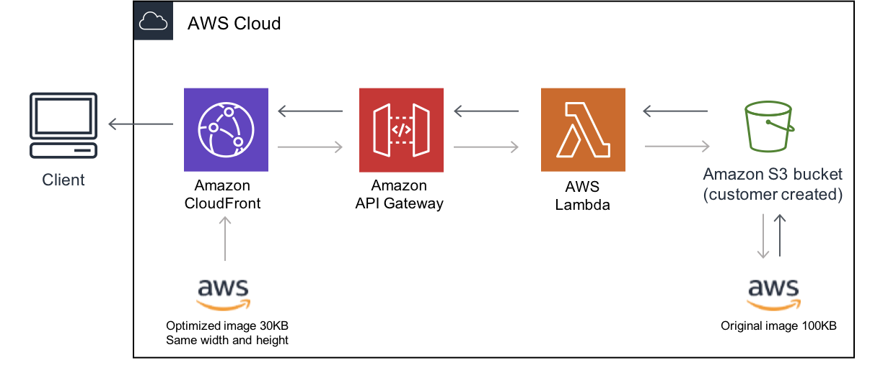
Serverless Computing - Backend as a Service
Cloud functions may also consume serverless object storage, message queues, key-value store databases, a group of services offerings known collectively as Backend-as-a-Service (BaaS).

Slide 6
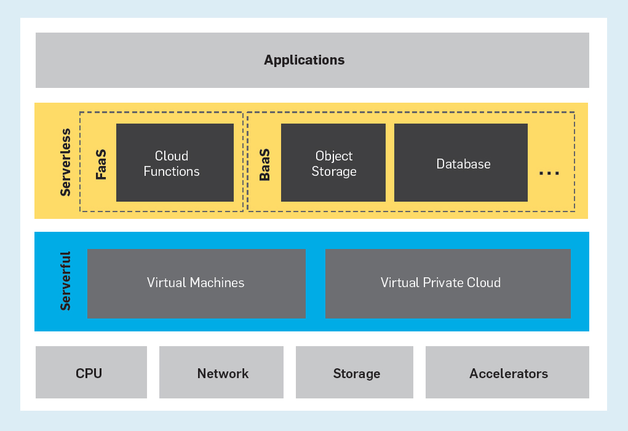

Slide 7
Serverless Computing - Innovation
The main innovation of serverless is hiding servers, which have an inherently complex programming and operating model.
Adjust capacity heuristically, a form of autoscaling, but these too require detailed configuration and ongoing monitoring.
Establish autoscaling parameters.

Slide 8
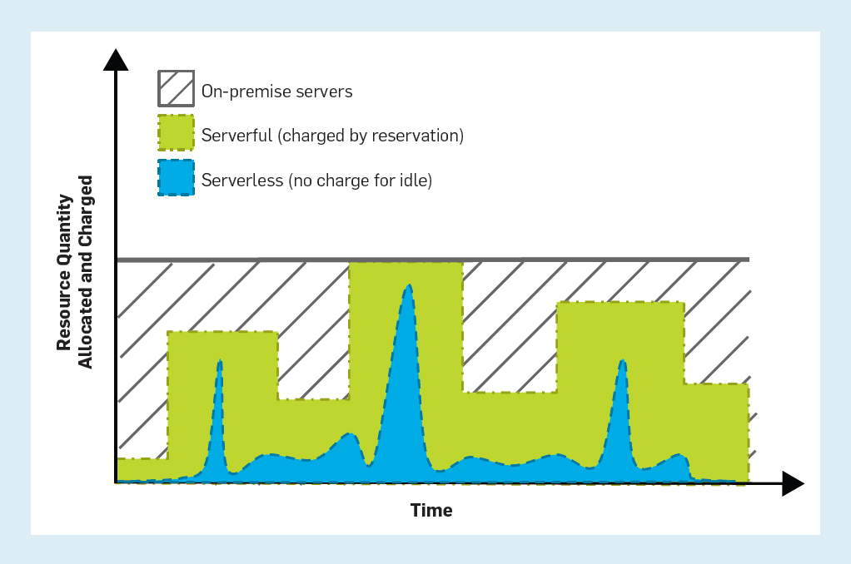

Slide 9
Summarizing - Qualities of Serverless Computing
1. Providing an abstraction that hides the servers and the complexity of programming and operating them.
2. Offering a pay-as-you-go cost model instead of a reservation-based model, so there is no charge for idle resources
3. Automatic, rapid, and unlimited scaling resources up and down to match demand closely, from zero to practically infinite.

Slide 10
“We project that the majority of data center computing will be dominated by serverless computing but we also believe that serverless computing will depart substantially from the serverless offerings of today”

Slide 11
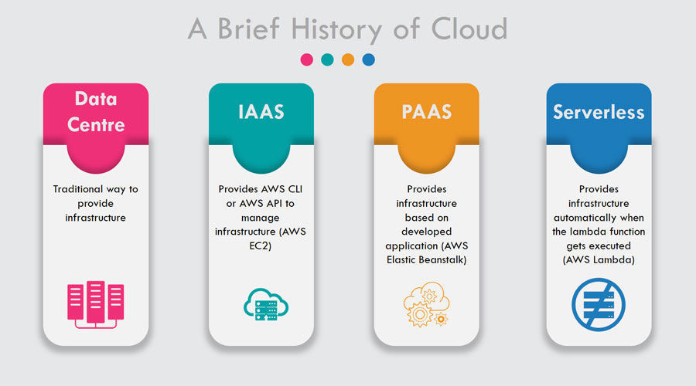

Slide 12
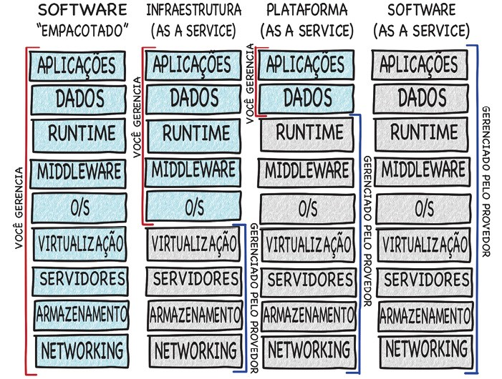

Slide 13
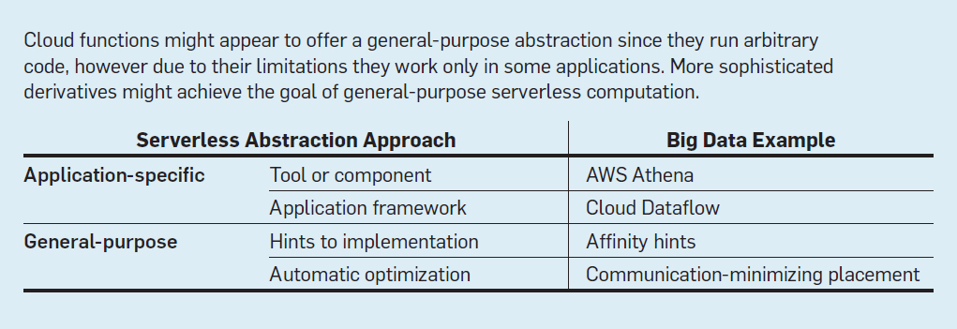
The Next Phase of Cloud Computing
Application-specific abstractions solve a particular use case, and several of them exist in products today.
General-purpose abstractions must work well in a broad variety of uses and remain a research challenge.

Slide 14
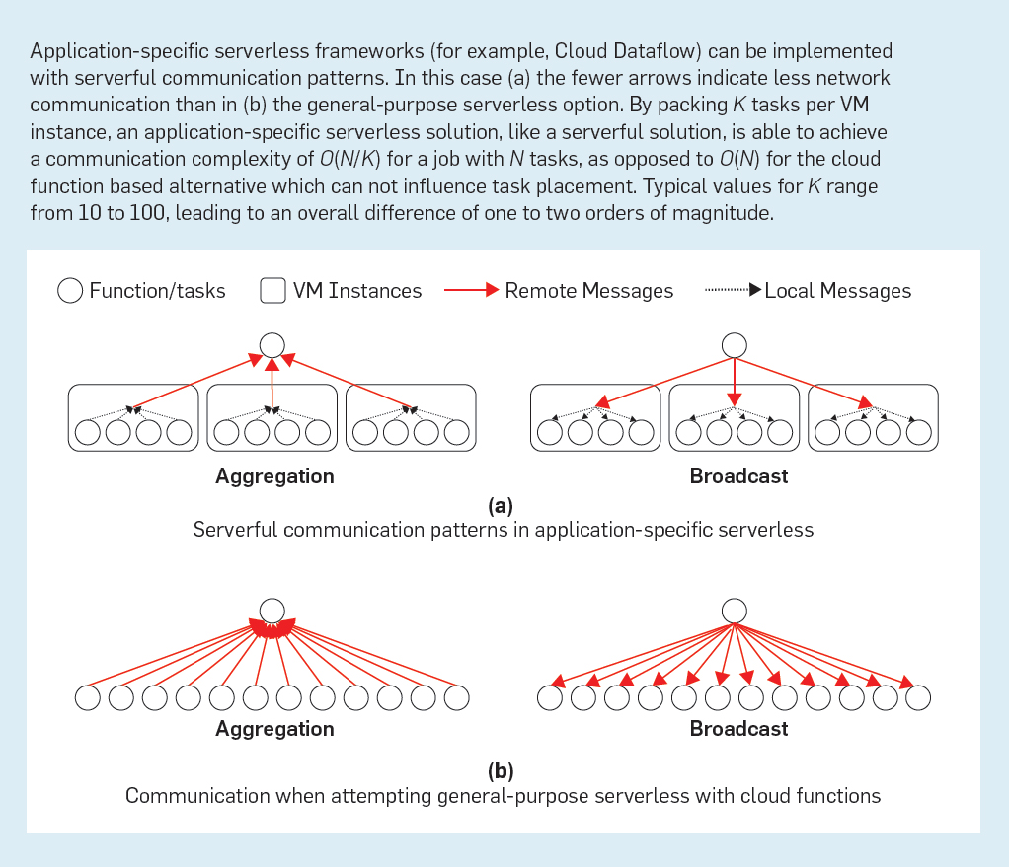

Slide 15
The Next Phase of Cloud Computing
Two suggested paths
Hints provided by the programmer might indicate how to achieve better performance.
Inefficiencies being removed by automatic optimization. Infer locality optimizations from observed communication patterns.

Slide 16
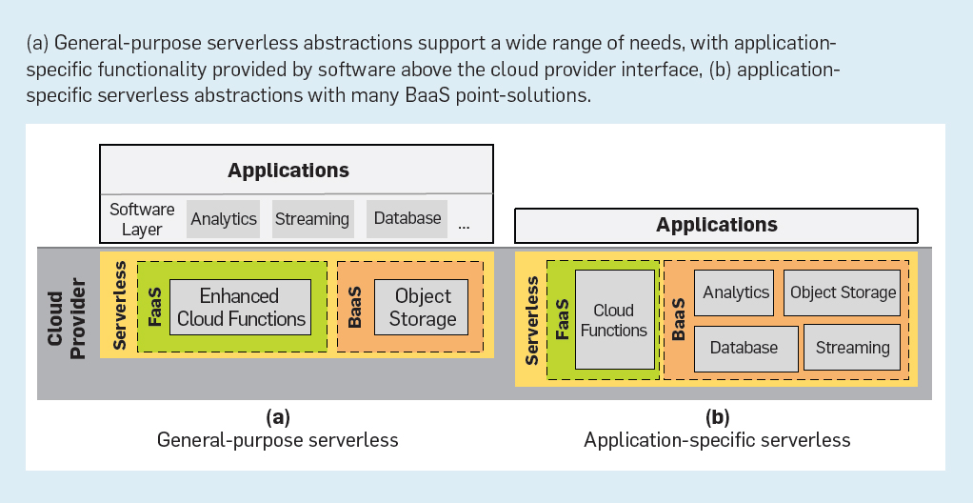

Slide 17
The Next Phase of Cloud Computing
Today: serverless computing remains entirely of the application-specific variety. Even cloud functions, which can execute arbitrary code, are popular mainly for stateless API serving and event-driven data processing.
Expectation: potential emergence of general-purpose serverless abstractions, which could host software ecosystems catering to every need.
“In our view, only the general-purpose approach can ultimately displace servers to become the default form of cloud programming. However, general-purpose serverless technology does not exist today, and developing it presents research challenges.”

Slide 18
Research Challenges
State management
Networking
Predictable performance
Security
Programming Languages
Machine learning
Hardware

