Slide 1
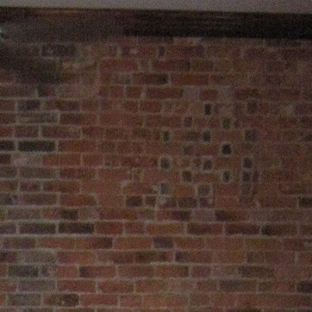
brick = 0.972
stone = 0.007
tile = 0.003
carpet = 0.002
other = 0.002
Notes:
data/zhangpengjie/zhangpengjie/Workspace/Datasets/minc-2500/images/brick/brick_001981.jpg

Slide 2
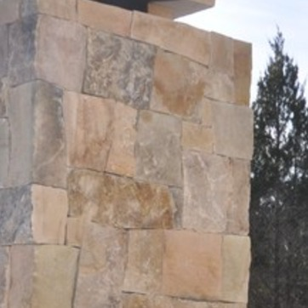
stone = 0.950
brick = 0.014
water = 0.007
tile = 0.006
foliage = 0.003
Notes:
/data/zhangpengjie/zhangpengjie/Workspace/Datasets/minc-2500/images/stone/stone_000810.jpg

Slide 3
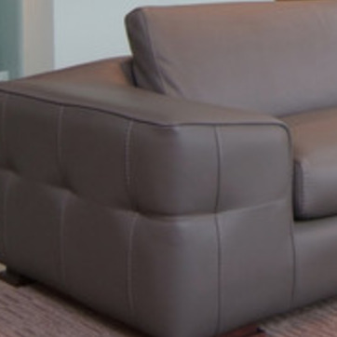
leather = 0.944
fabric = 0.028
metal = 0.003
wood = 0.003
tile = 0.003
Notes:
/data/zhangpengjie/zhangpengjie/Workspace/Datasets/minc-2500/images/leather/leather_000159.jpg

Slide 4
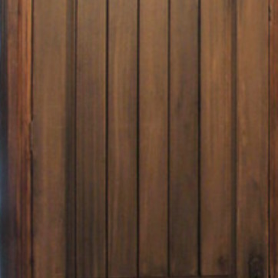
wood = 0.900
fabric = 0.012
wallpaper = 0.010
painted = 0.009
stone = 0.007
Notes:
/data/zhangpengjie/zhangpengjie/Workspace/Datasets/minc-2500/images/wood/wood_002182.jpg

Slide 5
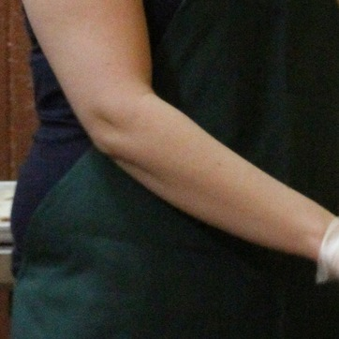
skin = 0.896
fabric = 0.033
hair = 0.017
plastic = 0.013
food = 0.005
Notes:
/data/zhangpengjie/zhangpengjie/Workspace/Datasets/minc-2500/images/wood/wood_002182.jpg

Slide 6

water = 0.933
fabric = 0.027
hair = 0.004
plastic = 0.004
food = 0.003
Notes:
/data/zhangpengjie/zhangpengjie/Workspace/Datasets/minc-2500/images/wood/wood_002182.jpg

Slide 7
brick
0.972
wood
0.900
leather
0.944
stone
0.007
fabric
0.012
fabric
0.028
tile
0.003
wallpaper
0.010
metal
0.003
carpet
0.002
painted
0.009
wood
0.003
other
0.002
stone
0.007
tile
0.003
stone
0.950
skin
0.896
water
0.933
brick
0.014
fabric
0.033
fabric
0.027
water
0.007
hair
0.017
hair
0.004
tile
0.006
plastic
0.013
plastic
0.004
foliage
0.003
food
0.005
food
0.003

Slide 8
brick
0.972
wood
0.900
stone
0.007
fabric
0.012
tile
0.003
wallpaper
0.010
carpet
0.002
painted
0.009
other
0.002
stone
0.007
stone
0.950
skin
0.896
brick
0.014
fabric
0.033
water
0.007
hair
0.017
tile
0.006
plastic
0.013
foliage
0.003
food
0.005
leather
0.944
water
0.933
fabric
0.028
fabric
0.027
metal
0.003
hair
0.004
wood
0.003
plastic
0.004
tile
0.003
food
0.003

Slide 9
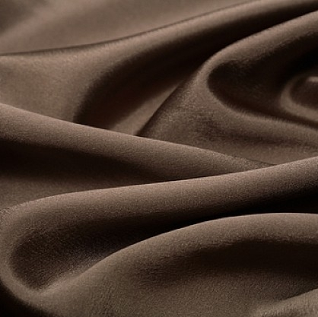
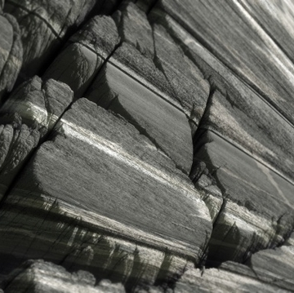
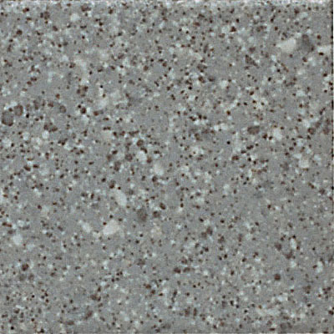

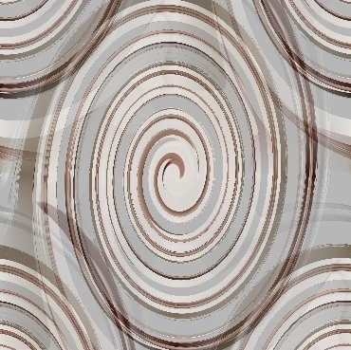
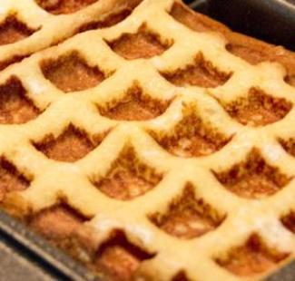
wrinkled
0.156
stratified
0.156
cracked
0.047
cracked
0.087
smeared
0.046
potholed
0.079
gauzy
0.045
porous
0.060
pleated
0.036
marbled
0.043
flecked
0.149
spiralled
0.896
porous
0.117
swirly
0.033
potholed
0.094
braided
0.017
potholed
0.071
cobwebbed
0.013
marbled
0.042
veined
0.005
swirly
0.183
waffled
0.177
paisley
0.132
freckled
0.055
interlaced
0.076
frilly
0.048
lacelike
0.070
bumpy
0.047
spiralled
0.057
knitted
0.041

