Slide 1
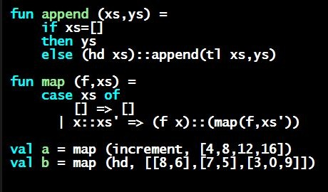
Programming Languages Dan Grossman
Polymorphic Datatypes

Slide 2
Finish the story
Claimed built-in options and lists are not needed/special
Other than special syntax for list constructors
But these datatype bindings are polymorphic type constructors
int list and string list and int list list are all types, not list
Functions might or might not be polymorphic
val sum_list : int list -> int
val append : ’a list * ’a list -> ’a list
Good language design: Can define new polymorphic datatypes
Semi-optional: Do not need to understand this for homework 2

Slide 3
Defining polymorphic datatypes
Syntax: put one or more type variables before datatype name
Can use these type variables in constructor definitions
Binding then introduces a type constructor, not a type
Must say int mylist or string mylist or ’a mylist
Not “plain” mylist
datatype ’a option = NONE | SOME of ’a
datatype ’a mylist = Empty | Cons of ’a * ’a mylist
datatype (’a,’b) tree =
Node of ’a * (’a,’b) tree * (’a,’b) tree
| Leaf of ’b

Slide 4
Nothing else changes
Use constructors and case expressions as usual
No change to evaluation rules
Type-checking will make sure types are used consistently
Example: cannot mix element types of list
Functions will be polymorphic or not based on how data is used

