Slide 1
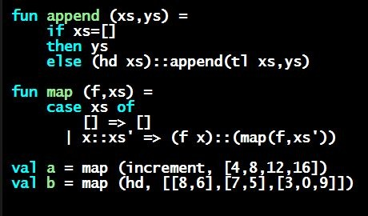
Programming Languages Dan Grossman
Type Synonyms

Slide 2
Creating new types
A datatype binding introduces a new type name
Distinct from all existing types
Only way to create values of the new type is the constructors
A type synonym is a new kind of binding
Just creates another name for a type
The type and the name are interchangeable in every way
Do not worry about what REPL prints: picks what it wants just like it picks the order of record field names
type aname = t

Slide 3
Why have this?
For now, type synonyms just a convenience for talking about types
Example (where suit and rank already defined):
type card = suit * rank
Write a function of type
card -> bool
Okay if REPL says your function has type
suit * rank -> bool
Convenient, but does not let us “do” anything new
Later in course will see another use related to modularity

