Slide 1
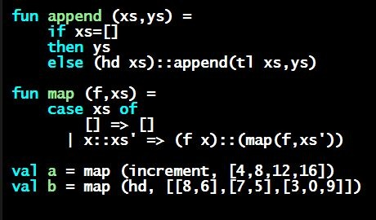
Programming Languages Dan Grossman
Functions (Informally)

Slide 2
Function definitions
Functions: the most important building block in the whole course
Like Java methods, have arguments and result
But no classes, this, return, etc.
Example function binding:
(* Note: correct only if y>=0 *)
fun pow (x : int, y : int) =
if y=0
then 1
else x * pow(x,y-1)
Note: The body includes a (recursive) function call: pow(x,y-1)

Slide 3
Example, extended
fun pow (x : int, y : int) =
if y=0
then 1
else x * pow(x,y-1)
fun cube (x : int) =
pow (x,3)
val sixtyfour = cube 4
val fortytwo = pow(2,2+2) + pow(4,2) + cube(2) + 2

Slide 4
Some gotchas
Three common “gotchas”
Bad error messages if you mess up function-argument syntax
The use of * in type syntax is not multiplication
Example: int * int -> int
In expressions, * is multiplication: x * pow(x,y-1)
Cannot refer to later function bindings
That’s simply ML’s rule
Helper functions must come before their uses
Need special construct for mutual recursion (later)

Slide 5
Recursion
If you’re not yet comfortable with recursion, you will be soon ☺
Will use for most functions taking or returning lists
“Makes sense” because calls to same function solve “simpler” problems
Recursion more powerful than loops
We won’t use a single loop in ML
Loops often (not always) obscure simple, elegant solutions

