Slide 1
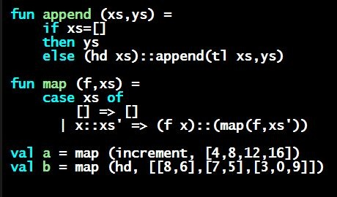
Programming Languages Dan Grossman
ML Expressions and Variable Bindings

Slide 2
Mindset
“Let go” of all programming languages you already know
For now, treat ML as a “totally new thing”
Time later to compare/contrast to what you know
For now, “oh that seems kind of like this thing in [Java]” will confuse you, slow you down, and you will learn less
Start from a blank file…

Slide 3
A very simple ML program
[The same program we just wrote in Emacs; here for conveniene if reviewing the slides]
(* My first ML program *)
val x = 34;
val y = 17;
val z = (x + y) + (y + 2);
val q = z + 1;
val abs_of_z = if z < 0 then 0 – z else z;
val abs_of_z_simpler = abs z

Slide 4
A variable binding
val z = (x + y) + (y + 2); (* comment *)
More generally:
val x = e;
Syntax:
Keyword val and punctuation = and ;
Variable x
Expression e
Many forms of these, most containing subexpressions

Slide 5
The semantics
Syntax is just how you write something
Semantics is what that something means
Type-checking (before program runs)
Evaluation (as program runs)
For variable bindings:
Type-check expression and extend static environment
Evaluate expression and extend dynamic environment
So what is the precise syntax, type-checking rules, and evaluation rules for various expressions? Good question!

