Slide 1
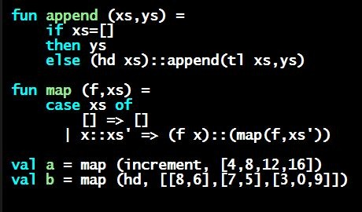
Programming Languages Dan Grossman
Datatype Bindings

Slide 2
Datatype bindings
A “strange” (?) and totally awesome (!) way to make one-of types:
A datatype binding
datatype mytype = TwoInts of int * int
| Str of string
| Pizza
Adds a new type mytype to the environment
Adds constructors to the environment: TwoInts, Str, and Pizza
A constructor is (among other things), a function that makes values of the new type (or is a value of the new type):
TwoInts : int * int -> mytype
Str : string -> mytype
Pizza : mytype

Slide 3
The values we make
datatype mytype = TwoInts of int * int
| Str of string
| Pizza
Any value of type mytype is made from one of the constructors
The value contains:
A “tag” for “which constructor” (e.g., TwoInts)
The corresponding data (e.g., (7,9))
Examples:
TwoInts(3+4,5+4) evaluates to TwoInts(7,9)
Str(if true then "hi" else "bye") evaluates to Str("hi")
Pizza is a value

Slide 4
Using them
So we know how to build datatype values; need to access them
There are two aspects to accessing a datatype value
Check what variant it is (what constructor made it)
Extract the data (if that variant has any)
Notice how our other one-of types used functions for this:
null and isSome check variants
hd, tl, and valOf extract data (raise exception on wrong variant)
ML could have done the same for datatype bindings
For example, functions like “isStr” and “getStrData”
Instead it did something better

