Slide 1
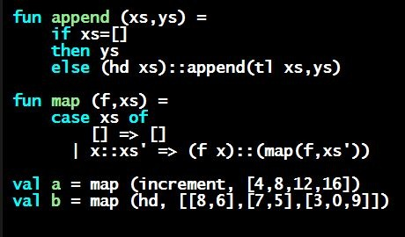
Programming Languages Dan Grossman
Case Expressions

Slide 2
Case
ML combines the two aspects of accessing a one-of value with a case expression and pattern-matching
Pattern-matching much more general/powerful (soon!)
Example:
A multi-branch conditional to pick branch based on variant
Extracts data and binds to variables local to that branch
Type-checking: all branches must have same type
Evaluation: evaluate between case … of and the right branch
fun f x = (* f has type mytype -> int *)
case x of
Pizza => 3
| TwoInts(i1,i2) => i1+i2
| Str s => String.size s

Slide 3
Patterns
In general the syntax is:
For today, each pattern is a constructor name followed by the right number of variables (i.e., C or C x or C(x,y) or …)
Syntactically most patterns (all today) look like expressions
But patterns are not expressions
We do not evaluate them
We see if the result of e0 matches them
case e0 of
p1 => e1
| p2 => e2
…
| pn => en

Slide 4
Why this way is better
0. You can use pattern-matching to write your own testing and data-extractions functions if you must
But do not do that on your homework
You cannot forget a case (inexhaustive pattern-match warning)
You cannot duplicate a case (a type-checking error)
You will not forget to test the variant correctly and get an exception (like hd [])
Pattern-matching can be generalized and made more powerful, leading to elegant and concise code

