Slide 1
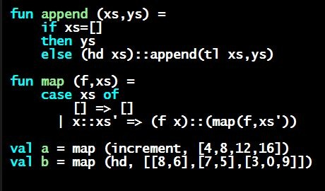
Programming Languages Dan Grossman
Useful Datatypes

Slide 2
Useful examples
Let’s fix the fact that our only example datatype so far was silly…
Enumerations, including carrying other data
Alternate ways of identifying real-world things/people
datatype suit = Club | Diamond | Heart | Spade
datatype rank = Jack | Queen | King
| Ace | Num of int
datatype id = StudentNum of int
| Name of string
* (string option)
* string

Slide 3
Don’t do this
Unfortunately, bad training and languages that make one-of types inconvenient lead to common bad style where each-of types are used where one-of types are the right tool
Approach gives up all the benefits of the language enforcing every value is one variant, you don’t forget branches, etc.
And it makes it less clear what you are doing
(* use the student_num and ignore other fields unless the student_num is ~1 *)
{ student_num : int,
first : string,
middle : string option,
last : string }

Slide 4
That said…
But if instead, the point is that every “person” in your program has a name and maybe a student number, then each-of is the way to go:
{ student_num : int option,
first : string,
middle : string option,
last : string }

Slide 5
Expression Trees
A more exciting (?) example of a datatype, using self-reference
An expression in ML of type exp:
How to picture the resulting value in your head:
datatype exp = Constant of int
| Negate of exp
| Add of exp * exp
| Multiply of exp * exp
Add (Constant (10+9), Negate (Constant 4))
Add
Constant
Negate
19
Constant
4

Slide 6
Recursion
Not surprising:
Functions over recursive datatypes are usually recursive
fun eval e =
case e of
Constant i => i
| Negate e2 => ~ (eval e2)
| Add(e1,e2) => (eval e1) + (eval e2)
| Multiply(e1,e2) => (eval e1) * (eval e2)

