Slide 1
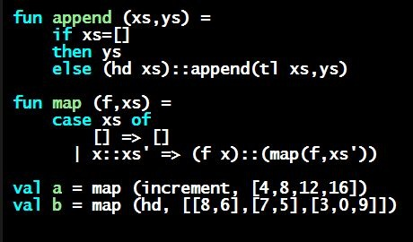
Programming Languages Dan Grossman
Pattern-Matching So Far: Precisely

Slide 2
Careful definitions
When a language construct is “new and strange,” there is more reason to define the evaluation rules precisely…
… so let’s review datatype bindings and case expressions “so far”
Extensions to come but won’t invalidate the “so far”

Slide 3
Datatype bindings
datatype t = C1 of t1 | C2 of t2 | … | Cn of tn
Adds type t and constructors Ci of type ti->t
Ci v is a value, i.e., the result “includes the tag”
Omit “of t” for constructors that are just tags, no underlying data
Such a Ci is a value of type t
Given an expression of type t, use case expressions to:
See which variant (tag) it has
Extract underlying data once you know which variant

Slide 4
Datatype bindings
case e of p1 => e1 | p2 => e2 | … | pn => en
As usual, can use a case expressions anywhere an expression goes
Does not need to be whole function body, but often is
Evaluate e to a value, call it v
If pi is the first pattern to match v, then result is evaluation of ei in environment “extended by the match”
Pattern Ci(x1,…,xn) matches value Ci(v1,…,vn) and extends the environment with x1 to v1 … xn to vn
For “no data” constructors, pattern Ci matches value Ci

