Slide 1
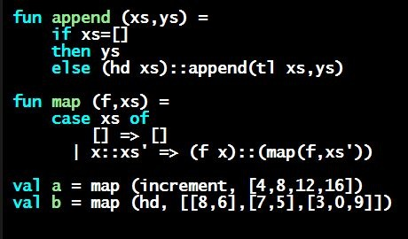
Programming Languages Dan Grossman
Another Expression Example

Slide 2
Putting it together
datatype exp = Constant of int
| Negate of exp
| Add of exp * exp
| Multiply of exp * exp
Let’s define max_constant : exp -> int
Good example of combining several topics as we program:
Case expressions
Local helper functions
Avoiding repeated recursion
Simpler solution by using library functions
See the .sml file…

