Slide 1
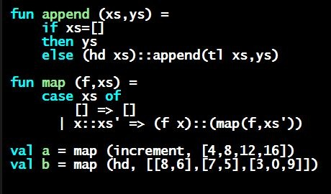
Programming Languages Dan Grossman
Let Expressions to Avoid Repeated Computation

Slide 2
Avoid repeated recursion
Consider this code and the recursive calls it makes
Don’t worry about calls to null, hd, and tl because they do a small constant amount of work
fun bad_max (xs : int list) =
if null xs
then 0 (* horrible style; fix later *)
else if null (tl xs)
then hd xs
else if hd xs > bad_max (tl xs)
then hd xs
else bad_max (tl xs)
let x = bad_max [50,49,…,1]
let y = bad_max [1,2,…,50]

Slide 3
Fast vs. unusable
if hd xs > bad_max (tl xs)
then hd xs
else bad_max (tl xs)
bm [50,…]
bm [49,…]
bm [48,…]
bm [1]
bm [1,…]
bm [2,…]
bm [3,…]
bm [50]
bm [3,…]
2⁵⁰
times
…
bm [2,…]
bm [3,…]
bm [3,…]
bm [50]

Slide 4
Math never lies
Suppose one bad_max call’s if-then-else logic and calls to hd,
null, tl take 10⁻⁷ seconds
Then bad_max [50,49,…,1] takes 50 x 10⁻⁷ seconds
And bad_max [1,2,…,50] takes 1.12 x 10⁸ seconds
(over 3.5 years)
bad_max [1,2,…,55]takes over 1 century
Buying a faster computer won’t help much ☺
The key is not to do repeated work that might do repeated work that might do…
Saving recursive results in local bindings is essential…

Slide 5
Efficient max
fun good_max (xs : int list) =
if null xs
then 0 (* horrible style; fix later *)
else if null (tl xs)
then hd xs
else
let val tl_ans = good_max(tl xs)
in
if hd xs > tl_ans
then hd xs
else tl_ans
end

Slide 6
Fast vs. fast
let val tl_ans = good_max(tl xs)
in
if hd xs > tl_ans
then hd xs
else tl_ans
end
gm [50,…]
gm [49,…]
gm [48,…]
gm [1]
gm [1,…]
gm [2,…]
gm [3,…]
gm [50]

