Slide 1
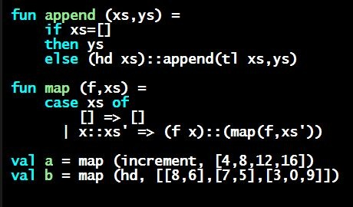
Programming Languages Dan Grossman
Options

Slide 2
Motivating Options
Having max return 0 for the empty list is really awful
Could raise an exception (future topic)
Could return a zero-element or one-element list
That works but is poor style because the built-in support for options expresses this situation directly

Slide 3
Options
t option is a type for any type t
(much like t list, but a different type, not a list)
Building:
NONE has type 'a option (much like [] has type 'a list)
SOME e has type t option if e has type t (much like e::[])
Accessing:
isSome has type 'a option -> bool
valOf has type 'a option -> 'a (exception if given NONE)

Slide 4
Example
fun better_max (xs : int list) =
if null xs
then NONE
else
let val tl_ans = better_max(tl xs)
in
if isSome tl_ans
andalso valOf tl_ans > hd xs
then tl_ans
else SOME (hd xs)
end
val better_max = fn : int list -> int option
Nothing wrong with this, but as a matter of style might prefer not to do so much useless “valOf” in the recursion

Slide 5
Example variation
fun better_max2 (xs : int list) =
if null xs
then NONE
else let (* ok to assume xs nonempty b/c local *)
fun max_nonempty (xs : int list) =
if null (tl xs)
then hd xs
else
let val tl_ans = max_nonempty(tl xs)
in
if hd xs > tl_ans
then hd xs
else tl_ans
end
in
SOME (max_nonempty xs)
end

