Slide 1
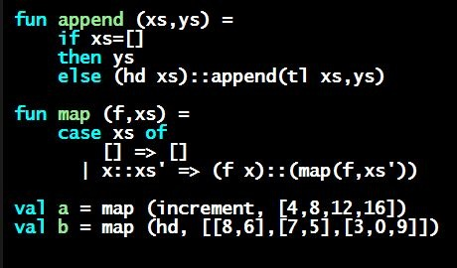
Programming Languages Dan Grossman
More Boolean and Comparison Expressions

Slide 2
Some More Expressions
Some “odds and ends” that haven’t come up much yet:
Combining Boolean expressions (and, or, not)
Comparison operations

Slide 3
Boolean operations
e1 andalso e2
Type-checking: e1 and e2 must have type bool
Evaluation: If result of e1 is false then false else result of e2
e1 orelse e2
not e1
Syntax in many languages is e1 && e2, e1 || e2, !e
&& and || don’t exist in ML and ! means something different
“Short-circuiting” evaluation means andalso and orelse are not functions, but not is just a pre-defined function

Slide 4
Style with Booleans
Language does not need andalso , orelse , not
Using more concise forms generally much better style
And definitely please do not do this:
(* e1 andalso e2 *)
if e1
then e2
else false
(* e1 orelse e2 *)
if e1
then true
else e2
(* not e1 *)
if e1
then false
else true
(* just say e (!!!) *)
if e
then true
else false

Slide 5
Comparisons
For comparing int values:
= <> > < >= <=
You might see weird error messages because comparators can be used with some other types too:
> < >= <= can be used with real, but not 1 int and 1 real
= <> can be used with any “equality type” but not with real
Let’s not discuss equality types yet

