Slide 1
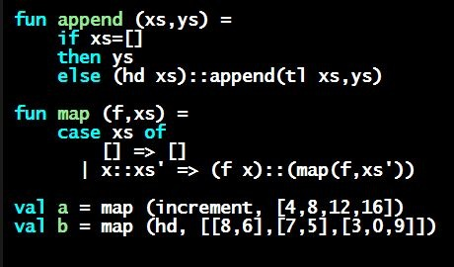
Programming Languages Dan Grossman
Ways to Build New Types

Slide 2
How to build bigger types
Already know:
Have various base types like int bool unit char
Ways to build (nested) compound types: tuples, lists, options
Coming soon: more ways to build compound types
First: 3 most important type building-blocks in any language
“Each of”: A t value contains values of each of t1 t2 … tn
“One of”: A t value contains values of one of t1 t2 … tn
“Self reference”: A t value can refer to other t values
Remarkable: A lot of data can be described with just these building blocks
Note: These are not the common names for these concepts

Slide 3
Examples
Tuples build each-of types
int * bool contains an int and a bool
Options build one-of types
int option contains an int or it contains no data
Lists use all three building blocks
int list contains an int and another int list or it contains no data
And of course we can nest compound types
((int * int) option * (int list list)) option

Slide 4
Coming soon
Another way to build each-of types in ML
Records: have named fields
Connection to tuples and idea of syntactic sugar
A way to build and use our own one-of types in ML
For example, a type that contains an int or a string
Will lead to pattern-matching, one of ML’s coolest and strangest-to-Java-programmers features
Later in course: How OOP does one-of types
Key contrast with procedural and functional programming

