Slide 1
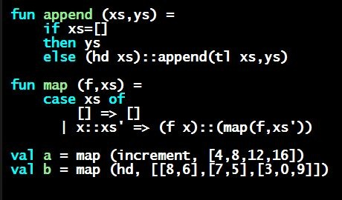
Programming Languages Dan Grossman
Let Expressions

Slide 2
Review
Huge progress already on the core pieces of ML:
Types: int bool unit t1*…*tn t list t1*…*tn->t
Types “nest” (each t above can be itself a compound type)
Variables, environments, and basic expressions
Functions
Build: fun x0 (x1:t1, …, xn:tn) = e
Use: e0 (e1, …, en)
Tuples
Build: (e1, …, en)
Use: #1 e, #2 e, …
Lists
Build: [] e1::e2
Use: null e hd e tl e

Slide 3
Now…
The big thing we need: local bindings
For style and convenience
This segment:
Basic let-expressions
Next segments:
A big but natural idea: nested function bindings
For efficiency (not “just a little faster”)
The construct to introduce local bindings is just an expression, so we can use it anywhere an expression can go

Slide 4
Let-expressions
3 questions:
Syntax:
Each bi is any binding and e is any expression
Type-checking: Type-check each bi and e in a static environment that includes the previous bindings.
Type of whole let-expression is the type of e.
Evaluation: Evaluate each bi and e in a dynamic environment that includes the previous bindings.
Result of whole let-expression is result of evaluating e.
let b1 b2 … bn in e end

Slide 5
Silly examples
fun silly1 (z : int) =
let val x = if z > 0 then z else 34
val y = x+z+9
in
if x > y then x*2 else y*y
end
fun silly2 () =
let val x = 1
in
(let val x = 2 in x+1 end) +
(let val y = x+2 in y+1 end)
end
silly2 is poor style but shows let-expressions are expressions
Can also use them in function-call arguments, if branches, etc.
Also notice shadowing

Slide 6
What’s new
What’s new is scope: where a binding is in the environment
In later bindings and body of the let-expression
(Unless a later or nested binding shadows it)
Only in later bindings and body of the let-expression
Nothing else is new:
Can put any binding we want, even function bindings
Type-check and evaluate just like at “top-level”

