Slide 1
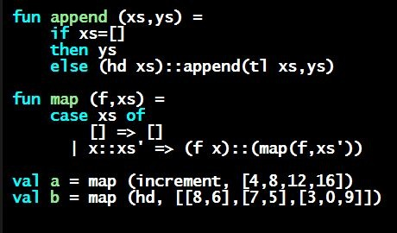
Programming Languages Dan Grossman
Nested Functions

Slide 2
Any binding
According to our rules for let-expressions, we can define functions inside any let-expression
This is a natural idea, and often good style
let b1 b2 … bn in e end

Slide 3
(Inferior) Example
fun countup_from1 (x : int) =
let fun count (from : int, to : int) =
if from = to
then to :: []
else from :: count(from+1,to)
in
count (1,x)
end
This shows how to use a local function binding, but:
Better version on next slide
count might be useful elsewhere

Slide 4
Better:
fun countup_from1_better (x : int) =
let fun count (from : int) =
if from = x
then x :: []
else from :: count(from+1)
in
count 1
end
Functions can use bindings in the environment where they are defined:
Bindings from “outer” environments
Such as parameters to the outer function
Earlier bindings in the let-expression
Unnecessary parameters are usually bad style
Like to in previous example

Slide 5
Nested functions: style
Good style to define helper functions inside the functions they help if they are:
Unlikely to be useful elsewhere
Likely to be misused if available elsewhere
Likely to be changed or removed later
A fundamental trade-off in code design: reusing code saves effort and avoids bugs, but makes the reused code harder to change later

