Slide 1
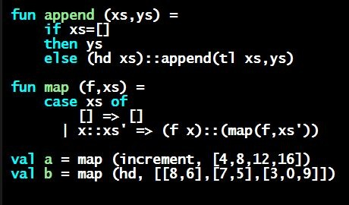
Programming Languages Dan Grossman
Pairs and Other Tuples

Slide 2
Tuples and lists
So far: numbers, booleans, conditionals, variables, functions
Now ways to build up data with multiple parts
This is essential
Java examples: classes with fields, arrays
Now:
Tuples: fixed “number of pieces” that may have different types
Coming soon:
Lists: any “number of pieces” that all have the same type
Later:
Other more general ways to create compound data

Slide 3
Pairs (2-tuples)
Need a way to build pairs and a way to access the pieces
Build:
Syntax:
Evaluation: Evaluate e1 to v1 and e2 to v2; result is (v1,v2)
A pair of values is a value
Type-checking: If e1 has type ta and e2 has type tb, then the pair expression has type ta * tb
A new kind of type
(e1,e2)

Slide 4
Pairs (2-tuples)
Need a way to build pairs and a way to access the pieces
Access:
Syntax: and
Evaluation: Evaluate e to a pair of values and return first or second piece
Example: If e is a variable x, then look up x in environment
Type-checking: If e has type ta * tb, then #1 e has type ta and #2 e has type tb
#1 e
#2 e

Slide 5
Examples
Functions can take and return pairs
fun swap (pr : int*bool) =
(#2 pr, #1 pr)
fun sum_two_pairs (pr1 : int*int, pr2 : int*int) =
(#1 pr1) + (#2 pr1) + (#1 pr2) + (#2 pr2)
fun div_mod (x : int, y : int) =
(x div y, x mod y)
fun sort_pair (pr : int*int) =
if (#1 pr) < (#2 pr)
then pr
else (#2 pr, #1 pr)

Slide 6
Tuples
Actually, you can have tuples with more than two parts
A new feature: a generalization of pairs
(e1,e2,…,en)
ta * tb * … * tn
#1 e, #2 e, #3 e, …
Homework 1 uses triples of type int*int*int a lot

Slide 7
Nesting
Pairs and tuples can be nested however you want
Not a new feature: implied by the syntax and semantics
val x1 = (7,(true,9)) (* int * (bool*int) *)
val x2 = #1 (#2 x1) (* bool *)
val x3 = (#2 x1) (* bool*int *)
val x4 = ((3,5),((4,8),(0,0)))
(* (int*int)*((int*int)*(int*int)) *)

