Slide 1
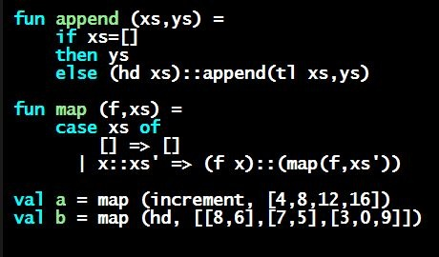
Programming Languages Dan Grossman
Introducing Lists

Slide 2
Lists
Despite nested tuples, the type of a variable still “commits” to a particular “amount” of data
In contrast, a list:
Can have any number of elements
But all list elements have the same type
Need ways to build lists and access the pieces…

Slide 3
Building Lists
The empty list is a value:
In general, a list of values is a value; elements separated by commas:
If e1 evaluates to v and e2 evaluates to a list [v1,…,vn], then e1::e2 evaluates to [v,…,vn]
[]
[v1,v2,…,vn]
e1::e2 (* pronounced “cons” *)

Slide 4
Accessing Lists
Until we learn pattern-matching, we will use three standard-library functions
null e evaluates to true if and only if e evaluates to []
If e evaluates to [v1,v2,…,vn] then hd e evaluates to v1
(raise exception if e evaluates to [])
If e evaluates to [v1,v2,…,vn] then tl e evaluates to [v2,…,vn]
(raise exception if e evaluates to [])
Notice result is a list

Slide 5
Type-checking list operations
Lots of new types: For any type t, the type t list describes lists where all elements have type t
Examples: int list bool list int list list (int * int) list (int list * int) list
So [] can have type t list list for any type
SML uses type 'a list to indicate this (“quote a” or “alpha”)
For e1::e2 to type-check, we need a t such that e1 has type t and e2 has type t list. Then the result type is t list
null : 'a list -> bool
hd : 'a list -> 'a
tl : 'a list -> 'a list

