Slide 1
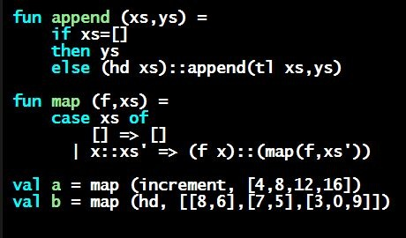
Programming Languages Dan Grossman
List Functions

Slide 2
Functions over lists
Gain experience with lists and recursion by writing several functions that process and/or produce lists…

Slide 3
Example list functions
fun sum_list (xs : int list) =
if null xs
then 0
else hd(xs) + sum_list(tl(xs))
fun countdown (x : int) =
if x=0
then []
else x :: countdown (x-1)
fun append (xs : int list, ys : int list) =
if null xs
then ys
else hd (xs) :: append (tl(xs), ys)

Slide 4
Recursion again
Functions over lists are usually recursive
Only way to “get to all the elements”
What should the answer be for the empty list?
What should the answer be for a non-empty list?
Typically in terms of the answer for the tail of the list!
Similarly, functions that produce lists of potentially any size will be recursive
You create a list out of smaller lists

Slide 5
Lists of pairs
Processing lists of pairs requires no new features. Examples:
fun sum_pair_list (xs : (int*int) list) =
if null xs
then 0
else #1(hd xs) + #2(hd xs) + sum_pair_list(tl xs)
fun firsts (xs : (int*int) list) =
if null xs
then []
else #1(hd xs) :: firsts(tl xs)
fun seconds (xs : (int*int) list) =
if null xs
then []
else #2(hd xs) :: seconds(tl xs)
fun sum_pair_list2 (xs : (int*int) list) =
(sum_list (firsts xs)) + (sum_list (seconds xs))

