Slide 1
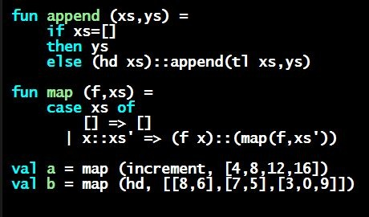
Programming Languages Dan Grossman
ML Rules for Expressions (Seen So Far)

Slide 2
A very simple ML program
This program has integers, variables, addition, if-expressions, less-than, subtraction, and calling a pre-defined function
(* My first ML program *)
val x = 34;
val y = 17;
val z = (x + y) + (y + 2);
val q = z + 1;
val abs_of_z = if z < 0 then 0 – z else z;
val abs_of_z_simpler = abs z

Slide 3
Expressions
We have seen many kinds of expressions:
34 true false x e1+e2 e1<e2
if e1 then e2 else e3
Can get arbitrarily large since any subexpression can contain subsubexpressions, etc.
Every kind of expression has
Syntax
Type-checking rules
Produces a type or fails (with a bad error message ☹)
Types so far: int bool unit
Evaluation rules (used only on things that type-check)
Produces a value (or exception or infinite-loop)

Slide 4
Variables
Syntax:
sequence of letters, digits, _, not starting with digit
Type-checking:
Look up type in current static environment
If not there, fail
Evaluation:
Look up value in current dynamic environment

Slide 5
Addition
Syntax:
e1 + e2 where e1 and e2 are expressions
Type-checking:
If e1 and e2 have type int,
then e1 + e2 has type int
Evaluation:
If e1 evaluates to v1 and e2 evaluates to v2,
then e1 + e2 evaluates to sum of v1 and v2

Slide 6
Values
All values are expressions
Not all expressions are values
Every value “evaluates to itself” in “zero steps”
Examples:
34, 17, 42 have type int
true, false have type bool
() has type unit

Slide 7
A slightly tougher one
What are the syntax, typing rules, and evaluation rules for conditional expressions?
Let’s write it out…

Slide 8
Now you try one
Syntax, type-checking rules, and evaluation rules for less-than comparisons?

