Slide 1
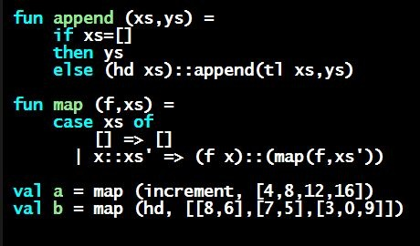
Programming Languages Dan Grossman
The REPL and Error Messages

Slide 2
Pragmatics
Last two segments have built up key conceptual foundation
But you also need some pragmatics:
How do we run programs using the REPL?
What happens when we make mistakes?
Work on developing resilience to mistakes
Slow down
Don’t panic
Read what you wrote very carefully

Slide 3
use
use “foo.sml” is an unusual expression
It enters bindings from the file foo.sml
Result is () bound to variable it
Ignorable

Slide 4
The REPL
Read-Eval-Print-Loop is well named
Can just treat it as a strange/convenient way to run programs
But more convenient for quick try-something-out
Then move things over to a testing file for easy reuse
For reasons discussed in next segment, do not use use without restarting the REPL session
(But using it for multiple files at beginning of session is okay)

Slide 5
Errors
Your mistake could be:
Syntax: What you wrote means nothing or not the construct you intended
Type-checking: What you wrote does not type-check
Evaluation: It runs but produces wrong answer, or an exception, or an infinite loop
Keep these straight when debugging even if sometimes one kind of mistake appears to be another

Slide 6
Play around
Best way to learn something: Try lots of things and don’t be afraid of errors
Maybe watching me make a few mistakes will help…

