Slide 1
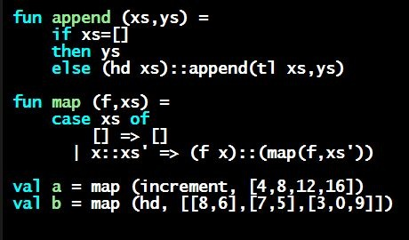
Programming Languages Dan Grossman
Shadowing

Slide 2
Multiple bindings of same variable
Multiple variable bindings of the same variable is often poor style
Often confusing
But it’s an instructive exercise
Helps explain how the environment “works”
Helps explain how a variable binding “works”
(Emphasize this now to lay the foundation for first-class functions)

Slide 3
Our example
val a = 10
val b = a * 2
val a = 5
val c = b
val d = a
val a = a + 1
(* val g = f – 3 *)(* does not type-check *)
val f = a * 2

Slide 4
Two reasons (either one sufficient)
val a = 1
val b = a (* b is bound to 1 *)
val a = 2
Expressions in variable bindings are evaluated “eagerly”
Before the variable binding “finishes”
Afterwards, the expression producing the value is irrelevant
There is no way to “assign to” a variable in ML
Can only shadow it in a later environment

Slide 5
use
This is why I am so insistent about not reusing use on a file without restarting the REPL
Else you are introducing some of the same bindings again
May make it seem like wrong code is correct
May make it seem like correct code is wrong
(It’s all well-defined, but we humans get confused)

