Slide 1
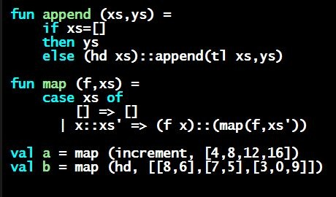
Programming Languages Dan Grossman
Records

Slide 2
Records
Record values have fields (any name) holding values
Record types have fields (and name) holding types
The order of fields in a record value or type never matters
REPL alphabetizes fields just for consistency
Building records:
Accessing pieces:
(Evaluation rules and type-checking as expected)
{f1 = v1, …, fn = vn}
{f1 : t1, …, fn : tn}
{f1 = e1, …, fn = en}
#myfieldname e

Slide 3
Example
Evaluates to
And has type
If some expression such as a variable x has this type, then get fields with:
Note we did not have to declare any record types
The same program could also make a
{id=true,ego=false} of type {id:bool,ego:bool}
{name = “Amelia”, id = 41123 - 12}
{id = 41111, name = “Amelia”}
{id : int, name : string}
#id x #name x

Slide 4
By name vs. by position
Little difference between (4,7,9) and {f=4,g=7,h=9}
Tuples a little shorter
Records a little easier to remember “what is where”
Generally a matter of taste, but for many (6? 8? 12?) fields, a record is usually a better choice
A common decision for a construct’s syntax is whether to refer to things by position (as in tuples) or by some (field) name (as with records)
A common hybrid is like with Java method arguments (and ML functions as used so far):
Caller uses position
Callee uses variables
Could do it differently; some languages have

