Slide 1
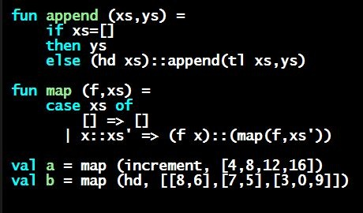
Programming Languages Dan Grossman
Tuples as Syntactic Sugar

Slide 2
The truth about tuples
Previously, we gave tuples syntax, type-checking rules, and evaluation rules
But we could have done this instead:
Tuple syntax is just a different way to write certain records
(e1,…,en) is another way of writing {1=e1,…,n=en}
t1*…*tn is another way of writing {1:t1,…,n:tn}
In other words, records with field names 1, 2, …
In fact, this is how ML actually defines tuples
Other than special syntax in programs and printing, they don’t exist
You really can write {1=4,2=7,3=9}, but it’s bad style

Slide 3
Syntactic sugar
“Tuples are just syntactic sugar for
records with fields named 1, 2, … n”
Syntactic: Can describe the semantics entirely by the corresponding record syntax
Sugar: They make the language sweeter ☺
Will see many more examples of syntactic sugar
They simplify understanding the language
They simplify implementing the language
Why? Because there are fewer semantics to worry about even though we have the syntactic convenience of tuples
Another example we saw: andalso and orelse vs. if then else

