Slide 1
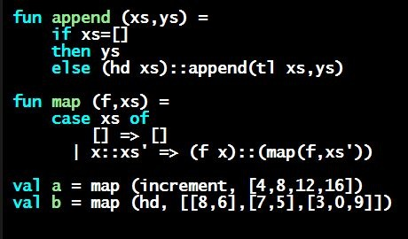
Programming Languages Dan Grossman
Lists and Options are Datatypes

Slide 2
Recursive datatypes
Datatype bindings can describe recursive structures
Have seen arithmetic expressions
Now, linked lists:
datatype my_int_list = Empty
| Cons of int * my_int_list
val x = Cons(4,Cons(23,Cons(2008,Empty)))
fun append_my_list (xs,ys) =
case xs of
Empty => ys
| Cons(x,xs’) => Cons(x, append_my_list(xs’,ys))

Slide 3
Options are datatypes
Options are just a predefined datatype binding
NONE and SOME are constructors, not just functions
So use pattern-matching not isSome and valOf
fun inc_or_zero intoption =
case intoption of
NONE => 0
| SOME i => i+1

Slide 4
Lists are datatypes
Do not use hd, tl, or null either
[] and :: are constructors too
(strange syntax, particularly infix)
fun sum_list xs =
case xs of
[] => 0
| x::xs’ => x + sum_list xs’
fun append (xs,ys) =
case xs of
[] => ys
| x::xs’ => x :: append(xs’,ys)

Slide 5
Why pattern-matching
Pattern-matching is better for options and lists for the same reasons as for all datatypes
No missing cases, no exceptions for wrong variant, etc.
We just learned the other way first for pedagogy
Do not use isSome, valOf, null, hd, tl on Homework 2
So why are null, tl, etc. predefined?
For passing as arguments to other functions (next week)
Because sometimes they are convenient
But not a big deal: could define them yourself

