Slide 1
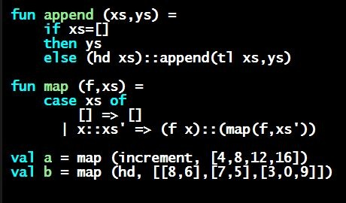
Programming Languages Dan Grossman
A Key Benefit of Immutable Data

Slide 2
A valuable non-feature: no mutation
Have now covered all the features you need (and should use) on hw1
Now learn a very important non-feature
Huh?? How could the lack of a feature be important?
When it lets you know things other code will not do with your code and the results your code produces
A major aspect and contribution of functional programming:
Not being able to assign to (a.k.a. mutate) variables
or parts of tuples and lists
(This is a “Big Deal”)

Slide 3
Cannot tell if you copy
fun sort_pair (pr : int * int) =
if #1 pr < #2 pr
then pr
else (#2 pr, #1 pr)
fun sort_pair (pr : int * int) =
if #1 pr < #2 pr
then (#1 pr, #2 pr)
else (#2 pr, #1 pr)
In ML, these two implementations of sort_pair are indistinguishable
But only because tuples are immutable
The first is better style: simpler and avoids making a new pair in the then-branch
In languages with mutable compound data, these are different!

Slide 4
Suppose we had mutation…
val x = (3,4)
val y = sort_pair x
somehow mutate #1 x to hold 5
val z = #1 y
x
3
4
?
y
?
3
4
What is z?
Would depend on how we implemented sort_pair
Would have to decide carefully and document sort_pair
But without mutation, we can implement “either way”
No code can ever distinguish aliasing vs. identical copies
No need to think about aliasing: focus on other things
Can use aliasing, which saves space, without danger

Slide 5
An even better example
fun append (xs : int list, ys : int list) =
if null xs
then ys
else hd (xs) :: append (tl(xs), ys)
val x = [2,4]
val y = [5,3,0]
val z = append(x,y)
x
2
4
y
5
3
0
(can’t tell,
but it’s the
first one)
z
2
4
or
x
2
4
y
5
3
0
z
2
4
5
3
0

Slide 6
ML vs. Imperative Languages
In ML, we create aliases all the time without thinking about it because it is impossible to tell where there is aliasing
Example: tl is constant time; does not copy rest of the list
So don’t worry and focus on your algorithm
In languages with mutable data (e.g., Java), programmers are obsessed with aliasing and object identity
They have to be (!) so that subsequent assignments affect the right parts of the program
Often crucial to make copies in just the right places
Optional Java example in next segment

