Slide 1
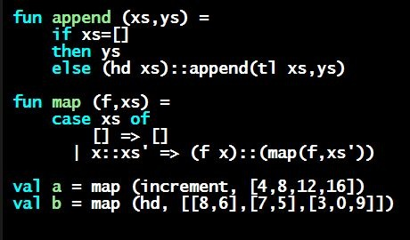
Programming Languages Dan Grossman
Optional: Java Mutation Bug

Slide 2
ML vs. Imperative Languages
In ML, we create aliases all the time without thinking about it because it is impossible to tell where there is aliasing
Example: tl is constant time; does not copy rest of the list
So don’t worry and focus on your algorithm
In languages with mutable data (e.g., Java), programmers are obsessed with aliasing and object identity
They have to be (!) so that subsequent assignments affect the right parts of the program
Often crucial to make copies in just the right places
Optional Java example…

Slide 3
Java security nightmare (bad code)
class ProtectedResource {
private Resource theResource = ...;
private String[] allowedUsers = ...;
public String[] getAllowedUsers() {
return allowedUsers;
}
public String currentUser() { ... }
public void useTheResource() {
for(int i=0; i < allowedUsers.length; i++) {
if(currentUser().equals(allowedUsers[i])) {
... // access allowed: use it
return;
}
}
throw new IllegalAccessException();
}
}

Slide 4
Have to make copies
The problem:
p.getAllowedUsers()[0] = p.currentUser();
p.useTheResource();
The fix:
public String[] getAllowedUsers() {
… return a copy of allowedUsers …
}
Reference (alias) vs. copy doesn’t matter if code is immutable!

