Slide 1
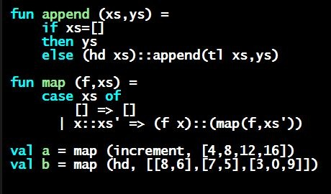
Programming Languages Dan Grossman
The Pieces of Learning a Language

Slide 2
Five different things
Syntax: How do you write language constructs?
Semantics: What do programs mean? (Evaluation rules)
Idioms: What are typical patterns for using language features to express your computation?
Libraries: What facilities does the language (or a well-known project) provide “standard”? (E.g., file access, data structures)
Tools: What do language implementations provide to make your job easier? (E.g., REPL, debugger, code formatter, …)
Not actually part of the language
These are 5 separate issues
In practice, all are essential for good programmers
Many people confuse them, but shouldn’t

Slide 3
Our Focus
This course focuses on semantics and idioms
Syntax is usually uninteresting
A fact to learn, like “The American Civil War ended in 1865”
People obsess over subjective preferences
Libraries and tools crucial, but often learn new ones “on the job”
We are learning semantics and how to use that knowledge to understand all software and employ appropriate idioms
By avoiding most libraries/tools, our languages may look “silly” but so would any language used this way

