Slide 1
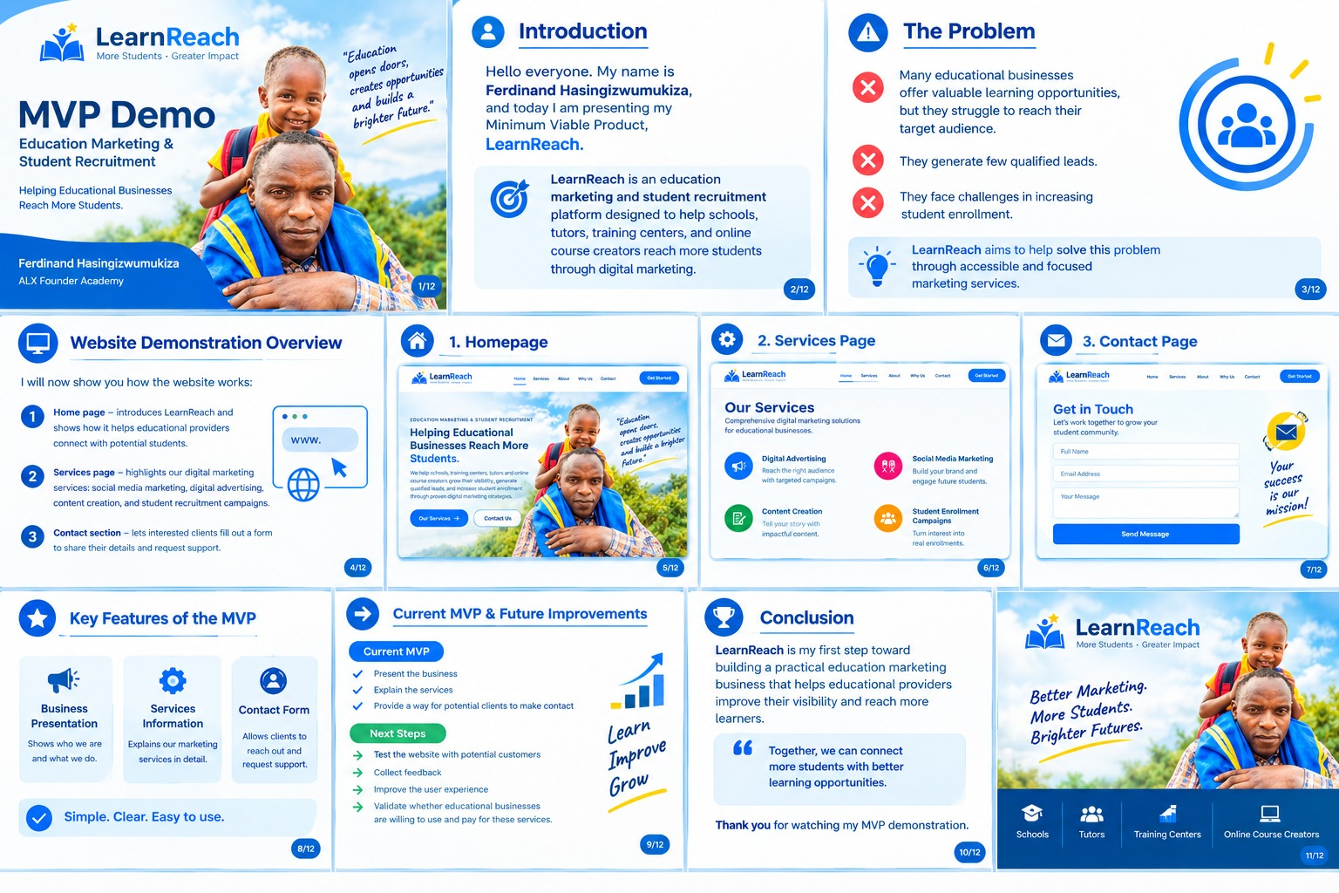
LearnReach
More Students • Greater Impact
Helping educational businesses
reach more students.
Education marketing & student recruitment
A focused service MVP for schools, tutors, training centers, and online course creators.
Ferdinand Hasingizwumukiza
ALX Founder Academy • Final Project
Pitch Deck • Draft for validation
01

Slide 2
The Problem
Valuable learning opportunities can be hard to discover when marketing and follow-up are inconsistent.
Low visibility
Few qualified enquiries
Enrollment challenge
Potential learners may not discover courses that could help them.
Providers may attract attention without reaching the right prospective students.
Unclear messages and weak follow-up can make it harder to convert interest into enrollment.
Core problem to validate: small education providers need practical, focused support to promote their programs and manage learner enquiries.
Validation plan: interview course creators and training providers; document current channels, pain points, and enrollment goals.
02

Slide 3
The Solution
A focused service first—not a complex platform before customer demand is proven.
LearnReach helps providers:
Clarify the value of their courses
Plan practical digital promotion
Create useful content for target learners
Encourage enquiries and improve follow-up
Current MVP: homepage • services • contact form
03

Slide 4
Market Size & Initial Focus
Market sizing is a research task in progress; these are customer segments, not verified market counts.
TAM — Total market
SAM — Serviceable market
SOM — Initial target
Education and training providers that need marketing and learner recruitment support.
Next: build a sourced list of providers across the wider market.
Providers LearnReach can realistically serve through digital channels and direct outreach, starting in Rwanda.
Next: define geography, provider type, and service fit.
Planning target: 10 paying pilot clients in year one.
This is an internal goal, not a verified share of the market.
Evidence needed before final submission
Use credible sources to count relevant providers and define the reachable segment.
Cite the source, year, geography, and calculation method on this slide.
04

Slide 5
Business Model
Service revenue with a clear, testable pricing hypothesis.
Who pays?
What do they buy?
How much / how often?
Independent online-course creators and small training providers with an existing course offer.
Campaign setup or monthly marketing support: messaging, content, promotion, enquiry tracking, and review.
Working hypothesis: RWF 150,000 per month for a defined package. Test willingness to pay before treating this as final pricing.
Value promise: clearer promotion, a more organized enquiry process, and reporting that helps clients decide what to improve.
Pricing validation: discuss budgets, expected outcomes, and package scope during discovery calls and paid pilots.
05

Slide 6
Traction & Validation
Current proof is the working MVP; customer and revenue traction still need to be earned.
Built
Next 30 days
Next 60–90 days
A website MVP with a business homepage, services information, and a contact section.
Interview at least 10 course creators or training providers to test the problem and offer.
Aim to run 2 pilot campaigns, gather feedback, and review whether clients would renew.
Metrics to track
Outreach replies and discovery calls booked
Proposals accepted and paid pilots won
Qualified enquiries, client feedback, and renewal intent
06

Slide 7
Competition & Positioning
A focused education niche is the starting position—not yet a proven moat.
DIY promotion
General freelance marketers
LearnReach
Providers manage social media and course promotion themselves.
Trade-off: low cash cost, but time and consistency can be challenges.
Offer broad marketing services across many industries.
Trade-off: providers may need to explain education-specific goals and workflows.
Focused support for course promotion and learner enquiries.
Planned differentiation: education-specific learning, reliable delivery, and clear reporting.
Next step: interview target customers about the alternatives they use today, what they pay, and what is missing.
Named competitor research is still required before claiming a unique or defensible advantage.
07

Slide 8
Go-to-Market Strategy
Win a narrow beachhead first, then expand based on evidence.
Phase 1 — Beachhead
Phase 2 — Expansion
Phase 3 — Repeatability
Target: independent online-course creators and small training providers.
Channel: personalized founder-led outreach.
Goal: 10 interviews; 2 paid pilot campaigns.
If pilots show value, add tutors and training centers with similar needs.
Channels: referrals, LinkedIn, email, WhatsApp, and education communities.
Standardize campaign packages, onboarding checklists, and reporting.
Expand only when delivery and customer acquisition become repeatable.
Channel success metrics
30 personalized prospects contacted
Replies → discovery calls → proposals → paid pilots
Cash and founder time per acquired client; renewal intent after delivery
08

Slide 9
Financial Projections
Illustrative revenue scenarios based on the current pricing hypothesis—not actual results.
Year
Average active clients
Price / client / month
Illustrative annual revenue
Year 1
3
RWF 150,000
RWF 5,400,000
Year 2
10
RWF 150,000
RWF 18,000,000
Year 3
22
RWF 150,000
RWF 39,600,000
Assumptions & limitations
Revenue = average active clients × RWF 150,000 × 12 months.
Figures exclude expenses, taxes, churn, ramp-up time, and months without clients.
Validate price, conversion, retention, and delivery capacity before using as a forecast.
09

Slide 10
Team
Founder-led at MVP stage; build capability around the customer problem.
Ferdinand Hasingizwumukiza
Current focus
Customer discovery, service definition, and MVP testing.
Founder, LearnReach
Building an education marketing and student recruitment service through the ALX Founder Academy journey.
Capability to develop
Campaign delivery, measurement, customer success, and repeatable operations.
As the business grows, LearnReach will use customer feedback and pilot results to identify where specialist support or partnerships are needed.
10

Slide 11
The Ask
A proposed funding request to validate demand and deliver early pilots.
US$5,000
Use of funds (proposed)
• Customer discovery and pilot delivery
• Marketing and content
• Essential digital tools
• Specialist support when needed
Proposed pre-seed / grant request
Subject to funder fit, budget quotes, and pilot requirements.
Milestone
Complete interviews, deliver 2 paid pilot campaigns, document outcomes, and refine a repeatable service package.
The ask is a proposal, not funding already secured.
11

Slide 12
LearnReach
Better Marketing.
More Students.
Brighter Futures.
Let's help good education reach the learners who need it.
Ferdinand Hasingizwumukiza
hasingizwumukiza@gmail.com • +250 733 220 022
github.com/SitaMusita/learnreach-mvp
12

