Slide 1

St. Francis Institute of Technology Department of Computer Engineering Mini Project – Sem VI
Analysis of scanned prescriptions
Group Members
Name of Student | Class-Roll No.
SITANSHU KUSHWAHA | TE CMPN A-37
NISHA LADHE | TE CMPN A-38
VINIT MASRANI | TE CMPN A-42

Slide 2
Content
Introduction
Literature
Problem Statement
Proposed Solution
Work flow of the system and Block Diagram
Algorithm with Implementation details
Data set description
Working demo along with validation
Results/Analysis

Slide 3
Introduction
Currently hospitals keep scanned copies of doctor’s prescriptions in their database.
These document can potentially contribute to research and analysis of trends associated with season, diseases, medicines etc.
But as these information is stored in image or pdf format it cannot practically be used.
There is a need for a system that could detect and recognize handwritten text from images.

Slide 4
Introduction
The System can detect and recognize doctor’s handwritten prescriptions and saves it in database in machine readable format.
Thus, various research and analysis are now possible.

Slide 5
Literature
Title | Technique | Result | Inference
MediPic: A Mobile Application for Medical Prescriptions | Tesseract Engine (Character recognition) Bag of words (Result mapping) | Best matched medicines among the bag of words(medicines) is returned as an output | Mapping the result of character recognition to a bag of words(Medicines)
EAST: An Efficient and Accurate Scene Text Detector | Implemented in C++ | The pipeline directly predicts words or text lines of arbitrary orientations and quadrilateral shapes in full images, eliminating unnecessary intermediate steps (e.g. word partitioning), with a single neural network. | Implemented in Python

Slide 6
Objective
To develop a stable and reliable software solution that can be able to recognize doctor’s handwritten prescriptions.
Scope
The system can be used by hospitals to preserve patient’s prescription history without having to worry about storage.
End product of this system can be used for research and analysis.

Slide 7
Problem Statement
To develop a Handwritten Text Recognition System that recognize handwritten text from patient’s scanned medical prescription and automate the process of saving it in hospital’s Database

Slide 8
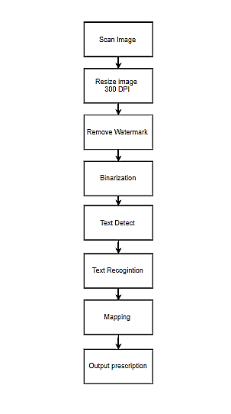
Work Flow of the system

Slide 9
Description of data set
Text Detection
Dataset | Parameter
ICDAR 2015 training images | Images of 80,000 documents
ICDAR 2013 training images | 7,000 Training images
Text Recognition
Dataset | Parameter
Prepared our own dataset by collecting samples of handwritten prescriptions of doctors. | Input X: image of 200x60px with 300 dpi. Label Y: Name of a medicine.

Slide 10
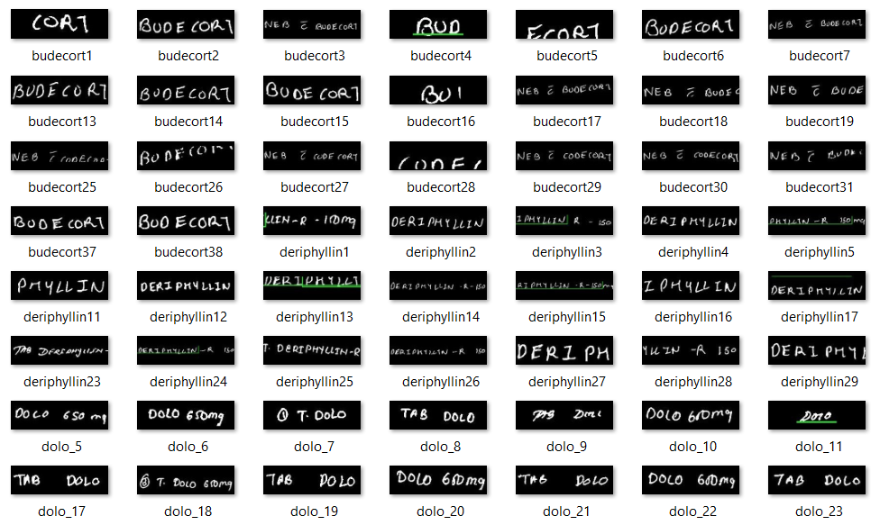
Dataset Length : 572 images
Dimensions : 59 * 199
Training Data Length : 515
Testing Data Length : 57

Slide 11
Algorithm used
EAST(Efficient and Accurate Scene Text)
CNN (Convolution Neural Networks)

Slide 12
EAST(Efficient and Accurate Scene Text)
EAST ( Efficient accurate scene text detector) is a simple yet powerful approach for text detection. Using a specialized network.
It is limited only to text detection (not actual recognition)
The network is actually a version of the well known U-Net, which is good for detecting features that may vary in size.
The underlying feed forward “stem” of this network may very.
The network allows two types of outputs rotated bounding boxes: either a standard bounding box with a rotation angle (2X2+1 parameters) or “quadrangle” which is merely a rotated bounding box with coordinates of all vertices.

Slide 13
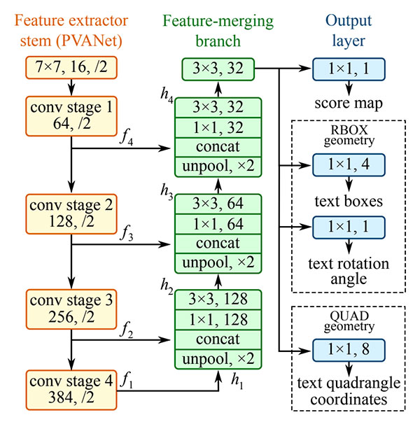
EAST(Efficient and Accurate Scene Text)

Slide 14
CNN (Convolution Neural Networks)
CNN model consists of an input and output layer, as well as multiple hidden layer.
Our model uses: -
The first hidden layer is a convolutional layer called a Convolution2D. The layer has 32 feature maps, which with the size of 5×5 and a rectifier activation function.
Next we define a pooling layer that takes the max called MaxPooling2D. It is configured with a pool size of 2×2.
The next layer is a regularization layer using dropout called Dropout.
Next is a layer that converts the 2D matrix data to a vector called Flatten.
Next a fully connected layer with 128 neurons and rectifier activation function.
Finally, the output layer has 10 neurons for the 10 classes and a softmax activation function.

Slide 15
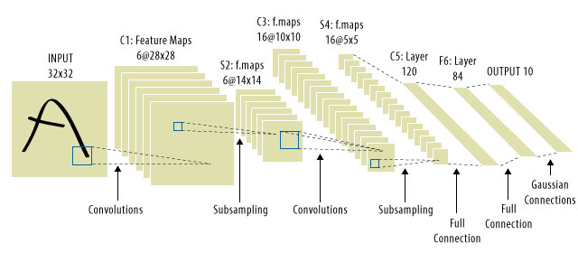
CNN (Convolution Neural Networks)

Slide 16
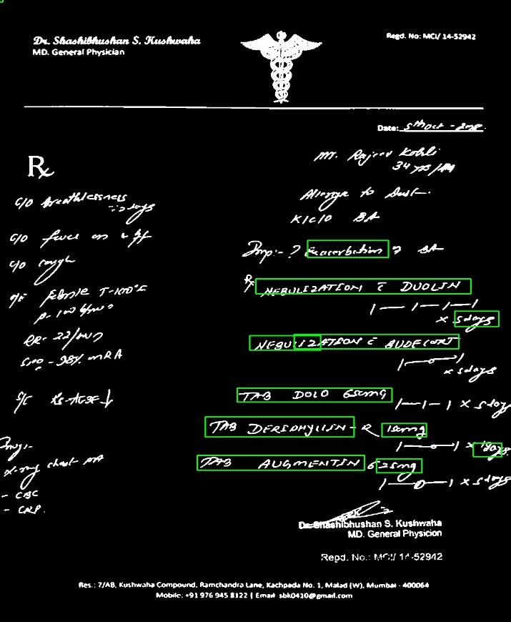
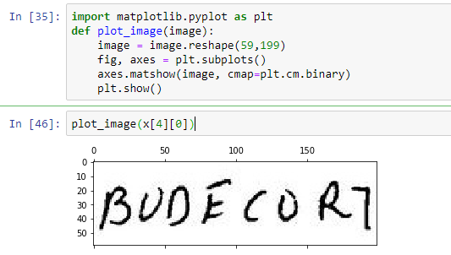
Working demo along with validation
INPUTS
Text Detection Text Recognition

Slide 17
Results consolidated/Analysis
Our current accuracy is 56.2 %

Slide 18
Conclusion
Thus with the help of large and dense Convolution Neural Networks (CNNs) we have got accuracy of 56.2%.
Doctor’s handwriting is not readable by common people and our model will detect it and store in dataset where people can easily see what doctor prescribes.
It will eliminate the mistakes which may happen due to misinterpretation of doctor handwriting.

Slide 19
Limitations and Future Scope
Needs predefined bag of words(Medicines)
Fails on slanted text
No systematic structure available to perform analysis of result

Slide 20
References
EAST: An Efficient and Accurate Scene Text Detector
Xinyu Zhou, Cong Yao, He Wen, Yuzhi Wang, Shuchang Zhou, Weiran He, Jiajun Liang
Submitted on 11 Apr 2017 (v1), last revised 10 Jul 2017 (this version, v2)
Title : MediPic: A Mobile Application for Medical Prescriptions
Published in : IISA 2013
Date Of Conference : 10 - 12 July 2013
Conference Location : Piraeus, Greece

